Slide 1
Foundations of Data Analytics
Tecsys Point of Use

Slide 2
Meet Your Facilitator

Slide 3
Module 1: Introduction to Tecsys POU
Lesson 1 | Tecsys Overview
Lesson 2 | Terminology
Lesson 3 | General Configuration
Module 2: Tecsys Navigation | CDUI and Features
Lesson 1 | Main Layout and Navigation
Module 3: Tecsys Point of Use | CDUI and Features
Lesson 1 | Supply Chain Overview
Lesson 2 | Resource Mapping
Module 4: Tecsys Reports | CDUI and Features
Lesson 1 | POU Operations Monitor
Lesson 2 | Data Validations View
Lesson 3 | Reports in Tecsys

Slide 4
Training Structure & Flow
Each functionality covered today will follow the following 4-step process:
Content
Q & A
Demos
Exercises
Notes:
Each functionality covered today will follow the following 4-step process:
Watch the facilitator’s lead to follow the steps of how the functionality works to accomplish the scenario
Utilize the scripted example to facilitate a self-guided exercise
Collective recap of the scripted scenario focusing on:
Key Takeaways
Challenges
Q & A

Slide 5
Introduction to Tecsys POU
1
Tecsys Overview
Terminology
General Configuration

Slide 6
Tecsys Overview
Introduction to Tecsys POU

Slide 7
Tecsys Overview
Summarize how the Tecsys, Epic, and Workday applications centralize data.
Identify the benefits of the Tecsys Point of Use solution.
Correlate how Tecsys, Epic, and Workday are integrated.
Recognize the solutions available in Tecsys.
Identify the application that is the “Source of Truth”.

Slide 8
Overview of Tecsys Point Of Use
Tecsys POU
Current platforms:
What it interfaces with:
Replenishments
Inventory Management
Case Cart Management
Case Documentation
What it is:
What it handles:
Iris
MSCM (in surgical & procedural areas)
Optiflex
Epic
Workday
QSight
A healthcare centric inventory management solution that allows for a higher level of control and visibility over hospital inventory
Notes:
Script:
Tecsys POU is an inventory management solution that gives more control and visibility over hospital inventory.
Your current platforms are Qsight, Iris, MSCM, and Optiflex. Tecsys will take their place as just one entity.
POU interfaces with Epic and Workday which we spoke about in the slide prior.
POU manages Replenishments, Inventory Management, Case Cart Management, and Case Documentation.
Who will be directly using Tecsys POU: clinicians working in Surgical, Procedural, and Inventory Management.

Slide 9
Tecsys Point of Use Solutions
Inventory Management
Manages items and locations.
Case Documentation User Interface (CDUI)
Creates and manages surgical and procedural cases.
Tissue and Implant Tracking
Case Cart Management
Centralizes and standardizes a material system.
Monitors the use of tissue and implants.
Consignment Items and UDI Tracking
Tracks supplies through specific processes and the scanning of barcodes.
Notes:
Script:
Let’s walk through the various Tecsys POU solutions and the data that is subsequentially stored and managed within Tecsys.
First, Inventory Management. These areas support item availability, utilization, and any inventory adjustments.
Consignment Items and UDI Tracking improves item usage, visibility, and recall management.
Case Cart Management, includes more accurate par levels, automated reordering, and standard items for surgical and procedural areas. As well as improved time, space, and staff efficiency.
Case Documentation User Interface (CDUI) holds all the case data for your organization. This include a case’s pick list and items consumed, wasted, or putaway. The cases also include patient, room, cart, procedure, and physician information.
Tissue and Implant Tracking tracks the location and patient history connected to an implant or tissue.

Slide 10
Source of Truth
Centralized inventory management data strategy
Integrates data from multiple systems into one centralized software platform.
Tecsys will be the platform for internal supply inventory management for the hospital system.
Results:
Better and cleaner data
Raise trust and
reliance on data
Increase data-based decisions
Notes:
Script:
Your entire healthcare system is implementing a centralized inventory management data strategy.
This strategy integrates data from various systems into one software platform. The platform then becomes the “source of truth” for inventory management. This is otherwise known as, master data, which we will discuss in a following lesson.
Tecsys will be your platform that holds the master data for your inventory management.
The results of implementing this data management strategy, is that advisement and any subsequent decisions are all based on the same source of data.
Finally, stakeholders and clinicians become more trusting of the data and become empowered in their roles to make informed decisions for the hospital: financially, process efficiency, and patient treatment wise.

Slide 11
Centralized Data
Workday
Epic
Financial Management Software
Supply Chain Management System
Tecsys
Software Company
Electronic Medical Record Software Application
Notes:
Script:
A large struggle for healthcare supply chain is due to problems with data.
As Data Analysts know, hospitals produce a massive amount of data, so it is not a problem of a lack of data, but a lack of system integration which causes data to be separated and difficult to access and bring together. A solution to this challenge is implementing a Supply Chain Management system which integrates an ERP, EMR, and any financial software platforms. This brings data from various sources, all to one place.
This allows the stories that Data Analyst’s draw from the data to not only be more accurate, but also more actionable.

Slide 12
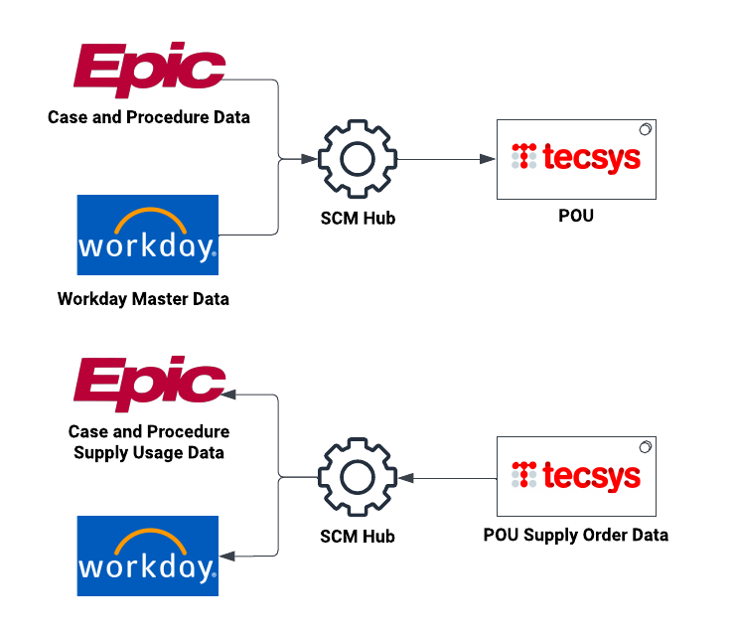
Tecsys Integrations with Epic and Workday
Notes:
Both Epic and Workday integrate with Tecsys to create single solution of data.
SCM facilitates master data interfaced from Workday to POU, and supply order data from POU to Workday.

Slide 13
Direct Impact of Data Captured in Tecsys
Reduce errors in treating and diagnosing patients.
Easier removal of contaminated and expired items.
Support correct inventory levels.
Understand patient issues that are treated within the institution.
Support healthcare resourcing to increase hospital capacity.
Predict or track trends.
Infection control.
Identify areas of cost savings.
Notes:
Script:
More data does not help if the data is not accurate. With the support of these solutions, users will see an increase in data accuracy in the areas for supply counts, inventory levels, Case Costs, supply costs, and consumption tracking.
So, what does all this centralized and added clean data mean for Data Analysts?
Better data means users are better equipped to use the data to create real change quicker and more efficiently.
Clinicians will be using the exact same platform as analytics users which will promote better communication between non-clinical and clinical users.
Users will also have a higher confidence when sharing findings with healthcare leaders because users are providing more actionable and accurate process and patient advisement.
Later in this training, we are going to cover how to find and utilize this data in Tecsys to push supply optimization, process efficiencies, and financial improvements to support patients and clinicians.

Slide 15
Terminology
Introduction to Tecsys POU

Slide 16
Terminology
Review terms and acronyms commonly used in the Tecsys application.

Slide 17
System Integrations
Management Systems
Embedded Tools
POU (SMS)
SCM (DMS)
EMR
ERP
CDUI (Tecsys Resource within Epic)
Cognos
Dashboards
Notes:
Script:
Let’s go over some basic terminology a user will need to know.
Management Systems:
POU – Point of Use - Tecsys application being implemented in the perioperative space. The Tecsys application provides updated views into the inventory levels of your internal supply network and responds automatically to everyday replenishment requirements. Also provides an embedded Epic resource for the point of use documentation of products during case documentation. POU is another way of saying SMS. SMS stands for Supply Management System.
EMR – Electronic Medical Records system – A medical system such as Epic that gathers standard medical a and clinical data (e.g. patient names, medical data, and procedures). POU allows importing medical data from many of the leading EMR systems. It also interfaces generically with Epic.
Epic - An EMR system that Tecsys (POU) Point of Use interfaces with for the purpose of transmitting relevant patient, procedure and supply usage data. Tecsys (POU) Point of Use uses an embedded view in Epic for certain processes. Epic sends information to Tecsys (POU) Point of Use about patients, case pick items and other information needed for surgical procedures, along with scheduling details.
ERP – Enterprise Resource Planning - A typical financial back-end used by hospitals which tracks inventory and financial data. DMS is an ERP system. Lawson is an ERP system used by many hospitals. POU is capable of transmitting financial data between either system. Workday send information to SMS about items, Locations, Location Items, Vendors, and Deliveries. SMS sends information to Workday about Supply Orders, receipt confirmation for Vendor P/Os, and item movements for GL enteries.
EMR (Electronic Medical Record): Medical system that gather medical and clinical data specific to a hospital visit. Your organization’s EMR is Epic.
Tools:
CDUI – Case Documentation User Interface – an embedded Tecsys view within Epic in order to document usage of supplies, implants, and trays. This documented data is then sent via an interface to Epic.
Cognos – Third party reporting software integrated into the Tecsys application to provide a toolset for reporting, analytics and monitoring of events and metrics using various dashboards and reports.
Dashboards – An analytic reporting interface that allows the ability to examine inventory data.

Slide 18
Tecsys Users
Supply Chain Staff
Data Analysts
Circulating Nurses
Clinicians
Finance
Notes:
Script:
Let’s meet the types of people who will be using Tecsys.
Supply Chain Staff: these users manage the planning, prep, and picking for a case. They also manage any returns and putaway. They also administer supply counts, replenish supply areas, receive deliveries, complete verifications of cases, and putaway unused supply.
Data Analysts: these are users like you who navigate within Tecsys to pull and view specific data that is collected and held by the system.
Circulating Nurses – these are Registered Nurses (RN) responsible for providing patient care before, during and after surgical procedures. They monitor the procedures in the OR suite, assisting the surgical team by providing supplies needed on demand which were not included on the case cart. Documents the supply usage during the procedure.
Clinicians – these users are champions for change, clinicians will directly benefit from improvements and will drive the project tasks. This is an umbrella term referring to anyone involved during medical procedure such as the Circulating Nurse or surgical techs.
Finance – Users who are focused on the financial progress of your organization. They primarily use the financial divisions within Tecsys for your hospital system called Cost Center. Cost centers are used to post financial costs using a standard department structure. This data is used in a movement transaction table in the Tecsys system.

Slide 20
General Configuration
Introduction to Tecsys POU

Slide 21
General Configuration
Explain how master data is used.
Identify the areas of configuration needed for system use and data collection.

Slide 22
Master Data Configuration
Data from Epic
Manufacturer
Tecsys
Items
Data from Workday
Vendors
Vendor Catalogs
Master Data
Manufacturer Items
Notes:
Script:
Configured into the Tecsys application is the centralized “master data” that is used as the basis for any action.
This data must first be configured from Epic and Workday for the system to work.
The master data is configured into the Tecsys application and that's the core data that is used for any transactions.
Without having master data transferred from Workday to Tecsys, you won’t be able to do anything from there.
Some examples of master data are SCM (DMS) items, manufacturer, manufacturer items, vendor, and vendor catalog.
These are all what is called “interfaced from loss” in or Workday through SCM (DMS) into POU (SMS).

Slide 23
Areas of Configuration
Items
Item Families
Item Specialties
Item Annotations
Inventory Adjustment Reasons
Manufacturers (Interfaced)
Manufacturer Items (Interfaced)
Hospitals
Cost Centers
Supply Areas
Locations
Vendors (Interfaced)
Reorder Groups/Schedules
Physical Sources
Location Items
Supply Orders
Internal
Items (Interfaced)
Notes:
Script:
Let’s walk through the areas that are configured within Tecsys to fit your hospital system.
These are the main tables that are normally looked at when setting up the Point of Use system.
There are Items, Item Families, Item Specialties, Item Annotations, etc.
Item Family Table: Follows the standard flow of events for masters; Represents the root parent table for the item family setup sequence; and Stores item families.
Item Family: Used for Item categorization. For Example: gloves, drains, tubes, drapes, etc. This grouping can be used to assign an Item in the Item table. Items can have two family associations.
The items come in through Tecsys SCM (DMS), then the integration hub flows from SCM (DMS) into POU (SMS).
The vendors go into Locations and then the Vendor Items go into the Location Items field.
Notes:
These will be the commonly used tables in POU (SMS) for all users.
This presentation describes the generic fields needed.

Slide 25
Tecsys Navigation
2
Main Layout and Navigation

Slide 26
Main Layout and Navigation
Tecsys Navigation

Slide 27
Main Layout and Navigation
Log in to Tecsys.
Navigate the Tecsys home and Analytics menu.
Execute a search and save a search.
Notes:
Script:
You may be using SSO to go into Tecsys POU.

Slide 28
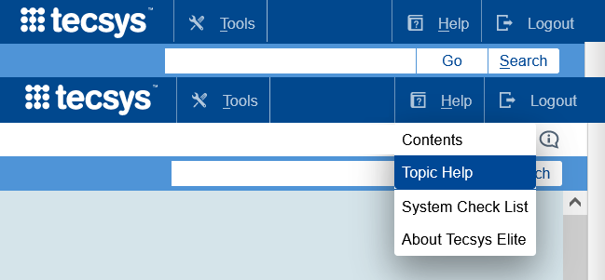
Navigation
Go
Search
Topic Help
access a specific resource page
use keywords to view a list of resource locations
quick go-to guide for software questions and help specific to the resource page
Notes:
Script:
Before we get familiar with the main layout of Tecsys, let’s discuss some of the basic features that will help a user navigate the site.
Users can enter a specific resource page and select the Go button. If typed correctly, Go will take users directly to the exact resource page they requested.
Users can use the search button by entering key words and selecting Search. This will provide users with a list of all available resource locations that they can choose from.
Users should utilize the Help feature while on a resource page or select Topic Help. This will take a user directly to the Help section for that resource.

Slide 29
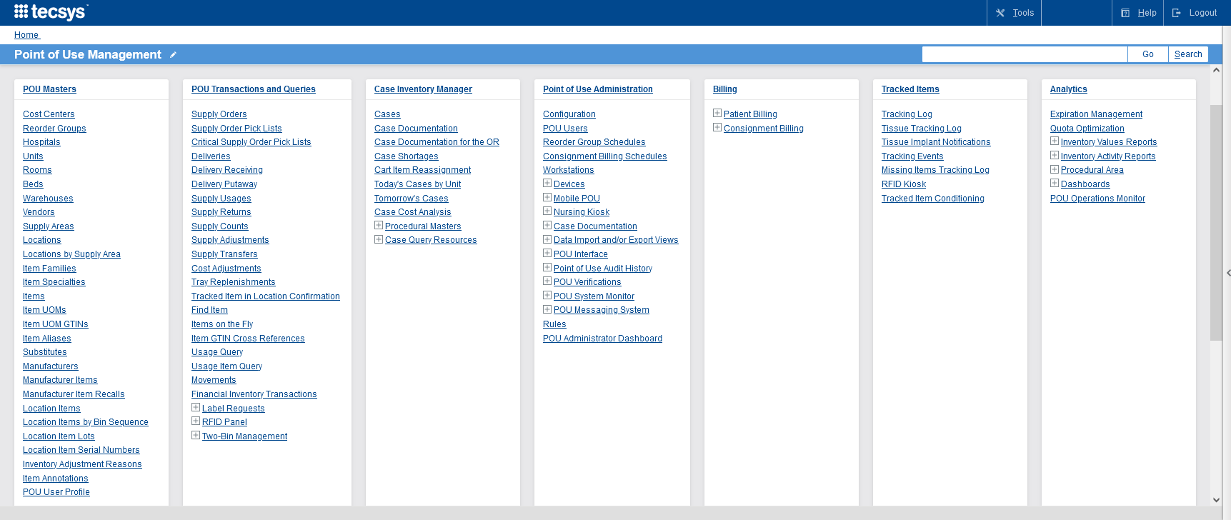
Tecsys POU Home Menu
Notes:
Script:
On the home page, I first want to point out the locations that a user will be utilizing the most.
On the main screen, a user will see that there is an Analytics menu.

Slide 30
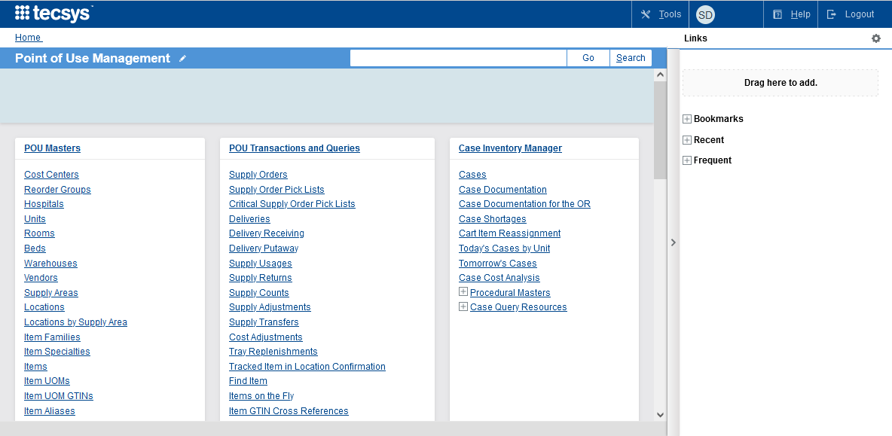
Navigation Support
Tools: Allows the System Administrator to monitor system processes and look at statistics in the system.
Profile: Make changes to the general settings and update preferences.
Help: You can find Topic Help here. You can make searches and look for information about the application.
Logout: End your session.
The Home Menu layout changes based on user access. Layouts may be different than shown.
Drag and drop resources in the “Drag here to add” rectangle to bookmark them.
To remove a resource from the Bookmarks, select the gear icon next to “Links.”
Notes:
Script:
The Home Menu layout can be changed based on a user’s preference.
If there are resources that a user will continually go to, they can drag and drop them into their bookmarks section for ease of use.
A user can use Tools to Allow the System Administrator to monitor and view statistics in the system.
A user can select Profile to make changes to the general settings and update any of their preferences.
They can also select Help and find Topic Help. Again, a user can use this feature to make searches and find useful information.
Finally, a user can select Logout from the top right corner to end their session within the application.

Slide 31
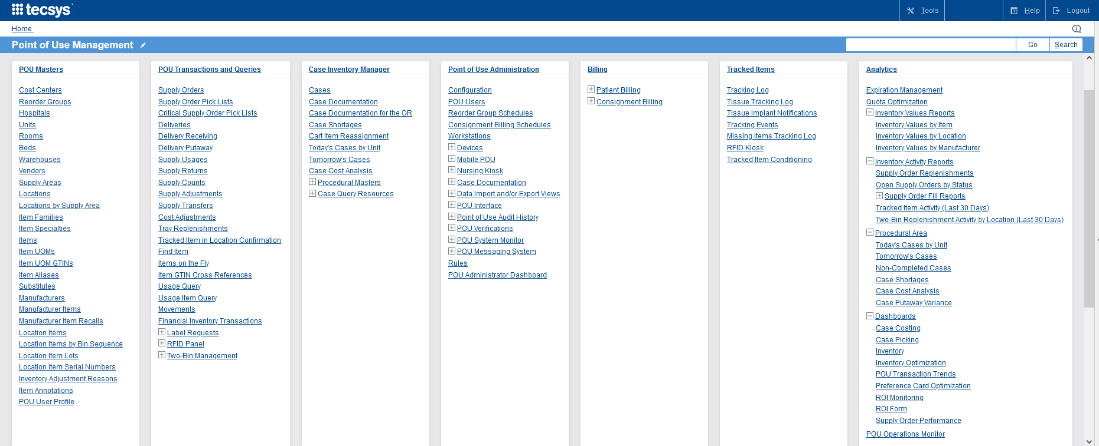
Analytics Menu
Search bar is used to find resources
Select the “+” to expand and “-” to collapse
Bookmark bar
Notes:
Script:
Next, here’s a broad overview of the home menu.
A user's home screen will reflect all resource pages that they have access to based on their security.
Note, that there is a bookmark bar to the right of the screen.
You can search for a resource using the search bar.
Select the expand or collapse icon to open and close a menu section.

Slide 32
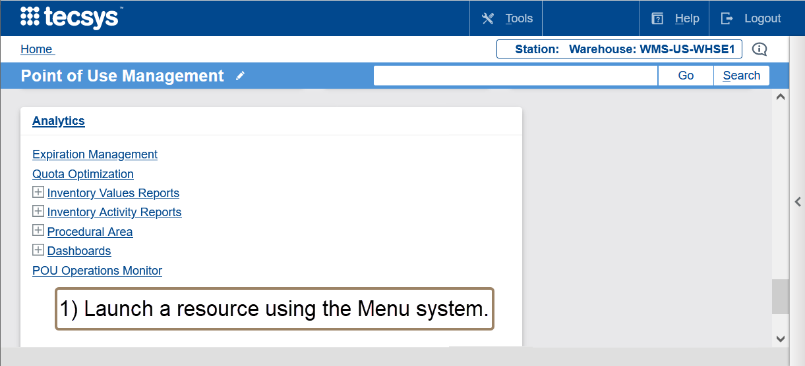
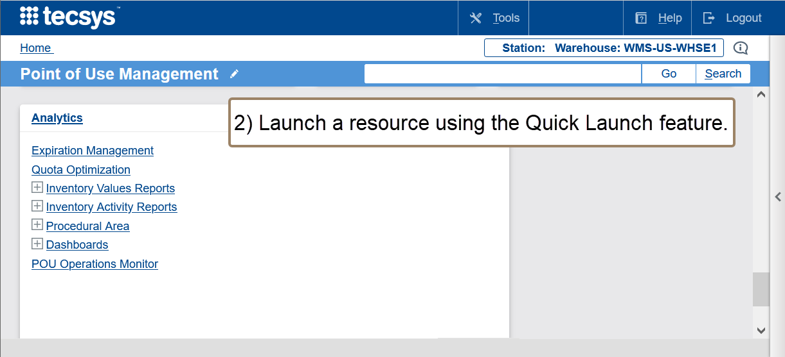
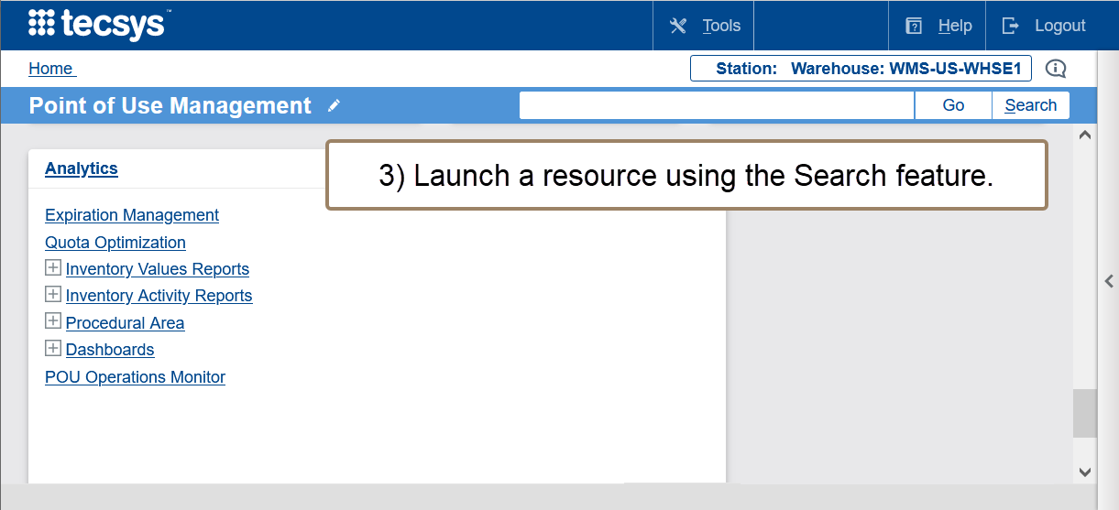
Menu Search Functionality
There are three ways to launch resource pages.
Notes:
Script:
As you can see, a user can simply select the resource page that they need from the home page, if they see it.
Otherwise, a user can use the Quick Launch feature at the top right corner of the window.
The difference between Go and Search is that when a user selects Go, it would take them exactly to the resource page they requested, if they typed it in correctly.
If they use the search button after typing in key words, it will provide them a list of all available resource locations that they can choose from.

Slide 33
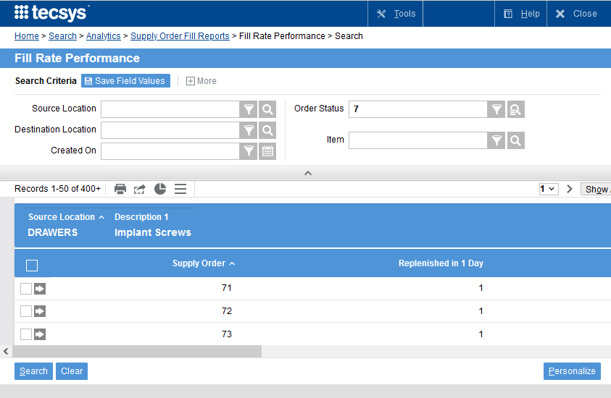
Top Multi-Action Menu Options
Generate Graph
Export to Excel: All records from the search performed
Print
Menu:
Analyze with Excel: All records from the search performed
Notes:
Script:
Let’s discuss the Top Multi-Action Menu Options.
Once a user has their search results, they can make updates or changes to the individual records, or even print, export to excel, or generate a graph.
They can select the rows that they would like to update or export by checking the box on each line.
If all records are to be impacted, the user can press the blue box at the top of the search results section to select all of the results.

Slide 34
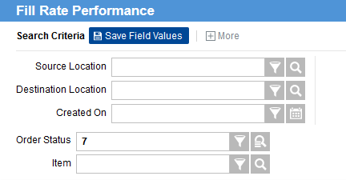
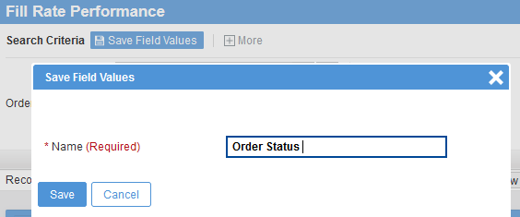
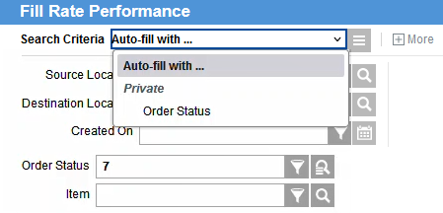
Save a Search
2
4
3
1
1. Enter Search Criteria.
2. Select Save Field Values.
3. Name the saved fields.
4. Use the saved search criteria instead of entering the information manually.
Notes:
Script:
Let’s dive deeper into the Search Criteria section.
Users also have the capability to save search criteria.
This is used if a user has a search they are frequently entering and would like to save time.
An example of a search criteria a user could save is if they only want to see Supply Orders with a status of New.
Another example, is if there are certain Locations a user would like to easily navigate to without having to repeatedly type in the search requirements.
A user can save a frequent search for the future by entering the search criteria and selecting the Save Field Values button.
A user will need to name their saved search.
So, the next time they enter a search, they will enter the title of their saved search, and the Search Criteria will prepopulate with the saved information.

Slide 35

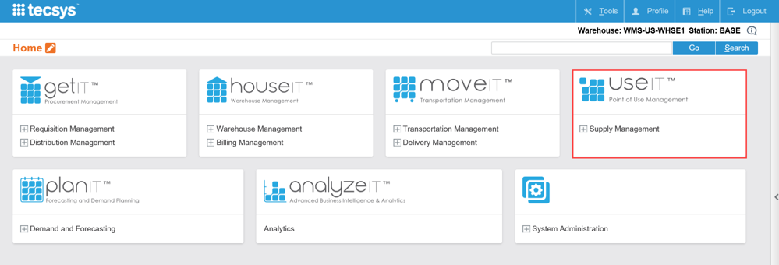

Application Navigation
Learn how to log in to the system, navigate the application, and make searches.
Notes:
Script:
Let’s jump into a demo to learn how to log in, navigate the application, and make basic searches in Tecsys.

Slide 36
Application Navigation
Learn how to log in to the system, navigate the application, and make searches.
Login to the System
Search Criteria

Slide 38
Tecsys Point of Use
3
Supply Chain Overview
Resource Mapping

Slide 39
Supply Chain Overview
Tecsys Point of Use

Slide 40
Supply Chain Overview
Visualize how Tecsys CDUI embeds within Epic.
Review the typical tasks and processes for staff within Tecsys Point of Use.
Identify how items are tracked and replenished.
Connect how data is impacted by user processes and case documentation.

Slide 41
Supply Management and Process
Pre-Operative
Interoperative
Post-Operative
Case Planning & Prep
In-Case Consumption
Case Picking
Returns
Analytics & Optimization
Clinical Staff
Supply Chain Staff
Clinical Staff
Supply Chain Staff
Management
Supply Chain Staff
Notes:
Script:
Tecsys manages inventory pre-operatively, inter-operatively, and post-operatively.
We are going to begin with the Pre-Operative portion of the process.
Case Cart and Supply Chain Staff manage the planning, prep, and picking for a case. They also manage any returns and putaway. Planning refers to the process of allocating product to a case.
The Planning system process reviews the product and quantities needed from the preference card pick list received from Epic and locates these items in locations defined by the Planning Group.
When quantity is available to be picked in the Planning Group locations, these items are allocated (reserved) for that case. When the requested quantity is not fully available in any of the Planning Group locations, the remainder is indicated as a shortage.
Planning groups are defined in the Locations table and are used to limit case picking and planning activities to the locations within the defined Planning Group. When a location is not defined as a case pick location, then the Planning Group field is restricted and not used.
All of these areas can be influenced by data analytics.
Inventory Management includes managing tracked, recalled, and expired items. They also administer supply counts, replenish supply areas, receive deliveries, complete verifications of cases, and putaway unused supply.
In this lesson we are going to walk through the steps of these processes so you can gain a better insight into how this data is collected and why.

Slide 42
Inventory Items
Tracked Items
Conditioned with a Tecsys generated barcode
Serial numbers are used for Barcode tracking.
Recalls can be created with a specific lot, expiry date, and serial number.
Manufacturer Item Recall
Expiration Management
Reports on items that are:
Available
Nearing a lot's expiry date
Expired
Receipt
Putaway
Expiry must be documented during:
Notes:
Script:
As we have discussed before, any location must be configured within Tecsys.
A location is set up as Barcode tracked, that means all items that live in that location will be tracked by its serial number.
This is done by Supply Chain Staff once the product physically arrives in its destination and prior to putaway.
The item is scanned into the tracked item conditioning resource and the user is instructed to scan or key in the serial number and expiration date.
A unique Tracked item number is then generated in the system and a label is printed that will be added to the item.
This label can be scanned directly into CDUI by the circulating nurse. It will populate the serial number and expiration in Epic and will decrement that specific item from inventory.
Tracked Locations are supply areas which are using Barcode technology. Items in Tracked locations are conditioned, which is a form of receiving and attaching barcode labels. Items are usually lot controlled and have expiry dates and can be serialized.
Tracked Items are unique items such as any high value items which are identified through a barcode label for the purpose of tracking the item throughout its lifecycle within the hospital system by showing its statuses and Locations. These items can be serialized, lot-controlled, and expiry driven.
A Tracking Event are canned and user defined events are applied to tracked items, along with the status of the item, throughout the lifecycle of the tracked item. Tracking Events are found in the Tracking Log for both barcoded tracked items.
The Tracking Log is a Tecsys system log containing entries for tracked items identified through a Tecsys generated barcode label. Each log entry represents the tracking history of the item throughout its life cycle within the hospital by showing its statuses and locations.
Manufacturer Item Recall:
Recalled items - A product recall is a request to return a product after the discovery of safety issues or product defects that might endanger the consumer or put the maker/seller at risk of legal action.
Recalls can be created for manufacturer items with a specific lot, expiry date and serial number.
It is important to note that recall and expiration management is contingent upon selecting the option of capturing lot, expiry and or serial numbers on perpetual items. If users have chosen to not capture this information, then users will not be able to utilize these resources.
Expiration Management:
Expiration Management is used to report on items that are nearing a lot’s expiry date or are expired.
To be able to utilize expiration management, expiry must be captured during receipt or putaway.
There is a change UDI option at the line level. This can be used to correct UDI information, if needed.

Slide 43
Par vs. Perpetual Items
Par
Perpetual
Quantity visibility not in real time
Min and max quantities are equal
Lower-value items
Counting is considered usage
Does not capture:
Lot
Expiry Date
Serial Number
Quantity visibility in real time
Min and max quantities are not equal
Higher-value items
Counting is considered an inventory adjustment
If configured, can capture:
Lot
Expiry Date
Serial Number
Notes:
Script:
It is important to recognize the difference between a Par and a Perpetual item.
Par Inventory – Refers to management of supply levels. Items set to a par level are kept at a specific quantity. Supply counts are done by the Materials Management staff. When the quantity counted is below par, a supply order is generated to bring the supplies back up to par.
Perpetual Inventory – Refers to the type of management of supply levels. Items defined as perpetual allow for real time visibility of the quantity on hand. As items are received the inventory quantity on hand in the Tecsys systems is incremented. During usage, the inventory quantity on hand in Tecsys is decremented. When the item’s quantity on hand reaches the minimum level to have on hand or goes below, a replenishment order is generated.
Par
A lot of the times these are for lower value items that we put into a par location or par managed location.
Typically, the par levels are kept at specific quantity, so the minimum level is equal to the maximum level.
Supply Counts must be performed at regular intervals to maintain a constant on hand quantity.
For par, when users are counting the par location, that's when you consider it a used item
That's when it decrements from inventory. There's no capturing of lot, expiry, or serial number.
Perpetual
This is real time visibly of quantity on hand.
In this case Supply Chain Staff would set up a different minimum and maximum for these perpetual locations, when the minimum falls below the set amount, Supply Chain Staff will order back up to the maximum and a lot of times these are for higher value items.
Inventory is decremented upon consumption in CDUI.
Since Perpetual items are decremented from inventory based on consumption, users can only do a supply count if they notice the quantity is off for multiple items in the area. This is considered an inventory adjustment. Staff can also use the supply adjustment resource to make supply adjustments for one item at a time.
For Perpetual, users do have the ability to capture the lot, expiry, and serial number when configured as such.

Slide 44



Receive and Putaway Delivery Process
Does Location Item Schedule Require Modification?
Does an Item need to be returned?
Go to Location
Return Item to its original location
Approve as
Required
Start
No
Yes
Yes
No
Review Location Item Count Configuration
Modify
Location
Item Count Configuration
Perform
Par Count
Supply Orders
are Generated
Yes
No
Approval
Required?
LOCATION ITEM SCHEDULING
LOCATION ASSESSMENT
Supply
Order Pick List
Source of Replenishment
Pick Items
for Delivery
Internal
Deliver Product
to Location
Store and
Confirm Putaway
Delivery Expected Receipt
End
External
SUPPLY EXECUTION
Notes:
Script:
Supply Orders are requests in Tecsys to replenish inventory from another Location within the hospital, from a Vendor, or from a Warehouse. They can be generated manually or automatically based on pre-defined criteria such as quantities, reorder groups and queue timers.
For Vendor replenishments, the supply order is sent to Workday to generate the P/O to send to the vendor.
Once a supply order is generated, then it goes through approvals. All par counts will be automatically approved for processing.
If it's internal, we must do a supply order pick.
If it's external, it goes to Workday, and a delivery expected receipt will interface to Tecsys POU.
Putaway will be performed for all locations through the deliveries resource.
The Supply Chain staff will then deliver the product to its proper location.
Internal Replenishment:
Out-of-Stock means there are no on hand quantity items available to be allocated against.
Replenishment is the act of restocking, refilling, or satisfying supply requirements. Inventory can be replenished from a vendor (purchase order), another warehouse location (warehouse transfer) or by production (work order). Replenishment is defined for each item warehouse record.
The internal process is in the mobile POU (SMS).
Supply Chain Staff will navigate to their supply order picks, then search by supply order source location, destination location, or by item.
Then they will bring up the supply order pick, which shows the supply order number, the item, the source location, and the destination location.
They would scan the item, pick the quantity, confirm it, and then once the supply order pick is done, it will ask the user if they want to put it away.
External Replenishment:
Once a count has been submitted, a supply order is generated. It is then sent for replenishment.
The product is physically received, and the receipt is transmitted to Tecsys
Instead of scanning a putaway for par items, Supply Chain Operations will perform a putaway for all items based on the receipt in the deliveries resource.
On hand is updated and product is physically stocked.
Default Replenishment UOM Indicates that this item unit of measure is the default replenishment Unit of Measure (UOM) for the item. There can only be one default Replenishment Unit of Measure (UOM) per item.
Default Usage UOM indicates that this unit of measure is the default usage Unit of Measure (UOM) for the item. There can only be one default Usage Unit of Measure (UOM) per item.

Slide 45
Consignment Billing Request Process
Confirm consumption and trigger the request for billing in POU (SMS).
Usage information is sent to Workday where “Bill Only” and “Bill and Replace” requisitions are created.
Add the required line-item information needed for processing in the requisition within Workday.
Workday sends the “Bill Only” and “Bill and Replace” POs to the vendors.
Tecsys POU (SMS) will create a delivery automatically upon creation of a bill and replace an order.
The replacement will be received in Tecsys POU (SMS) once arrived at the hospital.
0 - New (default)
1 - Billing Requested
2 - Returned
Usage was reversed in Case Documentation.
Issuance of billing requests to the host system is approved.
Billing items where no request has been sent.
Notes:
Script:
The records stored in the Consignment Billing Requests table will be in one of three statuses: New, Billing Requested, and Returned.
Once staff approve the billing and request the billing, the status changes from New to Billing Requested.
Although rare, if usage were reversed after billing has been requested, an email will be sent to notify the appropriate staff of the change. Staff will want to notify procurement to modify or cancel the purchase order.
If usage is reversed after billing has been requested, an email is sent to notify the appropriate staff.
All records are created in New status. If an item was documented in CDUI but then removed, then the item will automatically be marked as Returned in the log.
Here we have an example of what it looks like once the user requests the billing.
The information is then sent to Workday where the Billing process will occur.
Note that staff will have to go into the requisition in Workday to populate the required information that they sent to a vendor for Bill Only and Bill and Replace items, such as lot and serial number.

Slide 46

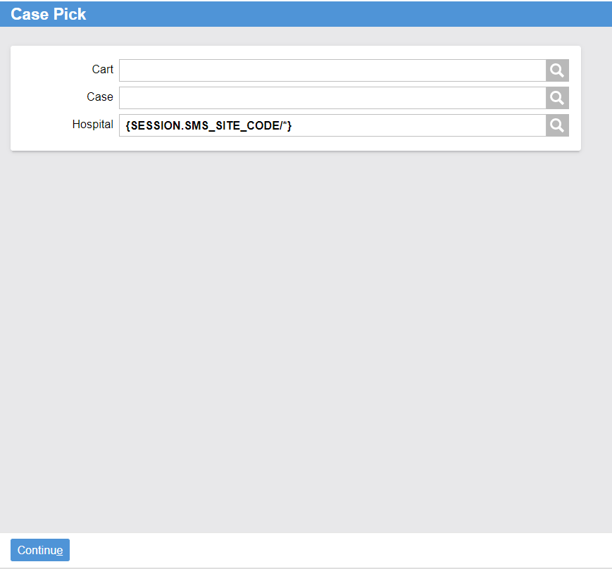
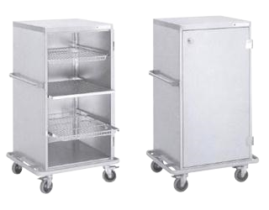
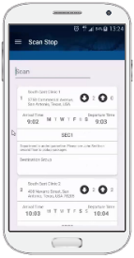
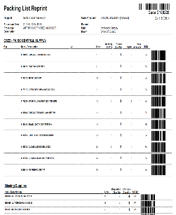
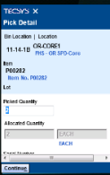
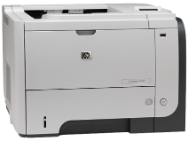
Picking Supplies for a Case
Case Selection
Assign Case Cart
Case Picking
Packing List
Notes:
Script:
A Case contains information on a patient, procedure and required supplies, and is typically transferred into the system by Epic.
Cases are planned, assigned to a Case Cart, and supplies are picked before the procedure.
This is a quick visual of the case picking process.
Case
Next, let’s discuss the Cases resource and case picking. All cases are scheduled in Epic and then interfaced into Tecsys POU in real time with a status of “New.” These New cases are the cases that are ready for the case picking process.
Tecsys can assign an item that has been approved for use as a replacement for a backordered item.
Case Cart Assignment
In the user’s mobile device, the user will first select the case and select a case cart. A Case Cart is a physical cart used to transport case supplies. A tote can act as a ‘Cart’ within the application.
The user’s case selection will depend on what their facility has decided works best for their operations.
Case Picking
The user will then be guided by their mobile device for the case picking activities.
Users will use Pick lists to Identify the items that must be picked from both the Sterile Processing Department (SPD), sterile core and any other locations defined a pick location within the Tecsys system. Picking is organized according to item storage location to help the person assembling the case cart to pick following a logical path. They can confirm what is being picked by scanning the bin barcode or the product barcode
Once all supplies have been loaded the case cart is sent to the sterile core for staging until the scheduled procedure.
The status of the case will adjust once picking is complete. The status will change to, “Ready”.
Packing List
Then once completely picked, a packing list will print out for the user to attach to the PDC and product to accompany the case cart.
A packing List contains:
Items placed on the case cart.
Any missing items.
Barcodes for items in the case.
And substitute items for any of the missing items.
Planning – The process of allocating product to a case. The Planning system process reviews the product and quantities needed from the preference card pick list received from Epic and locates these items in locations defined by the Planning Group. When quantity is available to be picked in the Planning Group locations, these items are allocated (reserved) for that case. When the requested quantity is not fully available in any of the Planning Group locations, the remainder is indicated as a shortage.
Planning Groups - Planning groups are defined in the Locations table and are used to limit case picking and planning activities to the locations within the defined Planning Group. When a location is not defined as a case pick location, then the Planning Group field is restricted and not used.
Pick lists – Identify the items that must be picked from both the SPD, sterile core and any other locations defined a pick location within the Tecsys system. Picking is organized according to item storage location to help the person assembling the case cart to pick following a logical path. Once all supplies have been loaded the case cart is sent to the sterile core for staging until the scheduled procedure.
Case Cart: Physical cart used to transport case supplies. A tote can act as a ‘Cart’ within the application. o assign an item that has been approved for use as a replacement for a backordered item

Slide 47
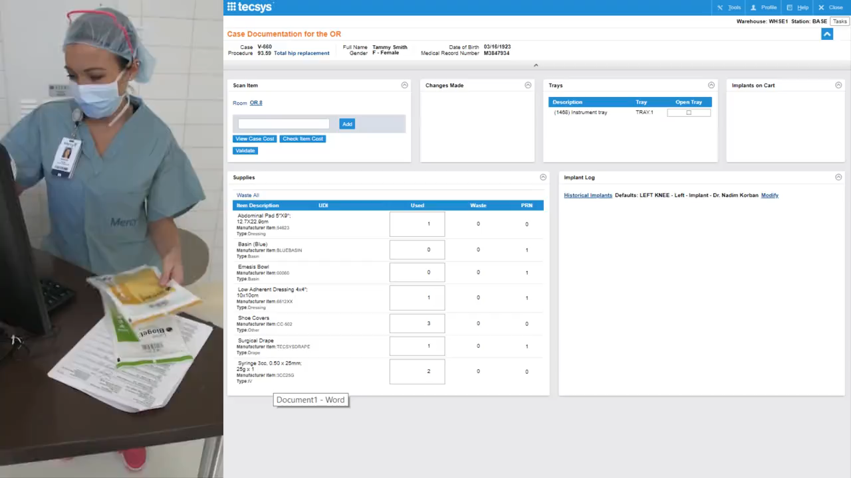
CDUI in OR
Notes:
Script:
Case Documentation for the OR is the name of the resource that is very crucial to Surgical and Procedural areas.
Circulating Nurses are responsible for providing patient care and assist the surgical team by providing supplies and document any supply usage.
Circulating Nurses use CDUI to scan items and document information directly into a case.
This video shows the CDUI in action in the OR.
As a note, this is a previous version of the software and modifications have been made.
Here, the circulating nurse is scanning in the barcode of the item being consumed during the case. This will add the item into the supplies section.
As you can see, the changes made section will update with the most recent items being scanned at the top.
Here you can see she will scan in implants, and they will appear the Implants Log.
If an item has gone to waste, the user can document that in the Supplies section and choose a waste reason. They can also document it within the Implant Log.
There are different types of items:
Add-On Item- An additional item during an OR procedure that was not initially requested so it was not picked onto the case cart but must be delivered and documented onto the case. Once an item has been added, the data will transfer to Epic, it is just not immediate.
Item on the Fly – During case documentation using CDUI, when an item’s packaging barcode is scanned and does not return an item number, the item can be created at that point in the documentation by using the Add on the Fly functionality. This creates the Item on the Fly with the item details entered manually by the circulating nurse.
Consigned item - A product owned by the supplier until it is used. The hospital is liable for any physical loss or damage to products while held on the premises. The vendor is responsible for replacing at no charge any consigned product that has expired. Consigned items typically acquired by OR on a consignment basis include: surgical trays, surgical instruments, and implants.

Slide 48





Epic Embedded Resource
Clinical Documentation (Notes)
Material Usage Capture
User Identification
Select the Case
Replenishment Demand
CDUI
Case / Patient Consumption
Notes:
Script:
Let’s discuss how Tecsys fits within the existing EMR.
Users will start the documentation for cases in the Tecsys application that is embedded in Epic.
Users will log into Epic, select the case, and once in the case, they will see a CDUI tab that’s been added.
The CDUI tab is where users will document both supplies and implants.
The system will update Epic automatically upon case validation, and inventory will be decremented properly so that replenishment can occur.
Validation is the process within CDUI that validates all required fields have been properly populated. Once the circulating nurse has completed all documentation of supplies, implants, and tissue they will select the Validate button which then validates the data. Upon successful validation, the data is sent to Epic
The user can still make changes in the CDUI process after validation that will update in EPIC as long as that case is still open and active.
Once that case is closed in Epic, users can no longer make any changes in CDUI that will pass through.

Slide 49
Supply Source Depletion Path
Supply Source Depletion Path defines the item location
Inventory is decremented from the expected pick location
Clinician picks item
Notes:
Script:
It is incredibly important for each of you to learn and understand what they are, how they are set up, and how they are used.
A Supply Source Depletion Path is built for each procedure room.
It is used to define the most probable location an item is taken from when pulled during a procedure. This helps with ensuring the item is replenished properly and to the correct inventory location.
In other words, when a user picks an item, the system automatically determines the path to manage inventory at the expected location.
Let’s briefly discuss how the paths are created.
Your organization worked to create your Supply Source Depletion Paths based on input from each department.
However, there could be updates that need to be made based on analyzation of the data.

Slide 50
Depletion Path Example
GH.SA_SPC
GH.SA_BLUE
GH.SA_OR
GH.SPC-PAR
100100
A.1.2
GH.BC-PAR
100100
A.2.1
GH.OR1
100100
B.2.2
100102
B.6.3
100102
G.4.5
100102
A.1.2
100104
C.8.2
100104
F.1.1
100104
A.1.3
GH.SPC-PERP
100200
E.1.1
GH.BC-PERP
100200
B.5.6
GH.OR2
100100
B.1.2
100202
A.5.3
100202
E.2.2
100102
B.3.4
100204
A.4.8
100204
C.1.1
100104
C.1.1
GH.SPC-TRAYS
100300
F.4.3
GH.BC-TISSUE
100400
C.1.1
GH.OR3
100100
B.1.2
100302
A.1.5
100402
A.5.1
100102
C.2.1
100304
C.4.4
100404
C.3.3
100104
A.4.1
Notes:
Script:
Let’s walk through an example of a depletion path.
As a note, this is just a sample, and the data may not reflect your system.
In this example, OR Room 3 had three add on items documented in CDUI. (item 10010, 100102 and 100104).
The system first looked in the Blue Core in the Perpetual and Par locations since that was the first place to look in their depletion path.
It found all three items in the GH.BC-PAR and that will be reflected in CDUI.
However, it’s also in the SPC area in the GH.SPC-PAR.
If the Blue Core were out, the system would then assume it came from the latter location.

Slide 51
Data for Item Consumption
Waste Reason Types
Supply
Implant
Cancellation
Must match Epic Waste Reasons
When a waste reason is used, it will update the inventory to ensure an accurate inventory adjustment.
Used
Unused
Putaway
Putaway in Tecsys
When an item is not used, return items to physical location.
Case Verification
Notes:
Script:
Next, let’s talk about the data for item consumption. This is something documented in CDUI within a case.
Once an item has been scanned to a case, like we saw the Circulating Nurse do in an earlier slide, items can be further documented as used or unused.
If an item was left unused and unopened, the item can go through the putaway process and returned to the location from which it was picked.
If an item was used, the user would mark the item within the case as Used.
Users can select various reasons for an item to be considered Waste. Waste is any supplies which have had their sterilization compromised. Waste can happen at any point in the lifecycle of a supply, implant, or tray. Waste codes are assigned to items which are considered as wasted in the sytem.
Different waste reasons have been configured already within the system.
In the Tecsys system, we have set up 3 types of reasons for an item to be wasted.
These are, Supply, Implant, and Cancellation.
Supply is any supply item that was used during the case.
Implant waste is any implant or explant that was used or removed during the case.
Cancellation is for when a scheduled case has been canceled last minute and an items have already been opened. These opened items still need to be wasted due to their contamination.
Another term you should familiarize yourself with is PRN – (Latin pro re nata or “as needed”). Any item considered as “open” means the item is open and ready ahead of the procedure, PRN refers to an item that is not open but is ready and opened when needed. PRN supplies are returned on a cart or in a tote after the procedure has been completed. PRN items are then returned to the inventory storage locations. Within POU PRN items are tracked in the system as part of the on-hand quantity because they are usually returned unused to their storage locations.
Again, the reasons are configured already, and they do have to match an Epic Waste Reason.
During the case, while a user is documenting, they’ll be able to go into Tecsys and select exactly why they are wasting an item.
Providing a reason for why an item is being wasted and ensuring the waste reason matches with Epic helps keep inventory data accurate and current.

Slide 52
Case Verification
Goal
Outcomes
Ensure that all returned items are accounted for.
Enter Case Verification resource.
Scan Case Cart barcode.
Confirm piece count of items to be returned.
Piece Count = Expected Usage
System ends verification.
Continue directly to case cart putaway. or verification of next case cart.
Piece Count ≠ Expected Usage
User scans items, quantity to putaway, and additional details if required.
Notes:
Script:
Let’s discuss Case Verification. Case Verification is a Part of Case Cart Management Return process.
Materials Management staff counts the returned items to verify usage and waste quantities documented during the procedure.
When there is a mismatch, each item is then scanned before the Putaway process can be started.
This occurs after the case is completed by the clinician.
Here’s the process:
Once the user validates the case in CDUI, the case status changes to Usage Complete.
The case is now ready to begin the case cart return process.
Case Verification is the first step in the case return process.
Any extra products from the case that were unopened will be packaged in a bag with the case label attached.
The label is needed for the case verification process.
Why should users do this?
This ties the products back to the case which helps with preference card reporting. This process assists with keeping the preference cards as clean as possible to avoid waste.
The users will be using the Case Verification resource on their mobile device.
When a user scans the case cart barcode, the system will ask them to perform a piece count. The system wants to know how many individual items are being returned.
The system knows how many items should be returned based on what was documented in the case.
If the user’s total matches the expected total, the system will direct them to putaway the items.
If the user’s total does not match the expected total, they will be asked to scan each item so that it understands what's missing, or what's extra.

Slide 53
Case Putaway
Unused items are expected to be returned.
User confirmation ensures inventory accuracy.
A path is generated to direct the user to each returned item home location.
Notes:
Script:
Once a case is verified and the piece count has been managed, staff can begin the putaway process of returning any unused items to their correct locations.
A path leads the staff member to each location for putaway.
All these processes store a lot of data that can be analyzed for improved efficiencies to support staff and patient care.

Slide 54
Impacts to Data
Case Documentation
Process
Includes information to benefit clinicians and patient care
Increase accuracy for replenishments based on
Item waste
Consumption
Contamination
Putaway
Items Tracked
Depletion path configuration
Accurate documentation
Notes:
Script:
Correct documentation is pivotal to the accuracy of the data stored within CDUI and Tecsys as a whole.
The item waste, consumption, contamination, and putaway of each case is tracked and documented within CDUI.
Any changes made to the documentation of a case are also saved within the case.
Making sure the processes for documentation are correct benefits the clinicians and patient care. They also ensure that enough data is collected.
With the accurate data, improvements can be made to the overall process and efficiency of a facility.
For example, advising on depletion path configuration, removing expired items, and ensuring locations are properly stocked.

Slide 56
Resource Mapping
Tecsys Areas

Slide 57
Resource Mapping
Review Tecsys Elite Analytics tables and metadata.

Slide 58
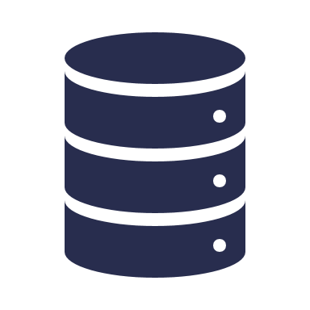
Tecsys - Data Storage Systems
  Analysis Model
Extracts specific data through structure and mapping
Has an analysis model that tracks metadata
Data Mart
  Analysis Model
Data Mart
  Analysis Model
Data Mart
Data Mart
  Analysis Model
Notes:
Script:
Your organization utilizes data storage systems called data marts. These data marts helps users find what they are looking for in the data quicker and more efficiently.
So, while Tecsys holds the data from Epic and Workday and any other source, it also has a way of sorting and organizing data.
Specific data can be extracted, transformed, and loaded from the master data into the data mart.
Each one has a matching analysis model that tracks the metadata that holds up the structure of a data mart.

Slide 59
Data Marts in Tecsys
  Analysis Model
Data can be pulled to run reports and uncover specific findings
Helps users navigate data
SCM Item Demand
  Analysis Model
WMS Warehouse Performance
  Analysis Model
TMS Shipping Performance
POU Point of Use Management
  Analysis Model
Notes:
Script:
Here are a few of the data marts configured for Tecsys to better visualize the configuration.
The stored and organized data within the data marts can be pulled to run reports and uncover specific findings.

Slide 60
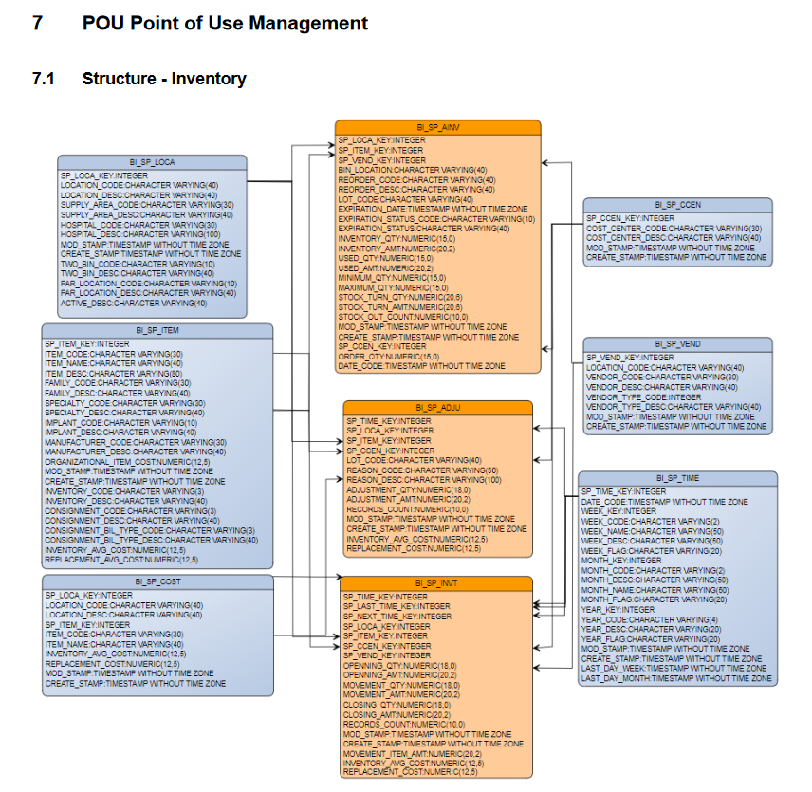
Database Schema Design – Analysis Model
Notes:
Script:
This is what a model for a data mart looks like written out. Each line is a different piece of metadata.
These models can be found in the Cognos portal to run reports.
To create a report, the data needs to be pulled from the correct models and all the models need to be configured and mapped correctly.

Slide 61
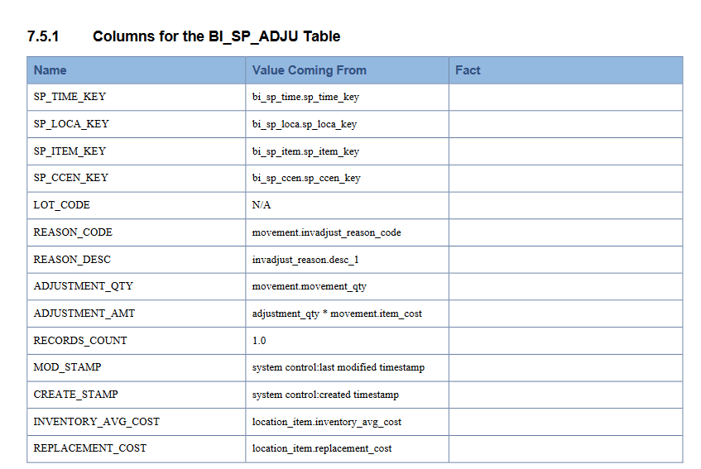
Mapping Information
Notes:
Script:
This is what the mapping for each individual item of metadata looks like! Metadata is data that describes other data. Within Tecsys, it is the structured reference data that helps to sort and identify attributes of the information it describes.
The metadata is broken up into Name (the title of the specific metadata), Value Coming From (the source of the metadata) and any relevant Facts.

Slide 62
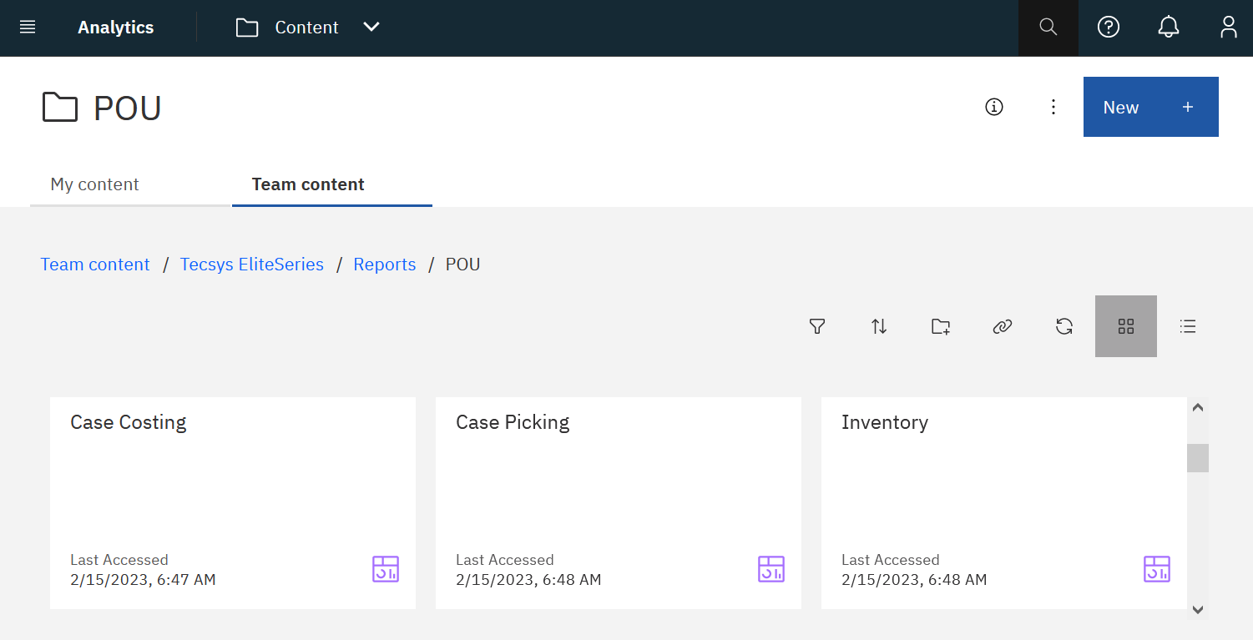
Reporting with Data Marts
Notes:
Script:
As we have been discussing, reports can be run with the data that is pulled from the data marts.
Compelling, informative, and actionable reports can be created in Cognos by users with this data.
Users can view the Analytics Data Mart Schema and Mapping Guide to support their use of Tecsys and Cognos.

Slide 63
Data Mart Schema and Mapping Guide
Utilize the guide to gain insight into the configuration of the data marts.
Analytics Data Mart Schema and Mapping Guide

Slide 65
Tecsys Reports
4
Operations Monitor
Data Validations View
Reports In Tecsys

Slide 66
Operations Monitor
Tecsys Reports
Notes:
Script:
Welcome to Point Of Use Operations Monitors.
We are going to be looking at the monitoring screen within POU.
This monitor provides a high-level view of what is going on within a specific hospital.
We're also going to look at some data validation views and some reports that can be ran within the monitor.

Slide 67
Operations Monitor
Identify how the POU (SMS) application functions.
Access the Operations Monitor.
Take action on items on the dashboard.

Slide 68
Operations Monitor
Monitor hospital activities.
Identify what needs special attention.
Ensure the system is running efficiently.
Notes:
Script:
The POU (SMS) Operations Monitor is used to monitor the hospital's activities at quite a high-level, but also allows users to pinpoint specific areas that need special attention.
For example, providing details around supply orders, and stock counts.
The dynamic dashboard displays a current snapshot of what’s in the system.
There are 8 sections to the dashboard, and we will go through them one by one.

Slide 69
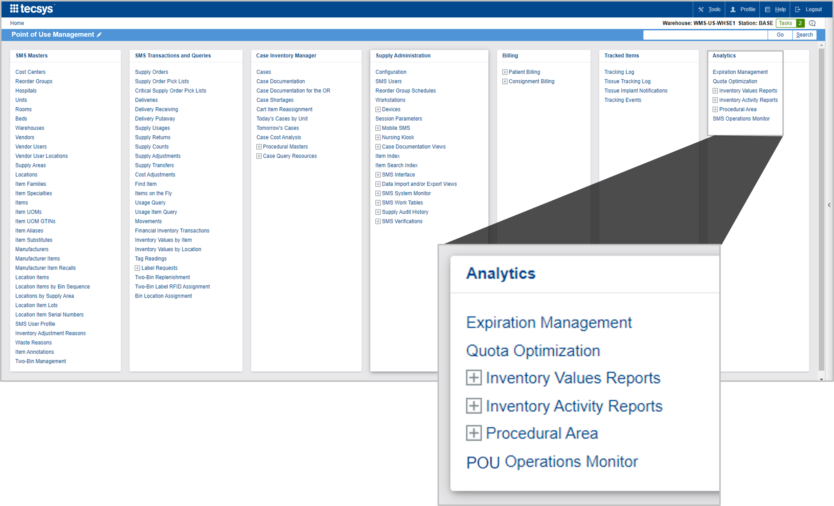
Access the Operations Monitor
Notes:
Script:
The POU (SMS) Operations Monitor is available on the menu of your homepage.
This is what your homepage looks like when you have access to absolutely everything.
And under the Analytics menu users can find the POU (SMS) Operations Monitor.

Slide 70
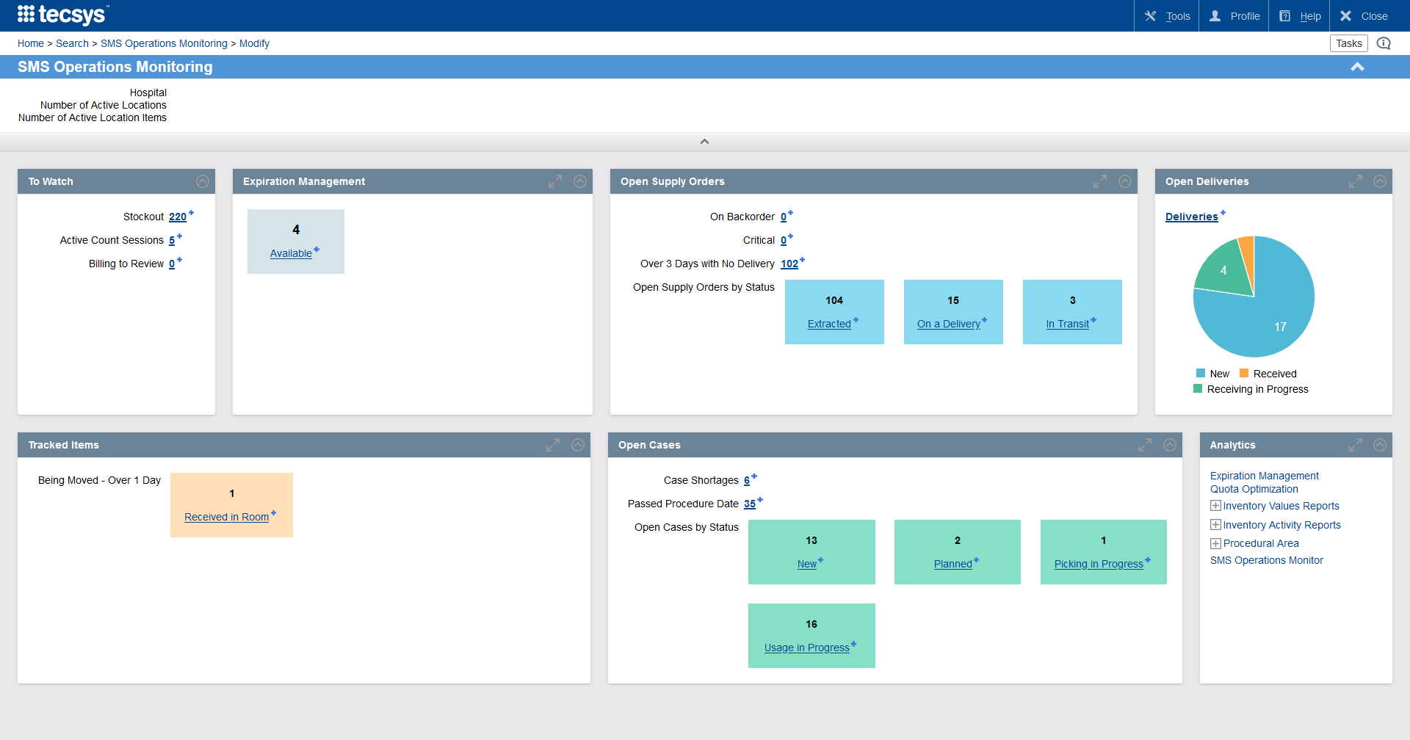
Operations Monitor Overview
Notes:
Script:
Once selected, the hospital that is defaulted to you automatically displays.
You cannot see the entire system at one time, but if you have access to other hospitals, you will be able to click on your name at the top right of the screen, select session parameters, and update the hospital. When you go back into the operations monitor, you will now see the newly assigned hospital.
In the coming slides we will delve deeper into each section.

Slide 71
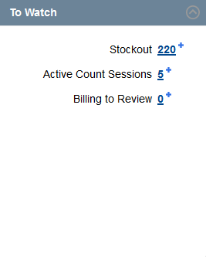
To Watch
Active Count Sessions
Billing to Review
On Backorder
Critical Orders
Number of open count sessions not submitted
Number of consignment billing requests not approved
Number of open supply orders flagged “on backorder”
Number of open supply orders generated as “critical order”
Stockout
Number of location items that allow reorder when the
in-location quantity is zero
Notes:
Script:
The first section is the To Watch section.
Here is the area that you may have some critical activities associated to what's displayed here.
For example, the first one that you'll see is stock outs, everything everywhere in the system where the location quantity is 0 it will show up here as a record.
As you can see everything here is a hyperlink, by selecting the link, it will bring you directly to the records concerned with the specific issues.
For example, Stock Out, once you select on the hyperlink, it's going to show you all the location items with 0 on hand quantity.
It will display within the POU (SMS) Operations Monitor with all the correct filters to show you the results.
Next, is the Active Count Sessions.
This displays the number of count sessions that are open and that have not been submitted.
When a user does a supply count and they don’t select submit, that counts as an active count session and will display here.
Users could use this, for example, at the end of the day to see if there are any open counts that have not been closed out.
Billing to Review, this is what is currently sitting in the Consignment Billing Requests resource that is pending review.
Next is the Backorder section.
Remember that this is only created if someone manually goes into a supply order and drops down the backorder flag as a way to know of any ongoing backorder.
Critical orders shows you all the open supply orders that were generated as critical supply orders.
Critical supply orders are based on the critical minimum quantity that users will have previously set at the location item level.
Please note that this isn’t something that is often used.

Slide 72
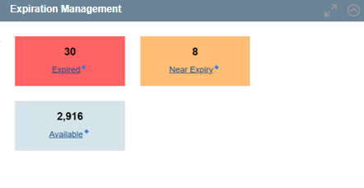
Expiration Management
Near Expiry
Available
Expired
Inventory on hand that is near expiry
Inventory on hand that is not expired or near expiry
Inventory on hand that is expired
Notes:
Script:
The next box in the POU (SMS) Operations Monitor is our Expiration Management box.
Note that only items that are set to track expiration will be represented in this box.
Here there are three areas.
First is expired, this will show you all of the location items that are expired and need to be removed from the shelves.
You have your near expiry, so at the supply area level you will be setting the number of days that you want to indicate to the system that the item is near expiry, and that's the value that this box is going to take.
All items that are near expiry, within that limit of days that you'll have indicated to the system it's going to put it in near expiry and available is all the ones for all of the expiry managed items that are not expired or near expiry.
Near expiry is not a global number, based at the supply area level.
Notes:
A value of 2 - Near Expiry indicates that the expiry date is within the value set in the Supply Area's Lot Expiry Alert Days field.

Slide 73
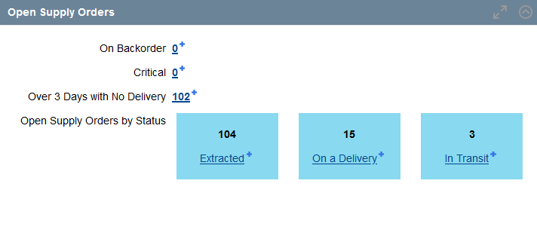
Open Supply Orders
New
Approved
On a Delivery
In Transit
Partially Delivered
The delivery record has been interfaced; the receiving process has been started but not completed
A delivery record has been interfaced and captured against the supply order, but the inventory was not received in Tecsys
A delivery record has been interfaced and captured against the supply order, but the delivery quantity only partially fulfills the initially ordered quantity
A supply order has been generated from the application, but no action was taken
A supply order has been generated and has gone through the approval procedure
Notes:
Script:
The next box is open supply orders.
Here it's going to show you all of your open supply orders based on their status.
The status of New is a supply order that's been generated but requires approval before it can be processed.
Approved is a supply order that has been approved but has not yet been extracted.
On a Delivery is a supply order that has been physically received and has been interfaced. Note that since BSWH is interfacing the actual receipt from the host system, on a delivery is a status you would only see if you were creating a manual delivery inside the system.
In Transit is what you see when the receipt has been interfaced into Tecsys and is ready to be putaway.
Partially delivered is when the full quantity of the delivery has not been received yet.
Notes:
On a delivery: A value of 1 - Yes indicates that a delivery has been created for the supply order, and the delivery's status is set to 1 - New and its In Transit field is set to No.

Slide 74
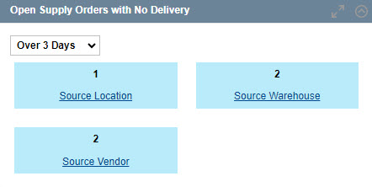
Open Supply Orders with No Delivery
Supply order records that are not associated to a delivery.
Notes:
Script:
The next section is Open Supply Orders with No Delivery.
You can set this to show 3, 7, 14, 30 or all days open.
This is useful for keeping track of aging supply orders. If something hasn’t been delivered after X number of days, users will want to research the status.

Slide 75
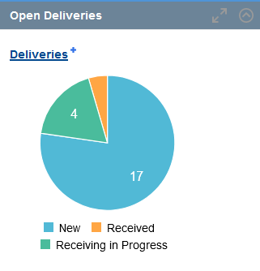
Open Deliveries
New
In Transit
Received
Putaway in Progress
Receiving in Progress
A delivery generated from the application with no action was taken on it.
The delivery record is interfaced but the inventory was not received in Tecsys.
The Delivery record is interfaced; the inventory was Received in Tecsys but not yet putaway.
The delivery record is interfaced; the inventory was Received in Tecsys, and the Putaway process was started but not completed.
The delivery record is interfaced; the Receiving process has been started but not completed.
Notes:
Script:
The next section is Open Deliveries. Each of statuses are available here.
This is good to review to understand what physical product that was received in your host system, and you are expecting to putaway in Tecsys.
If a delivery’s status is New, that means the delivery was manually created in Tecsys.
In Transit means the receipt was sent to Tecsys and the delivery is ready for putaway.
Putaway in Progress means that someone is actively performing putaway on the delivery.

Slide 76
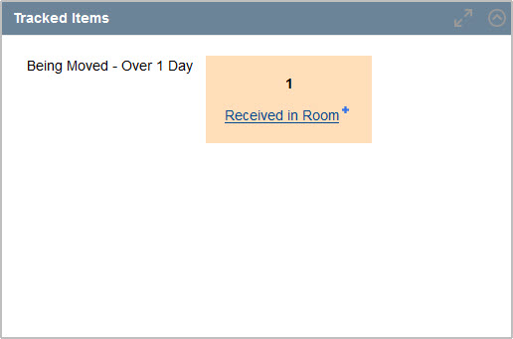
Tracked Items
Received
Case Pick
Received in Room
Implanted
When the last action performed on the tracked item was receiving. The item will be considered “being moved” until a user completes the putaway process.
When the last action performed on the tracked item was picking. The item will be considered “being moved” until a user completes the documentation process in CDUI.
When the last action performed on the tracked item was to document it as used in CDUI. The item will be considered “being moved” until the case is validated.
Applicable to implants only. When the last action performed on the tracked item was to document the “implantation” section of the implant log in CDUI. The item will be considered as “being moved” until the case is validated.
Notes:
Script:
The next section is Tracked Items, which is when each individual item is tracked by its serial number which is scanned into the system, a unique tracked item number is generated, and a barcode is affixed to the packaging.
Received: These are tracked items that have been received in the system, but they have not been put away yet.
Case Pick: This is if your tracked item is currently in a bag on the way to the OR.
Received in Room: This is when a track item has been scanned into CDUI, but the case is not yet validated. (note that received in room is only seen with RFID Labels)
Implanted: This is when the last action is implantation within CDUI.
Notes:
Prepared: Only applicable to tissue tracked items, when the last action performed on the tracked item was to document the ‘preparation’ section of the implant log in CDUI. The item will be considered as ‘being moved’ until the case is Validated.

Slide 77
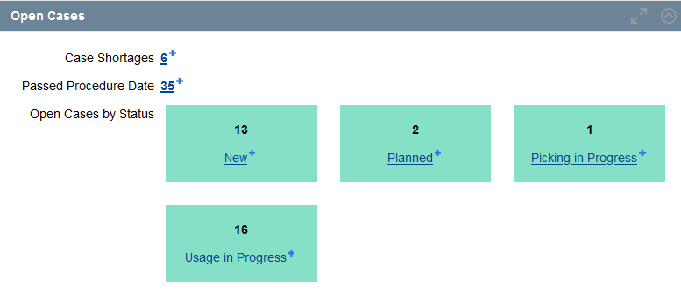
Open Cases
Case Shortages
Passed Procedure Date
Number of cases that are opened but passed the procedure date
Number of missing items for planned, being picked or picked cases
Notes:
Script:
The last section is Open Cases.
At the top you have the case shortages, this shows you all of the shortages that were reported from planned cases, being picked cases, or picked cases.
There is also a hyperlink for open cases that are past their procedure date.
This means that the status of that specific case is still open. It hasn't been closed out.
Potential causes are that case verification wasn't done by supply chain operations or potentially a circulator did not validate the case in CDUI for the OR.

Slide 78
Open Cases by Status
New: Case where no action was taken from the point it was created.
Planned: Case where supplies were allocated.
Picking in Progress: Case where the picking process was started but not completed.
Ready: Case where the picking was completed and is pending clinical documentation.
Usage in Progress: Case where documentation was started but never completed.
Usage Completed: Case where documentation was completed and validated but not return process was initiated.
Putaway in Progress: Case where the return process was initiated but never completed.
Next user action required is planning.
Next user action required is picking.
Next user action required is to finalize the picking process.
Next user action required is open the case in CDUI.
Next user action required is to validate the case in CDUI.
Next user action required is to perform case verification and putaway.
Next user action is to finalize the item returns.
Notes:
Script:
This goes into further detail by Open Cases status.
In the drop-down menu, users can select the specific surgical or procedural area that they would like to view if they want to limit or filter their results. Otherwise, all cases will be seen on the screen.

Slide 79
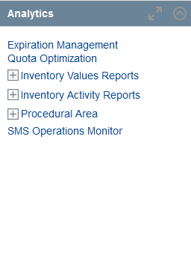
Analytics
Access to the most useful reports within the POU application.
Notes:
Script:
Analytics has a couple of quick links to various reports: for example, expiration management, inventory activity reports, procedural area, and the quota optimization resource.
Note that Dashboards is a link to the reports. If you have access to reports, you will also see this on your main menu.

Slide 80
Management and Action
Taken on the Dashboard
Learn how to manage the dashboard.
Identify the components in the Operations Monitor.
Add filters to the components to adjust and narrow the viewed results.

Slide 81
Management and Action
Taken on the Dashboard
Learn how to manage the dashboard.
Identify the components in the Operations Monitor.
Add filters to the components to adjust and narrow the viewed results.

Slide 83
Data Validation Views
Tecsys Reports
Notes:
Script:
Data Validation Views.
The data validation views are specific resources that were created in the system in order to help you validate that your data is cohesive with the needs and requirements of the Tecsys application.
There are three data views:
location verification view
location item verification view
movement verification

Slide 84
Data Validation Views
Access Verifications.
Monitor the number of transactions generated.

Slide 85
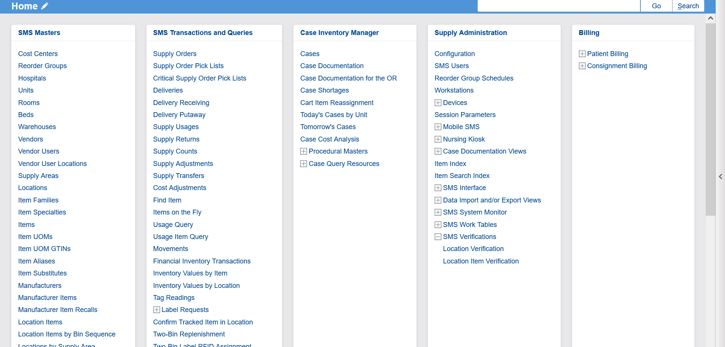
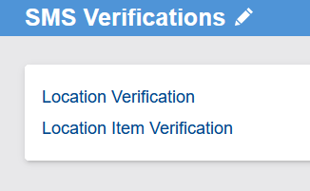
Access Verifications
Notes:
Script:
To access the POU (SMS) verifications area, find it within the Supply Administration menu on the home page under the Verifications resource. under the point of use administration box on your home menu under POU or SMS Verification.

Slide 86
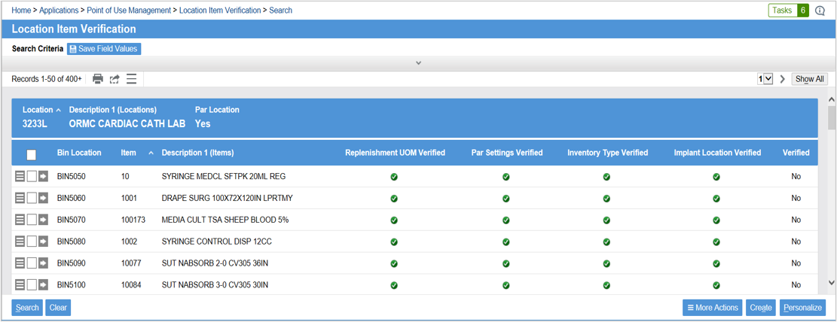
Replenishment UOM Verified
Notes:
Script:
The first verification view is the location item verification.
It displays all the location items or whichever location items correspond to the search criteria that you've entered on this view.
By default, there are multiple columns.
The first column is the Replenishment UOM Verified.
This column validates that the unit of measure multiplier of the base unit of measure is less than the difference between the min and the max. A replenishment request cannot be generated if the assigned UOM has a multiplier that is greater than the range between the min and the max.
Replenishment UOM Verified:
Validates that the replenishment UOM multiplier when the base UOM is less than either the difference between the minimum and maximum or the par/quota level.
A replenishment request cannot be generated if the assigned replenishment UOM has a multiplier that is greater than the range between the defined minimum and maximum for perpetual locations, or greater than the par/quota level for par locations.

Slide 87
Par Settings Verified
Notes:
Script:
Next is the Par Settings Verified.
This validates that the Lot and Expiry option and the serial number tracking method flags are set to none for par locations. It is not possible to track this information, UDI information, within a par location.
Par Settings Verified:
Validates that for any item assigned to a par location, the “lot and expiry” option and “serial number tracking method” flags are set to “0 - None at the location item level”.
It is not possible to track lot numbers and expiry dates or serial numbers in a par location.

Slide 88

Inventory Type Verified
Notes:
Script:
Inventory Type Verified.
This validates that the inventory type matches the location type for each location.
Inventory Type Verified:
Validates that the inventory type matches the location type for each location item.
Generally, the norm is to assign an inventory type of expense to par location items and asset to perpetual location items.

Slide 89
Implant Location Verified
Notes:
Script:
Implant Location Verified.
This validates that implants are in a perpetual location because they require UDI tracking such as lot, expiry, and serial.
Implant Location Verified:
An expression column that validates that implants are assigned to perpetual locations.
Implants usually require lot and expiry or serial number tracking, but each individual instance of the items are not monitored when living in a par location.

Slide 90
Verified
Notes:
Script:
Verified is a manual flag that you can switch from no to yes.
Once you have validated the specific records.
Verified:
Flag that can be used to manually confirm that a verification has been made and is approved.

Slide 91
Movement Verification View
Filters for time intervals include:
Today
Yesterday
Last 30 Days
Last 60 Days
Last 90 Days
Transactions generated by movement type and user are presented in three grids:
Item Type
Lot, Expiry Date, and Serial Number
Consignment
Notes:
Script:
The Movement verification view allows you to monitor the number of transactions that were generated in the movements view. This can help with testing effort before go live.
The view contains a filter for today, yesterday, last 30 days, last 60 days, and there are three different grids: item type, UDI information, and consignment.

Slide 92
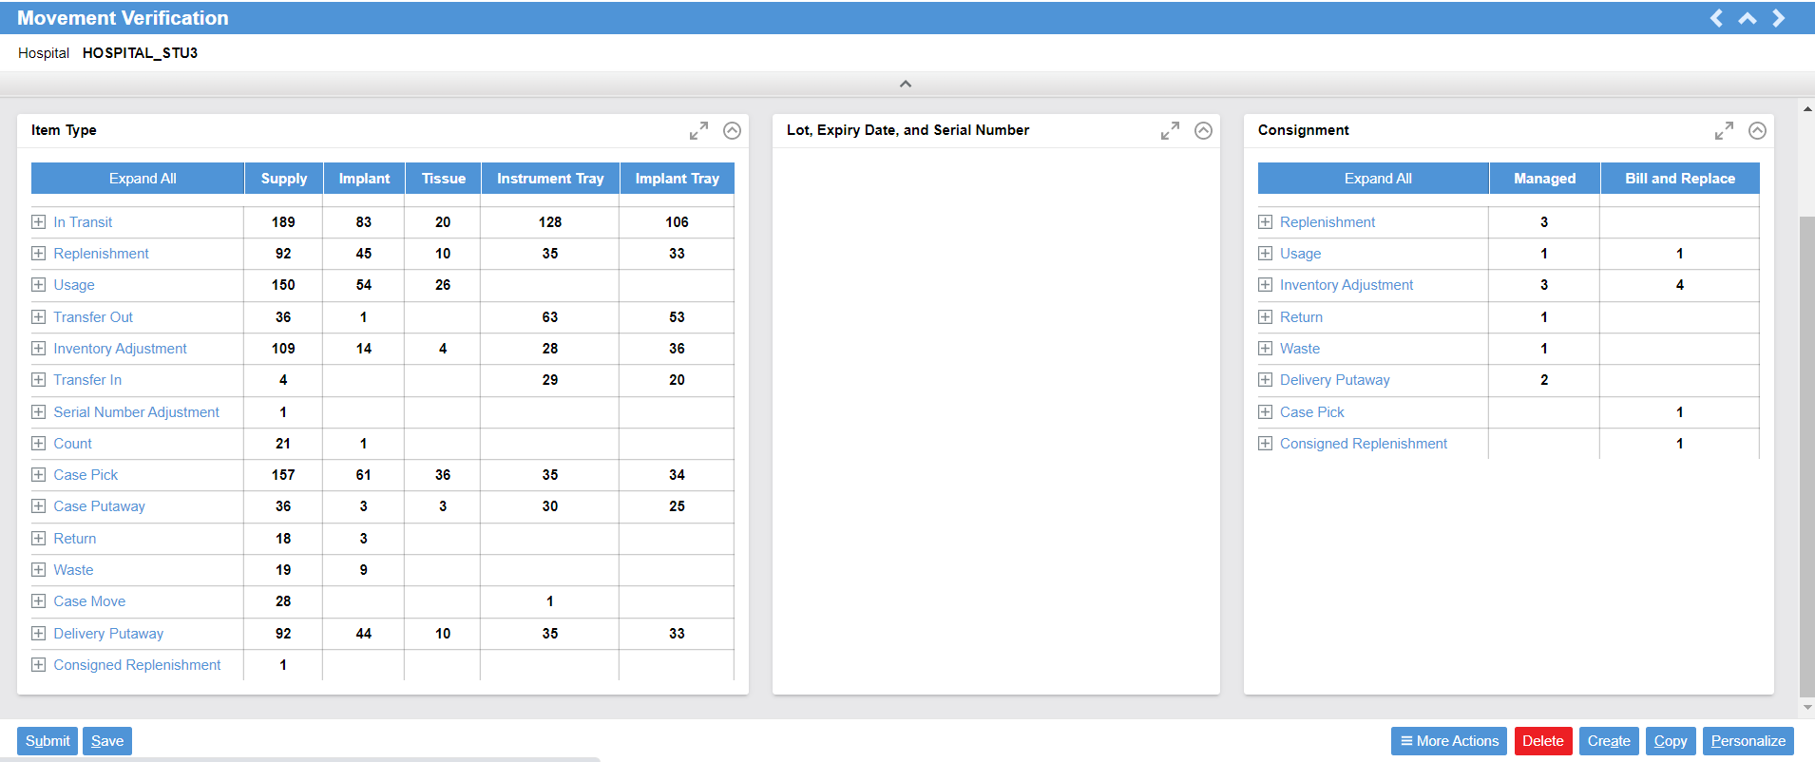
Movement Verification
Notes:
Script:
This is movement verification; it shows you your quantity of movement in each movement type.
Lot, expiry, serial number are dynamics.
Consignment shows, “Where is?”, “What were the movements?”, “What did you have in the last 60 days?”

Slide 93
View Data Validations
Access the POU data validations.
Access data validations.
Recognize the types of validations.

Slide 95
Reports in Tecsys
Tecsys Reports
Notes:
Script:
Next, we will look at a couple of reports that are available in the Texas system.

Slide 96
Reports in Tecsys
Run reports on usage and case pick queries.
Analyze reporting views to understand the movement, expiration, shortages, fill rate, and tracked item activities.

Slide 97
Reporting Views
Query
Analysis
Usage Query
Usage Item Query
Case Pick Query
Case Completion Query
Movements
Expiration Management
Case Shortages
Case Cost Analysis
Fill Rate Performance
Fill Rate by Source
Tracked Item Activity
Notes:
Script:
We have specific queries and specific analysis.
Let’s go through these.

Slide 98
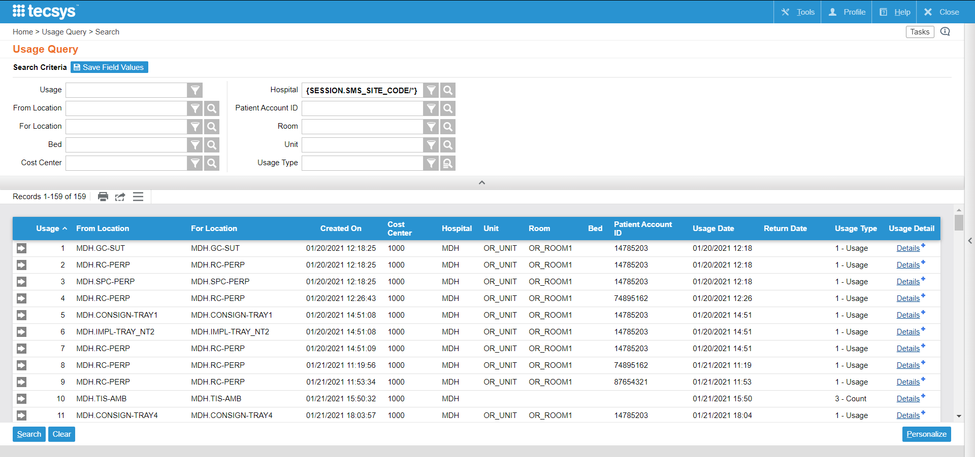
Usage Query
Search locations history of supply usage, return, and count activities.
Item-level information is not provided.
Notes:
Script:
First let's talk about usage queries.
The Supply Transfers resource can only be used to transfer inventory between one POU location to another. If only one location is in POU, you have to use the supply usages resource to transfer the inventory.
Usage Query is a view where you can see the history of supply usages performed, as well as supply returns, and supply counts.
Here on Usage Query, you are able to view the to and from location and the cost center.
This is a high-level query and does not go to the item level.

Slide 99
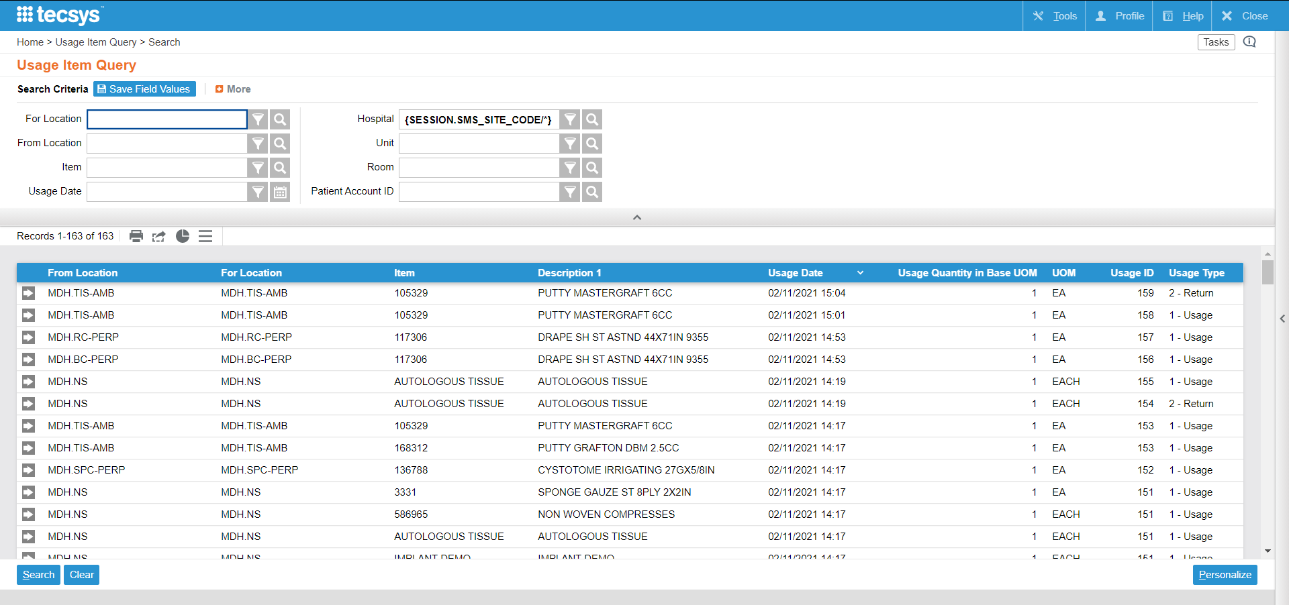
Usage Item Query
“Usage Item Query” view is used to query supply usage, return, and count activities.
Item-level information is provided.
Notes:
Script:
The item information is in the Usage Item Query.
Here you see specifically which item was used, counted, or returned from; in which location to which location, and to which cost center.

Slide 100
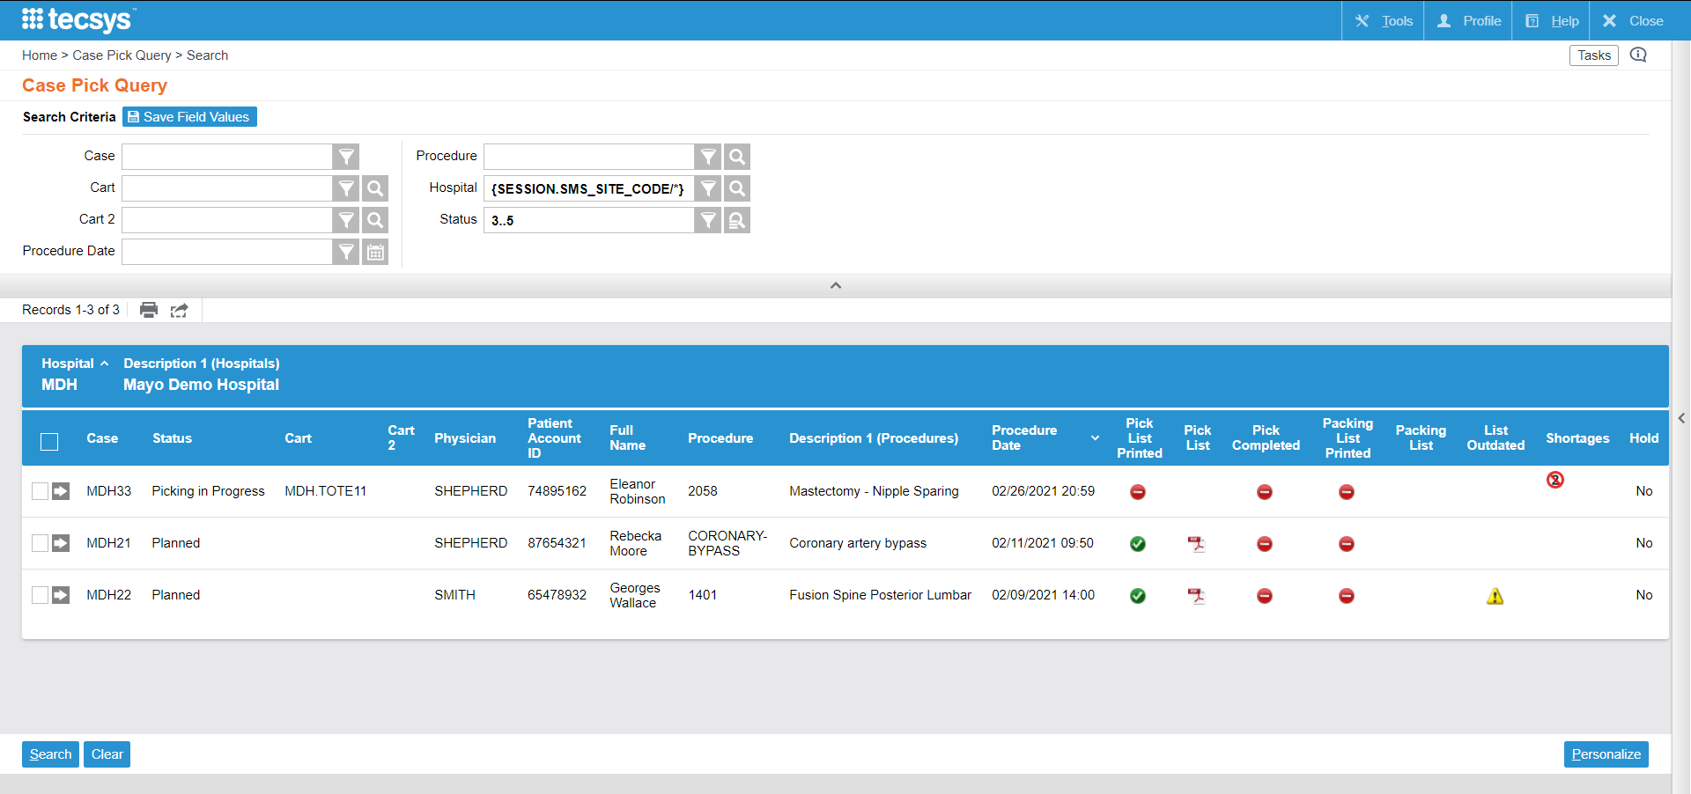
Case Pick Query
This view allows users to query the records in the cases table that needs to be picked or for which the picking process has already started.
Notes:
Script:
The case pick query view allows you to monitor the case pick level to see which cases have been picked, which ones have the pick list printed, and when picking has been completed.

Slide 101
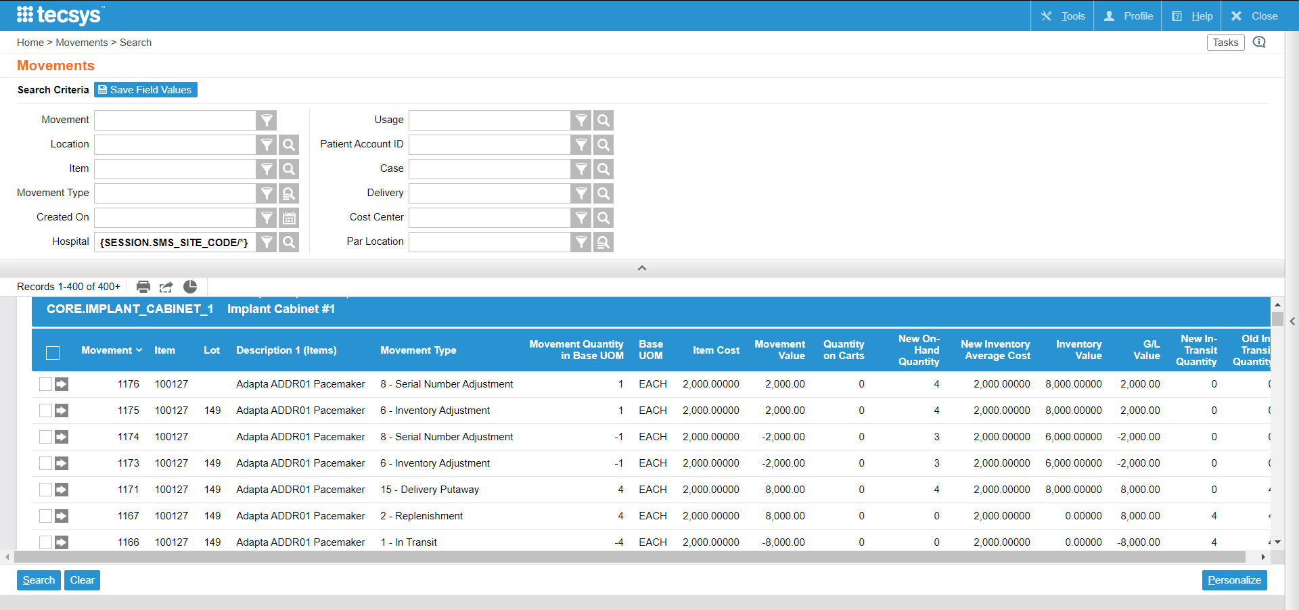
Movements
The “Movements” view is used to query on the history of location item movement activities and any resulting item value changes.
Notes:
Script:
Next let's look at some reporting Analysis views.
First, the Movements view is good view to view movement activities and transactions.
It works well to monitor what end users did, you can see it in movements, you can customize the Movements View to display what you want to see, and you can filter by user or by department.

Slide 102
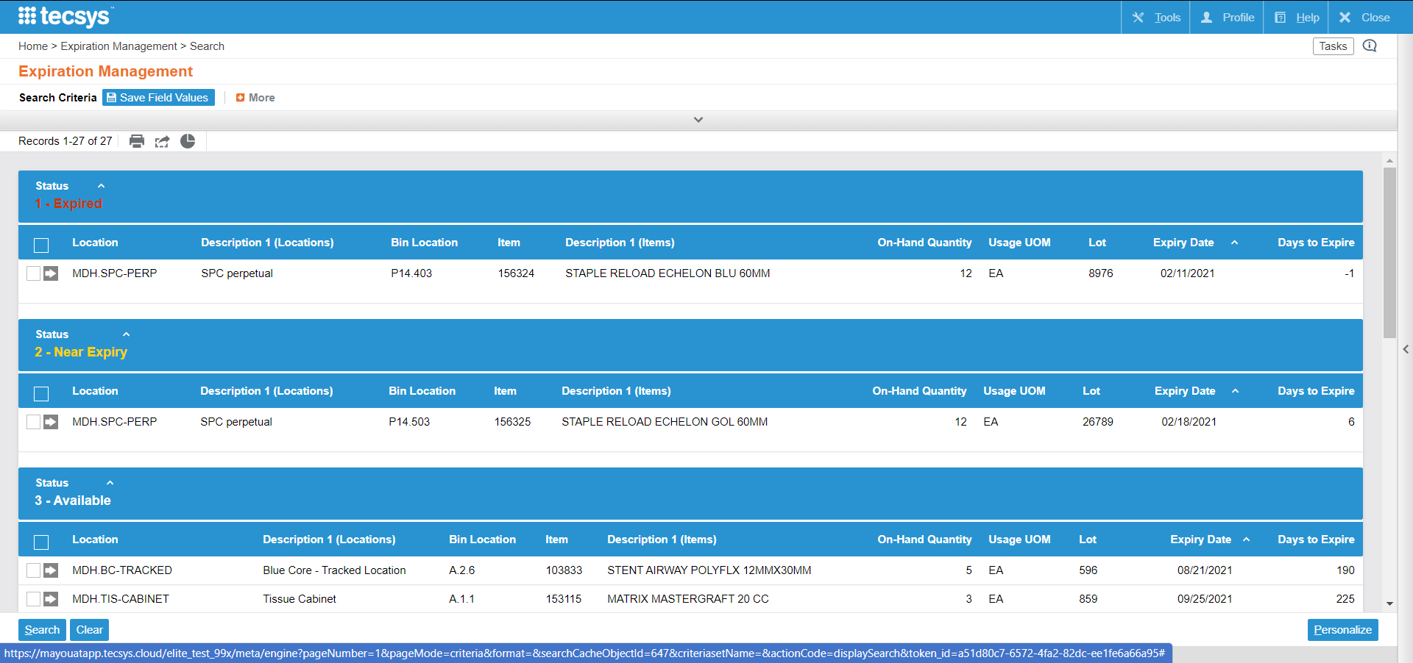
Expiration Management
The “Expiration Management” view is used to report on items that are nearing a lot's expiry date or are expired.
The predefined search criteria makes it possible to display all lots where the expiry date is within the value defined in the Lot Expiry Alert Days field of the locations table.
Notes:
Script:
Next is expiration management, this one is to view all your expiry managed inventory and specifically to see which ones are expired or near expiry.
As a reminder, it will only show items that are being expiry tracked, meaning expiration date is scanned at putaway.

Slide 103
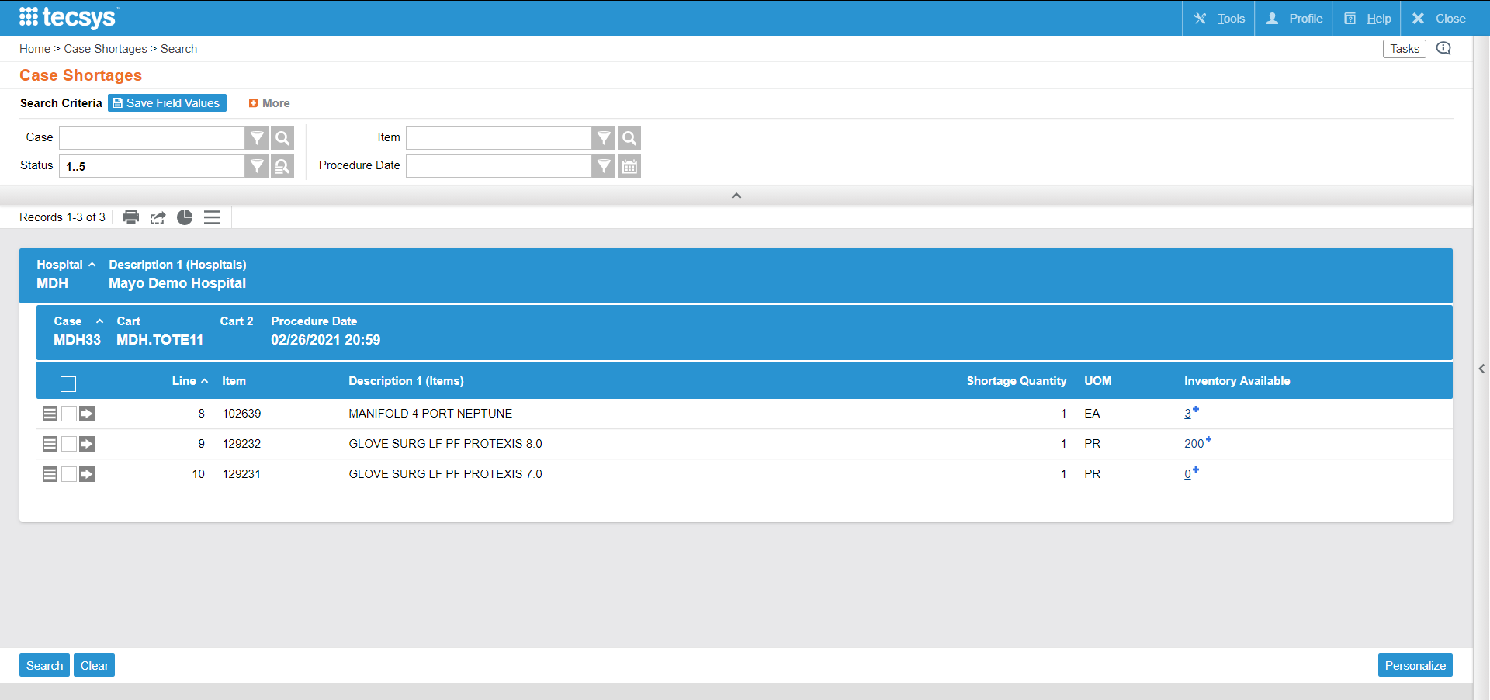
Case Shortages
The “Case Shortages” view is used to query case shortages and is able to specify specific case statuses.
Notes:
Script:
Case shortages are available within the Operations Monitor or directly from a resource in the system on your case.
You can see it within the POU (SMS) Operations dashboard, or you can go search for it directly in your menu.
Notes:
It is possible that the case was either planned or pick prior to a shipment being received, or also perhaps inventory is available in a location that is not part of the planning group

Slide 104
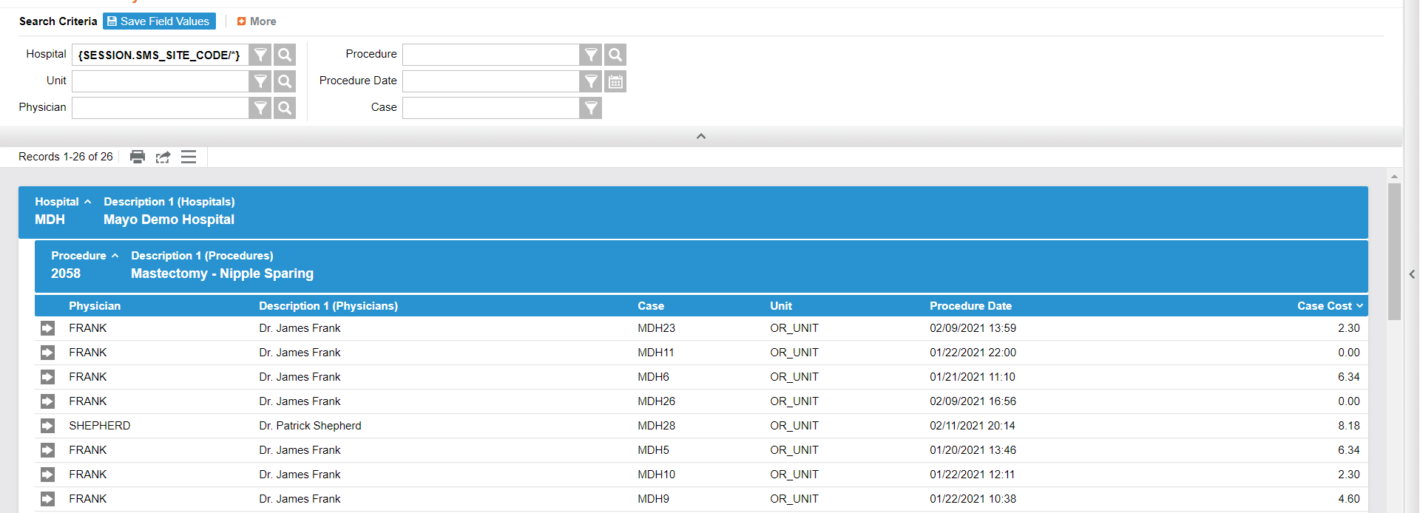
Case Cost Analysis
The “Case Cost Analysis” view is used to query the case cost for completed cases.
Notes:
Script:
The Case Cost Analysis is where you can view the case cost based on the replacement cost of these items.

Slide 105
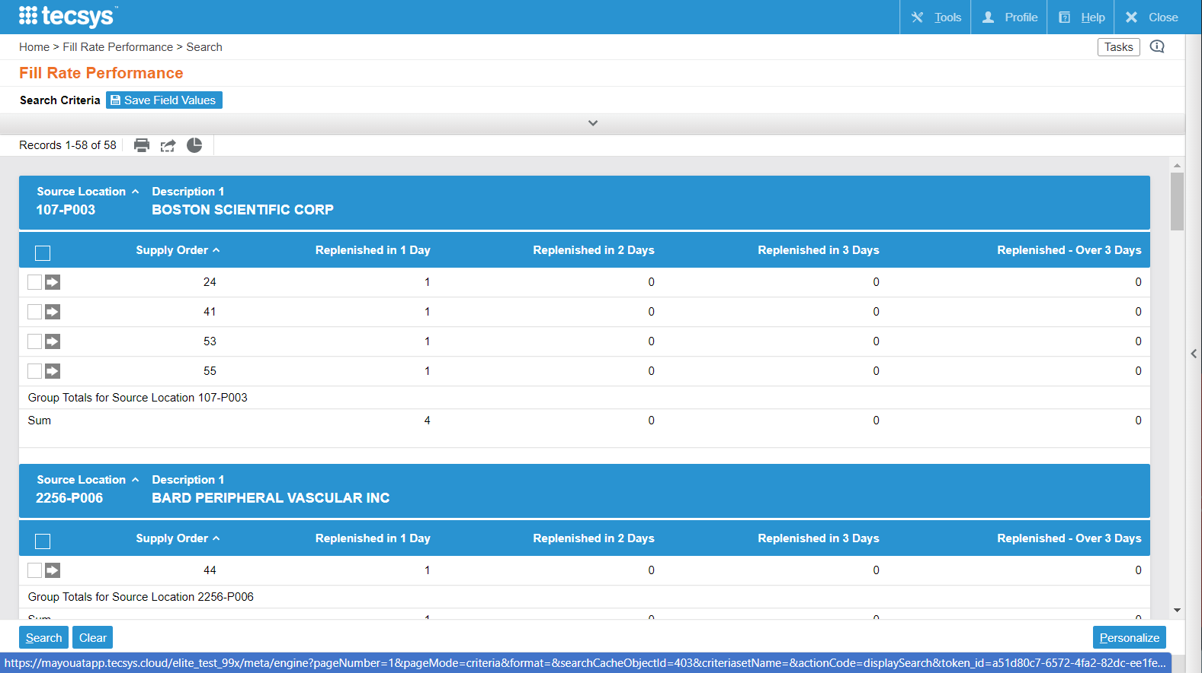
Fill Rate Performance
The “Fill Rate Performance” view is used to display the supply orders in each source location. It will show completed supply orders replenished between 1-3 days, or greater than 3 days. A specific supply order is identified.
Notes:
Script:
The fill rate performance is how long it took for supply orders to be replenished.

Slide 106
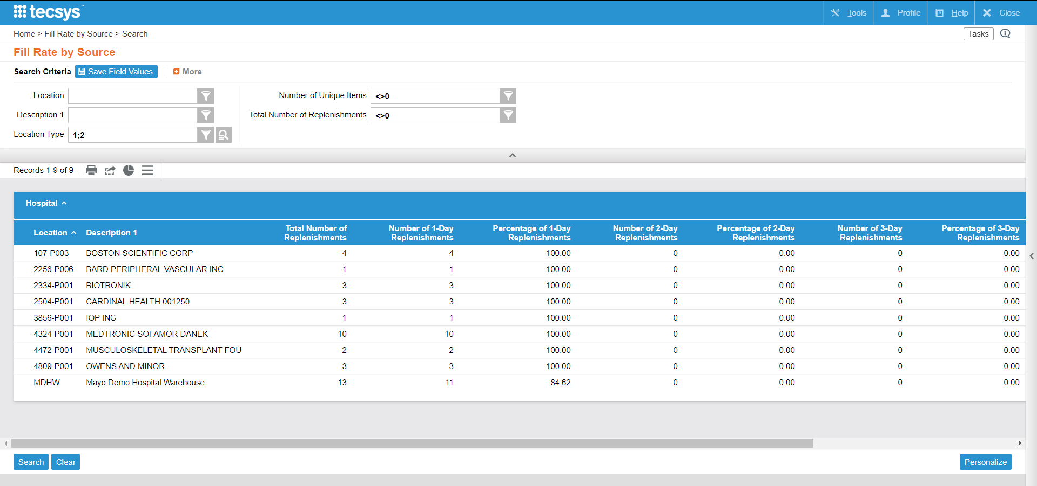
Fill Rate by Source
Displays completed supply orders and how many supply orders were completed in total, in 1-3 days, or greater than 3 days.
Percentages of supply orders that were completed in relation to the historical total number of completed supply orders
Notes:
Script:
The Fill Rate by Source is how long it took to be replenished based on the source location.
Displays completed supply orders and how many supply orders were completed in total, in 1-3 days, or greater than 3 days.
Displays the percentages of supply orders that were completed in 1-3 days or greater than 3 days in relation to the historical total number of completed supply orders
Notes:
Differences: % + sum of supply orders
The Fill Rate by Source view is one of the five views in the Supply Order Fill Reports suite.
Fill Rate Performance
Fill Rate by Source
Fill Rate by Source (Last 30 Days)
Fill Rate by Source (Last 60 Days)
Fill Rate by Source (Last 90 Days)

Slide 107
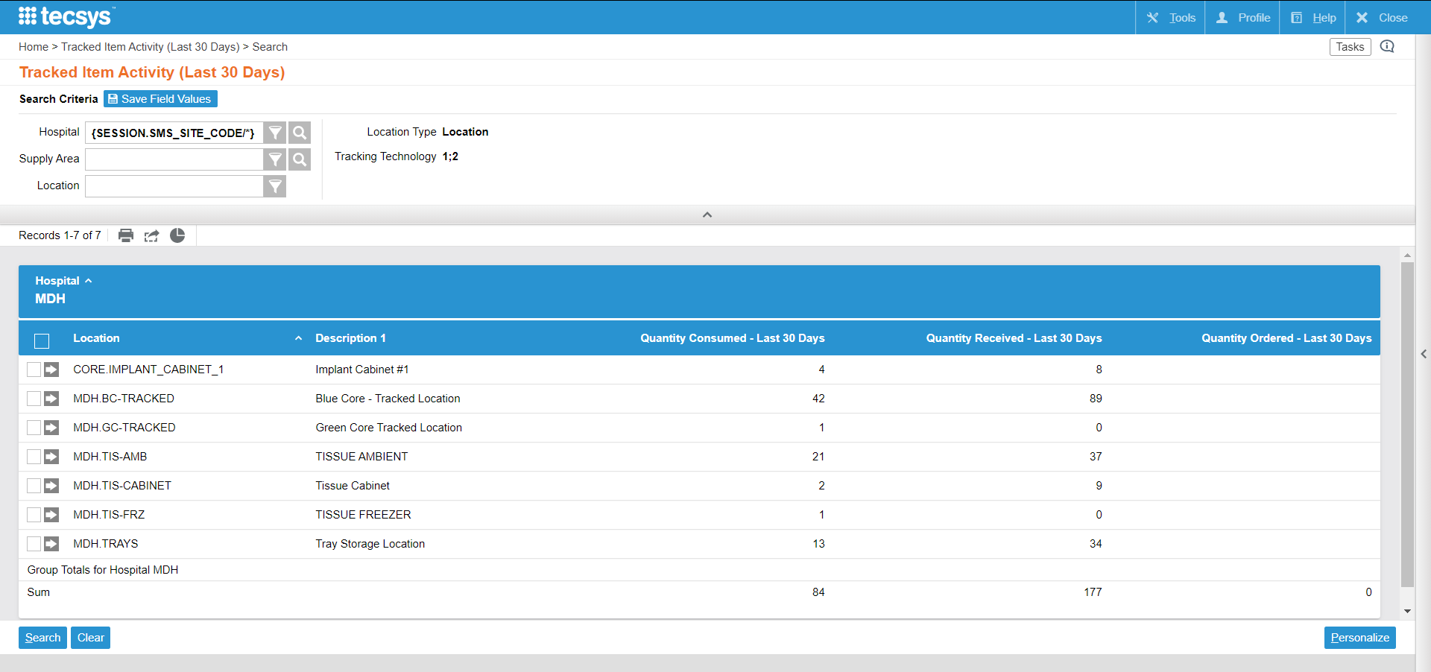
Tracked Item Activity
Displays the quantity of items in a tracked location.
Notes:
Script:
The Tracked Item Activity shows the quantity of items in a tracked location that have been consumed, ordered, and received in the past 30 days.

Slide 108
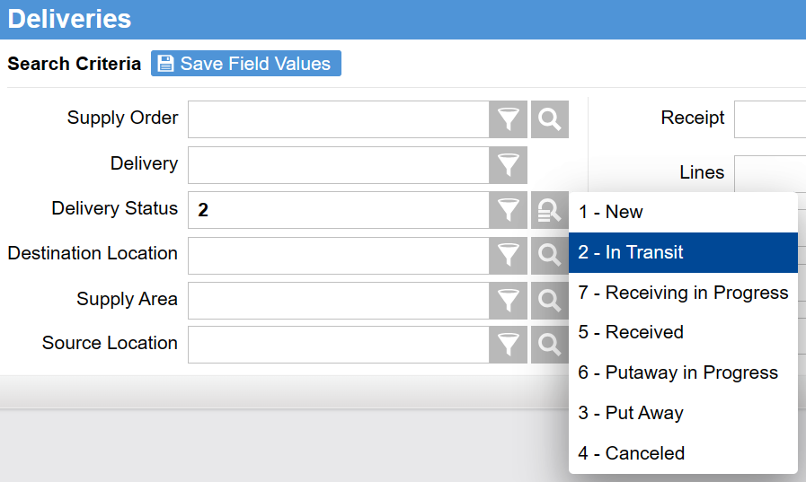
Research Individual Deliveries
2 – In Transit
6 – Putaway in Progress
Open Deliveries Report
Putaway Status Report
Delivery Status
Notes:
Script:
There are two primary ways to generate an Open Deliveries or Putaway Status Report. The first is through the Deliveries activity, which is best used when wanting to research and/or take direct action on individual Deliveries. The second is through the Supply Order Performance Cognos dashboard report, which is best used to analyze Delivery performance trends.
From the home page, navigate to the SMS Transactions and Queries menu and select the Deliveries resource.
Enter the necessary information into the Search Criteria.
Enter In Transit or Putaway in Progress into the Delivery Status.
Open deliveries can be researched in multiple ways, such as the Supply Order number, Delivery number, or the Delivery Status.
Select Search.
The results for the report will appear and can be exported to Excel.

Slide 109
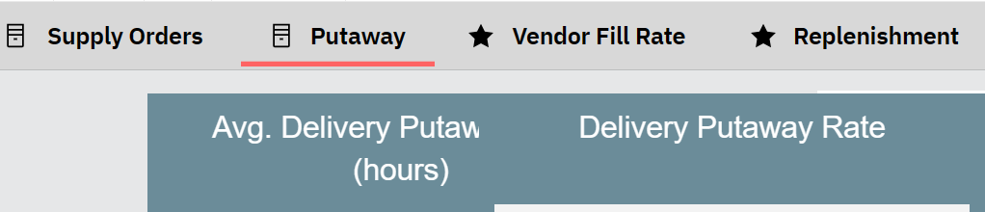

Analyze Performance Trends
Notes:
Script:
The best way to analyze Putaway and Order performance trends is through the Supply Order Performance Cognos dashboard report.
From the home page, users can navigate to the Analytics menu and expand the Dashboards drop-down.
Users can select the Supply Order Performance report resource and the tool will open. Users can select different tabs for different analytic results.
The Supply Orders and Putaway tab will provide the Open Deliveries and Putaway Status of the inventory.

Slide 110
Report on Deliveries
Learn how to generate a report to identify the status of a delivery and putaway.
Create a Putaway Status Report.
Create an Open Deliveries Report.

Slide 111
Report on Deliveries
Learn how to generate a report to identify the status of a delivery and putaway.
Putaway Status Report
Open Deliveries Report

Slide 112


Calculate Inventory Value Report
Inventory Value Reports resource
  Choose to open a report by Item, Location, or Manufacturer
Narrow the search using the Search Criteria
Review the Sum Inventory Value column.
  Export to Excel
Notes:
Script:
Let’s discuss how to generate a report calculating the value of inventory within Tecsys.
From the POU (SMS) home page, users can navigate to the Analytics menu. Expand the Inventory Value Reports menu and select a report to generate it.
Reports can be generated by Item, Location, or Manufacturer.
Users can enter a specific Item or Location name into the Search Criteria fields to narrow the search.
Reviewing the Sum Inventory Value column will provide information on the value.
Users can then select the Export to Excel button to export the results to Excel. An Excel spreadsheet is downloaded.

Slide 113

Supply Expense/Case Cost Report
Dynamic Analytics
Case Costing Cognos Dashboard Report
Customizable Report
Real-Time Analytics
Open a case in CDUI
Select View Case Cost or Verify Item Cost
Case Completed Analytics
Case Cost Analysis resource
Search for the case number
Notes:
Script:
Let’s now discuss how to generate a report to calculate the total cost of a case.
There are three primary ways to look at Supply Expense/Cast Cost.
First, users can use the CDUI navigator to view a report in real-time through the course of a case. To do this, users should open a case and select the View Case Cost or Verify Item Cost buttons in the Scan Item window.
To view the case cost once a case has been completed, view the Case Cost Analysis resource. Users can enter the Case number into the Case field to find the cost for a specific case.
For more dynamic analytics information, use the Case Costing analytics resource linked to Cognos reporting. Users can expand the Dashboards drop-down menu from the Analytics menu on the home page, then select the Case Costing Cognos dashboard report. This report can be customized as needed.

Slide 114
Value and Cost Reports
Learn more about creating reports in Tecsys.
Enter Search Criteria to narrow the results.
Review the results.
Export results to an Excel spreadsheet.

Slide 115
Value and Cost Reports
Learn more about creating reports in Tecsys.
Inventory Value Report
Supply Expense/Surgical Case Report

Slide 116

Item Velocity with Customized Search Results
Create a Customized Report
Navigate to the location Items resource.
Select Personalize.
Update the Search Results and Criteria tabs.
Submit the new report.
Why research Item Velocity?
Support replenishment
Avoid stockouts or overstock
Notes:
Script:
Let’s discuss how to research Item Velocity. Users can create reports to supports facilities replenishments and to avoid stockouts or overstock.
There are two primary ways to analyze Item Velocity. The first is through customized search results in the Location Items activity and the second is with Inventory reporting tools which are pre-structured inventory reports within Tecsys.
To customize the search results in the Location Items activity, navigate to the Location Items resource under the POU (SMS) Masters menu.
Select the Personalize button at the bottom right of the screen.
Some ideas for possible options for researching Item Velocity include Days on Hand, Six Months Usage Quantity, and Total Number of Replenishments – 30 Days.

Slide 117

Item Velocity with Inventory Reporting Tools
Select a pre-structured report to view specific inventory reports.
Notes:
Script:
To research Item Velocity using the inventory reporting tools, start in the Analytics menu.
Expand Inventory Activity Reports and select a report.
Expand Dashboards to launch the needed report(s), such as Inventory Optimization.

Slide 118
Item Velocity
Learn how to create reports to investigate the Item Velocity in the facility.
Customize the search results.
Review the Inventory Reporting Tools.

Slide 119
Item Velocity
Learn how to create reports to investigate the Item Velocity in the facility.
Item Velocity Report

Slide 121
Tecsys Point of Use
Tecsys Reports
Introduction to Tecsys POU
Tecsys Navigation
Notes:
Script:
This concludes the training for Foundations of Data Analytics!
Let’s review what we learned.
In Module 1, Introduction Tecsys POU, we discussed an overview of Tecsys, key terminology used in the system, and the general configuration of the system for data collection.
In Module 2, Tecsys Navigation, we walked through how to log in and familiarize oneself with the Tecsys home and Analytics menu. As well as, how to search in the system and save frequently made searches.
In Module 3, Tecsys Point of Use, we walked through the typical supply chain processes within your facility and the Elite Analytics tables and metadata that flow from these processes.
In Module 4, Tecsys Reports, we discussed the POU (SMS) Operations Monitor, data validations, viewing, and creating reports in Tecsys.

Slide 122
Next Steps/Takeaways
Now it is your turn to try it for yourself. Over the next few days, you should try to complete the following on the test site:
Log in to Tecsys.
Review the Operations Monitor.
Access data validations.
Create a report.

Slide 123
Utilize the Tecsys “Help” button for support within the Tecsys application.

