Slide 1
Inventory Management
Point Of Use

Slide 2
Meet Your Facilitator

Slide 3
Module 1 | Introduction to Tecsys POU
Module 2 | General Configuration
Module 3 | Barcode Tracking Configuration
Module 4 | Recalls and Expired Items
Module 5 | Inventory Replenishment
Module 6 | Inventory Maintenance
Module 7 | POU (SMS) Operations Monitor
Module 8 | Tecsys SCM Financials via SCM Hub

Slide 4
Training Structure & Flow
Each functionality covered today will follow the following 4-step process:
Content
Q & A
Demos
Exercises
Notes:
Each functionality covered today will follow the following 4-step process:
Watch the facilitator’s lead to follow the steps of how the functionality works to accomplish the scenario
Utilize the scripted example to facilitate a self-guided exercise
Collective recap of the scripted scenario focusing on:
Key Takeaways
Challenges
Q & A

Slide 5
Introduction to Tecsys POU
1
Overview of the POU (SMS) Solution
Menu Layout and Navigation

Slide 6
Overview of the POU (SMS) Solution
Introduction to Tecsys POU

Slide 7
Overview of the POU (SMS) Solution
Identify the benefits of the Tecsys Point of Use solution.
Recognize the features available in the Tecsys mobile supply chain.

Slide 8
What’s in the Name?
Tecsys
POU (SMS)
Software Platform
Point Of Use Management System
SCM (DMS)
Supply Chain Management System
Notes:
Script:
SCM is a hub that is used to interface the master data into POU. It is also used to transmit supply orders to the procurement tool for replenishment.

Slide 9
What is Tecsys POU (SMS)?
Tecsys POU
Replaces :
Interfaces with:
Replenishments
Inventory Management
Case Cart Management
Case Documentation
What it is:
A healthcare centric inventory management solution that allows for a higher level of control and visibility over hospital inventory.
Handles:
MSCM
Epic
Workday
Notes:
Script:
Tecsys POU is being implemented in surgical and procedural areas. It will replace your organization’s current POU system, if you have one.
Mobile supply chain will still be used in all other areas.

Slide 10

Tecsys Point of Use (SMS) Solutions
Inventory Management
Consignment Items & UDI Tracking
Case Cart Management
Case Documentation User Interface
(CDUI)
Tissue & Implant Tracking
Notes:
Enter here the Solutions the organization already has or will be implementing.

Slide 11
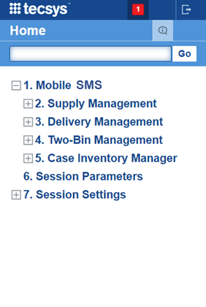
Mobile Supply Chain
Supply Management
Case Management
Delivery Management
Cart Assignment
Case Pick
Case Verification
Case Putaway
Cart Item Reassignment
Cart Waypoints
Supply Order Pick
Supply Counts
Adjustments
Transfers
Returns
Receiving
Putaway
Notes:
Script:
Users will still be using a mobile handheld device for par counts. In fact, it’s the same process handheld. However, instead of using Mobile Supply Chain, users will be logging into Tecsys POU (SMS).
The role of the handheld device is expanding to POU (SMS) as it can be used in case picking, as well as receiving, and the putaway of delivered items.

Slide 13
Main Layout and Navigation
Introduction to Tecsys POU

Slide 14
Main Layout and Navigation
Log in to Tecsys.
Navigate the Tecsys home menu.
Execute and save a search.
Notes:
Script:
You will be using SSO to go into Tecsys POU.

Slide 15
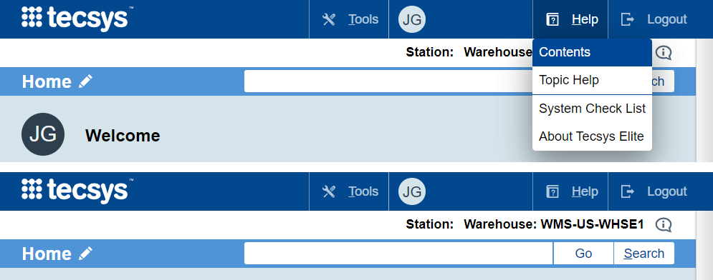
Navigation
Tools
Allows the System Administrator to monitor system processes and look at statistics in the system
Profile
Make changes to the general settings and update preferences
Help
Quick go-to guide for software questions and help specific to the resource page
Logout
End your session
Go
Access a specific resource page
Search
Use keywords to view a list of resource locations
Notes:
Script:
Before we get familiar with the main layout of Tecsys, let’s discuss some of the basic features that will help a user navigate the site.
Users with System Administrator access can use Tools to monitor system process and look at statistics
From your user profile you can make changes to the general settings and preferences
Users should utilize the Help feature while on a resource page or select Topic Help. This will take a user directly to the Help section for that resource.
Select Logout to end your session in Tecsys
Users can enter a specific resource page and select the Go button. If typed correctly, Go will take users directly to the exact resource page they requested.
Users can use the search button by entering key words and selecting Search. This will provide users with a list of all available resource locations that they can choose from.

Slide 16
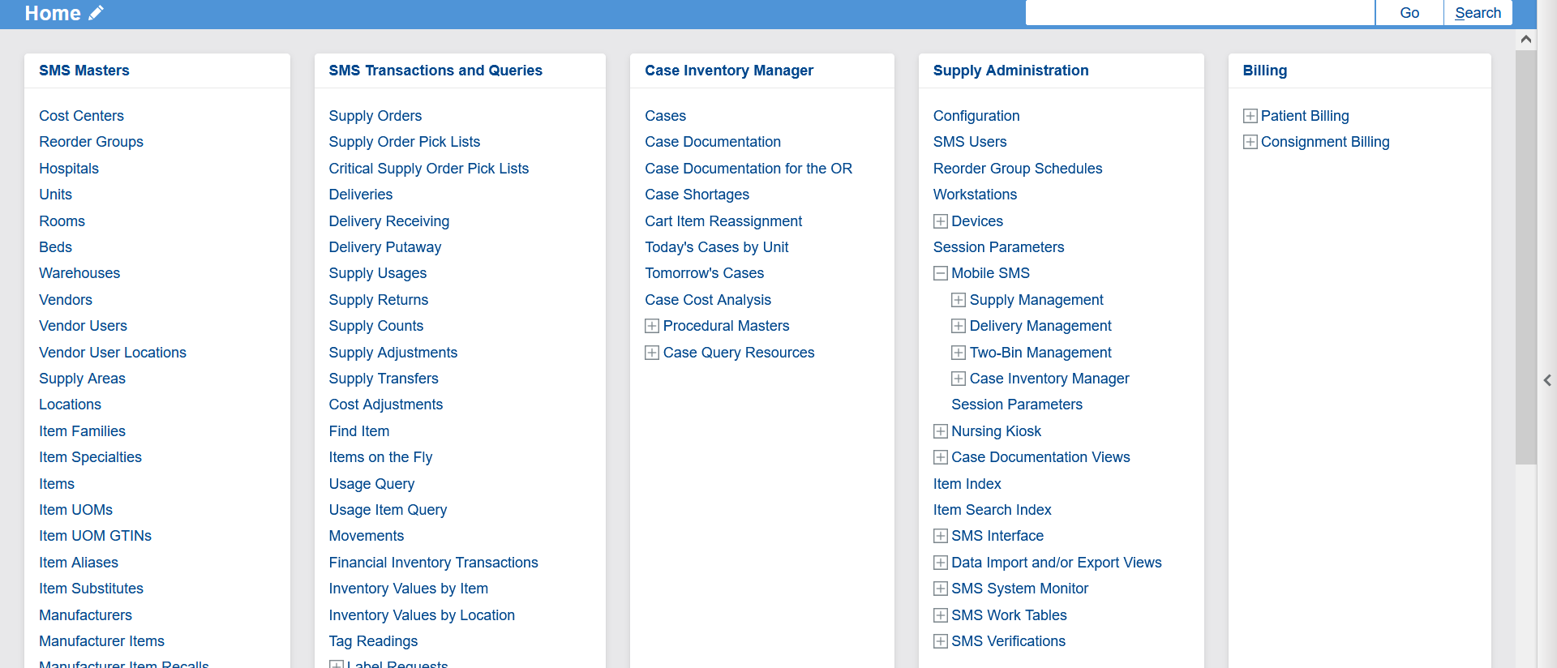
Home Menu POU (SMS)
Case picking and putaway options appear under the Case Inventory Manager and Mobile POU areas.
Notes:
Script:
On the home page, I first want to point out the locations that a user will be utilizing the most.
On the main screen, a user will see that there are two areas that they can go to for Case Inventory Management.
The third column is fully dedicated to Case Inventory Management.
In the fourth column, under Mobile SMS, a user will again see, Case Inventory Manager.
As a note, this is the same view a user would see when using a mobile device.
The Home Menu layout changes based on user access. Layouts may be different than shown.

Slide 17
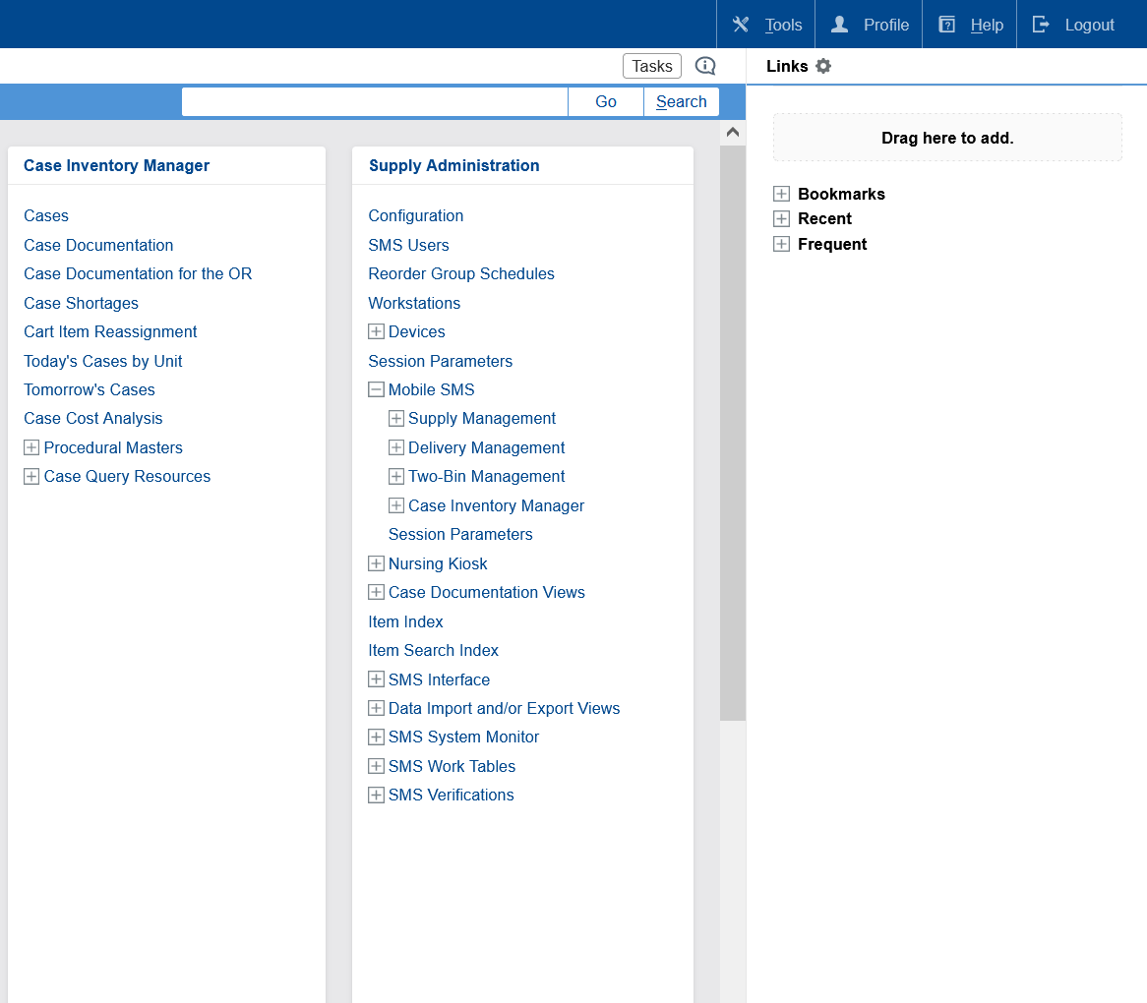
Home Menu
Select the “+” icon to expand and “-” to collapse
All resources found on the handheld can also be found under Mobile POU
Drag resources into the Bookmark bar for quick access
Notes:
Script:
Next, here’s a broad overview of the home menu for someone with the POU_administrator role.
A user's home screen will reflect all resource pages that they have access to based on their security.
Note, that there is a bookmark bar to the right of the screen.
Drag and drop resources in the “Drag here to add” rectangle to bookmark them.
To remove a resource from the Bookmarks, select the gear icon next to “Links.”
It is also worth noting that in the Supply Administration section, a user will see Mobile SMS with a plus icon. All of these resources will also be accessible and viewable on a mobile device.
If you look at the POU Transactions and Queries section, you will also see the same resource pages that are in Mobile POU. So, there are three ways to access the same thing.

Slide 18
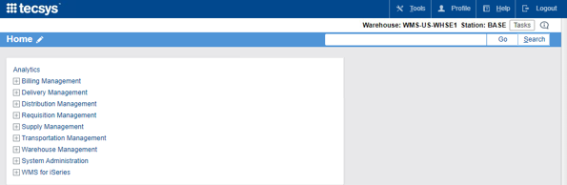
Menu Search
There are three ways to launch resource pages.
Menu System
Quick Launch
Search
Notes:
Script:
As you can see, a user can simply select the resource page that they need from the home page, if they see it.
Otherwise, a user can use the Quick Launch feature at the top right corner of the window.
The difference between Go and Search is that when a user selects Go, it would take them exactly to the resource page they requested, if they typed it in correctly.
If they use the search button after typing in key words, it will provide them a list of all available resource locations that they can choose from.

Slide 19
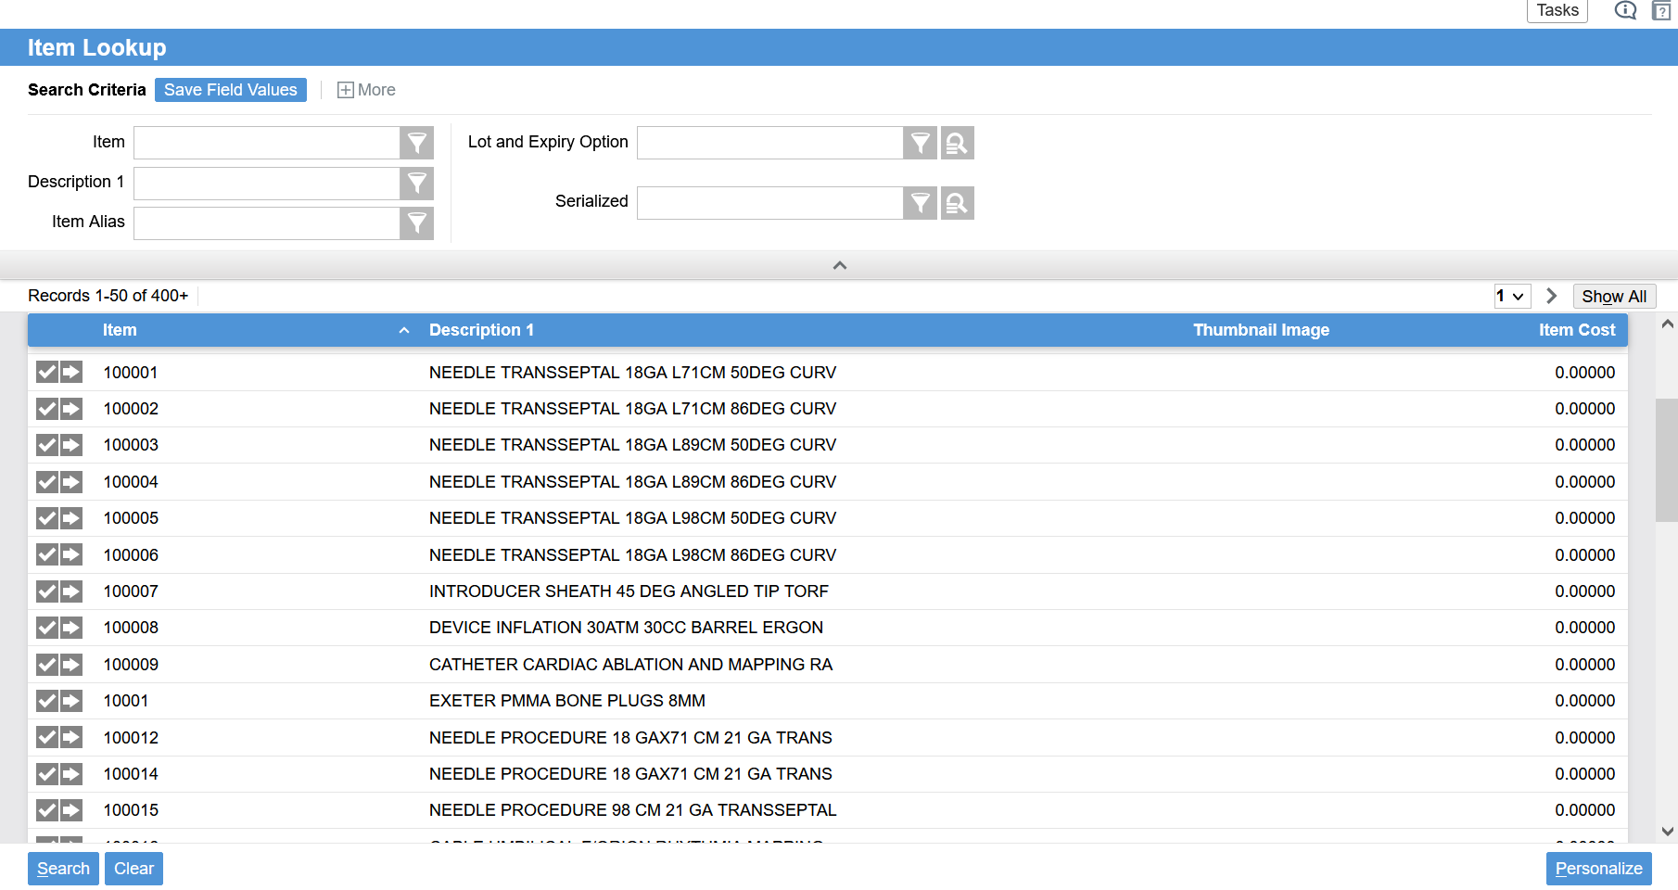
Resource Structure
Notes:
Script:
Let’s move on to the structure of a resource page.
The Item Lookup section of a page is for entering and refining searches.
The Search Criteria section is universal across all resource pages. A user can use the filter button to help with a broad search using partial words.
If there is a magnifying glass next to a searchable box, this will provide a drop-down list of all available options when selected.
Once a user has selected search, the search results will populate at the bottom half of the screen.
In the View Record section, if you press the arrow that is pointing to the right, it will take you to the details of that record.

Slide 20
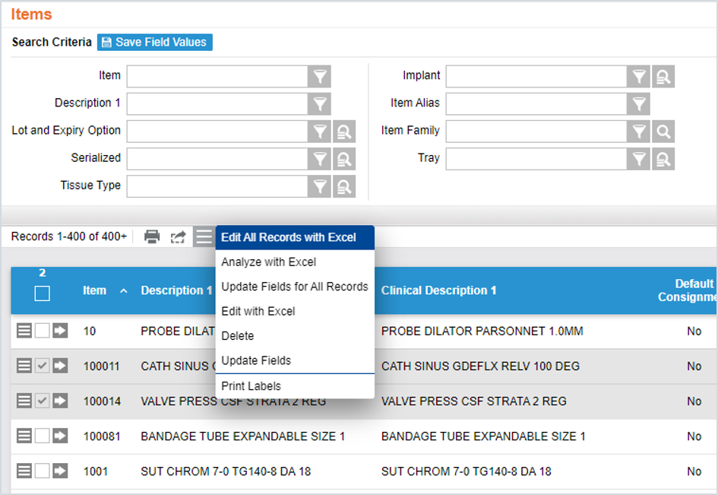
Multi-Action Menu
Print
All records viewed on the screen
Export
All records from the search performed
Menu
Edit All Records with Excel (all records)
Update Fields (only selected records)
Print Labels (only selected records)
Delete (only selected records)
Edit with Excel (only selected records)
Update Fields for All Records (all records)
Analyze with Excel (all records)
Notes:
Script:
Let’s discuss the Top Multi-Action Menu Options.
Once a user has their search results, they can make updates or changes to the individual records, print, and export them to excel.
They can select the rows that they would like to update or export by checking the box on each line.
If all records are to be impacted, the user can press the blue box at the top of the search results section to select all of the results.

Slide 21
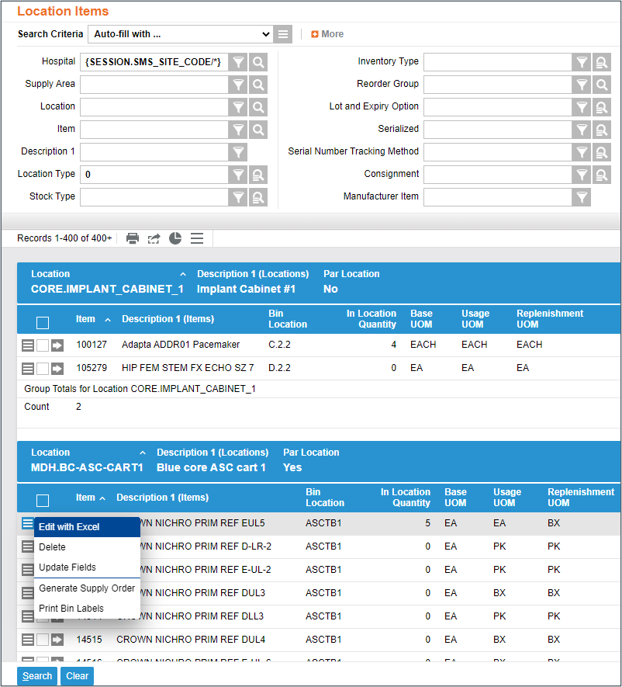
Record Multi-Action Menu
Menu
Edit with Excel
Delete
Update Fields
Generate Supply Order
Print Bin Labels
These actions will only be applied to the record on the same line as the menu. To edit, delete, or update multiple records at once, use the menu at the top.
Notes:
Script:
Note, that each line also has a Multi Action Menu. This is used when a user wants to make a change to an individual line.

Slide 22
Save Search
Enter search criteria.
Select Save Field Values.
Name the saved fields.
Use the saved search criteria instead of entering the information manually.
Notes:
Script:
Let’s dive deeper into the Search Criteria section.
Users also have the capability to save search criteria.
This is used if a user has a search they are frequently entering and would like to save time.
An example of a search criteria a user could save is if they only want to see Supply Orders with a status of New.
Another example, is if there are certain Locations a user would like to easily navigate to without having to repeatedly type in the search requirements.
A user can save a frequent search for the future by entering the search criteria and selecting the Save Field Values button.
A user will need to name their saved search.
So, the next time they enter a search, they will enter the title of their saved search, and the Search Criteria will prepopulate with the saved information.

Slide 23
Navigate the System
Learn how to log in to the system, navigate the application, and perform searches.
Login to the System
Search the System

