Slide 1
General Configuration
2
POU (SMS) General Configuration
Items Configuration
Main Structure
Location Items Configuration

Slide 2
POU (SMS) General Configuration
General Configuration

Slide 3
POU (SMS) General Configuration
Explain how master data is used.
Identify the configuration steps in the main tables.

Slide 4
What is Master Data?
The Master Data configured into the Tecsys application is the core data that is used as a basis for any transaction.
Users cannot perform transactions without it being configured first.
Examples include items, locations, manufacturers, vendors, etc.
A portion of the Master Data is being interfaced from Epic and Workday through Supply Chain Management (SCM/DMS) to POU (SMS).
Items
Manufacturer / Manufacturer Items
Vendors
Vendor Catalogs
Notes:
Script:
The master data is configured into the Tecsys application and that's the core data that is used for any transactions.
Without having master data transferred from Workday to Tecsys, you won’t be able to do anything from there.
Some examples of master data are SCM (DMS) items, manufacturer, manufacturer items, vendor, and vendor catalog.
These are all what is called “interfaced from loss” in or Workday through SCM (DMS) into POU (SMS).

Slide 5
Configuration Steps – Main Tables
Items (Interfaced)
Item Families
Item Specialties
Item Annotations
Inventory Adjustment Reasons
Manufacturers (Interfaced)
Manufacturer Items (Interfaced)
Hospitals
Cost Centers
Supply Areas
Locations
Internal
Vendors (Interfaced)
Reorder Groups/Schedules
Location Items
Internal
Vendor (Interfaced)
Notes:
Script:
Let’s walk through the Configuration Steps for POU (SMS).
These are the main tables that are normally looked at when setting up the Point of Use system.
There are Items, Item Families, Item Specialties, Item Annotations, etc.
The items come in through Tecsys SCM (DMS), then the integration hub flows from SCM (DMS) into POU (SMS).
The vendors go into Locations and then the Vendor Items go into the Location Items field.
Notes:
These will be the commonly used tables in POU (SMS) for all users.
This presentation describes the generic fields needed.

Slide 7
Items Configuration
General Configuration

Slide 8
Items Configuration
Classify item types.
Recognize item adjustment reasons.

Slide 9
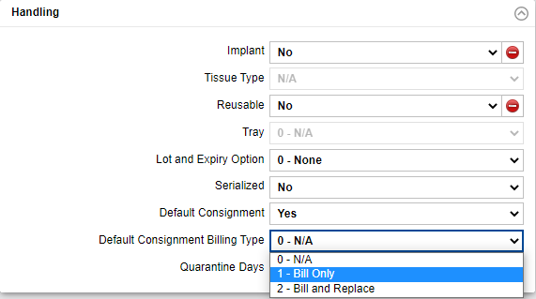
Consignment Items
Upon creation, indicate how to proceed when the item is consumed.
Only request a bill from the vendor (Bill Only).
Request a bill from the vendor and request a replacement item for the one used (Bill and Replace).
Notes:
Script:
The Tecsys item master is interfaced from the procurement tool through SCM (DMS) to POU (SMS). Inside of Tecsys, you will be utilizing the Workday item number and not the Epic number.
This is a key change. However, the Workday number is set up as an alias for the Workday item number.
Although the item file is interfaced from the Workday, there are still updates that need to be done once it is in the system.
When creating an item, we can choose whether the item should be defaulted as a consigned item and the associated billing type.
Although this can be defaulted at the item level in the Items resource, it won't be. It will be added at the Location item level.
The reason this is not defaulted is that one hospital may consign this item, but another hospital might own it.
When the Default Consignment field is set to Yes, Default Consignment Billing Type can be defined as either 1 - Bill Only, or 2 - Bill and Replace.
The Default Consignment and Default Consignment Billing Type field values set up in Items are retrieved automatically when creating location items and may be overridden if required.
Notes:
Important Fields:
Base UOM
Handling
Implant
Tissue Type
Lot and Expiry Option
Serialized
Default Consignment
Default Consignment Billing Type
Important fields:
Item Characteristics
Item Family
Item Family 2
Item Speciality
UNSPSC Classification

Slide 10
Item Family and Item Family 2
“Item Families” are:
Assigned to Items
Used for grouping liked Items
Useful for search functionalities
The second family is typically used to identify a subset family.
Notes:
Script:
Item family is associating an item with a categorization. This is flowing from the Procurement Tool and mirrors the commodity code in Workday.
Item family 2 is not currently being utilized.
Notes:
Item Family - The family associated with the item. Used for item categorization, e.g. gloves, drains, tubes, drapes, etc.
Item Family 2 - The second family is typically used to identify a subset family. For example, the initial item family can be a screw, while the second item family is defined as a cortex in order to identify a cortex screw.

Slide 11
Item Specialties
“Item Specialty” is used for grouping Items by specialty.
The specialty must be the same for all supply areas, locations, and hospitals.
The assignments can be used for analytics.
Item Specialties
Notes:
Script:
Item Specialty is used for grouping of items by specialty.
Assign the specialty to an item that will go through and must be applied to all supply areas, locations and hospitals.
It's mostly used for analytics.
If you have Item Specialty for Ortho, generally they will be pacemakers. That's where you would have your item specialties.
Notes:
Item Specialty - The specialty associated with the item, typically attributed when the item belongs to a specific surgical service or department.
Used for item categorization, e.g. ORTHO, ENT, etc.

Slide 12
Item UOMs
Created and updated through the existing item interface
ERP through SCM (DMS) to POU (SMS)
At least one UOM per item needs to be set as the “Default Usage UOM” and the “Default Replenishment UOM”.
Notes:
Script:
Item UOM is an embedded view within the SCM (DMS) or POU (SMS) item table.
The item UOMs are created and updated through the interface from Workday into SCM (DMS) and then to POU (SMS).
Anything that is created through the system will flow through and into the POU (SMS) master table and from there at least one UOM per item needs to be set as a default usage and then a default Replenishment UOM.
They can both be the same.
If you have three or four different UOMs you can overwrite the set default.
The multiplier that is associated with all the UOMs is based off of the item’s base UOM and POU (SMS) are stocking UOM in SCM (DMS).
The stocking base UM always has a multiplier of 1.
For example, the item UOM table is embedded within the POU (SMS) items table.
There is a box in each for example. These both have multiplier ones because this one's created afterwards.
Then you have your default usage and default replenishment UOMs for each as well.
This is where you will later create and maintain this data.
Notes:
Embedded view in the Item details resource to view additional UOMs at the time of Item creation, maintenance, or query.

Slide 13
Item UOM GTINs
GTIN Process
UDI Tacked Items
This process associates an item UOM with its GTIN (Global Trade Item Number) value.
GTINs are interfaced from procurement to SCM (DMS), then from SCM (DMS) to POU (SMS).
Once this table is set up, GTIN barcodes can be scanned into Tecsys workflow.
The serial numbers, lot numbers, and expiry dates will be captured and stored in the application by scanning the item’s GTIN barcode at putaway.
GTIN Format:(01)GTIN(17)EXPIRY(21)SERIAL(10)LOT
Notes:
Script:
This process associates an item UOM with its GTIN (Global Trade Item Number) value.
GTINs are interfaced from procurement to SCM (DMS), then from SCM (DMS) to POU (SMS).
Once this table is set up, GTIN barcodes can be scanned into Tecsys workflow.
For UDI Tracked Items, the serial numbers, lot numbers, and expiry dates will be captured and stored in the application by scanning the item’s GTIN barcode at putaway.

Slide 14
Item Substitutes
When an item is out of stock due to a backorder or other reasons, create a substitute for the purposes of case picking.
Item Substitutes
Notes:
Script:
Item Substitutes are created at the system level by data integrity using the existing vetting process to identify substitutions.
Substitutions are only set up and used for case picking.
The substituted item will need to be set up in a case pick location and will have to have inventory available for use.
If the OEM item is out of stock for this particular location, it'll automatically direct you to pick the substitute item.
The packing list that is printed once a case pick is complete will note that the original item wasn’t picked but will note what was subbed in its place.

Slide 15
Item Alias
An item alias can be created as an alternative way to search for a specific item in the system.
Unlimited aliases for each item
Stores HIBC or other barcode scans
Used for UPC barcodes
Notes:
Script:
An item alias is used to find and apply alternate item identifiers that also point to the originally requested item. If records in the item aliases table exist for the requested item, then an aliased item number may be applied.
Useful when trying to locate a called for item.
“Nurse friendly” shortcuts would be included here.
There is no limit on the number of aliases that can be created for an item.
Used for storing HIBC or other barcode scans
Used for UPC barcodes
An example of an item alias could be the ERP number that was replaced by the Workday number in POU (SMS).
An alias can be alpha and/or numeric in value but is another way to search for an item outside of the Workday number, general description, or catalog number.
There is no limit on the number of aliases that you can create.

Slide 16
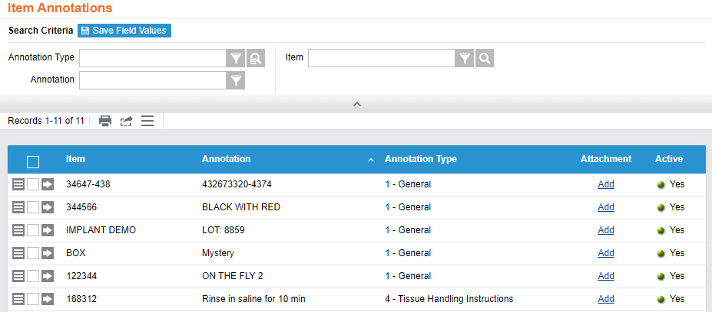
Item Annotation
Item annotations are used to add a message during a particular step of the workflow.
Receiving
Handing instructions
General information
Notes:
Script:
Item Annotation is used to add messaging during particular steps of a workflow.
For example, adding instructions for handling tissues during procedures, or rinse and saline for 10 minutes before using or handling.
Notes:
This is most often used for Bone and Tissue preparation requirements. Allowing for additional information to be available along with attachments during CDUI implant documentation. (For IFU – Instruction for Use).
A Record is created in Item Annotation when “On the Fly” item is added on a case with comments.
Annotation type = General

Slide 17
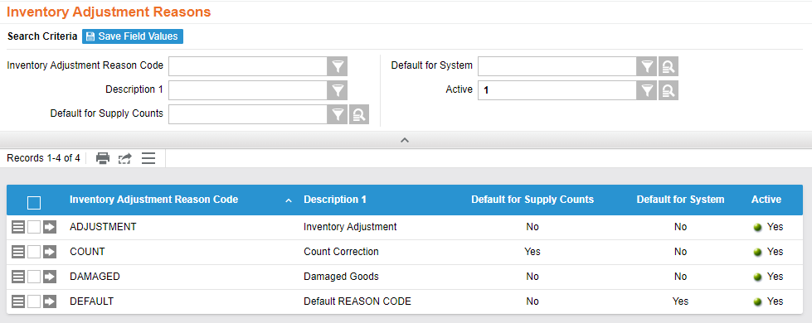
Inventory Adjustment Reasons
Code is required
No limit
Reported in the movements resource
Notes:
Script:
Inventory Adjustment Reasons is a one-time setup.
When you perform a certain type of adjustment transaction, there's a reason code that you must enter (required).
There is no limit on the number of reason codes that you figure.
Any reason code will then be reported in the movement resource page. This is where you can go to view any type of transactional history on perpetual items.

Slide 18
Manufacturers and Manufacturer Items
Manufacturers are interfaced from Workday.
Notes:
Script:
Manufacturers and Manufactured items are interfaced from Epic in the Manufacturers and the Manufactured Items are from Epic into Tecsys tables.
These cannot be created or updated inside Tecsys.
They're built dynamically within the FTM table and flow into POU (SMS).
The manufacturer item scan can be entered into various Tecsys workflows and is displayed on multiple screens. This is utilized to manage recalls.

Slide 20
Main Structure
General Configuration

Slide 21
Main Structure
Identify supply areas.
Use reorder group to create a reorder group schedule.

Slide 22
Supply Areas
Groups inventory locations.
Provides common default values to new locations created within a supply area.
Assigns a sequence number to establish a pick and putaway path.
Notes:
Script:
Let’s go over the Supply Areas resource. This resource is used to group inventory and location.
It provides common default values for new locations created within the supply area.
When assigning sequences to these, users can have elements that are considered by the system to determine the putaway path or the picking path.
When talking about supply picks, a user will look for the supply area, then the location, and then the power perpetual first.
Once a user goes into the Supply Areas resource to create, they will need to know what supply area you have already, what hospital you're linking it to, is it linked to the main hospital, as well as the hospital address you want to set the multiple locations equal-to?
As a note, users can have multiple locations within one supply area.
Notes:
sms_supply_area
Examples of other config fields in Supply Area: Default Par Location, Default Lot and Expiry Date Input Required, Default Serial Number Tracking Method, Default Reorder Group
Area
Lot Expiry Alert Days
How many days required prior to an expiration date for a warning message
Many default configurations are defined which are then used when creating Locations. These defaults can be overridden at the Location level.

Slide 23
Locations
Locations are created within POU (SMS) and tie to the location codes from Workday.
Locations that are replenished internally may live only in POU (SMS).
There are 3 types of Location within POU (SMS).
0 – Internal
1 – Warehouse (not currently used)
2 – Vendor
Notes:
Script:
Locations are created within POU (SMS), and they should match the location codes from Epic.
There are three types of locations within POU (SMS), internal, warehouse, and vendors.

Slide 24
0 – Internal Locations
Internal locations store product, such as:
Supply closets
Cores
OR suites
Cabinets
Code carts
Grouped by supply area
Set as par or perpetual
Notes:
Script:
Internal locations are where a user can create a location type of 0.
Locations can represent supply closets, cores, OR suites, cabinets, code carts, or any type of internal inventory.
Users can set them up as a par or a perpetual. We will discuss this more in greater detail in the next few slides.

Slide 25
Par Locations
Consistent quantity level
Depletion happens when the Location is counted
Supply order is generated when quantity is below par
Reminder
Notes:
Script:
For par locations, we are looking at quantities that are kept at a certain quantity level.
A manual supply count is how the inventory is decremented.
Depletion of inventory does not happen until the Location is counted.
Most of the time the on-hand quantities for par locations are the same. The min and your maxes are normally equal.
If the quantity on-hand for an item in the par location is below par, a supply order is generated for the necessary quantity to be lifted back to par.

Slide 26
Perpetual Locations
Minimum and maximum quantities
Depletion happens upon picking and consumption
Supply order is generated when quantity is at or below the minimum quantity on hand
Real-time inventory management
Notes:
Script:
For perpetual locations, normally a user is managing a minimum and maximum level.
The minimum you need to require one box to put in that location, but maximum you can keep up to three boxes this allows for trigger points.
You want to be able to reorder your inventory and then depletion happens when you're picking or you're consuming the items itself.
Then when the supply order comes, it's below the minimum is at or below the minimum quantity.
Holds items which are managed through minimum and maximum levels.
Depletion of inventory happens upon picking and consumption.
A replenishment Supply Order is generated when an item in a perpetual location is at or below the Minimum Quantity on hand.
The supply order is generated as per the assigned reorder group schedule for the necessary quantity to bring the location back up to the Maximum Quantity on hand depending on the defined replenishment UOM.
Perpetual inventory allows for real time inventory management.

Slide 27
Locations
Notes:
Script:
In the General box you have a quick view of your supply area you're tying a location to or whether it's a part. If it's a two-bin location, then automatic putaway is yes. Otherwise, it defaults to no.
Next is the Cost Centers.
The Workflows section shows tracking technology, pick confirmation, and putaway confirmation whether you want bin or item or both.
The Planning Group will show whether this location is part of your planning group for your picking.

Slide 28
Locations
General
Supply Area
Par Location
Workflows
Location Sequence
Used to determine the putaway location sequence for deliveries.
The order in which putaways are performed is in supply area sequence, then in location sequence, and finally in bin sequence.
Used in reverse for case cart putaway.
Tracking Technology Flag
Use to determine if items are tracked or not.
Cost Center
Via the embedded view or the Location Cost Center resource.
Notes:
Script:
There are some important fields as you're building your location that have to tie to a supply area.
There's a flag to determine if it is a par location, yes or no. This helps during case picking to determine the location sequence.
It determines the putaway location sequence for delivery order. Which putaways are performing supply area sequences, then in location sequences, and then finally in the bin sequences.
It is also used in reverse for case cart put away.
And here is where you have your cost center, it's an embedded view that you'll have to add for tracking technology flags.
This shows whether it's RFID barcode or there's no tracking technology for this location.

Slide 29
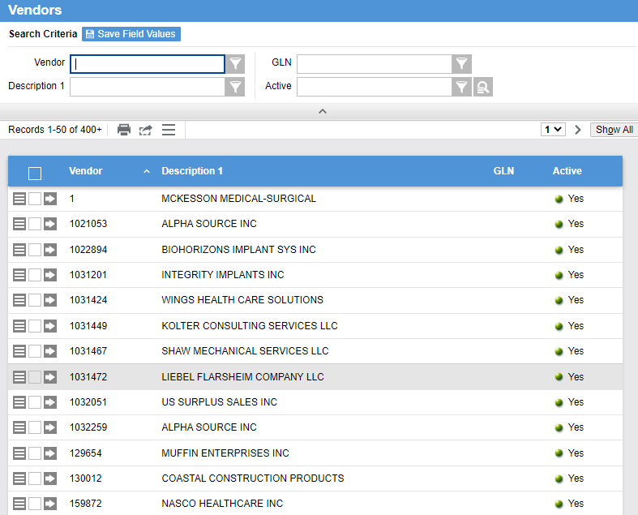
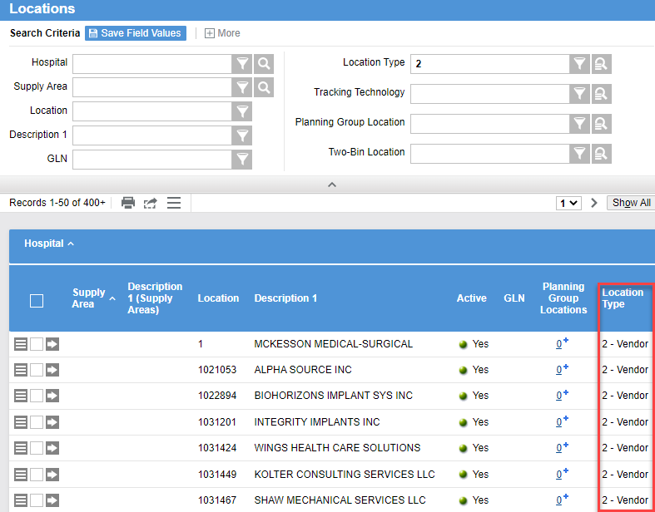
2- Vendor Locations
Vendors are interfaced over from Workday.
Vendors are set as the default replenishment location for vendor-direct items
Notes:
Script:
Vendor Locations is more of an informational piece where data comes in. If you need to search if the vendor exists, then you search based on location type 2.
Vendors are interfaced over from Epic.
When a vendor is created in Tecsys, a location record is created for the vendor with a location type of “2”.
In location items, vendors are set as the default replenishment location for vendor-direct items.
This information flows from Workday and cannot be updated in Tecsys.

Slide 30
Reorder Groups
Define when and how supply orders are generated
Can be set as a default in locations
Can be over-ridden in a locations item
One reorder group per item location
For perpetual locations they must be tied to a reorder group schedule
Notes:
Script:
Reordered Groups is the setting to define how supply orders can be generated.
It is assigned to location items. Can be set up as a default in locations but can be over-ridden in a locations item.
You can set the default group in your location, but it lives mainly in your location items as well, and only a single reorder group may be assigned to a location item.
Only a single reorder group may be assigned to a location item.
For perpetual locations, reorder group must be tied to a reorder group schedule.
That allows it to generate the orders automatically.
Important fields:
Supply Order Generation Rules
Defines whether the supply orders are set to ‘approved’ status when created through the different methods.
Schedule
Critical
Manual
Par Count

Slide 31
Supply Order Generation Rules
Schedule
Critical
Manual
Par Count
Orders that are scheduled.
Based on when manual supply orders are created.
When an inventory is below par.
Orders that are considered critical.
Notes:
Script:
For Reorder Groups there are a few rules that need to be generated.
For example, you can create a schedule rule to run at a specific day or time and you can set if you want the status to be approved or unapproved.
Notes:
Generated with Approved Status defines whether the supply orders are set to ‘approved’ status when created through the different methods
Schedule Rule: for orders that are scheduled, for example every day at 10 am (usually for perpetual inventory)
Manual rule: based on when you create manual supply orders
Par count rule: for par inventory.
As a note, Internal Replenishment must have their Supply Order Generation Rule set to Unapproved

Slide 32
Reorder Group Schedules
Create timers that generate supply orders
Perpetual
Triggered when on-hand inventory quantity reaches the defined minimum level
Work in conjunction with “SMS – Supply Order Generation” timer
Existing supply orders and open deliveries are considered
Par
Triggered when quantity is less than the minimum
No open orders or deliveries exist
Notes:
Script:
Reorder Groups Schedules are used to create timers to generate supply orders.
You can have multiple Reorder Group schedules for one reorder group. An example is if you’d like for the system to generate supply orders for a given reorder group more than once per day.
Reorder Group Schedules are used by the system timers to generate supply orders for perpetual inventory when their on-hand quantity reaches the defined minimum level.
They also works in conjunction with the ‘SMS – Supply Order Generation’ timer.
Existing Supply Orders are considered by this process as well as open deliveries
This also applies for par locations that are tied to a Reorder Group for which a schedule exists.
If a par location is tied to a Reorder Group for which a schedule exists, the system will trigger an order for the location if its on-hand quantity is < min and no open order/delivery exists.

Slide 33
Location Items Configuration
General Configuration
Notes:
Script:
Location Items Configuration

Slide 34
Location Items Configuration
Explain location items and their attributes.
Create a location item record for items and locations.

Slide 35
Location Items
Bin location
Quantities are shown in the base UOM
States the reorder group
Inventory Information
In-location quantity, supply order quantity, and delivery quantity
Allow reorder, standard replenishment location, and critical replenishment location
Item lots and item serial numbers on-hand
Identifies the min/max inventory quantities
Location Items Record
Notes:
Script:
Location Items is a unique combination of an item and a location in which it is stocked.
The bin location of the stock item is specified in the Location Items record.
Add the bin location and sequences.
Configure the min and maximum inventory quantities. All quantities are shown in the Base UOM.
Defines the usage and replenishment UOM which should default to what’s interfaced from Workday.
Defines the reorder group of the stocked Item.
Locations Items also includes Inventory Information such as quantities, replenishment settings, as well as item lots and item serial numbers that are on-hand.

Slide 36
Location Items Overview
Notes:
Script:
It is important to define the multiplier because anything that we have is always going to be considered based on the base unit.
This is an overview of all the location items.
This depicts two Locations. The first shows that it has only 5 items assigned to it.
Some key fields is the Workday item number, description, Bin location, in Location quantity as well as the minimum quantity and maximum quantity, to name a few.
From this screen you get a quick snippet of the current state of your inventory by location.

Slide 37
Location Items Setup
Notes:
Script:
Starting in the General set up, you will need to add your bin location. The expense type will default from the Location setup. And the Usage and Replenishment UOM should populate based on what was interfaced from Workday.
A lot of the item characteristics can pre-populate from other areas. For instance, If the location is specifically created for consignment items, then that could have been set in the Locations resource and will flow to the Location Item.
If not, then you can update the flag here. If yes, then you will also update the Consignment billing type as either Bill Only or Bill and Replace.
All other information defaults from the Items resource except for print delivery label, which isn’t being used so should default to no.
The reorder section can also have some pre-populated fields. For example, if the reorder group was created in the Location, then it will be here and allow reorder to yes will be displayed.
Note that if there is no reorder group listed, then Allow Reorder will be hard coded to no.
The Minimum and Maximum quantity will need to be filled out here.
Standard Replenishment Location can be set up in the Location resource as a default but can be over-ridden here. It is a required field.
The Item Count section is also pre-populated but can be updated by item.
Notes:
Important Fields:
Consignment
Consignment Billing type
$0 Replacement Cost
No Supply Order Generation

Slide 38
Location Items Configuration
Learn to create a Location Item record for your Items and Tracking Location.
Identify the location of an item.
Review item details in a specific location.

Slide 39
Location Items Configuration
Learn to create a Location Item record for your Items and Tracking Location.
Location Items Configuration

