Slide 1
Barcode Tracking Configuration
3
Tracked Inventory

Slide 2
Tracked Inventory
Barcode Tracking Configuration

Slide 3
Tracked Inventory
Create a location item record for items in a tracked location.
Create a tracking event with a code for adjusting inventory with system event applied.

Slide 4
Locations – Tracked Locations
Serial number
Barcode tracked
Conditioned with a Tecsys generated barcode
Notes:
Script:
If a location is set up as Barcode tracked, that means all items that live in that location will be tracked by its serial number.
This is done once the product physically arrives in its destination and prior to putaway.
The item is scanned into the tracked item conditioning resource and the user is instructed to scan or key in the serial umber and expiration date.
A unique Tracked item number is generated in the system and a label is printed that will be added to the item.
This label can be scanned directly into CDUI by the circulator. It will populate the serial number and expiration in Epic and will decrement that specific item from inventory.

Slide 5
Location Items – Tracked Locations
Learn to create a Location Item record for your Items and Tracking Location.
Track individual instances of an item.
Track an item with a barcode.
Tracked item conditioning.

Slide 6
Location Items
Learn to create a Location Item record for your Items and Tracking Location.
Location Items

Slide 7
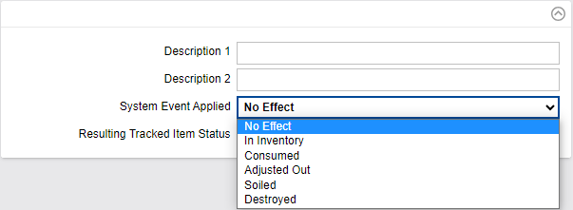
Tracking Events
Required for any adjustments to inventory
No limit
Six system events per tracking event
Notes:
Script:
Since a tracked item is managed at the lowest unit of measure based on serial number, all events that occur in the life of the item is tracked inside of tracking events.
This is also where you would go to adjust it out of inventory, if needed.
When inventory needs to be adjusted for a tracked item, it is performed in the Tracking Log.
To perform this transaction, a Tracking Event is required.
There are no limits to the number of Tracking Events created.
6 System Events can be applied to each Tracking Event Created.

Slide 8
Tracking Log Resource
Notes:
Script:
The Tracking Log resource provides insight and information about an item’s status and whereabouts.

Slide 9
Add a Tracking Event
No effect
Consumed
Adjusted
In inventory
Has no effect on the tracked item status.
The status is set to out of inventory.
The status is set to out of inventory.
Usually used when an item is out of inventory and gets back in inventory (example: return in inventory).
Notes:
Script:
It is possible to add a Tracking Event to your Tracked Item in order to change the Tracked Item Status.
Standard tracking event types are included in the system; however, new ones can be added based on your system’s need.
System Events can be:
No effect: will have no effect on the tracked item status
Consumed: the status will be out of inventory
Soiled: the status will be out of inventory
Adjusted: the status will be out of inventory
In inventory: usually used when an item is out of inventory and gets back in inventory (example: return in inventory)

Slide 10
Tracking Log
“Tracked Item Status” will update the tracked item based on the tracked event applied.
“Tracking Log Events” will show all the events that have been applied.
Notes:
Script:
From the tracking log, the status of a tracked item can be found.
A user can see all the events that have been applied to an item by selecting Details from an item line in the Tracking Log.

Slide 11
Tracking Events: Item
Learn to create a Tracking Event in the Tracking Log.
Create a tracking event for an item.
Review the tracking log.

Slide 12
Tracking Events
Learn to create a Tracking Event in the Tracking Log.
Tracking Events

