Slide 1
Recalls and Expired Items
4
Manufacturer Recalls
Expiration Date Management

Slide 2
Manufacturer Recalls
Recalls and Expired Items

Slide 3
Manufacturer Recalls
Record manufacturer recalls with specific lot, expiry date, and serial number.

Slide 4
Manufacturer Item Recalls
Recalls can be created for manufacturer items with a specific lot, expiry date, and serial number.
A recall prevents movement and usage if items are not yet consumed.
Notes:
Script:
Recalls can be created for manufacturer items with a specific lot, expiry date and serial number.
It is important to note that recall and expiration management is contingent upon selecting the option of capturing lot, expiry and or serial numbers on perpetual items. If you’ve chosen to not capture this information, then you will not be able to utilize these resources.

Slide 5
Manufacturer Item Recall Steps
Case Picking
Add-on in CDUI
Delivery Putaway Confirmation
Notes:
Script:
If a user tries to perform a transaction for a recalled item, the system will display a warning message. A Supply Adjustment will be required to take the recalled items out of inventory.

Slide 6
Manufacturer Item Recalls
Learn how to create a recall.
Create a recall in the Manufacturer Item Recalls resource using the pre-assigned items and lot.
De-Activate a Manufacturing Item Recall.
Delete a Manufacturing Item Recall

Slide 7
Manufacturer Item Recalls
Learn how to create a recall.
Manufacturer Item Recalls

Slide 9
Expiration Date Management
Recalls and Expired Items

Slide 10
Expiration Date Management
Report on items that are available, nearing expiry date, or are expired.

Slide 11
Expiration Management
The Expiration Management resource reports on items that are:
The Change UDI action is used to correct UDI information such as:
Available
Nearing a lot's expiry date
Expired
Lot
Expiry date
Serial number
Notes:
Script:
Expiration Management is used to report on items that are nearing a lot’s expiry date or are expired.
To be able to utilize expiration management, expiry must be captured during receipt or putaway.
There is a change UDI option at the line level. This can be used to correct UDI information, if needed.

Slide 12
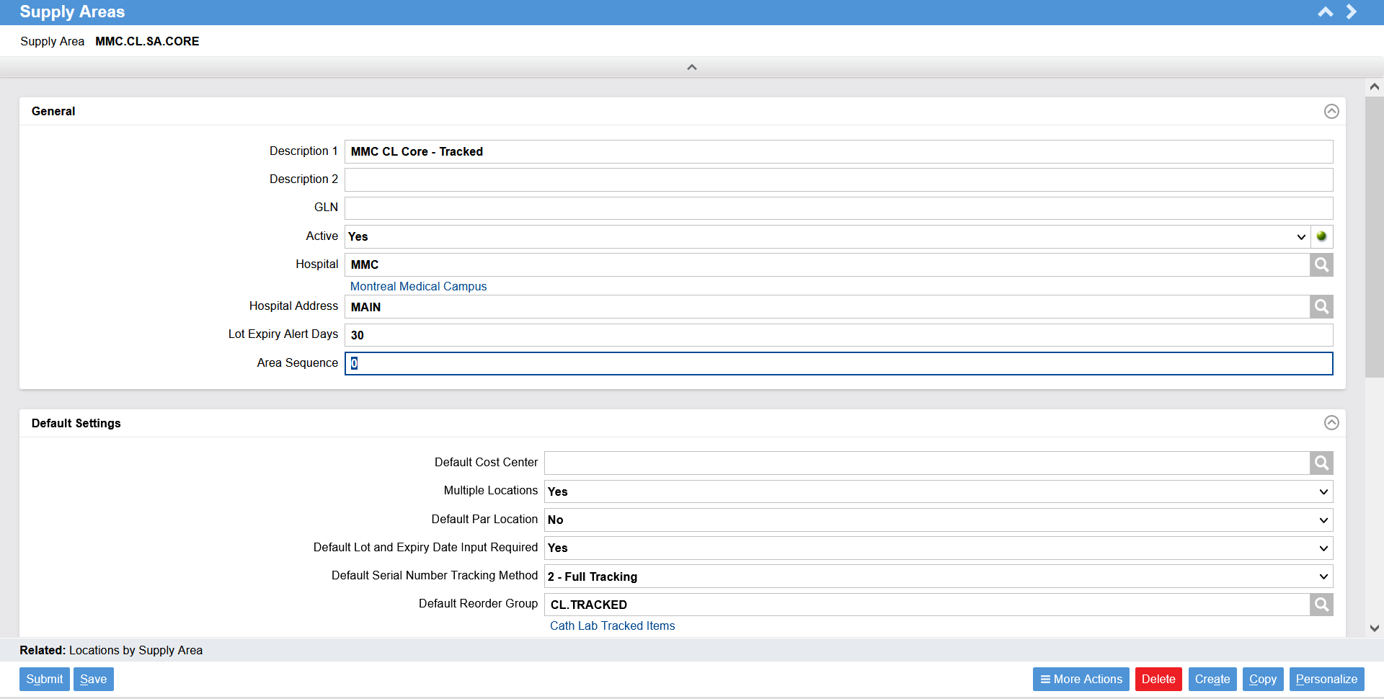
Supply Areas
Multiple Locations: set to “Yes”
Lot Expiry Alert Days: number of days prior to expiration date warning message
Default configurations: may be overridden at the location level
Notes:
Script:
Here is a reminder of where we set the lot expiry alert days. This triggers a warning when an item is coming close to expiration.
Multiple Locations should be set to “Yes” to assure many locations can be assigned to one supply area.
Lot Expiry Alert Days means how many days are required prior to an expiration date for a warning message to appear.
Many default configurations are defined which are then used when creating locations. These defaults can be overridden at the location level.
Examples of other configuration fields in Supply Area: Default Par Location, Default Lot and Expiry Date Input Required, Default Serial Number Tracking Method, and Default Reorder Group.

Slide 13
Expiration Management
Learn how to correct UDI information such as lot, expiry date, and serial number associated with an item.
Change the UDI information of the lot expiry date

Slide 14
Expiration Management
Learn how to correct UDI information such as lot, expiry date, and serial number associated with an item.
Item Expiration Management

