Slide 1
Inventory Replenishment
5
Par Versus Perpetual
Supply Count
Supply Inventory Transactions

Slide 2
Par Versus Perpetual
Inventory Replenishment
Notes:
Script:
This is a quick reminder of what Tecsys considers as Par versus Perpetual.

Slide 3
Par Versus Perpetual
Differentiate between par and perpetual.

Slide 4
Par vs. Perpetual Overview
Par
Perpetual
Quantity visibility not in real time
Incremented when items are received and putaway
Decremented through periodic manual supply counts
Min and max quantities are equal
Lower-value items
Quantity visibility in real time
Incremented when items are received and putaway.
Decremented when items are used
Min and max quantities are not equal
Higher-value items
Notes:
Script:
Par
A lot of the times these are for lower value items that we that we put into a par location or par managed location.
Typically, the par levels are kept at specific quantity, so your minimum is equal to your maximum.
Counts are performed at regular intervals to maintain a constant on hand quantity.
Perpetual
This is real time visibly of quantity on hand.
In this case you would set up a different minimum and maximum for that, so the minimum falls below a particular minimum.
You'll order back up to the maximum and a lot of times these are for higher value items.
Inventory is decremented upon consumption in CDUI.

Slide 5
Par and Perpetual Differences
Par
Perpetual
Counting is considered usage.
Does not capture:
Lot
Expiry Date
Serial Number
Counting is considered an inventory adjustment.
Can be set to capture:
Lot
Expiry Date
Serial Number
Notes:
Script:
For par, when you're counting the par location, that's when you consider it a used.
That's when it decrements from inventory. There's no capturing of lot, expiry, or serial number.
Since Perpetual items are decremented from inventory based on consumption, you only do a supply count if you notice the quantity is off for multiple items in the area. This is considered an inventory adjustment. You can also use the supply adjustment resource to make supply adjustments for one item at a time.
For Perpetual, you do have the ability to capture the lot, expiry, and serial number when you configure it as such.

Slide 7
Supply Count
Inventory Replenishment

Slide 8
Supply Count
Calculate supply counts for perpetual items and locations.
Transfer items to locations managed outside of the POU.
Report missing or unexpected items against a supply count.

Slide 9
Par Inventory Management
Does Location Item Schedule Require Modification?
Does an Item need to be returned?
Go to Location
Return Item to its original location
Approve as
Required
Start
No
Yes
Yes
No
Review Location Item Count Configuration
Modify
Location
Item Count Configuration
Perform
Par Count
Supply Orders
are Generated
Yes
No
Approval
Required?
LOCATION ITEM SCHEDULING
LOCATION ASSESSMENT
Supply
Order Pick List
Source of Replenishment
Pick Items
for Delivery
Internal
Deliver Product
to Location
Store and
Confirm Putaway
Delivery Expected Receipt
End
External
SUPPLY EXECUTION
Notes:
Script:
This is a basic process flow chart of the par inventory management process.
The first box is asking if the par location needs to be modified before proceeding to the location to perform the count.
If yes, make your updates before proceeding to the inventory location
If it doesn't, then you can go ahead to your location and start your supply count.
Once you perform your supply count and submit it, that's when your inventory adjustments will be made, and this will kick off the supply order generation process.

Slide 10
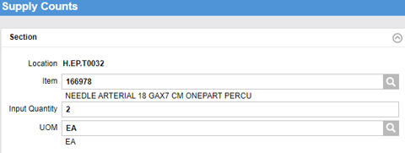
Supply Counts - Par
Notes:
Script:
Performing a supply count using the mobile POU (SMS) handheld is much like performing a supply count in mobile supply chain.
Once you identify the location you are to count, you can scan the bin location which will pop up the item on the screen. You will then key in the quantity in the bin and then scan the next item.
This slide shows how the system represents the supply count in the Location item resource. You can see that the system assumes the on hand is 10, which is the maximum quantity.
When the count was performed that showed there were only 2 each on the shelf, it triggered a supply order of 8 each. This will bring the inventory back to the maximum quantity.
The last picture shows the supply order that was created with a status of approved. This means that the supply order is available to be extracted to the host system.

Slide 11
Supply Counts – Par Inventory
Learn how to submit supply counts for par items and locations.
Submit count of par items from a mobile device.

Slide 12
Supply Counts - Par
Learn how to submit supply counts for par items and locations.
Par Inventory Supply Counts

Slide 14
Supply Counts - Perpetual
Notes:
Script:
This looks identical to the par count that was discussed earlier, and it is. The difference is that this supply count was done as an exception and not the rule.
In this case, consumption should have decremented the inventory. However, someone noticed it was off, so decided to perform a count to right size the inventory.
When this was done, the system will note that an inventory adjustment was performed on this item and will be reflected in the movements table, which is a resource that you can use to track the movements of Perpetual items.
Notes:
Counting a Perpetual location is considered an inventory adjustment
Real time visibility of the quantity on-hand
When items are received and putaway, inventory is incremented
When items are used, inventory is decremented
This is why there is not process flow for supply count for perpetual inventory

Slide 15
Supply Counts – Perpetual Inventory
Learn how to submit supply counts for Perpetual items and locations.
Submit count of perpetual items from a mobile device.

Slide 16
Supply Counts - Perpetual
Learn how to submit supply counts for Perpetual items and locations.
Perpetual Inventory Supply Counts

Slide 18
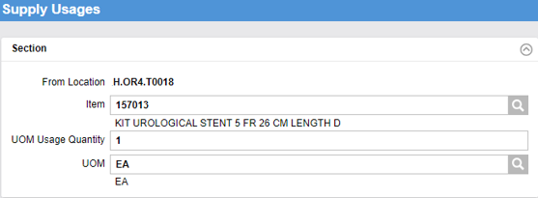
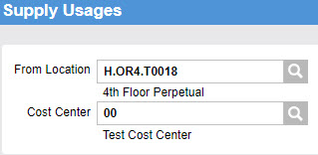
Supply Usage
Supply usage allows for a transfer Items to a location that is not managed in POU.
Notes:
Script:
Supply usages is where you have a need to transfer inventory to a location that is not managed in POU or transfer an item that is not in the other location’s inventory.
Input the source location of the item, then the cost center for the destination location.
How do you perform a usage for a different department?
In this instance if you have their cost center, you can input the location which is where you're sending it, you're providing the item and then you input the cost Center for the destination location.
The cost center will default to the From Location cost center to this needs to be manually changed.
This resource will be used to charge out items from “Cath Lab Core Perpetual”.
Cost center can charge the receiving cost center and decrement inventory levels.
Supply usages can be verified in the “Usage Item Query” activity.

Slide 19
Supply Usage
Learn how to perform a supply usage.
Enter Cost Center.
Enter Usage Quantity.
Review Item Usage.

Slide 20
Supply Usage
Learn how to perform a supply usage.
Supply Usage

Slide 22
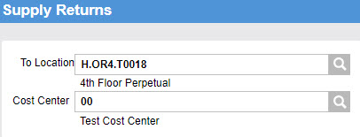
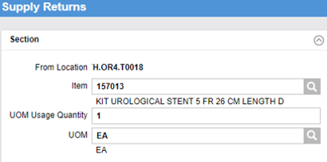
Supply Returns
Input the destination location of the item.
Input the cost center for the source location. This resource is used to reverse supply usages.
Verify Movements resource to validate.
Notes:
Script:
When items need to be transferred back to a location that is managed in POU, supply returns are performed.
The item was issued out, they didn’t take it, or a mistake was made.
Now you want to bring it back.
You can go into the resource supply return versus the supply usage.
Enter the location that that issued out and then return it back to the cost center.

Slide 23
Supply Returns
Learn how to perform a supply return.
Enter Destination.
Enter Cost Center.
Validate.

Slide 24
Supply Returns
Learn how to perform a supply return.
Supply Returns

Slide 26
Barcode Tracked Inventory Management
Missing Items Tracking Log report
No: Status is set to “Out of Inventory” and a tracking log event of “Adjusted” is created
Yes: Status is set to “Being Moved” and a tracking log event of “Missing” is created
Unexpected items
Automatically transferred in the system to the counted location with some exceptions
Missing items
Flag Uncounted Inventory as Missing
Notes:
Script:
Barcode track inventory management is only counted when you notice an issue with the on-hand quantity.
A count against a tracked location is performed to identify missing or unexpected items.
Missing items are reported in the missing items tracking log for further investigation or it can be adjusted out of inventory upon count submission.
This is driven by the location configuration.
There is a flag when we're creating our location for barcode earlier as well where it says flag uncounted, uncounted inventory as missing.
If you say no, it automatically takes it out of inventory.
If you say yes, it will flag it as being moved.
Notes:
No indicates that its status is set to Out of Inventory and a tracking log event of Adjusted is created.
Yes, indicates that its status is set to Being Moved and a tracking log event of Missing is created.
Location configuration in workflow section
Full Room Count = Location of item

Slide 27
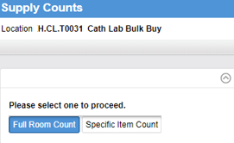
Supply Counts - Barcode Tracked Inventory
Notes:
Script:
In the tracking log enter the location to do the supply count. Because it's a tracked location, you have two options for counts.
You can select with full room count, meaning every item in that room, or you can choose a specific item count.
Remember that these items are tracked by the each at the serial number level, so you have to scan each individual item to find the specific items that might be missing. If you select full room count, then you are literally scanning each individual item in that room.
If you want to count that one specific item and then every track ID that's associated with it, select specific item count.

Slide 28
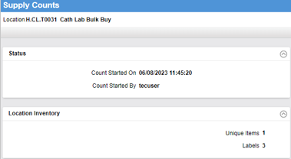
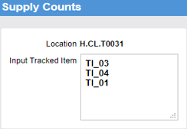
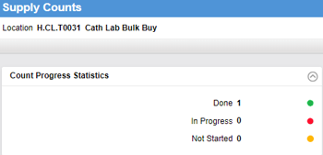
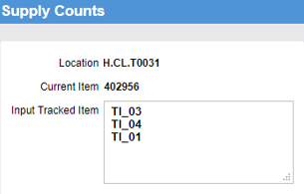
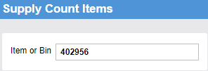
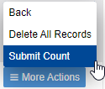
Supply Counts - Barcode Tracked Inventory
Notes:
Script:
When you select full room count and select continue it will show you the inventory.
In this example, there's only one unique item with three labels.
You complete your count.
Once you view the initial count you can View Statistics.
It will tell you the status of it being done, in progress, or not started yet.
For item specific count, it doesn't give you the view statistics.
Select item specific, select your item, put in your barcodes and realize when you're scanning it doesn't let you scan three at a time, it'll do a scan and it'll bring you to the next step just like the other one.
Or you can type it manually.

Slide 29
Supply Counts - Barcode Tracked
Learn how to submit supply counts for barcode tracked items.
Update supply counts.

Slide 31
Supply Inventory Transactions
Inventory Replenishment

Slide 32
Supply Inventory Transactions
Complete a supply adjustment.
Complete a supply transfer.

Slide 33
Maintaining Inventory
Supply Transfers
Supply Adjustments
Tracked Item Transfer
Tracked Item Adjustments

Slide 34
Supply Transfers
Maintaining Inventory
Supply Transfers
Supply Adjustments
Tracked Item Transfer
Tracked Item Adjustments

Slide 35
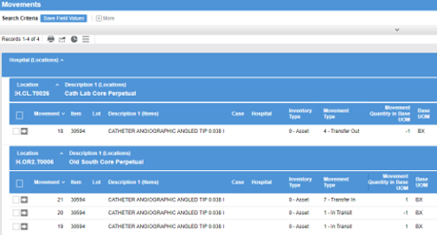
Non-Tracked Supply Item
A transfer can only occur between two locations inside Tecsys POU (SMS) and only for items that are stocked in both locations.
Specify the source and destination location for the transfer.
Inventory is adjusted automatically in both locations.
Inventory movement shows as Transfer Out & Transfer In.
Performed on either desktop or handheld devices.
Notes:
Script:
A transfer of inventory can be performed in the supply transfer resource.
It’s important to understand that a transfer in Tecsys means that inventory is moving from one Tecsys POU (SMS) location to another Tecsys POU (SMS) location and that the item being transferred is stocked in both locations.

Slide 36
Non-Tracked Supply Transfer
Learn how to perform a supply transfer for non-tracked items.
Perform a Supply Transfer.
Check inventory adjustment.
Check movements.

Slide 37
Non-Tracked Supply Transfer
Learn how to perform a supply transfer for non-tracked items.
Inventory Adjustment, Usage, and Transfer

Slide 39
Supply Adjustments
Maintaining Inventory
Supply Transfers
Supply Adjustments
Tracked Item Transfer
Tracked Item Adjustments

Slide 40
Inventory Adjustment
In a single resource, specify the source and destination location for the item.
Inventory is adjusted automatically in the specified location.
Movement type status is 6 - Inventory Adjustment.
Performed on either desktop or handheld devices.
Notes:
Script:
Supply adjustments are only done for perpetual items since they are tracked at the usage level.
Once an adjustment is made, it will immediately impact the in-location quantity.
This can be performed both on a desktop and on a handheld.

Slide 41
Inventory Adjustment
Learn how to perform an inventory adjustment.
Perform a supply adjustment from a pre-assigned location item.
Verify the movement.

Slide 42
Inventory Adjustment
Learn how to perform an inventory adjustment.
Inventory Adjustment, Usage, and Transfer

Slide 44
Tracked Item Transfer
Maintaining Inventory
Supply Transfers
Supply Adjustments
Tracked Item Transfer
Tracked Item Adjustments

Slide 45
Supply Transfer
Enter the tracked item record in the tracking log.
Change the location to where it is transferred
Ensure the location being transferred to is a tracked location.
Notes:
Script:
Transferring a tracked item is very similar to a regular supply transfer, except that it occurs in the tracking log since each item is tracked individually by their serial number.
Just like a supply transfer can only be performed from one POU location to another, a tracked item transfer can only be performed from one tracked item location to another tracked item location.

Slide 46
Movement Resource
Inventory movement shows as “Transfer Out” & “Transfer In”
Notes:
Script:
Note that the movement types are called transferred out and transferred in when looking in the movements resource.

Slide 47
Tracked Item Transfer
Learn how to conduct a supply transfer for a tracked item.
Change location of an item to a new destination.
Validate new item location.

Slide 48
Tracked Item Transfer
Learn how to conduct a supply transfer for a tracked item.
Inventory Adjustment, Usage, and Transfer

Slide 49
Tracked Item Adjustments
Maintaining Inventory
Supply Transfers
Supply Adjustments
Tracked Item Transfer
Tracked Item Adjustments

Slide 50
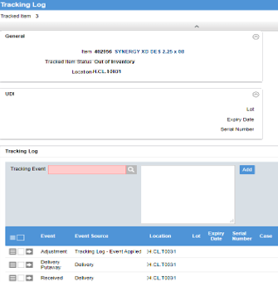
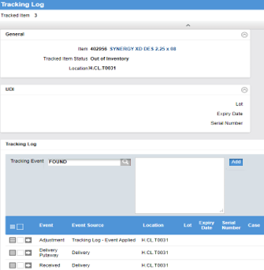
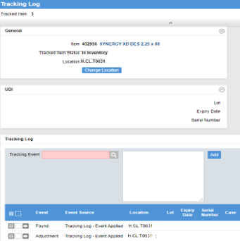
Tracking Log
Enter the tracked item record of the tracking log.
Apply a tracking event to the item.
The tracked item status will update based on the configuration of the tracking event.
Notes:
Script:
You will also use the Tracking log resource to make supply adjustments to a tracked item.

Slide 51
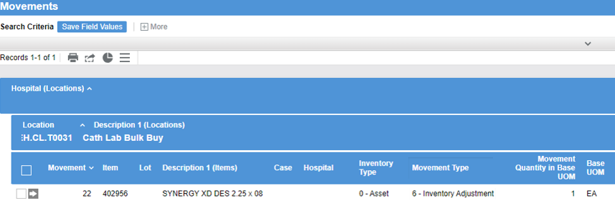
Movement Resource
All updates and changes for a tracked item can be found in the Movements resource.
Notes:
Script:
Again, looking at the movements resource, you can see all updates and changes that occurred for a tracked item.

Slide 52
Tracked Item Adjustment
Learn how to supply adjustment on a tracked item.
Apply a tracking event to the item.
Verify tracked item status change.

Slide 53
Tracked Item Adjustment
Learn how to conduct a supply transfer for a tracked item.
Inventory Adjustment, Usage, and Transfer

