Slide 1
POU (SMS) Operations Monitor
7
POU (SMS) Operations Monitor
Data Validation Views
Reporting in Tecsys POU (SMS)

Slide 2
POU (SMS) Operations Monitor
POU (SMS) Operations Monitor
Notes:
Script:
Welcome to Point Of Use Operations Monitors.
We are going to be looking at the monitoring screen within POU.
This is a high-level view of what is going on within a specific hospital.
We're also going to look at some data validation views and some reports, but mostly the operations monitor and data validation views.

Slide 3
POU (SMS) Operations Monitor
Identify how the POU (SMS) application functions.
Access the POU (SMS) Operations Monitor.
Take action on items on the dashboard.

Slide 4
POU (SMS) Operations Monitor
Monitor hospital activities.
Identify what needs special attention.
Ensure the system is running efficiently.
Notes:
Script:
The POU (SMS) Operations Monitor is used to monitor the hospital's activities at quite a high-level, but also letting you pinpoint specific areas that need special attention.
For example, providing details around supply orders, and stock counts.
The dynamic dashboard displays a current snapshot of what’s in the system.
There are 8 sections to the dashboard, and we will go through them one by one to access the POU (SMS) Operations monitor.

Slide 5
Accessing POU (SMS) Operations Monitor
Notes:
Script:
The POU Operations Monitor is available on the menu of your homepage.
This is what your homepage looks like when you have access to absolutely everything.
And under the analytics box you have POU (SMS) Operations Monitors.

Slide 6
POU (SMS) Operations Monitor Overview
Notes:
Script:
Once selected, the hospital that is defaulted to you automatically displays.
You cannot see the entire system at one time, but if you have access to other hospitals, you will be able to click on your name at the top right of the screen, select session parameters, and update the hospital. When you go back into the operations monitor, you will now see the newly assigned hospital.
In the coming slides we will delve deeper into each section.

Slide 7
To Watch
Stockout
Active Count Sessions
Billing to Review
On Backorder
Critical Orders
Number of location items that allow reorder where the in-location quantity is zero
Number of open count sessions not submitted
Number of consignment billing requests not approved
Number of open supply orders flagged “on backorder”
Number of open supply orders generated as “critical order”
Notes:
Script:
The first section is the To Watch section.
Here is the area that you may have some critical activities associated to what's displayed here.
For example, the first one that you'll see is stock outs, everything everywhere in the system where the location quantity is 0 it will show up here as a record.
As you can see everything here is a hyperlink, by selecting the link, it will bring you directly to the records concerned with the specific issues.
For example, Stock Out, once you select on the hyperlink, it's going to show you all the location items with 0 on hand quantity.
It will display within the POU (SMS) Operations Monitor with all the correct filters to show you the results.
Next, is the Active Count Sessions.
This displays the number of count sessions that are open and that have not been submitted.
When a user does a supply count and they don't click submit, that counts as an active count session and will display here.
You could use this, for example, at the end of the day to see if there are any open counts that have not been closed out.
Billing to Review, this is what is currently sitting in your consignment billing requests resource that is pending review.
Next is the Backorder section.
Remember that this is only created if someone manually goes into a supply order and drops down the backorder flag as a way to know of an ongoing backorder.
Critical orders shows you all the open supply orders that were generated as critical supply orders.
Critical supply orders are based on the critical minimum quantity that you'll have previously set at your location item level.
Please note that this isn’t something that is often used.

Slide 8
Expiration Management
Near Expiry
Available
Expired
Inventory on hand that is near expiry
Inventory on hand that is not expired or near expiry
Inventory on hand that is expired
Notes:
Script:
The next box in the POU (SMS) Operations Monitor is our Expiration Management box.
Note that only items that are set to track expiration will be represented in this box.
Here there are three areas.
First is expired, this will show you all of the location items that are expired and need to be removed from the shelves.
You have your near expiry, so at the supply area level you will be setting the number of days that you want to indicate to the system that the item is near expiry, and that's the value that this box is going to take.
All items that are near expiry, within that limit of days that you'll have indicated to the system it's going to put it in near expiry and available is all the ones for all of the expiry managed items that are not expired or near expiry.
Near expiry is not a global number, based at the supply area level.
Notes:
A value of 2 - Near Expiry indicates that the expiry date is within the value set in the Supply Area's Lot Expiry Alert Days field.

Slide 9
Open Supply Orders
New
Approved
On a Delivery
In Transit
Partially Delivered
The delivery record has been interfaced; the receiving process has been started but not completed.
A delivery record has been interfaced and captured against the supply order, but the inventory was not received in Tecsys.
A delivery record has been interfaced and captured against the supply order, but the delivery quantity only partially fulfills the initially ordered quantity.
A supply order has been generated from the application, but no action was taken.
A supply order has been generated and has gone through the approval procedure.
Notes:
Script:
The next box is open supply orders.
Here it's going to show you all of your open supply orders based on their status.
The status of New is a supply order that's been generated but requires approval before it can be processed.
Approved is a supply order that has been approved but has not yet been extracted.
On a Delivery is a supply order that has been physically received and has been interfaced. Note that since BSWH is interfacing the actual receipt from the host system, on a delivery is a status you would only see if you were creating a manual delivery inside the system.
In Transit is what you see when the receipt has been interfaced into Tecsys and is ready to be putaway.
Partially delivered is when the full quantity of the delivery has not been received yet.
Notes:
On a delivery: A value of 1 - Yes indicates that a delivery has been created for the supply order, and the delivery's status is set to 1 - New and its In Transit field is set to No.

Slide 10
Open Supply Orders with No Delivery
Supply order records that are not associated to a delivery.
Notes:
Script:
The next section is Open Supply Orders with No Delivery.
You can set this to show 3, 7, 14, 30 or all days open.
This is good to keep track of aging supply orders. If something hasn’t been delivered after X amount of days, you’ll want to research the status.

Slide 11
Open Deliveries
New
In Transit
Received
Putaway in Progress
Receiving in Progress
A delivery generated from the application with no action was taken on it.
The delivery record is interfaced but the inventory was not received in Tecsys.
The Delivery record is interfaced; the inventory was Received in Tecsys but not yet putaway.
The delivery record is interfaced; the inventory was Received in Tecsys, and the Putaway process was started but not completed.
The delivery record is interfaced; the Receiving process has been started but not completed.
Notes:
Script:
The next section is Open Deliveries and each of their status that you have that available here.
This is good to review to understand what physical product that was received in your host system, and you are expecting to putaway in Tecsys.
As a reminder, If It’s new, that means the delivery was manually created in Tecsys.
In transit means the receipt was sent to Tecsys and it’s ready for putaway
Putaway in progress means that someone is actively performing putaway on the delivery.

Slide 12
Tracked Items
Received
Case Pick
Received in Room
Implanted
When the last action performed on the tracked item was receiving. The item will be considered “being moved” until a user completes the putaway process.
When the last action performed on the tracked item was picking. The item will be considered “being moved” until a user completes the documentation process in CDUI.
When the last action performed on the tracked item was to document it as used in CDUI. The item will be considered “being moved” until the case is validated.
Applicable to implants only. When the last action performed on the tracked item was to document the “implantation” section of the implant log in CDUI. The item will be considered as “being moved” until the case is validated.
Notes:
Script:
The next section is Tracked Items, which is when each individual item is tracked by its serial number which is scanned into the system, a unique tracked item number is generated, and a barcode is affixed to the packaging.
Received: These are tracked items that have been received in the system, but they have not been put away yet.
Case Pick: This is if your tracked item is currently in a bag on the way to the OR.
Received in Room: This is when a track item has been scanned into CDUI, but the case is not yet validated. (note that received in room is only seen with RFID Labels)
Implanted: This is when the last action is implantation within CDUI.
Notes:
Prepared: Only applicable to tissue tracked items, when the last action performed on the tracked item was to document the ‘preparation’ section of the implant log in CDUI. The item will be considered as ‘being moved’ until the case is Validated.

Slide 13
Open Cases
Case Shortages
Passed Procedure Date
Number of cases that are opened but passed the procedure date
Number of missing items for planned, being picked or picked cases
Notes:
Script:
The last section is Open Cases.
At the top you have the case shortages, this shows you all of the shortages that were reported from planned cases, being picked cases, or picked cases.
There is also a hyperlink for open cases that are past their procedure date.
This means that the status of that specific case is still open. It hasn't been closed out.
Potential causes are that case verification wasn't done by supply chain operations or potentially a circulator did not validate the case in CDUI for the OR.

Slide 14
Open Cases by Status
New
Planned
Picking in Progress
Ready
Usage in Progress
Usage Completed
Putaway in Progress
Case where no action was taken from the point it was created.
Case where supplies were allocated.
Case where the picking process was started but not completed.
Case where the picking was completed and is pending clinical documentation.
Case where documentation was started but never completed.
Case where documentation was completed and validated but not return process was initiated.
Case where the return process was initiated but never completed.
Next user action required is planning.
Next user action required is picking.
Next user action required is to finalize the picking process.
Next user action required is open the case in CDUI.
Next user action required is to validate the case in CDUI.
Next user action required is to perform case verification and putaway.
Next user action is to finalize the item returns.
Notes:
Script:
This goes into further detail by Open Cases status.
In the drop-down menu, you select the specific surgical or procedural area that you would like to view if you want to limit your results. Otherwise, all will be seen on the screen.

Slide 15
Analytics
Access to the most useful reports within the POU application.
Notes:
Script:
Analytics has a couple of quick links to reports, for example, expiration management, inventory activity reports, procedural area, and quota optimization resource.
Note that dashboards is a link to the reports. If you have access to reports, you will also see this on your main menu.

Slide 16
Management and Action Taken on the Dashboard
Learn how to manage the dashboard.
Identify components of the dashboard.
Monitor activities in the POU (SMS) Operations Monitor.
Act on items on the dashboard.

Slide 17
Management and Action Taken on the Dashboard
Learn how to manage the dashboard.
Identify components of the dashboard.
Monitor activities in the POU (SMS) Operations Monitor.
Act on items on the dashboard.

Slide 19
Data Validation Views
POU (SMS) Operations Monitor
Notes:
Script:
Data Validation Views.
The data validation views are specific resources that were created in the system in order to help you validate that your data is cohesive with the needs and requirements of the Tecsys application.
There are three data views:
location verification view
location item verification view
movement verification

Slide 20
Data Validation Views
Access POU (SMS) verifications.
Monitor the number of transactions generated.

Slide 21
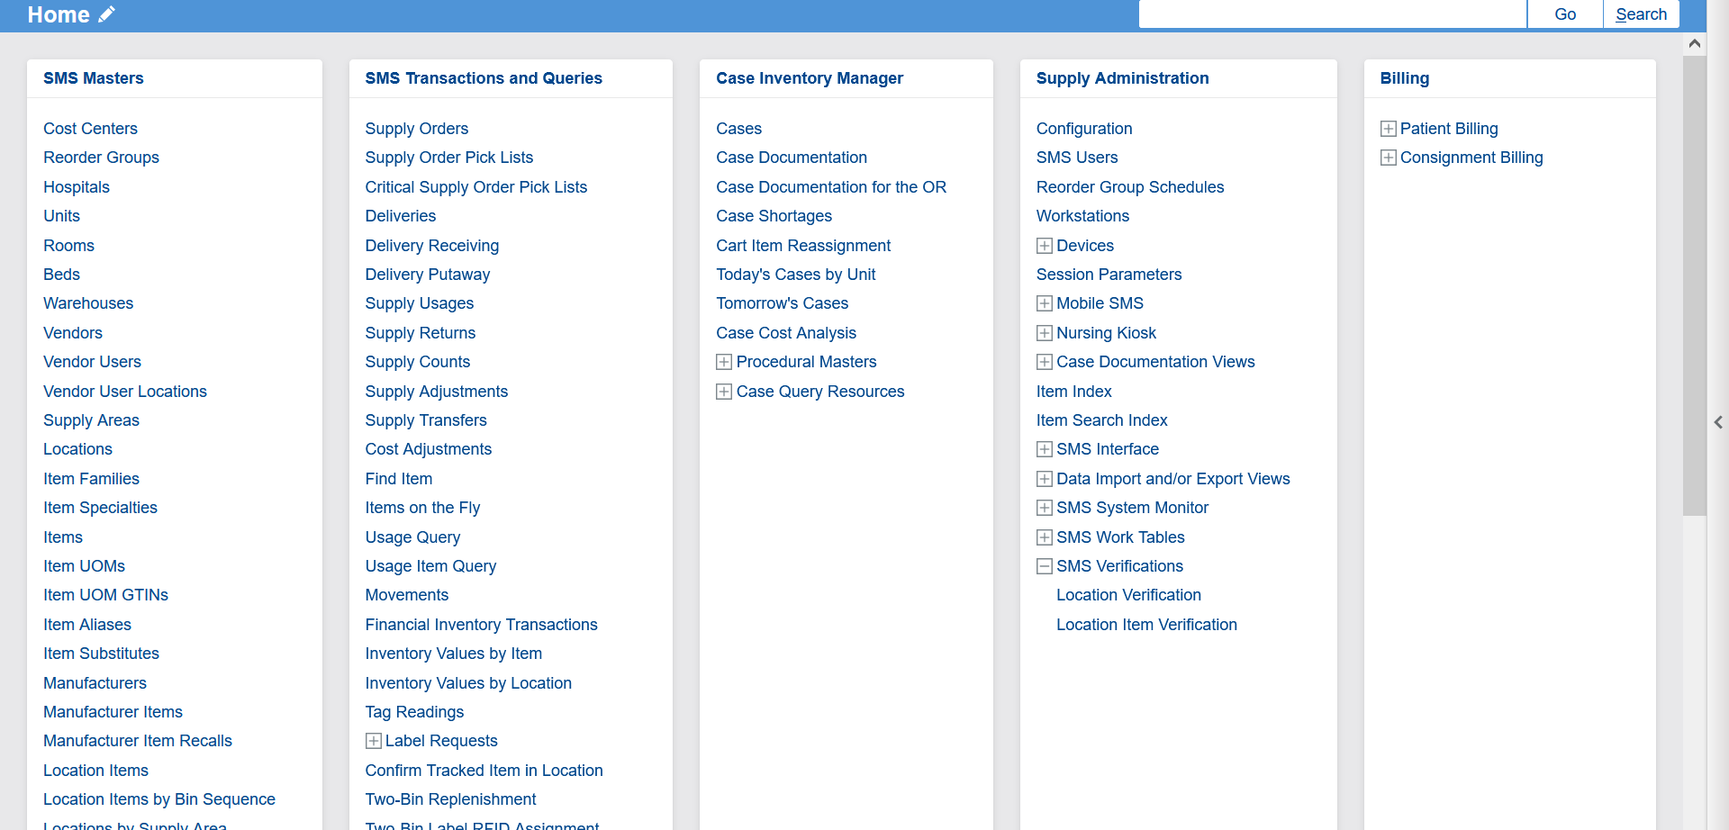
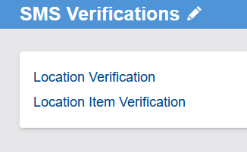
Accessing POU (SMS) Verifications
Notes:
Script:
To access the POU (SMS) verifications area, it's under the point of use administration box on your home menu under SMS Verification.

Slide 22
Replenishment UOM Verified
Notes:
Script:
The first verification view is the location item verification.
It displays all the location items or whichever location items correspond to the search criteria that you've entered on this view.
By default, there are multiple columns.
The first column is the Replenishment UOM Verified.
This column validates that the unit of measure multiplier of the base unit of measure is less than the difference between the min and the max. A replenishment request cannot be generated if the assigned UOM has a multiplier that is greater than the range between the min and the max.
Replenishment UOM Verified:
Validates that the replenishment UOM multiplier when the base UOM is less than either the difference between the minimum and maximum or the par/quota level.
A replenishment request cannot be generated if the assigned replenishment UOM has a multiplier that is greater than the range between the defined minimum and maximum for perpetual locations, or greater than the par/quota level for par locations.

Slide 23
Par Settings Verified
Notes:
Script:
Next is the Par Settings Verified.
This validates that the Lot and Expiry option and the serial number tracking method flags are set to none for par locations. It is not possible to track this information, UDI information, within a par location.
Par Settings Verified:
Validates that for any item assigned to a par location, the “lot and expiry” option and “serial number tracking method” flags are set to “0 - None at the location item level”.
It is not possible to track lot numbers and expiry dates or serial numbers in a par location.

Slide 24
Inventory Type Verified
Notes:
Script:
Inventory Type Verified.
This validates that the inventory type matches the location type for each location.
Inventory Type Verified:
Validates that the inventory type matches the location type for each location item.
Generally, the norm is to assign an inventory type of expense to par location items and asset to perpetual location items.

Slide 25
Implant Location Verified
Notes:
Script:
Implant Location Verified.
This validates that implants are in a perpetual location because they require UDI tracking such as lot, expiry, and serial.
Implant Location Verified:
An expression column that validates that implants are assigned to perpetual locations.
Implants usually require lot and expiry or serial number tracking, but each individual instance of the items are not monitored when living in a par location.

Slide 26
Verified
Notes:
Script:
Verified is a manual flag that you can switch from no to yes.
Once you have validated the specific records.
Verified:
Flag that can be used to manually confirm that a verification has been made and is approved.

Slide 27
Movement Verification View
Filters for time intervals include:
Today
Yesterday
Last 30 Days
Last 60 Days
Last 90 Days
Transactions generated by movement type and user are presented in three grids:
Item Type
Lot, Expiry Date, and Serial Number
Consignment
Notes:
Script:
The Movement verification view allows you to monitor the number of transactions that were generated in the movements view. This can help with testing effort before go live.
The view contains a filter for today, yesterday, last 30 days, last 60 days, and there are three different grids: item type, UDI information, and consignment.

Slide 28
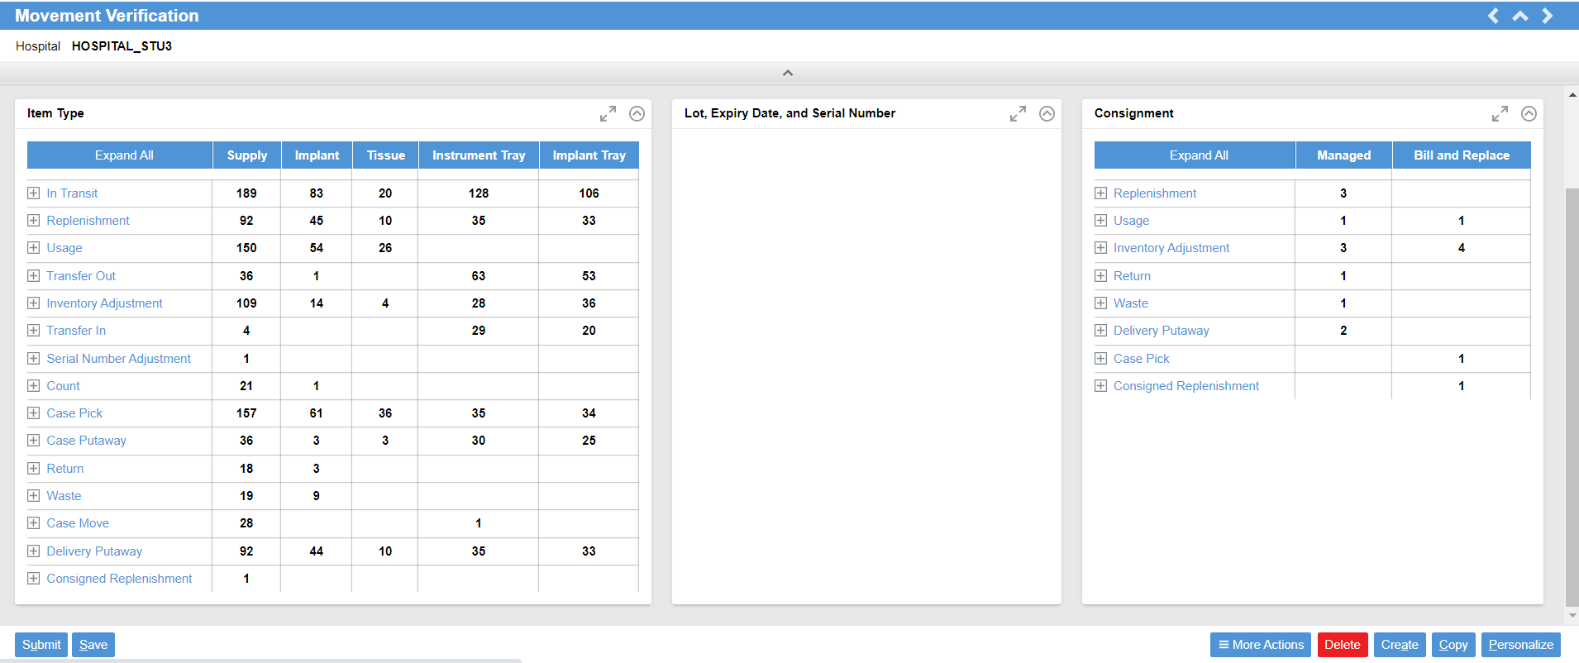
Movement Verification
Notes:
Script:
This is movement verification; it shows you your quantity of movement in each movement type.
Lot, expiry, serial number are dynamics.
Consignment shows, “Where is?”, “What were the movements?”, “What did you have in the last 60 days?”

Slide 29
View Data Validations
Access the POU data validations.
Access data validations.
Recognized the types of validations.

Slide 31
Reporting in Tecsys POU (SMS)
POU (SMS) Operations Monitor
Notes:
Script:
Next, we will look at a couple of reports that are available in the Texas system.

Slide 32
Reporting in Tecsys POU (SMS)
Run reports on usage and case pick queries.
Analyze reporting views to understand the movement, expiration, shortages, fill rate, and tracked item activities.

Slide 33
Reporting Views
Query
Analysis
Usage Query
Usage Item Query
Case Pick Query
Case Completion Query
Movements
Expiration Management
Case Shortages
Case Cost Analysis
Fill Rate Performance
Fill Rate by Source
Tracked Item Activity
Notes:
Script:
We have specific queries and specific analysis.
Let’s go through these.

Slide 34
Usage Query
Search locations history of supply usage, return, and count activities.
Item-level information is not provided.
Notes:
Script:
First let's talk at usage queries.
Remember that supply transfers resource can only be used to transfer inventory between one POU location to another. If only one location is in POU, you have to use the supply usages resource to transfer the inventory.
Usage Query is a view where you can see the history of supply usages performed, as well as supply returns, and supply counts.
Here on Usage Query, you are able to view the to and from location and the cost center.
This is a high-level query and does not go to the item level.

Slide 35
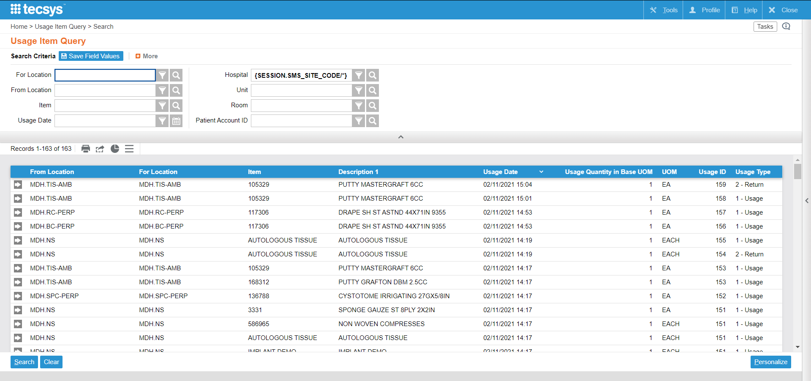
Usage Item Query
“Usage Item Query” view is used to query supply usage, return, and count activities.
Item-level information is provided.
Notes:
Script:
The item information is in the Usage Item Query.
Here you see specifically which item was used, counted, or returned from; in which location to which location, and to which cost center.

Slide 36
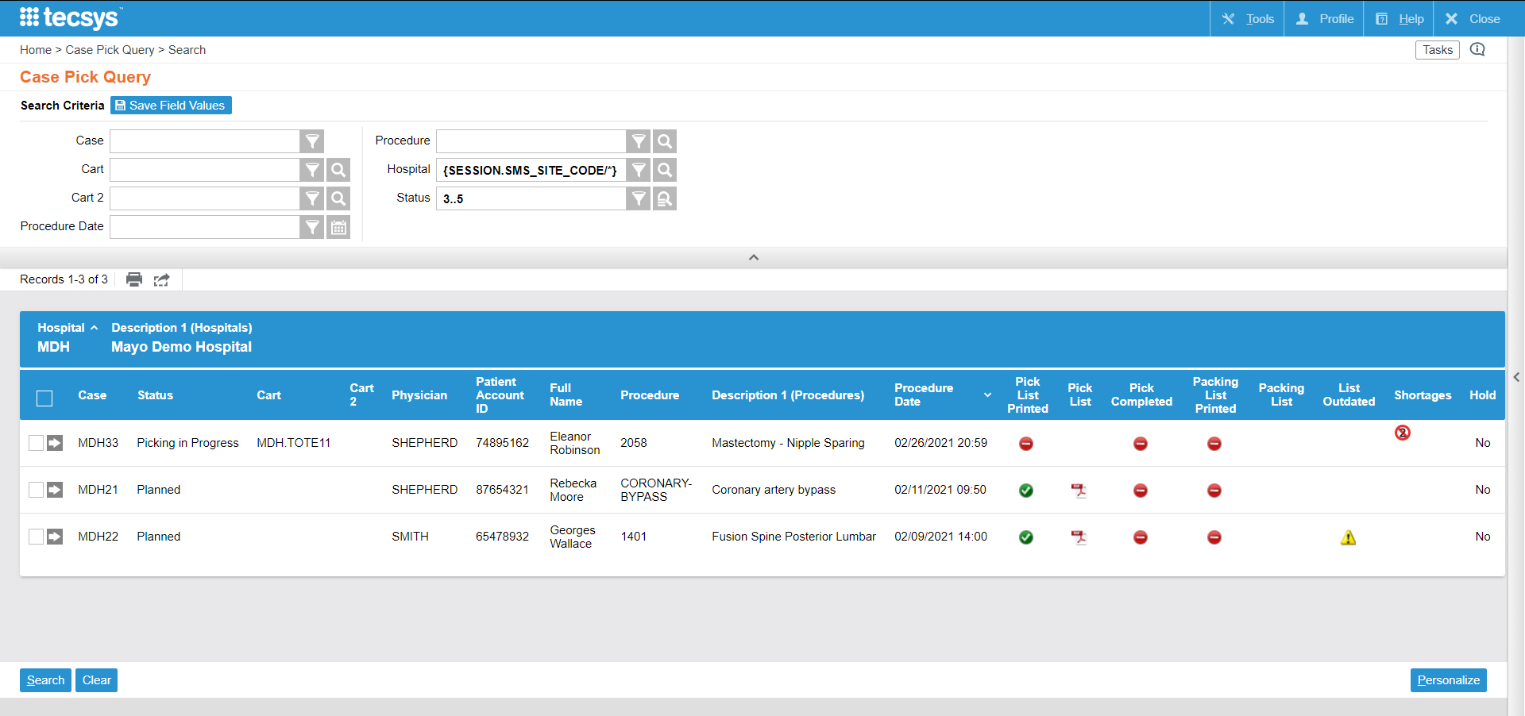
Case Pick Query
The “Cases Pick Query” view allows to query the records in the cases table that needs to be picked or for which the picking process has already started.
Notes:
Script:
The case pick query view allows you to monitor the case pick level to see which cases have been picked, which ones have the pick list printed, and when picking has been completed.

Slide 37
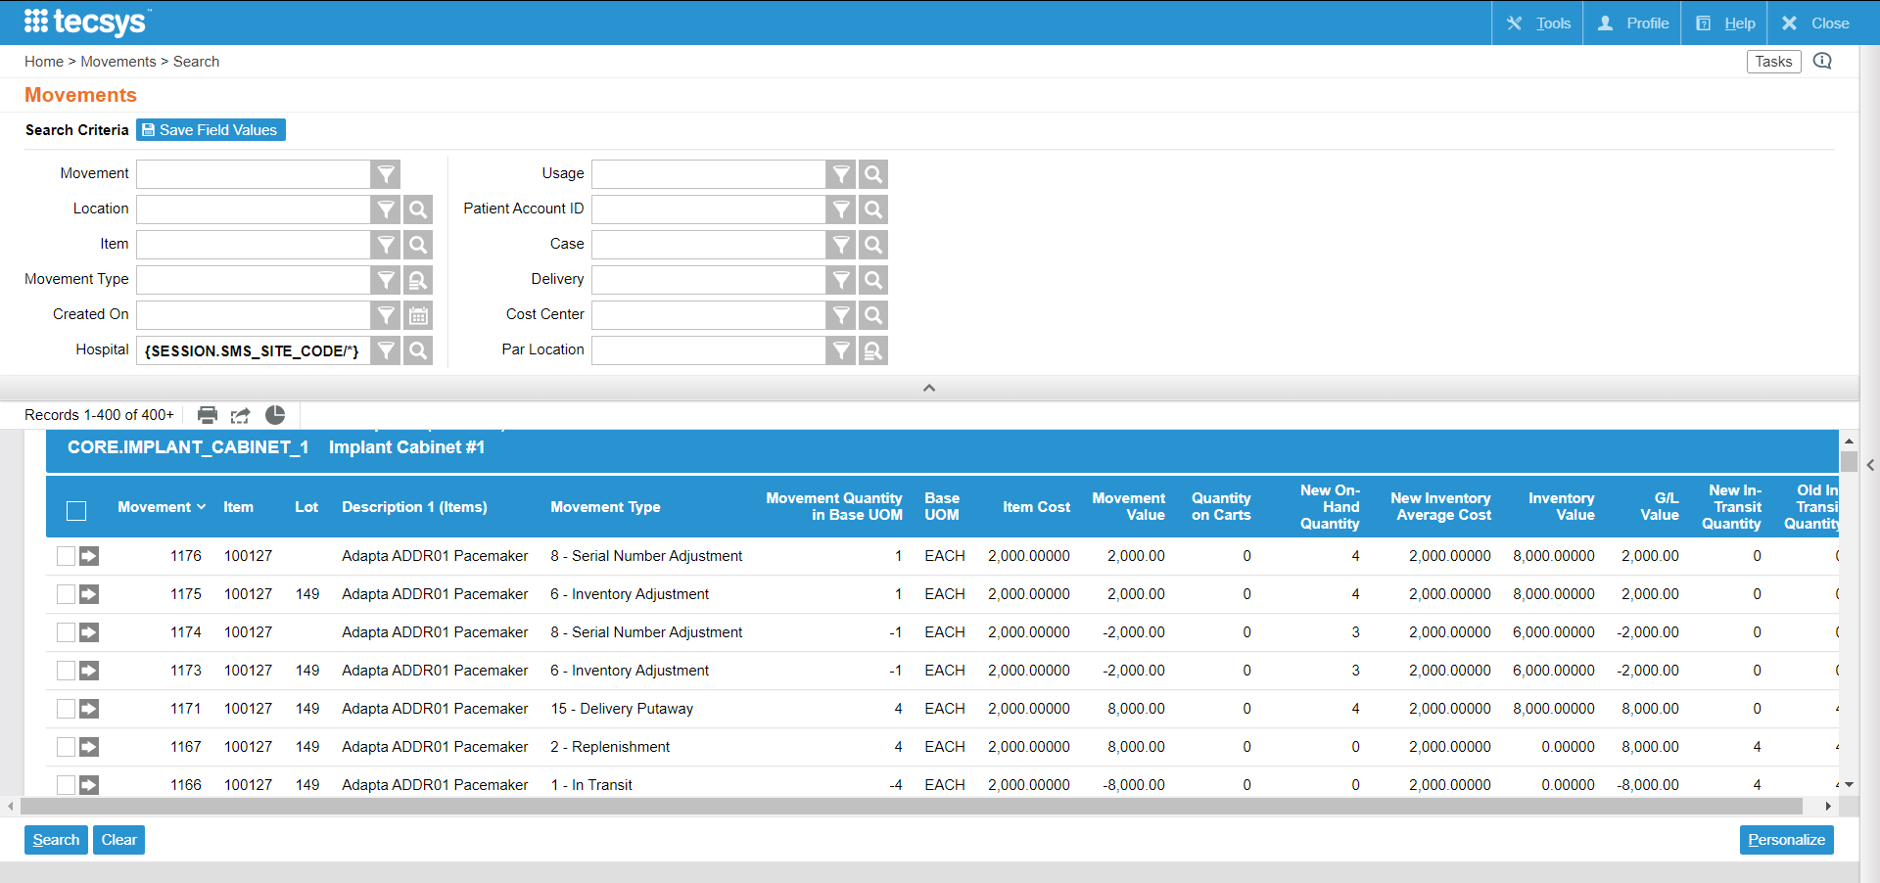
Movements
The “Movements” view is used to query on the history of location item movement activities and any resulting item value changes.
Notes:
Script:
Next let's look at some reporting Analysis views.
First, the Movements view is good view to view movement activities and transactions.
It works well to monitor what end users did, you can see it in movements, you can customize the Movements View to display what you want to see, and you can filter by user or by department.

Slide 38
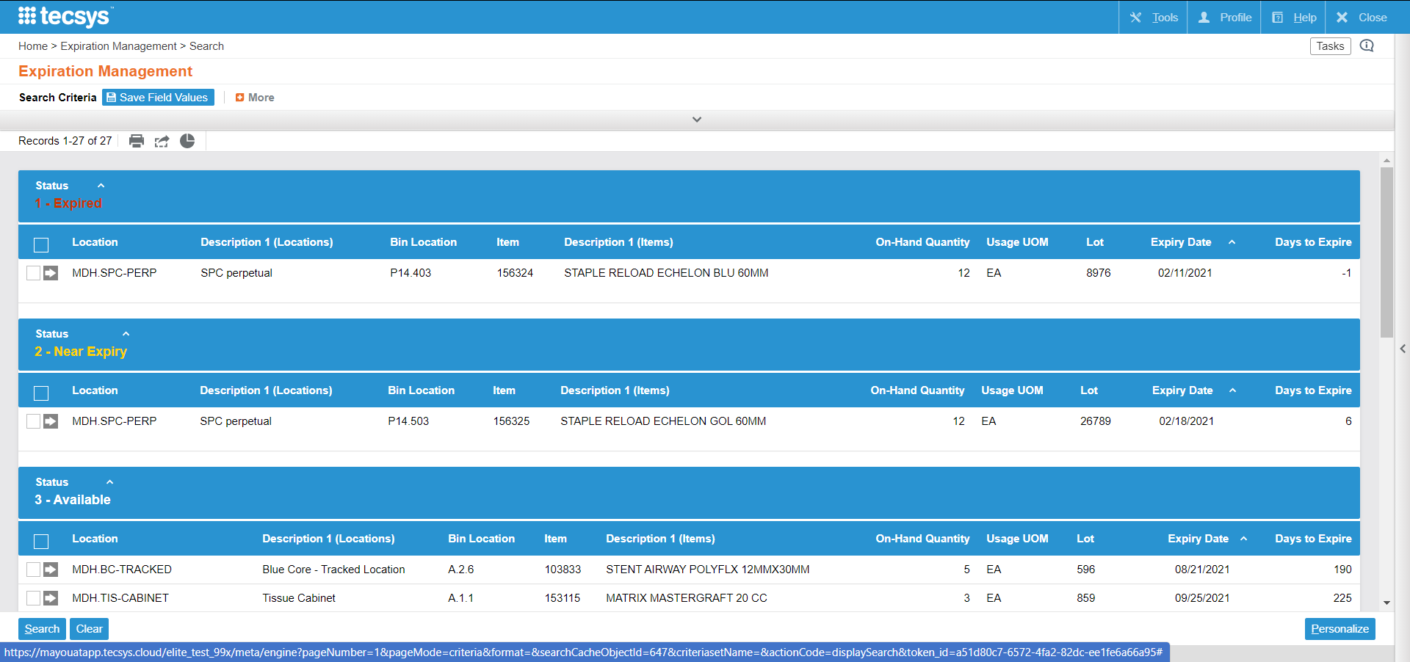
Expiration Management
The “Expiration Management” view is used to report on items that are nearing a lot's expiry date or are expired.
The predefined search criteria makes it possible to display all lots where the expiry date is within the value defined in the Lot Expiry Alert Days field of the locations table.
Notes:
Script:
Next is expiration management, this one is to view all your expiry managed inventory and specifically to see which ones are expired or near expiry.
As a reminder, it will only show items that are being expiry tracked, meaning expiration date is scanned at putaway.

Slide 39
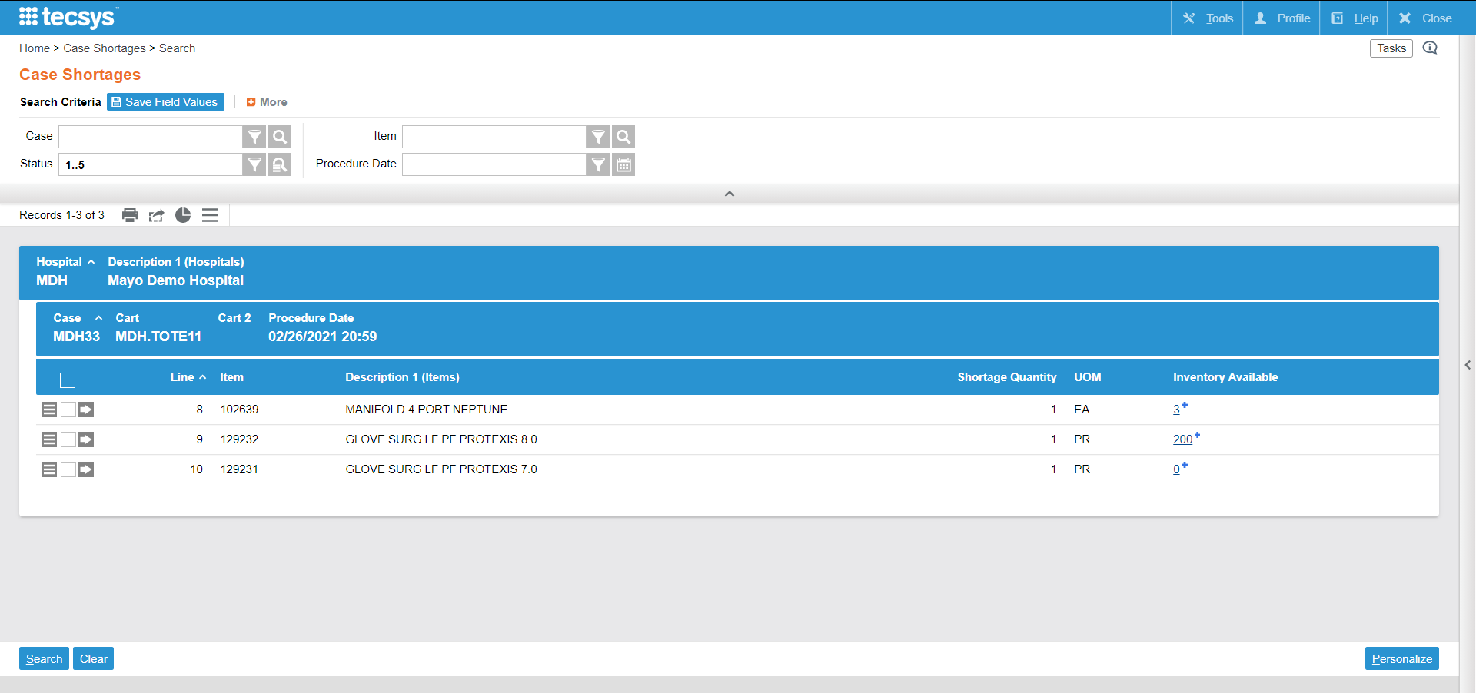
Case Shortages
The “Case Shortages” view is used to query case shortages and is able to specify specific case statuses.
Notes:
Script:
Case shortages are available within the Operations Monitor or directly from a resource in the system on your case.
You can see it within the POU (SMS) Operations dashboard, or you can go search for it directly in your menu.
Notes:
It is possible that the case was either planned or pick prior to a shipment being received, or also perhaps inventory is available in a location that is not part of the planning group

Slide 40
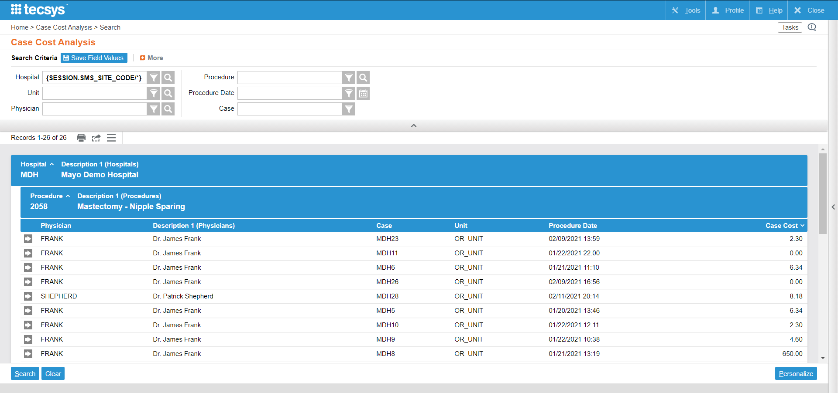
Case Cost Analysis
The “Case Cost Analysis” view is used to query the case cost for completed cases.
Notes:
Script:
The Case Cost Analysis is where you can view the case cost based on the replacement cost of these items.

Slide 41
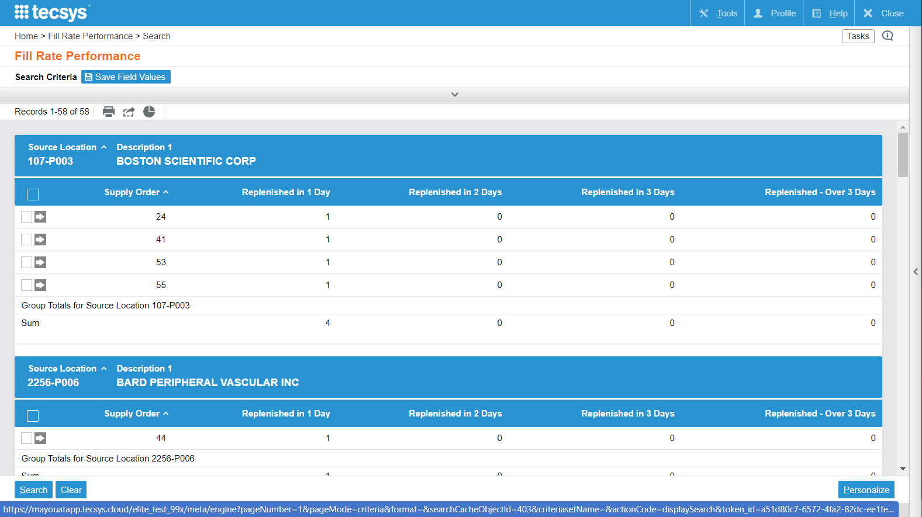
Fill Rate Performance
The “Fill Rate Performance” view is used to display the supply orders in each source location. It will show completed supply orders replenished between 1-3 days, or greater than 3 days. A specific supply order is identified.
Notes:
Script:
The fill rate performance is how long it took for supply orders to be replenished.

Slide 42
Fill Rate by Source
Displays completed supply orders and how many supply orders were completed in total, in 1-3 days, or greater than 3 days.
Percentages of supply orders that were completed in relation to the historical total number of completed supply orders
Notes:
Script:
The Fill Rate by Source is how long it took to be replenished based on the source location.
Displays completed supply orders and how many supply orders were completed in total, in 1-3 days, or greater than 3 days.
Displays the percentages of supply orders that were completed in 1-3 days or greater than 3 days in relation to the historical total number of completed supply orders
Notes:
Differences: % + sum of supply orders
The Fill Rate by Source view is one of the five views in the Supply Order Fill Reports suite.
Fill Rate Performance
Fill Rate by Source
Fill Rate by Source (Last 30 Days)
Fill Rate by Source (Last 60 Days)
Fill Rate by Source (Last 90 Days)

Slide 43
Tracked Item Activity
Displays the quantity of items in a tracked location
Notes:
Script:
The Tracked Item Activity shows the quantity of items in a tracked location that have been consumed, ordered, and received in the past 30 days.

Slide 44
Case Shortage Validation
Learn more about case shortage validations.
Use the Case Shortages view to identify case shortages.

