Slide 1
Inventory Maintenance
6
Supply Orders
Delivery
Consignment Billing Request

Slide 2
Supply Orders
Inventory Maintenance

Slide 3
Supply Orders
Replenish supplies using a supply order.
Determine when to use reorder groups and schedules.
Cancel or update a supply order.
Recognize supply order batches.

Slide 4
Supply Orders
Delivery Putaway
Supply Counts & Usage
Consignment Billing Request
Maintaining Inventory
Notes:
Script:
We will be going into the various ways a supply order can be generated.

Slide 5
Create Supply Orders
Methods
Reorder Group Schedules
Par Counts
Manually
Vendor Location
Internal Location
It is a Supply Order Pick to be processed within Tecsys.
It is sent via an interface to Workday as a requisition, which becomes a PO
Notes:
Script:
There are three ways to have a supply order created:
Reorder group schedules – is where the system has schedules in place that are set to look at the perpetual locations min/max. If the quantity is at or below the minimum, a supply order will be generated.
Par counts are used on par items. Once a count has been submitted, a supply order will be generated.
Manually – this is where you go into Location Items and select a location or a specific item in a location to generate a supply order. This is only performed on an as needed bases. Sometimes a change to an item can occur after a schedule occurs and you want to ensure that a supply order is generated that same day.
When a supply order for a vendor is created and approved, it is sent to an interface to Wokrday as a requisition and which then becomes the PO.
When a supply order from an internal location is created, it becomes a supply order pick within Tecsys and stays within Tecsys POU (SMS).
You go into your supply order, pick resource, pick your destination location and your source location, and then pick the item from a perpetual to replenish a par location.

Slide 6
Internal Replenishment
Par Inventory Management
Par count brings the in Location Quantity at or below minimum in POU (SMS)
Supply Order pick is generated in POU (SMS)
Supply Order Pick is performed at source location in POU (SMS)
Store and confirm the putaway in POU (SMS)
Notes:
Script:
In this scenario, one location is replenishing another. An example would be an OR room being replenished from a core.
For par inventory, you decrement inventory by performing a par count for the location.
A supply order pick is created wen the count is submitted
Someone goes into mobile POU (SMS), to supply order pick and physically picks the items from the replenishment location.
Once picked, they go to the destination location and performs a putaway.
The timer runs to batch all of the supply orders, by definition location and source location.
A requisition is then sent to Workday.
Physical inventory is received in Workday.
Delivery receipt from the Workday.
Then it is putaway in the POU (SMS).
For Warehouse and Vendor Orders
Note for vendor orders -> Mention how there are extra steps
After Supply order is generated, supply chain must create the Workday P/O, Receive Shipment in Workday
If it was a supply order for a perpetual location; must create delivery receipt in SMS

Slide 7
External Replenishment
Par Inventory Management
Par count brings in Location Quantity at or below minimum in POU (SMS)
Supply Order generated in POU (SMS)
Timer runs to batch supply orders by destination and source location
Requisition sent to Workday
Physical Receipt of items into Workday
Receipt transmitted to Tecsys
Putaway performed with mobile device
On hand is updated and product physically stocked
Notes:
Script:
Once a count has been submitted, a supply order is generated. It is then sent for replenishment.
The product is physically received, and the receipt is transmitted to Tecsys
Instead of scanning a putaway for par items, Supply Chain Operations will perform a putaway for all items based on the receipt in the deliveries resource.
On hand is updated and product is physically stocked.

Slide 8
Supply Count Process
Does Location Item Schedule Require Modification?
Does an Item need to be returned?
Go to Location
Return Item to its original location
Approve as
Required
Start
No
Yes
Yes
No
Review Location Item Count Configuration
Modify
Location
Item Count Configuration
Perform
Par Count
Supply Orders
are Generated
Yes
No
Approval
Required?
LOCATION ITEM SCHEDULING
LOCATION ASSESSMENT
Supply
Order Pick List
Source of Replenishment
Pick Items
for Delivery
Internal
Deliver Product
to Location
Store and
Confirm Putaway
Delivery Expected Receipt
End
External
SUPPLY EXECUTION
Notes:
Script:
The supply order is generated, then it goes through approvals. All par counts will be automatically approved for processing.
If it's internal, we must do our supply order pick.
If it's external, it goes to Workday, and a delivery expected receipt will interface to Tecsys POU.
Putaway will be performed for all locations through the deliveries resource.
Deliver the product to its proper location.

Slide 9
Supply Count Steps
Usage of supplies occurs.
Supply Chain staff use a mobile device to perform periodic supply counts.
Inventory levels are updated. If needed, Supply Orders are created and interfaced accordingly.
Receiving is performed in Workday and interfaced to Tecsys.
Putaway is performed and inventory is incremented.
Notes:
Script:
This is a cycle of the supply count.
Utilization does not decrement inventory. Just a supply count.

Slide 10
Supply Order Flow
Supply orders are generated
Orders are delivered
Putaway is completed
Inventory is updated
Notes:
Script:
A supply order is generated by the system upon the completion of a par location supply count when the quantity of the item is below its par level.
The supply order quantity is calculated to bring the location to par level, considering current on-hand and open orders and deliveries. Location quantity is not automatically decremented at the time of usage.

Slide 12
Perpetual Inventory
Do Supply Levels Trigger Order Generation?
Is Manual Intervention Warranted?
Assess Location Supply Status
No
No
Start
Yes
Yes
Generate
Supply Order
Create
Supply Order
Are There Modifications Needed?
Is Order Approval Required?
Delivery Expected Receipt
Barcode label
No
No
Type of Perpetual Inventory
SM-POU-102 | Conditioning and Putaway: Barcode Tracked
End
Yes
Yes
Modify
Order Quantity
Approve
Supply Order
Native Manufacturer Barcode
SM-POU-103 | Receiving and Putaway: Perpetual Inventory
LOCATION ASSESSMENT
ORDER COMPLETION
Notes:
Script:
This process shows how the replenishment process occurs.
The system first looks to see if supply levels will generate a supply order.
If yes, the order is generated.
Once a supply order is generated, there are a couple of things that you can do. You can update the status and you can cancel the order before extracts to the host system for processing. Note that you can update order quantity if status is New, but it’s not recommended as any quantity change would be outside the item’s min/max formulary.
If a supply order is not generated, but one is needed, then manual intervention is needed. This can be to update the min/max in the location and then generate a new supply order manually or creating a supply order from scratch. Note that if an order is created directly in the procurement tool, it would be outside of this process and a delivery would need to be created to update the on-hand quantity.
Based on the reorder group, a supply order might require approval before it can be extracted to the host system for processing. If that’s the case, the supply order will be in the status of New. The status would need to change to approve before it can be processed.
In all scenarios, once the order is processed and supplies are received into the host system, a receipt will interface to Tecsys. Once the putaway occurs, inventory will be updated to the new on hand quantity.

Slide 13
Supply Orders
Perpetual Inventory Management
A timer associated to a Reorder Group Schedule runs.
The system considers open supply order and delivery quantities of the item for the location.
Supply Orders are generated to increase the In Location Quantities for the location Items that have a quantity less than the Minimum Quantity.
Notes:
Script:
A timer associated to a Reorder Group Schedule runs, generating supply orders to increase In Location Quantities for the location Items that have a quantity less than the Maximum Quantity.
The system considers open supply order and delivery quantities of the item for the location.

Slide 15
On-Demand Supply Order Process
The system evaluates the item and creates a supply order if:
On-hand quantity is at or below the minimum quantity.
Total of on-hand and active supply order quantities for the location do not equal or exceed its maximum quantity.
Supply order quantity targeted to bring location to maximum. It will not impact the schedule of the reorder groups
Notes:
Script:
You can go into a specific location item and select the particular items you want instead of the whole location.

Slide 16
On-Demand Supply Orders
A user with the appropriate role can trigger the system to evaluate a perpetual inventory location for replenishment.
Enter Locations or the Location Items resource.
Select Generate Supply Order from the contextual menu.
Notes:
Script:
To generate a supply order right away, you can do this through your action button Generate Supply Order.
This isn’t used often. Typically, it’s done if changes were made to a location item and the reorder group has already run for the day, this would be performed to ensure an order is cut for the day prior to the interface running which would send the supply to Workday.

Slide 17
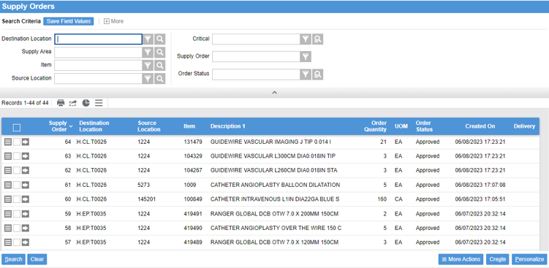
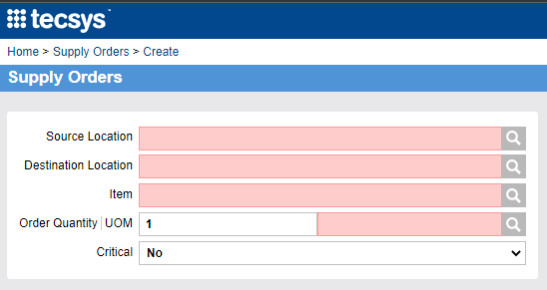
Manual Supply Order Process
When needed, it is possible to create a manual supply order in the Supply Orders resource.
Notes:
Script:
To create a supply order, you can go into the supply order resource.
Select create, add the source location which the vendor, enter the destination location where you want it delivered to, the item, the amount, and the UOM.
Note that the item must be set up and active in the destination location and the item must be set up to be replenished from the source location.

Slide 18
Manual Supply Orders
Supply orders can be created entirely manually.
To create a manual supply order, select the Create button in the Supply Orders resource
Location Item must be created at both the source and destination location.
If the assigned reorder group does not have the manual rule set to “Disallow”, the order will not be approved in the system.
Note:
Not recommended due to bypassing system replenishment logic, leading to overstock.
The ability to create a supply order is based on the security level of the system.
Notes:
Script:
You can do a manual supply order that is a one off and not under the minimum if your security level allows you to.
As long as manual is not set to disallow you can do a manual supply order, approve it, and then send it out.

Slide 19
On-Demand and Manual Supply Orders
Learn how to manage on-demand and manual supply orders.
Generate an on-demand supply order.
Create a manual supply order.

Slide 20
On-Demand and Manual Supply Orders
Learn how to manage on-demand and manual supply orders.
Manual Supply Orders

Slide 22
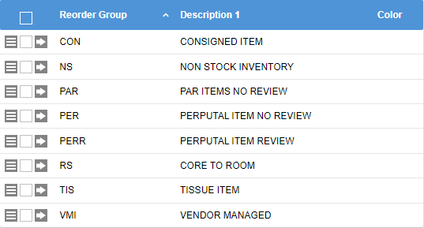
Reorder Groups
Reorder Groups create rules to tell the system how a location item can flow through the Supply Order resource page.
There is no limit to the number of reorder groups a hospital system can create.
Generation status:
Unapproved: Manually approve it in the system
Approved: No manual intervention needed
Disallow: Prevent supply orders generating
Notes:
Script:
Reorder groups are assigned to the location items to determine whether supply generated for a specific location.
There is no limit to the number of reorder groups a hospital system can create.
Notes:
This is where you decide if the supply orders are generated with approved status or unapproved status:
Approved: will be sent through to Workday for fulfillment (in this case DMS)
Unapproved: will need to be approved manually to be sent to DMS or the supply order can be fulfilled internally from a location within the hospital, which requires no approval
Disallow: will not generate with a specific method
There are 4 methods for supply order generation:
Schedule rule: used when you generate a supply order via the “Reorder Group Schedule”
Critical rule: for critical supply orders
Manual rule: Manual supply order creation
Par count rule: when a supply count is performed
Reorder Groups create rules to tell the system how a Location item can flow through the Supply Order Resource page to be replenished. There is no limit to the number of reorder groups a hospital system can create.

Slide 23
Reorder Group Schedules
Linked to each reorder group created.
Determine when approved supply orders should be generated for the location
Only applies to perpetual locations
Notes:
Script:
Reorder Group Schedules are linked to each reorder group created.
They determine when the approved supply orders should be generated for the location items assigned to the group.
It is only applicable for perpetual locations since par locations create supply orders through supply counts.
It is best to understand your business practice and your cut off times with various vendors to establish your reorder group schedules.
You can have multiple reorder group schedules for one reorder group if you have the business need.

Slide 25
Canceling a Supply Order
An order can be canceled manually in the order record.
No cancellation message is sent through the interface, an action must be taken in Workday if the order has been extracted.
Notes:
Script:
When you want to cancel a particular supply order, you'd go into the details of your supply order itself, you would change the approval to No, and then you would select cancel.
Note that you can do this prior to the supply order being in extracted status with no problems. Once it’s in extracted status, you must discuss with procurement first as the order must be cancelled in Workday first. This could mean that procurement must reach out to the vendor to cancel the order from their side as well.

Slide 26
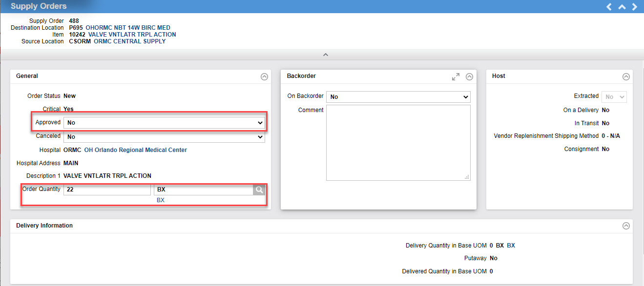
Updating a Supply Order
An order can be updated prior to extraction by the queue timer. The user must unplan the order to be able to update the requested quantity and UOM.
Notes:
Script:
An order can be updated prior to extraction by queue timer.
The order must be unapproved.
Next, update the order quantity, the UOM, and then you can approve it again.
Note that once extracted, the order quantity cannot be updated.

Slide 27
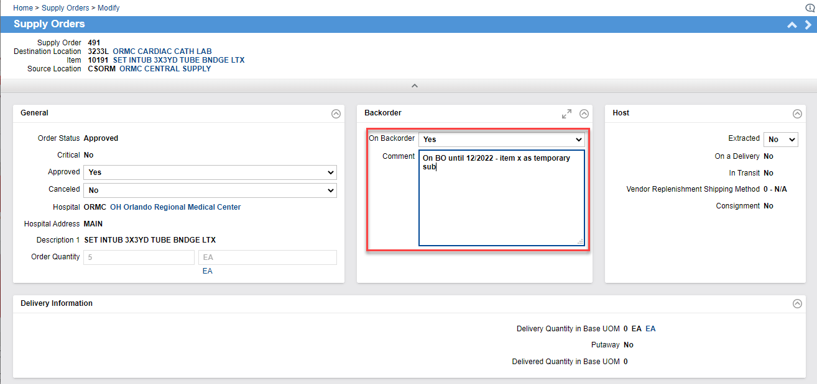
Add a Comment for Backorders
You may include comments for par and perpetual inventory backorders.
Notes:
Script:
You can add a comment for your par or perpetual inventory back order. For example, temporarily out of stock.
Note that the system will not be automatically updating the backorder status to yes. This is a manual process.

Slide 28
Modify a Supply Order
Learn how to cancel, update, and comment on a supply order.
Cancel a Supply Order.
Update a Supply Order.
Comment on Backorders.

Slide 29
Modify a Supply Order
Learn how to cancel, update, and comment on a supply order.
Modify a Supply Order

Slide 31
Supply Order Batch
Group supply orders by Source Location and Destination Location
Assigned a unique ID
A SCM (DMS) PO is created from the POU (SMS) Supply Order Batch
Notes:
Script:
Batching of orders is how when the timer runs from POU (SMS) to get extracted.
It's called the supply order batch generation. This is done with the queue timer “POU - Supply Order Batch Generation”.
It gives a supply order a unique ID and that's where it goes into SCM (DMS) to create a requisition to go into Workday.

Slide 33
Delivery
Inventory Maintenance
Notes:
Script:
A delivery is received in Workday.
That receipt is interfaced into Tecsys.
Then the order is putaway. For standard perpetual items, the item must be scanned using a mobile device and putaway in the system by scanning the bin location tag or item.
Lastly, for tracked items, since the receipt has already occurred, you have to go into tracked item conditioning to create a unique tracked item number for each serialized item to then have a tracking label print out, which will be attached to the package.

Slide 34
Delivery
Perform supply order pick and putaway.
Complete track item conditioning.
Validate location item.
Generate different types of orders for both par and perpetual locations.

Slide 35
Delivery Putaway
Does Location Item Schedule Require Modification?
Does an Item need to be returned?
Go to Location
Return Item to its original location
Approve as
Required
Start
No
Yes
Yes
No
Review Location Item Count Configuration
Modify
Location
Item Count Configuration
Perform
Par Count
Supply Orders
are Generated
Yes
No
Approval
Required?
LOCATION ITEM SCHEDULING
LOCATION ASSESSMENT
Supply
Order Pick List
Source of Replenishment
Pick Items for Delivery
Internal
Deliver Product
to Location
Store and
Confirm Putaway
Supply Expect Receipt
End
External
SUPPLY EXECUTION
Notes:
Script:
In this workflow, the delivery receipt and putaway process is seen in the supply execution section at the bottom of the screen.
The first process is for internal replenishment. As a reminder, that is when one inventory location is replenished by another inventory location. Both inventories are in Tecsys.
If the system noted an internal replenishment is needed, then you will go into your handheld and go to the supply order pick resource to pick the items from the source location, then putaway in the destination location.
Delivery for from an external source will be received in Workday which will interface to Tecsys. Since the receipt already occurs, you will just have to deliver the product to the final location and scan to putaway. Inventory will be incremented once this occurs.

Slide 36
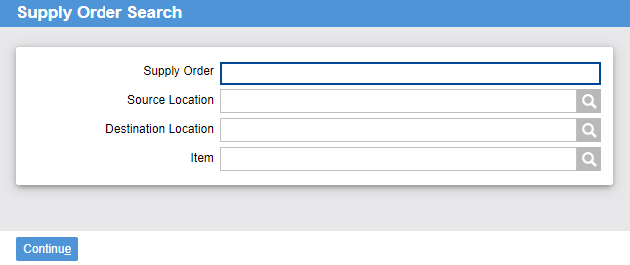
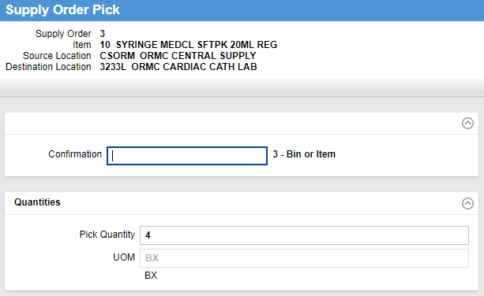
Internal Replenishment
From the Supply Order Pick resource.
Select all or specific supply orders for picking and putaway.
If the user completing the picks is the same as the one putting away the inventory, both actions can be performed in the same workflow.
Notes:
Script:
The internal process is in the mobile POU (SMS).
You go to your supply order picks, then search by supply order source location, destination location, or by item.
Then bring up the supply order pick, which shows the supply order number, the item, the source location, and the destination location.
You'd scan the item, pick the quantity, confirm it, and then once the supply order pick is done, it will ask you if you want to put it away?
Notes:
Open the Supply Order Pick resource on the handheld
Either enter search criteria or click continue to obtain all results
Use More Actions - Show Lines to select the items you would like to pick
Confirm the pick of each supply and continue to putaway right away
Delivery Putaway to be shown later in this session.

Slide 37
Internal Replenishment
Learn how to perform a supply order pick and putaway for internal replenishment.
Select Supply Orders for Picking and Putaway.

Slide 38
Internal Replenishment
Learn how to perform a supply order pick and putaway for internal replenishment.
Internal Replenishment

Slide 39
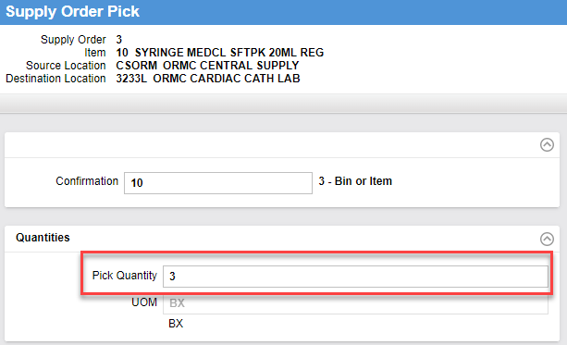
Short-Picking
If the supply order “Pick Quantity” is less than the “Order Quantity”, the balance is automatically killed for POU (SMS) internal replenishment. The supply order will be completed upon putaway.
Notes:
Script:
A short pick your supply order, meaning the quantity is less than what you've ordered, so in the previous case you were supposed to pick 4, you only pick 3.
The system will automatically kill the one that was short picked.

Slide 40
Par Delivery
Supply Configuration Types
Par
Tracked Item
Perpetual
Notes:
Script:
When the delivery receipt is interfaced to Tecsys, someone from Supply Chain Operations will go in daily and perform the putaway process for all supply orders on that delivery. That way the inventory is incremented and the only action to be performed is to put up stock.

Slide 41
Par Delivery
No UDI information will be captured for:
Lot
Expiry Date
Serial Number
Notes:
Script:
As a reminder in the configuration for par locations we don't capture UDI information.

Slide 42
Perpetual Delivery
Supply Configuration Types
Perpetual
Tracked Item
Par
Notes:
Script: Perpetual deliveries are received in Workday and that receipt is interfaced to Tecsys. So, when the product is delivered to its inventory location, either the item or the bin label will be scanned to formally putaway the item into the system. When this is done, the inventory will be updated appropriately. If an item is being lot, expiry or serial tracked, the system will ask for you to either scan the barcode to populate that information, or manually key it into the handheld.

Slide 43
Perpetual Delivery Information
Ability to capture, once configured:
Lot
Expiry Date
Serial Number
Notes:
Script:
As a reminder, you can capture lot, expiry and serial number information while you perform putaway. Your handheld will lead you to that action, but only if the item is set up to require its capture.

Slide 44
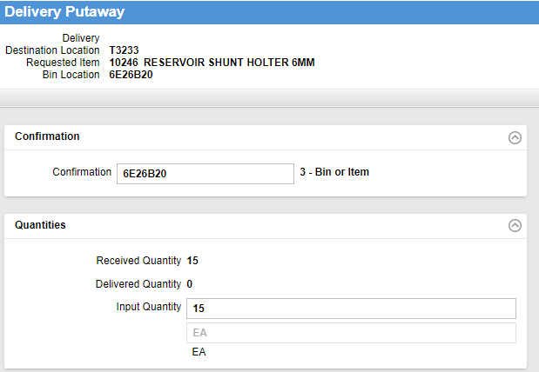
Perpetual Delivery Putaway
Delivery is received in Workday, and the supplies are put away into their final location through the “Delivery Putaway” workflow in a mobile device.
Notes:
Script:
To perform the putaway in a mobile device, you will either scan the bin label, or the item to confirm the item is being putaway. The received quantity will auto populate.
If what you are delivering is different than what the system states you should have, you can update the quantity in the input quantity section.
Select Continue to confirm the put away.

Slide 45
Tracked Item Delivery
Supply Configuration Types
Par
Perpetual
Tracked Item
Notes:
Script:
A tracked item is a perpetual item that is tracked by its unique serial number. This is done by a process called conditioning. This is a way to input the serial and expiry information into the system. A unique item number is created and a sticker is printed that reflects the tracked item number along with serial number and expiry. This is what the circulator will scan during a procedure to capture all UDI information. It will not only fill out all pertinent information into Epic but decrement this specific item from inventory.

Slide 46
Tracked Item Delivery Information
UDI information will be captured for:
Same attributes as perpetual
Visibility of each instance of an item
Tracking log to keep a record of every movement
Notes:
Script:
Note that a tracked item is considered a unique item at the SKU level, all actions being taken on the item must happen at the tracking event resource.

Slide 47
Tracked Item Conditioning
The status must be “In Transit.”
This is done automatically by the interface.
Notes:
Script:
Just like all other items, the receipt originates in Workday and is interfaced into Tecsys. Because it is already in In Transit status and because you need to have the UDI information captured, and barcode printed, you can’t go immediately to putaway.
The tracked Item is received in Workday but must be conditioned in Tecsys prior to Putaway.

Slide 48
Tracked Item Conditioning Resource
Print barcode labels
Complete the putaway of the items
Notes:
Script:
You will select your tracked item location and search for the delivery, then continue.
The Tracked Item Conditioning Resouce allows you to print barcode labels and complete putaway of the items.

Slide 49
Tracked Item Putaway
Notes:
Script:
On the next screen you can either scan the GTIN barcode or manually key in the required information and press continue. This triggers the barcode to print out to affix to the package.
Note that the adhesive on the label is made to easily be removed should the item need to be returned to the vendor for credit.
When you press continue, if you are done with the delivery, the system will ask you if you want to perform putaway.

Slide 50
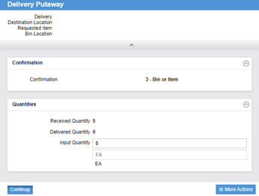
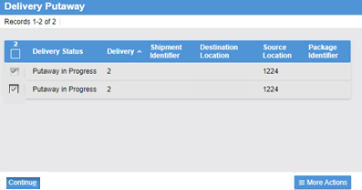
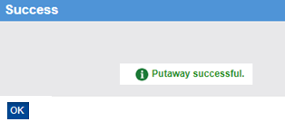
Deliveries
Notes:
Script:
Just like how you putaway your standard perpetual items, the system asks you to confirm your putaway by either canning the bin label, or the item number.
Since this is tracked by its serial number, it is best practice to scan the newly created barcode.

Slide 51
Tracked Item Putaway Continued
When supplies are putaway, the location item record is updated, and supplies are now available for usage.
Notes:
Script:
Just like with your standard perpetual item putaway process, once putaway, the in-location quantity will be updated.

Slide 52
Delivery Receiving Tracked Item
Learn how to perform the delivery workflow for tracked items.
Identify assigned deliveries.
Identify supply orders.
Perform track item conditioning.
Validate quantities.
Validate the location item record.

Slide 53
Delivery Receiving Tracked
Learn how to perform the delivery workflow for tracked items.
Delivery Receiving Tracked

Slide 55
Delivery Missing Receipts – Supply Order
All Supply Orders for external replenishment must have a delivery receipt interfaced from Workday.
Problem
Product is delivered to a location for Putaway but the Supply Order’s status is “Extracted.”
Solution
The Supply Order needs to be received in Workday for the Delivery Receipt to interface to Tecsys for Putaway to occur.
Notes:
Script:
Let’s discuss some exceptions that you might experience with Delivery Receiving.
In this scenario, you received product for Putaway, but there is no Delivery Receipt in Tecsys.
This means that, for some reason, this delivery was not received in Workday.
The resolution is to have the order received in Workday so that the Delivery receipt can occur in Tecsys.
Note:
In Tecsys you can manually create a receipt. However, this is not recommended in this instance as you must have the order received in Workday so that the invoice can be paid.
If you’ve requested the receipt to occur and are waiting for it to transmit over, but this is a critical item needed for a case, you can manually receive in Tecsys. The interfaced receipt from Workday will not over receive the order since the order will have been closed out.

Slide 56
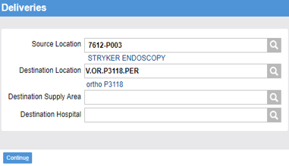
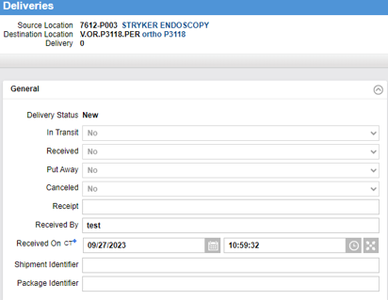
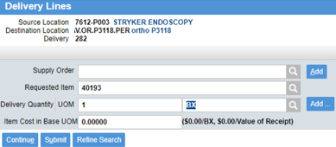
Manual Delivery Receiving
Manual Delivery is used in rare instances where an inventory item was ordered directly in Workday.
The system will not send a delivery receipt.
Therefore, one must be created internally.
Notes:
Script:
A manual delivery is only created in rare instances where an order originated in Workday. For the item to be added to the inventory location, a delivery will need to be created so that delivery receiving and putaway can occur.
An example of this use will be for bulk buy items for the OR. The order will originate in Workday. Received in Workday. Upon physical receipt, a delivery is created so that receiving, conditioning (if required) and putaway can occur.

Slide 57
Receive Overage
Tecsys does not accept over-receiving as this is seen as overstock.
Return it
Return the overstock to the vendor / warehouse
Receive it
Receive it into inventory and overstock the bins
Notes:
Script:
Should you physically receive more than was ordered, Tecsys will not allow you to over receive.
You can either return the product to the vendor/warehouse or create a manual delivery inside of Tecsys for the excess inventory.
Note that a location has to be designated in the locations resource as central putaway. This is the putaway location for all deliveries destined for a supply area or hospital without matching supply orders. Since this is an overage and this system won’t acknowledge it, it fits into this category.
Note: The ‘overstock’ would be first delivered in Central Putaway or a special location for users to act.

Slide 58
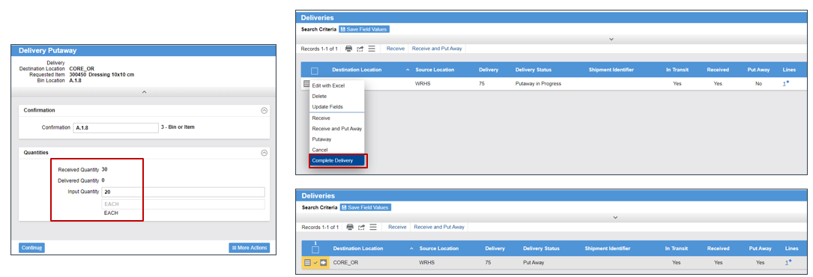
Putaway Less than Received Quantity
If the putaway quantity is less than the received quantity, the user has to close the delivery.
Notes:
Script:
Although rare, sometimes the quantity that was physically delivered to the location does not match what was received in the system.
You need to research why this is the case. It could be that the product is still coming from shipping and receiving or placed in the wrong location.
Since putaway is the step that increments your inventory, you should only putaway what you physically have. The delivery will stay open with a status of putaway in progress until the remainder arrives.
If it’s that it was accidentally over received, then only putaway what was delivered, then go into the Deliveries resource and complete the delivery. That will close out the delivery document and the status will be changed to putaway.

Slide 59
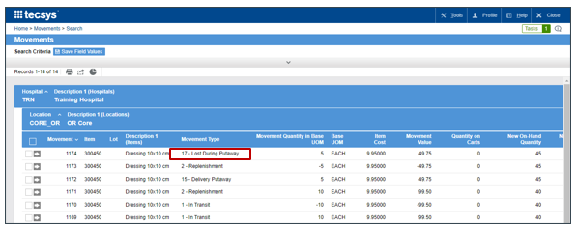
Putaway Less - Complete Delivery Process
Update the location item record.
Adjust Movement Type to “Lost During Putaway”.
Notes:
Script:
The downstream affect of not using ‘complete delivery’ of a shorted item is that the location item will still show quantity on a delivery and will use that in the replenishment calculation. If you do use the ‘complete delivery’ process, then the item record will reflect 0 delivery and will not be used in any replenishment calculation.
Also, All perpetual inventory is tracked via movements. So, any changes to inventory can be seen in movements. When a ‘complete delivery’ is performed, the items that were received, but not putaway are shown as lost during putaway inside the movements resource.

Slide 60
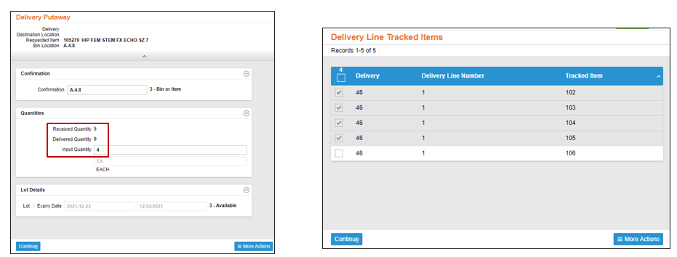
Putaway Less – Tracked Items
If the putaway quantity is less than the received quantity, the user will have to choose which tracked item is putaway.
Notes:
Script:
Since a tracked item has a conditioning process and is tracked at the serial number level, if the putaway is less than the received quantity, the mobile device will have you scan each item to identify which one is missing.

Slide 61
Putaway Delivery
Update the location item record.
Result in a “Lost During Putaway” inventory movement.
Completing the delivery will:
Notes:
Script:
The system performs the exact same process for tracked items as we discussed with the other perpetual items. The movement classification is still ‘lost during putaway’.

Slide 62
Tracking Log
The tracked item that was not putaway will be updated as “Out of Inventory”, with the tracking event “Lost Goods” automatically applied.
Notes:
Script:
The one difference with the tracked items is in the tracking log. As a reminder, this lot tracks an item to the unique tracked item number. For the item that was not putaway, it will show a status of out of inventory with the tracking event of lost goods being automatically applied.

Slide 63
Fill & Kill
Partially Delivered Orders
Require unfulfilled quantities to be cancelled so new supply orders can be generated.
End-user intervention is needed when partially shipped.
Pending orders are taken into consideration when new orders are generated.
Notes:
Script:
We’ve discussed how you need to maintain the open deliveries in the system and how it can impact the replenishment process for perpetual items. Now we will discuss the maintenance of the open Supply Orders in the system.
As we’ve seen, open supply orders are shown in the location item along with deliveries. These are used in the replenishment calculation. If there is an issue with an open supply order that is not addressed, you could potentially run short of inventory.
It’s important to monitor your supply orders, and if something is taking longer than expected to arrive, it should be researched. It’s also important to perform the process of ‘complete supply order’ for partially delivered items, or items that may have been killed on the purchase order side and will never be filled.
Best practice is to review perpetual supply orders on a regular basis to mitigate any potential issues with deliveries.
For fill/kill, it is best practice to review the supply orders daily and perform the ‘complete supply order’ process on any open supply orders that will not be arriving or may not have been fully replenished.
The Supply Order resource is accessed in POU (SMS) when Complete Supply Order is selected for orders that are “Partially Delivered”. The order status changes from “Partially Delivered” to “Putaway”.

Slide 64
Generate Orders
Learn how to generate orders for a perpetual location item and a par location item.
Generate a vendor order for perpetual and par.
Generate an internal order for perpetual and par.
Generate an on-demand order for perpetual and par.
Generate a manual supply order for perpetual and par.

Slide 65
Generate Orders
Learn how to generate orders for a perpetual location item and a par location item.
Generate a vendor order for perpetual and par.
Generate an internal order for perpetual and par.
Generate an on-demand order for perpetual and par.
Generate a manual supply order for perpetual and par.

Slide 67
Consignment Billing Request
Inventory Maintenance
Notes:
Script:
Consignment Billing Request.

Slide 68
Consignment Billing Request
Request billing for items used on a case.
Validate the supply order was generated for the bill and replace item.

Slide 69
Consignment Billing Request Resource
Usage item record is created
Record is sent to the Consignment Billing Requests resource
Select the record, and then the Request Billing button
Supply order generated
Notes:
Script:
When an item is consumed or used in CDUI, there's a resource called Consignment Billing Request.
A Consignment Billing Request allows you to manage billing requests for both “Bill and Replace” and “Bill Only” items prior to a supply order creation.
A usage item record is created upon consignment item being consumed.
The record will be sent to the Consignment Billing Requests resource for review.
You need to review all the used items in consignment and then approve it by selecting the request billing button.
This will trigger a supply order to flow to Workday.
In Workday, you will need to go into the requisition and populate the standard information needed for Bill Only’s and Bill and Request orders, such as LOT and Serial Number.
Notes:
Upon usage of the item in CDUI and after validation of the Case, a billing request will be generated in
The Consignment Billing Request table.
In this resource, you can review and query on any request that’s been generated and see its status (which we will review in the next slide)
You can see in the first example that the Billing Request is in Billing Requested Status

Slide 70
Consignment Billing Request Status
0 - New (default)
1 - Billing Requested
2 - Returned
Usage was reversed in Case Documentation.
Issuance of billing requests to the host system is approved.
Billing items where no request has been sent.
Notes:
Script:
The records stored in the Consignment Billing Requests table will be in one of three statuses:
Once you approve the billing and request the billing, the status changes from new to billing requested.
Although rare, if usage were reversed after billing has been requested, an email will be sent to notify the appropriate staff of the change. You will want to notify procurement to modify or cancel the purchase order.
If usage is reversed after billing has been requested, an email is sent to notify the appropriate staff.
Notes:
In the Consignment Billing Request table, you will see 3 different statuses, New, Billing Requested, and Returned
All records are created in New status. If an item was documented in CDUI but then removed,
then the item will automatically be marked as Returned in the log
For any New billing request, a user will open this resource, choose the record, and Request Billing. The status will then update to Billing Requested

Slide 71
Consignment Billing Request Process
Confirm consumption and trigger the request for billing in POU (SMS).
Usage information is sent to Workday where “Bill Only” and “Bill and Replace” requisitions are created.
Add the required line-item information needed for processing in the requisition within Workday.
Workday sends the “Bill Only” and “Bill and Replace” POs to the vendors.
Tecsys POU (SMS) will create a delivery automatically upon creation of a bill and replace an order.
The replacement will be received in Tecsys POU (SMS) once arrived at the hospital.
Notes:
Script:
Here we have an example of what it looks like once the user requests the billing.
The information is then sent to Workday where the Billing process will occur.
Note that you will have to go into the requisition in Workday to populate the required information that you sent to a vendor for bill only and bill and replace items, such as lot and serial number.

Slide 72
Consignment Billing Request
Learn how to perform a Consignment Billing Request.
Request billing for items.
Bill and replace items.
Validate supply order generation.

Slide 73
Consignment Billing Request
Learn how to perform a Consignment Billing Request.
Consignment Billing Request

