Slide 1
Professional Story RN4
Please click audio icon for voiceover
Lindsay Staiman

Slide 2
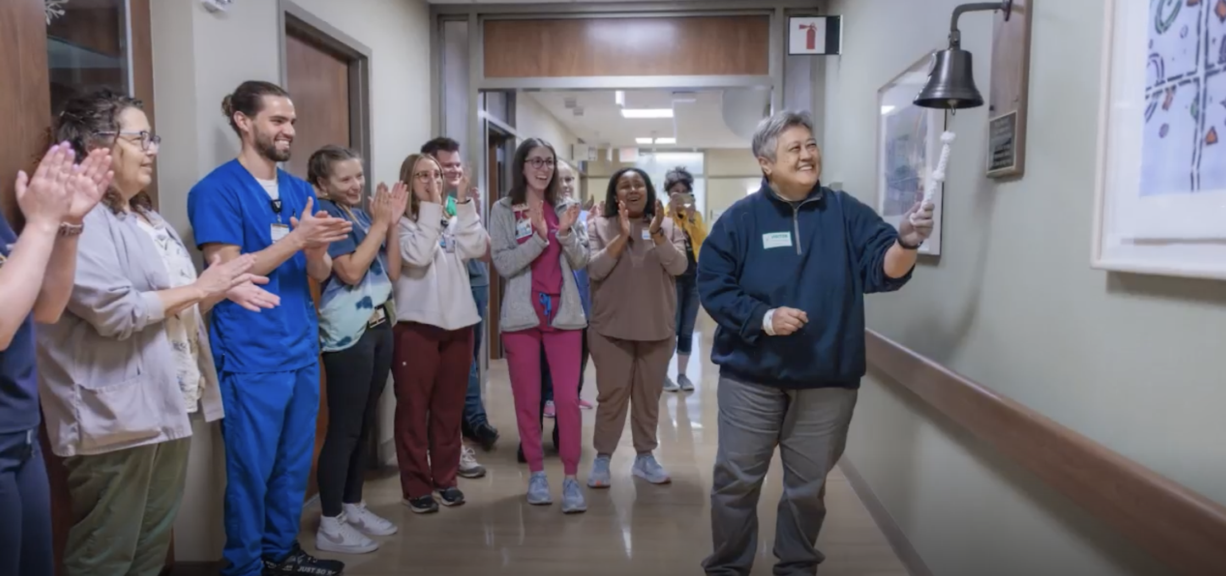
TL-7

Slide 3
EP-4

Slide 4
NK-4

Slide 5
EP-10

Slide 6
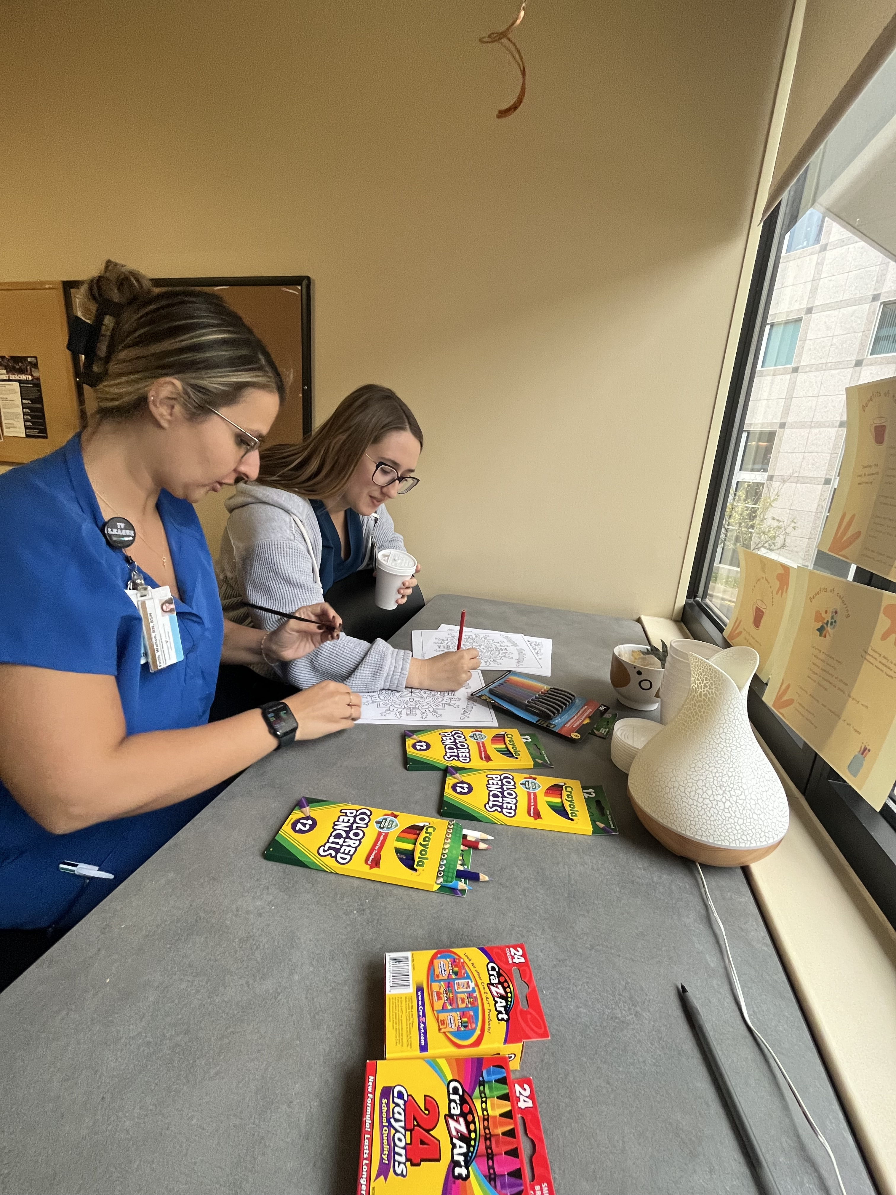
TL-3

Slide 7
TL-3

Slide 8
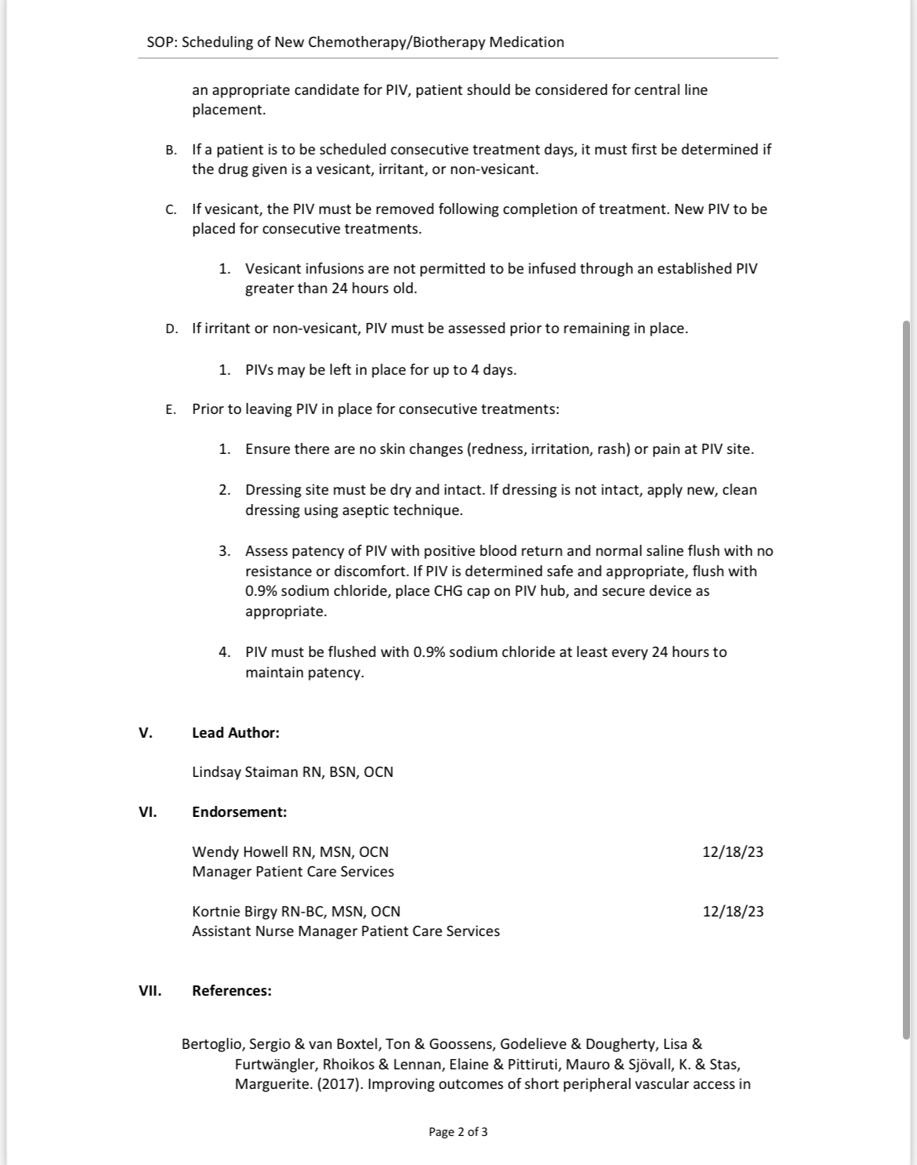
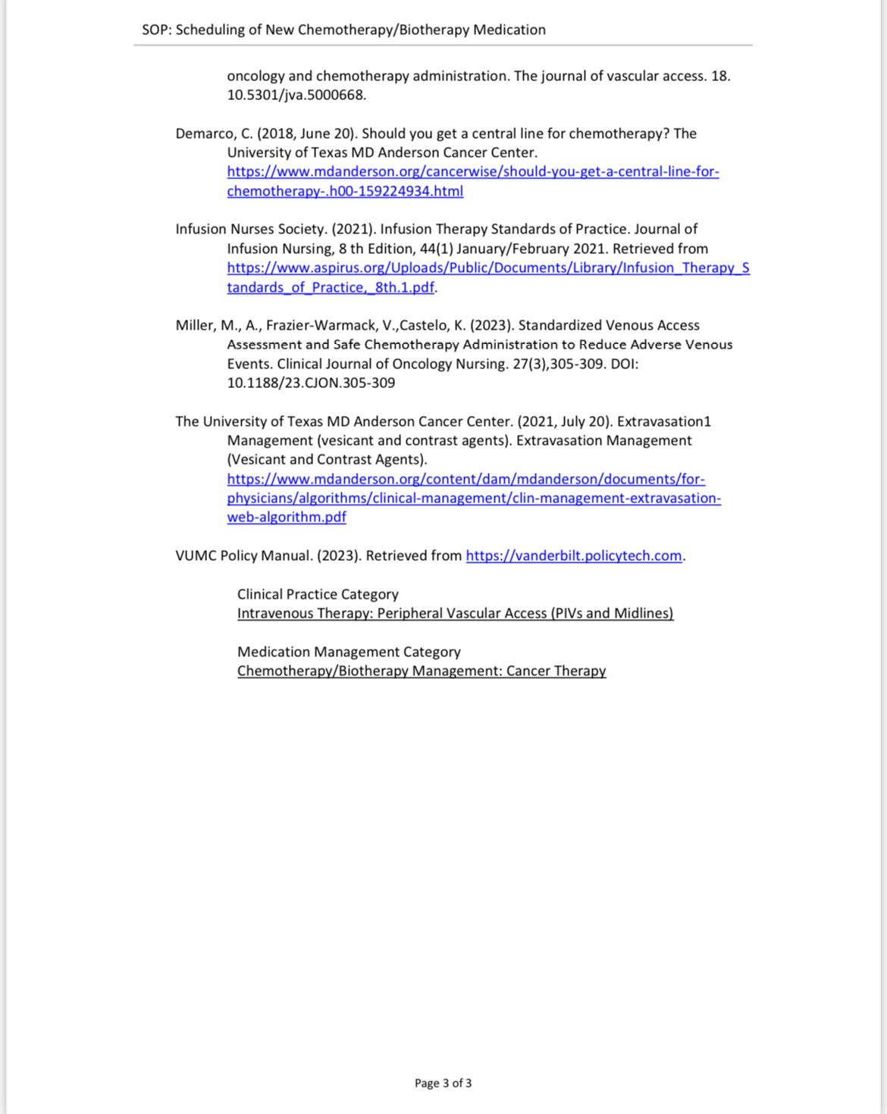
SE-8

