Slide 1
Academic-Community Partnerships for Precision Medicine
Chanita hughes Halbert, phd Department of Psychiatry and behavioral Sciences Hollings cancer center South Carolina Center for Translational Research Medical University of South Carolina

Slide 2
Vision for Precision Medicine
Promote health equity through individualized approaches for early detection, prevention, and treatment

Slide 4
Principles of academic-community partnerships
Community-based participatory research (in health) is a collaborative approach to research that equitably involves all partners in the research process and recognizes the unique strengths that each brings
CBPR begins with a research topic of importance to the community with the aim of combining knowledge and action for social change to improve community (health)

Slide 5
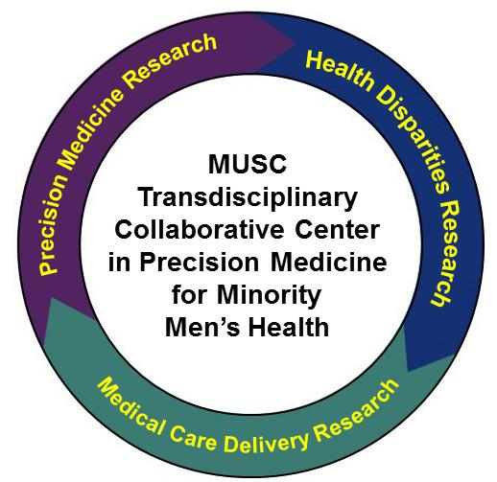
Mission
Establish a Consortium that supports the active engagement of diverse stakeholders in precision medicine and health disparities research
Conduct translational research to understand the interaction between biological, social, psychological, behavioral, and clinical factors and health care and disease outcomes among minority men
Support the dissemination of evidence related to precision medicine and health disparities
Integrate data on biological, social, psychological, and clinical factors to validate findings from prospective TCC research
NIMHD
Notes:
As you can see from this slide, we have four aims as part of our overall mission to address disparities in minority men’s health through precision medicine.
The first is to work regionally through a multi-institutional consortium that also includes community-based organizations to conduct research in precision medicine and health disparities.
As part of this, our research will understand the ways in which biological, social, psychological, behavioral, and clinical factors interact to contribute to health care and disease outcomes among minority men.
Also, work to disseminate evidence on precision medicine and health disparities to diverse stakeholders
Integrate different types of data generated from our TCC

Slide 6
Rationale
Minority men have poor health outcomes and lower life expectancy compared to non-minority men
African American men 30% more likely to die from heart disease than white men
African American men are 60% more likely to die from stroke than white men
Hispanic men are twice as likely than white men to die from diabetes
Hispanic men have a higher death rate from HIV compared to white men
Limited attention is given to minority men as part of health disparities research
Notes:
As we developed our TCC, we decided to focus on health disparities among minority men because they continue to have poorer health outcomes and lower life expectancy.
We saw the precision medicine initiative as an opportunity to fill a significant gap in the overall scope of health disparities research.

Slide 7
MUSC Transdisciplinary collaborative center in precision medicine and minority men’s health
Notes:
Consortium consists of academic and community partners who bring distinct expertise in areas relevant to our TCC:
Penn – community-based participatory research and translational research
Hampton – minority men’s health
UT – clinical cancer issues in Hispanic men

Slide 8
MUSC Transdisciplinary collaborative center in precision medicine and minority men’s health
Low Country AHEC
National Black Leadership Initiative on Cancer
Hope Institute, LLC
Southeast Health Equity Council
Notes:
Low Country AHEC – dissemination and implementation methods and resources
NBLIC- community outreach and education
HOPE Institute – ELSI research in minority populations
Southeast Health Equity – regional issues in racial disparities in health outcomes

Slide 9
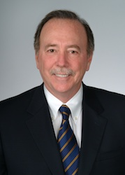
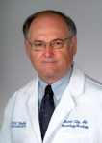
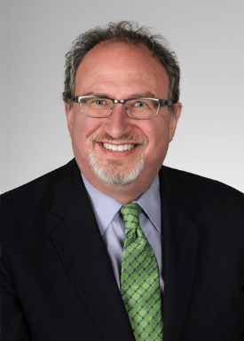
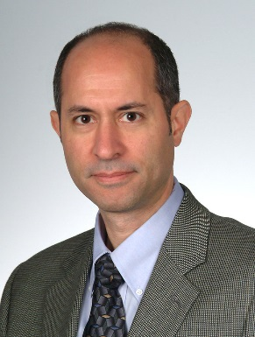
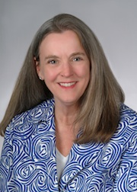
Transdisciplinary Collaborative Center in Precision Medicine and Minority Men's Health
Multi-PIs/Admin Hughes-Halbert, Lilly, & Ethier
Data Integration
Lenert, Obeid
Dissemination & Implementation
Melvin, Magwood
Notes:
As shown in next slide, we have a multidisciplinary team of investigators who are leading the MUSC TCC
Genomics
Urology
Informatics
Community-based research
Dissemination and implementation
Population and behavioral science
Health disparities and social determinants

Slide 10
Musc transdisciplinary collaborative center in precision medicine and minority men’s health
Allostatic Load
Minority men experience unique acute and chronic stressors
Social and psychological stressors impact biological processes involved in the initiation and progression of disease
Allostatic load is a marker of how much social and psychological stressors impact biological functioning
Racial disparities in allostatic load exist
Need to understand the effects of allostatic load on disease processes and outcomes
Adaptation Allostasis
Cumulative Life Stressors
Response to Stressors
Chronic Diseases
Behavioral
PROSTATE CANCER
Social Determinants
Diabetes
Psychological
Stress Exposure
Stroke
Physiological
Cardiovascular
Epigenetic Signature
Notes:
Through this collaborative center, address what we think is an important opportunity with precision medicine. That is, if we think about precision medicine as strategies that are designed to individualize health care based on genetic, environmental, and lifestyle factors, it is important to understand the ways in which these variables interact.
This has been supported through research which demonstrated that psychological and social stressors impact biological processes that play a role in the initiation and progression of disease; studies have now demonstrated that where you live is important to disease outcomes and cancer health disparities.
But, it is not only where you live, but how you live.

Slide 11
Precision medicine and disparities
Disease has a significant clinical and public health impact
Priority condition for community residents and other stakeholders
Biological, clinical, and public health relevance to other chronic conditions
Notes:
But, it is important to understand the effects of AL within the context of disease that has a significant clinical and public health impact.
Priority among diverse stakeholder groups.
Also, has relevant to other chronic conditions.

Slide 12
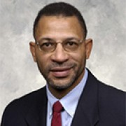
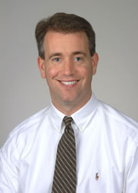
Triumphant Living Collaborative West Philadelphia Consortium to Address Disparities
Notes:
For instance, in our previous research funded by the NCI and NIMHD, we found that the current recommendation that the variables that are essential features of informed decision making had limited associations with ever or annual use of prostate cancer screening, suggesting that making an informed decision about screening may be difficult for African American men.

Slide 13
Notes:
Further, we found that perceived stress had consistent associations with both quality of life and how men reacted to being diagnosed with prostate cancer.

Slide 14
McDonald et al., Public Health Genomics, 2014
Halbert et al. PLOS One, 2016,
Notes:
Then, as we think about the overarching context of precision medicine and health disparities research, we have to consider several ethical, legal, and social issues involved in conducting these studies. One important aspect is the extent to which diverse populations are adequately represented in studies.
Our previous research has shown that…

Slide 15
Overview of center projects
Project 1: Sociobiological Responses to Stress in Prostate Cancer Survivors (M. Lilly, C. Hughes-Halbert, Co-Leads).
Examine the effects of stress reactions and allostatic load on immune responses to a prostate cancer vaccine among survivors at high risk for recurrence
Project 2: Defining an Integrated Allostatic Load Index with Immune and Tumor Microenvironment Factors (R. Drake and J. Wu, Co-Leads)
Identify novel biomarkers for prostate cancer based on metabolites, glycans, and immune modulators in clinical prostate cancer biopsy samples, prostatectomy tissues, tissue microarrays.
Characterize the distribution of these biomarkers based on allostatic load, racial background, social factors, and psychological characteristics
Project 3: Integrating Genomic and Sociobiological Data to Inform the Development of Prostate Cancer Treatment (S. Gattoni-Celli, Lead)
Evaluate the effects of Vitamin D supplementation on molecular changes in prostate cancer tissue
Examine the effects of Vitamin D on HPA axis functioning and allostatic load biomarkers to determine individual response to supplementation

Slide 16
Consortium core
Form a multi-regional infrastructure to provide the direction, priorities and governance of the TCC to promote health equity among minority men through precision medicine
Identify priorities for research in precision medicine and minority men among diverse academic, community, clinical, and public health stakeholders
Implement and monitor pilot project research to address minority men’s health in precision medicine
Translate findings from TCC research into clinic and community-based practices to address racial disparities among minority men

Slide 17
implementation core
Develop materials and methods to determine the needs, readiness, and capacity of stakeholders across multiple regions to implement and adopt precision medicine approaches into clinical care and public health practice.
Identify ethical, legal, and social issues related to linking and integrating data on biological, social, psychological, behavioral, and clinical factors and develop recommendations to address these issues.
Deliver Evidence Academies across the regions in the MUSC TCC Consortium to actively engage diverse stakeholders in the development of best practices for implementing precision medicine interventions into practice.

Slide 18
Data integration core
Create a standards-based resource using nationally-recognized tools including REDCap and Informatics for Integrating Bench to Bedside(i2b2), for integration of data on the tumor microenvironments derived from proteoglycan analyses of prostate tissue and clinical studies of impacts of glucocorticoids on pathways for vitamin D effects.
Develop natural language processing-based tools to extract discrete details on social stressors from clinicians’ notes and merge these data with clinical data within the i2b2 environment.
Integrate clinical and experimental data into longitudinal patient records to expand data sets to represent the chronological order of significant clinical and social events surrounding the timing of a critical cancer diagnosis.
Use data mining strategies to determine the temporal links between allostatic load and disease risk and outcomes.

Slide 19
How do you integrate these activities to facilitate academic and community engagement?

Slide 20
Khoury, Gwinn, Bowen, Dotson. Am J Public Health, 2012

Slide 21
Adopt definition of precision medicine
Precision medicine is an emerging approach for preventing and treating diseases that uses biological, environmental, and lifestyle information to help develop personalized treatments and procedures. By combining this information, the delivery of medical care will be more personalized as doctors and patients will be able to co-develop targeted plans for prevention, detection and treatment. The goal for precision medicine is to provide the right medical care in the right dose to the right patient at the right time.

Slide 22
Establish goals for community engagement
The MUSC TCC in Precision Medicine and Minority Men’s Health will engage diverse stakeholders in activities to ensure that groups, organizations, and individuals:
Are knowledgeable, aware, and informed about precision medicine
Have the capacity and resources to apply and/or use precision medicine as part of their health care or clinical practice
Have sufficient information to make informed decisions about participating in precision medicine research and/or referring patients/members for participation in studies
Understand how to assure that the use of precision medicine does not exacerbate racial and ethnic disparities in health care and outcomes

Slide 23
Community engagement strategies
Precision Medicine Survey: Identify priorities, concerns, and preferences of patients about precision medicine
Organizational Capacity for Precision Medicine: Identify resources and readiness for precision medicine
Evidence Academy: Dissemination strategy that focuses on enhancing knowledge about a health-related topic and developing tailored implementation strategies

Slide 24
Regional implementation teams
Composed of stakeholders in each region who are critical to promoting, implementing, and adopting precision medicine. Team members will represent individual patient, health care providers/teams, organizational, community, and policy groups.
Stakeholder interviews and review of draft documents and processes in Year 2
In-person regional meetings (Evidence Academies in Years 2 and 4)
Development and implementation of regional plans during years 2 & 3 using knowledge gained through TCC research to inform decisions and actions to change policies, programs and/or practices affecting the uptake and use of these interventions in their region and particularly among minority men

Slide 25
Issues for academic-community partnerships
Determining who are the right stakeholders?
Deciding on when to expand and limit partnerships?
Precision medicine versus basic health care services?
Administrative coordination and integration of groups and activities

Slide 26
Musc transdisciplinary collaborative center in precision medicine and minority men’s health
Claudia Baquet, MD
Bettina Beech, DrPH
Kathleen Cartmell, PhD
Ernestine Delmoor, MPH
Richard Drake, PhD
Sebastiano Gattoni-Celli, MD
Stephen Ethier, PhD
Chanita Hughes-Halbert, PhD
Melanie Jefferson, PhD
Les Lenert, MD
Michael Lilly, MD
Gaynell Magwood, PhD
Cathy Melvin, PhD
Raymond Samuel, MD
Stephen Savage, MD
Ian Thompson, MD
Jennifer Wu, PhD

