Slide 1
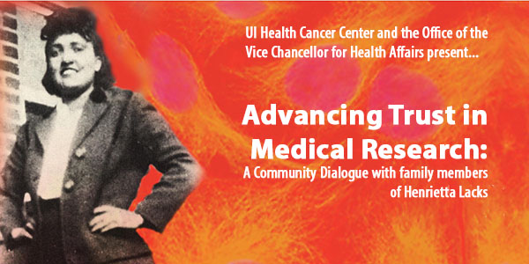
Advancing Trust to Engage Diverse Participation in Research:
Dialogue and Partnerships
Dr. Karriem S. Watson, DHSc, MS, MPH-UI Cancer Center and UIC School of Public Health
Nicole Fisher-UI Cancer Center
Dr. Robert A. Winn, MD-Director UI Cancer Center and Assoc. Vice Chancellor Community Based Practice

Slide 2
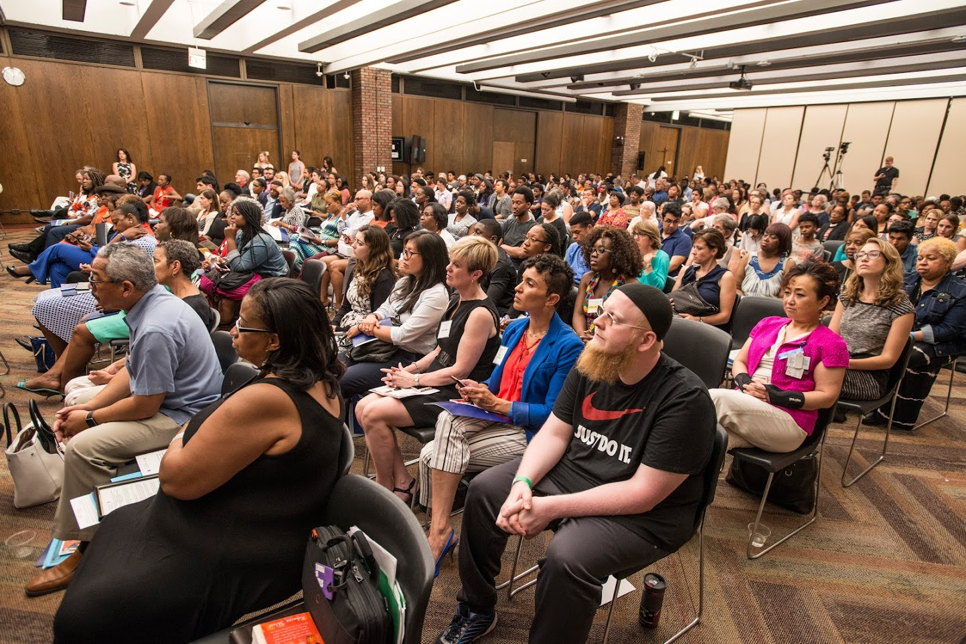
Overview and Aims of the Conversation
Why Dialogue?
Who should be at the table?;
What has already been said?;
How we can keep talking.
Notes:
Briefly Discuss the difference between recruitment and community engag
Highlight some best practices in innovative and community centric models to engage/involve the community in open dialogue
Review feedback/surveys from a Community Dialogue with the Henrietta Lacks Family on Precision Medicine and Diverse participation in Research

Slide 3
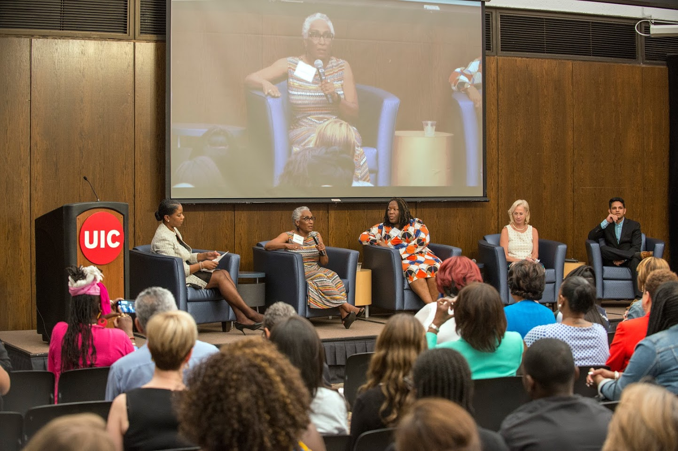
“Why” Dialogue: The Story of Ms. Rose Marie
UI Cancer Center “Patient Brigade”
Vision of UI Cancer Center Director: Move beyond “engagement” to “involvement”
Ms. Rose Marie’s Concerns….. “I was the only one at the table.”
Notes:
Here I will provide background as to why we decided to have this discussion. I will briefly describe what the UI Cancer Center Patient Brigade is and discuss how it is helping up move from engagement to involvement

Slide 4
Best Practices: When Partners Talk, Trust is Built
Community Campus Partnerships for Health: CCPH with PCORI
September 2016: NIH Columbia university community workshop;
March 2017: Engagement studio with Dr. Consuelo Wilkins’ team and American Indian Health Center;
March 2017: On the Table with Chicago Community Trust (20 conversations over 200 people);
July 2017: Sisters Network Chicago: Discussion on Breast Cancer Clinical Trials in African American women
Notes:
Here I will discuss the importance of beginning to catalog best practices. One thing that we are hearing from community members is this concern of conversation fatigue, the same thing being said in different venues without moving the conversation forward. We must be better at noting who has been saying this and learning what we heard from them. I will describe the two pictures above as examples of two different groups, both community, and both initiatied by community stakeholders and partnered with industry and academic partners similar conversations of trust and have convened community members with successful outcomes. May 2017, CCPH partnered with UI Cancer Center and Northwestern Univ. Cancer Center for Community Dialogue and in July 2017 we partnered with Sister’s Network and I will discuss what we heard at these meetings

Slide 5
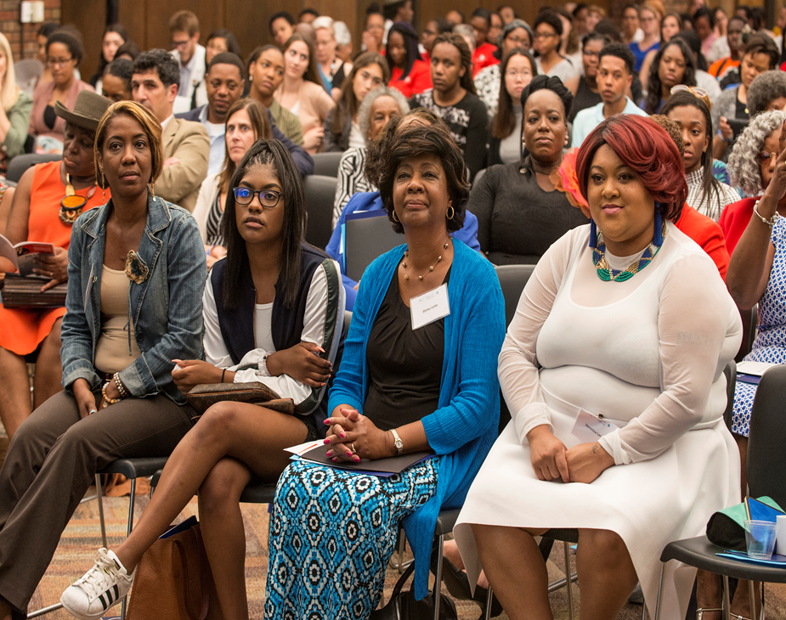
Advancing Trust by Acknowledging the Past to Inform the Future
“Chicago, everything I’ve seen today, Mile Square, you are keeping the community engaged, you are exactly what we are about.”
– Veronica Robinson, great granddaughter of Henrietta Lacks on WGN News

Slide 6
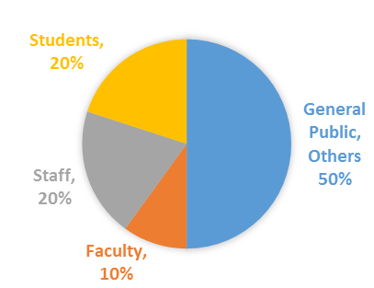
Diversity: Who is Invited to the Table Matters
659 registered, approx. 518 attendees;
122 surveys completed (24% Response Rate); 85% Knew the Story of Henrietta Lacks.;
15% Introduced to the Story through the Event.
Notes:
We had 659 people registered and more than 500 attendees (low no-show rate of 25%, typically 30-40%).
Three official welcome letters from federal officials:
Senator Dick Durbin
Congressman Danny Davis
Congresswoman Robin Kelly
Representatives from elected officials in attendance, and joined private lunch
Gennifer Geer (Senator Durbin’s office)
Tran Nguyen (Senator Durbin’s office)
Nikki Harvey – Congressman Davis’s office s
Roland Vaughn (Congresswoman Kelly’s office
UIC leadership in attendance and joined private lunch
Several Patient Brigade Members in attendance and joined private lunch
City/academic/medical institutions including:
Illinois Medical District
Rush
Northwestern University
Cook County HHS
Harvard/Duke
Howard Brown
Elevate, AIDS Foundation of Chicago
Howard Brown
City of Chicago
Pfizer

Slide 7
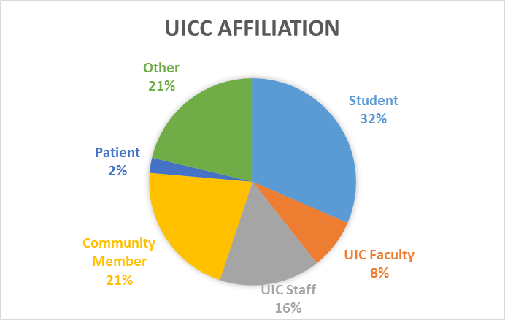
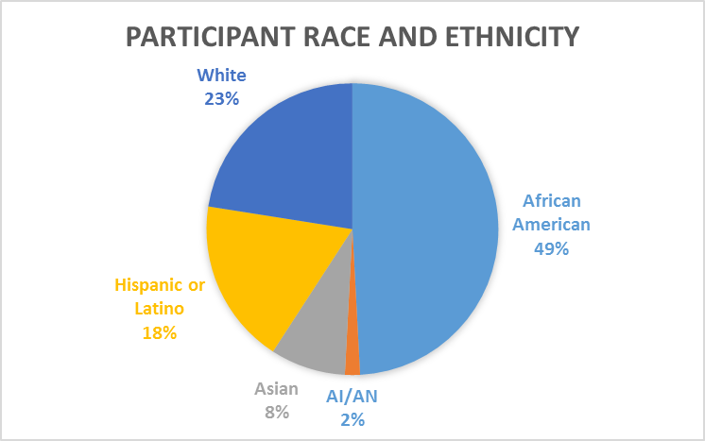
Diversity at the Table Can Advance Diversity in Research
Notes:
The percentages reflect each question’s total responses. The denominator varies per question as not everyone respondent answered each question.
Of the respondents, 76% were women and 24% were male.

Slide 8
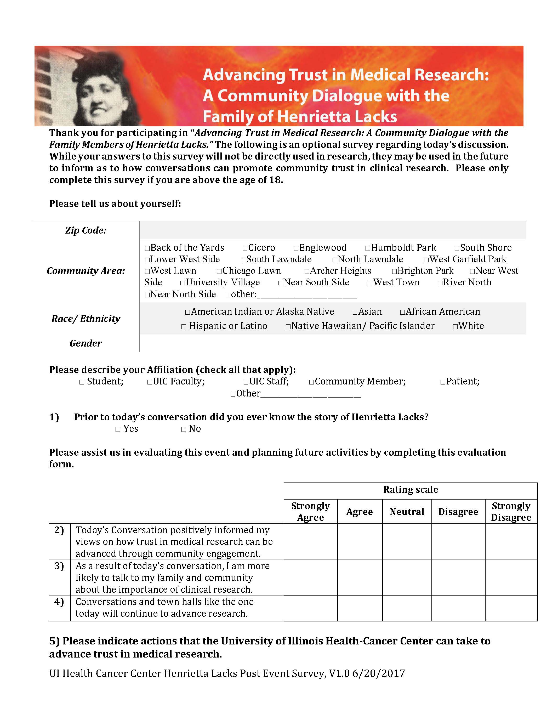
Understanding Where We are in Dialogue
“Please Assist us in evaluating this event and planning future activities by completing this evaluation form.”

Slide 9
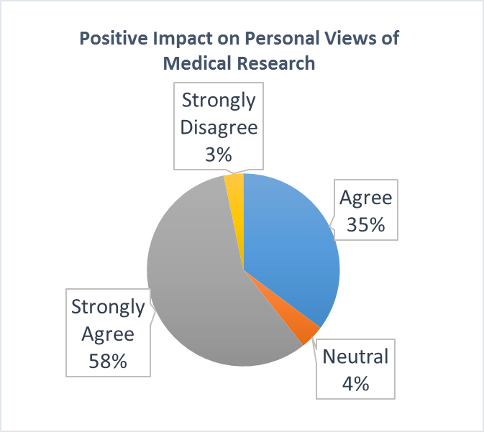
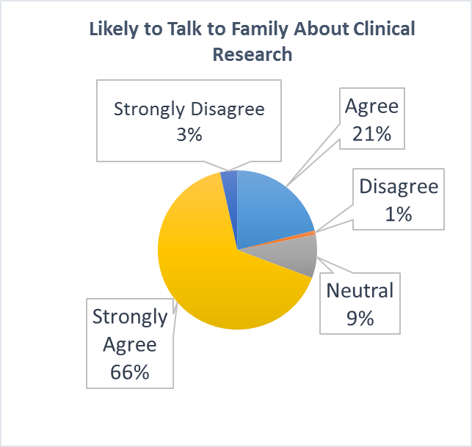
Q2: Today's Conversation positively informed my views on how trust in medical research can be advanced through community engagement.
Q3: As a result of today's conversation, I am more likely to talk to my family and community about the importance of clinical research.
Notes:
In case it comes up, the final Likert question was: “Conversations and town halls like the one today will continue to advance research.”
Strongly Agree = 81%
Agree = 16%
Disagree = 1%
Strongly Disagree = 2%

Slide 10
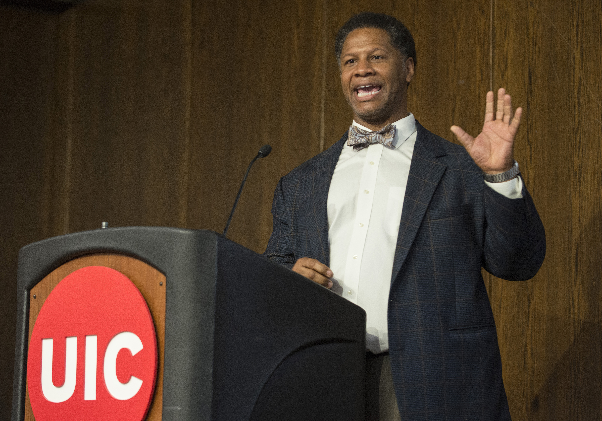
Leadership MUST Support the Partnership AND the Dialogue
“If loving science is wrong, then I don’t want to be right. But in that science there is a framework of social justice. Science devoid of social justice may even be considered bad science,”
– Robert A. Winn, MD, Chicago Magazine interview

Slide 11
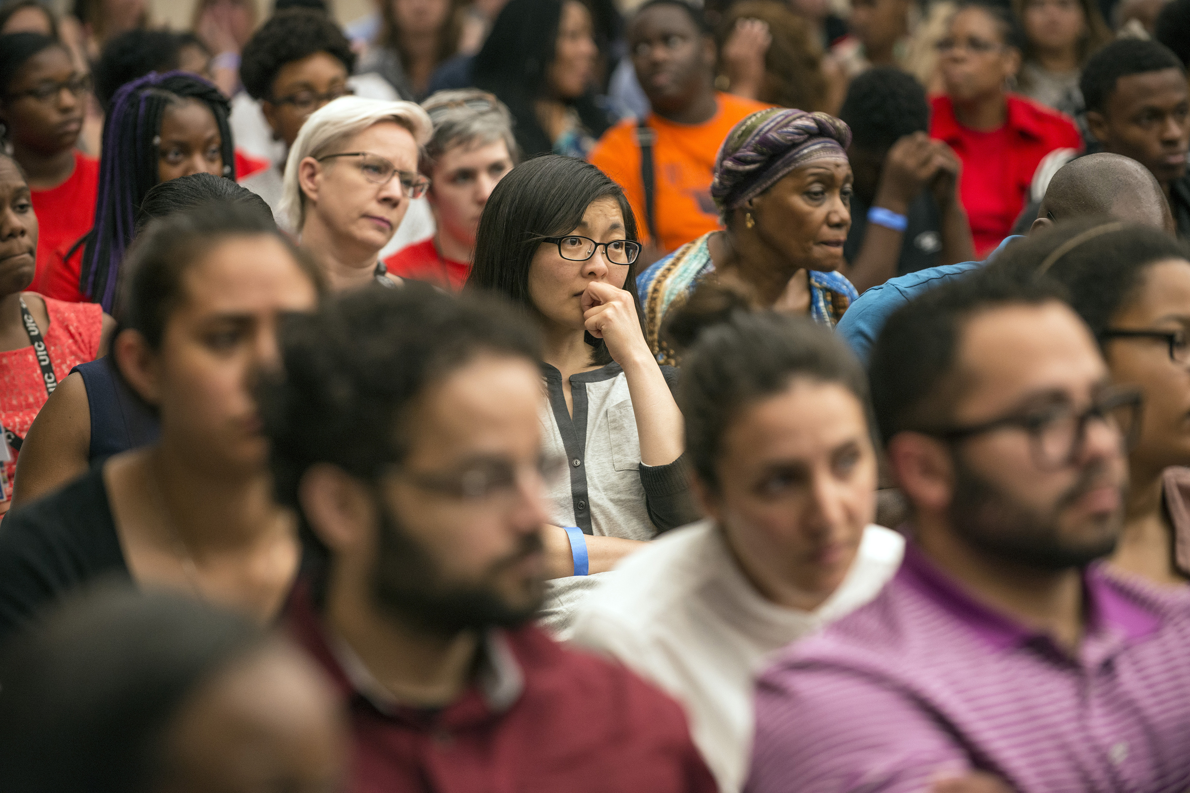
How do we advance trust?: The Community Response
“Continue to promote community awareness and engagement. Trust will come when people know who you are and what you do. Make things are clear and easy to understand as possible. Appeal to the public interests. Thank you for all the great work that you do!!!” [sic]
- Community Member

Slide 12
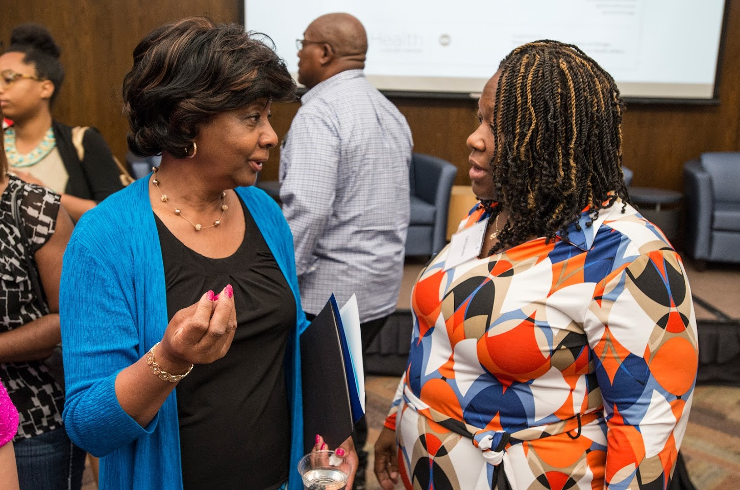
Partnerships and Dialogue: The Lacks Family and the UICC Patient Brigade
“In conferences like this, healthcare providers should step up, acknowledge and take responsibility and assure the communities that it wont happen again. In discussion please indicate health care providers who states what change they've done and what they're planning to do in order to get the community trust again.” [sic]
– Community Member
Notes:
The theme that echoed from panelists to audience members was that of community trust. In order to obtain and maintain trust we must continue to facilitate conversations such as these geared towards the community. Through feedback from the community after events such as the HeLa Community Dialogue we can continue these conversations in ways that are directly informed by those it seeks to service.

Slide 13
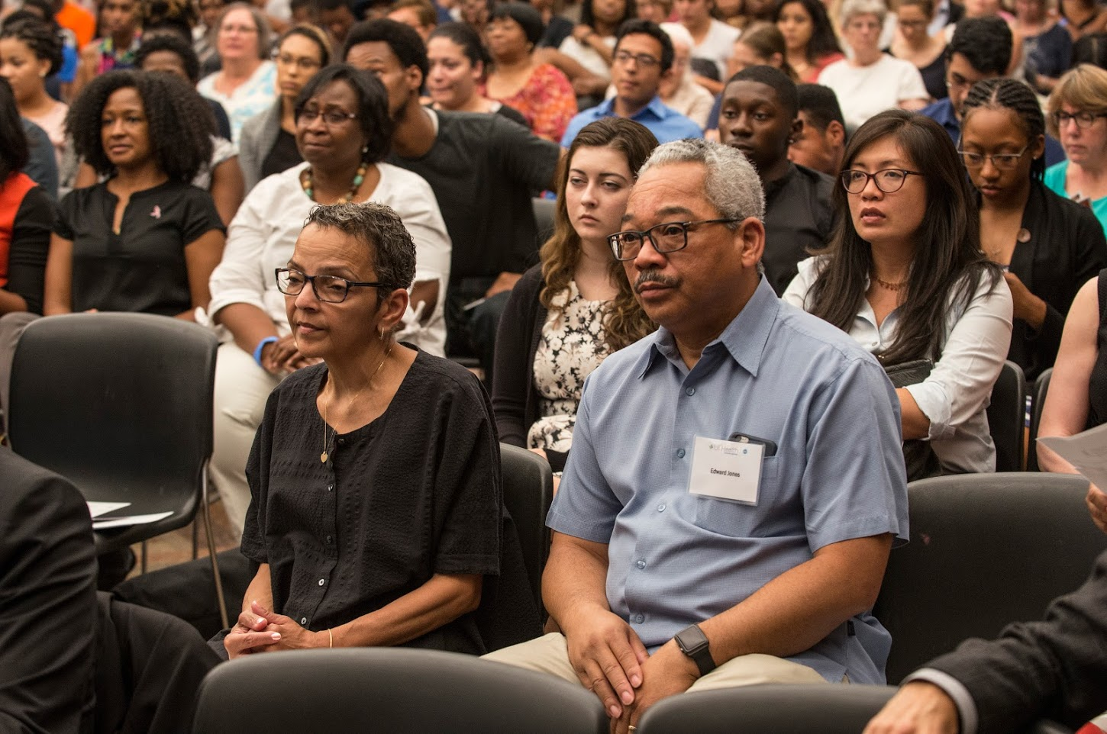
Why Diversity in Clinical Trials Matters to Us: The Story of DJ Tim Buck2
"Your struggle is my struggle, and I'm here to fight with you. To the ones with too much pride, and don't like going to the doctor because they are too proud and can handle it all, I have high hopes that my journey and story brings you back down to earth.“
- Timothy Francis Jones
AKA DJ Tim Buck2

Slide 14
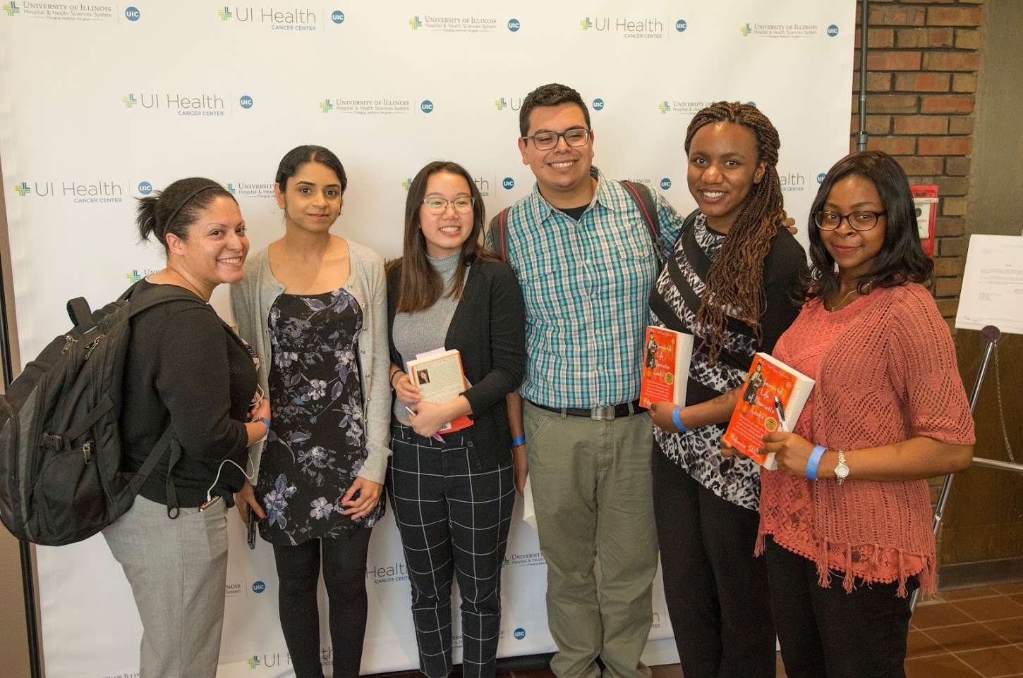
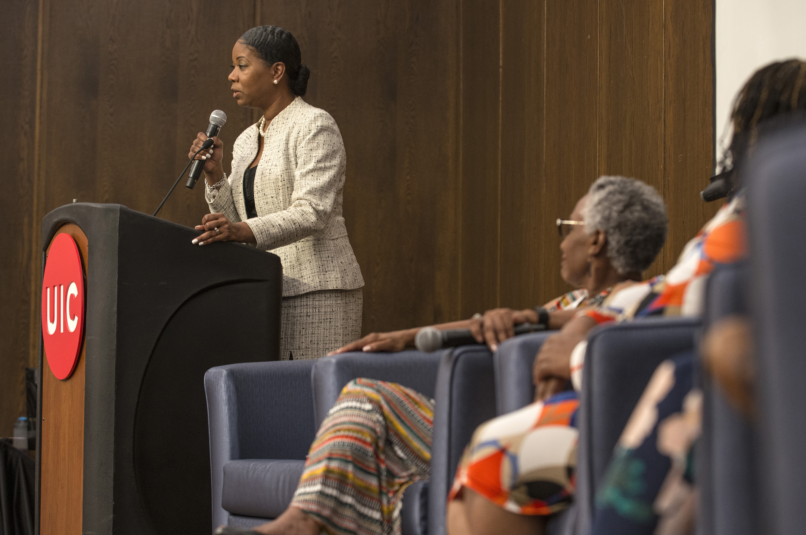
Advancing Trust Through Students, Training, Committed Leadership and Patient Partners

Slide 15
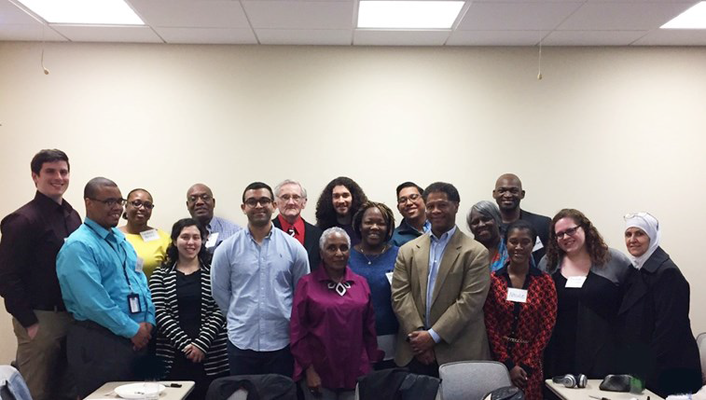
UICC Patient Brigade: At the Table and Determining the Menu
Thank you for your contributions as ambassadors and as reflections
of UI Health Cancer Center’s quality of care.

Slide 16

Henrietta Lacks Family Members
Shirley Lacks
Jeri Lacks-Whye
Veronica Robinson
ADVANCING TRUST IN
MEDICAL RESEARCH

Slide 17
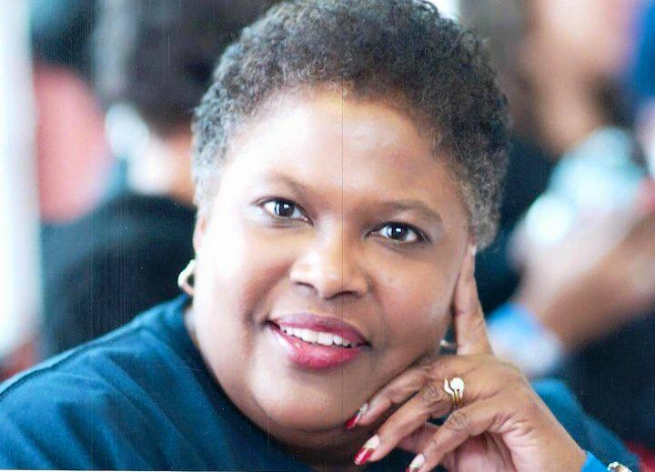
Honoring the Life and Legacy of Dr. Cynthia “Cee” Barnes-Boyd

Slide 18
Lisa Anderson-Shaw, DrPH, MA, MSN, ANP-BC
Clinical Assistant Professor of Medical-Surgical Nursing in Medical Education
College of Nursing, UIC
Director of the Clinical Ethics Consult Service, UI Health
Ashish Ansal, MD
Family Medicine, Mile Square Health Center, Englewood
Carol Gyimatey
UI Health Cancer Center Patient Brigade Member
RoseMarie Rogers
UI Health Cancer Center Patient Brigade Member
ADVANCING TRUST IN
MEDICAL RESEARCH

