Slide 1


BIG DATA Research-Ready Communities in Chicago Advancing The Science of Community Engaged Research September 14-15, 2017
Regina Greer-Smith MPH LFACHE
Healthcare Research Associates, LLC
President/Chief Engagement Officer/Engagement Activists

Slide 2
BIG DATA Research-Ready Communities in Chicago
Our story from the south side and south suburbs of Chicago.
How to we collectively developed our unique method for faith-based communities to engage, train, and develop surveys to learn about our data.
How we developed a method to share our data with our faith-based communities and more.
How We Will Use Our Data to Make our Communities Healthy thru Research.

Slide 3
Our Mission
BIG DATA Research-Ready Communities in Chicago
“To increase the participation of underserved communities of color in comparative effectiveness research and patient centered outcomes research through the design, development and implementation, reporting and dissemination of research”
We will achieve this by:
Partnering with researchers from academic health research centers
Fostering relationships to build a robust research infrastructure in the communities of the congregations
Building the capacity of faith based communities to engage in health research
Notes:
Our mission is to

Slide 4
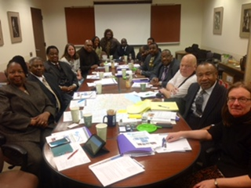
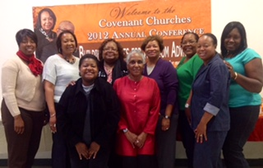
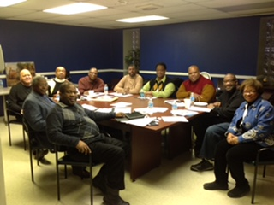
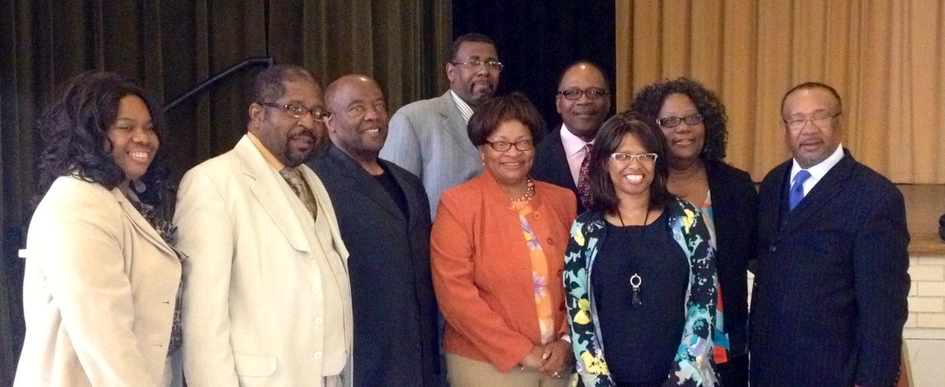
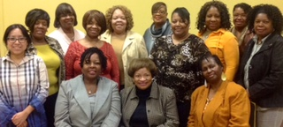
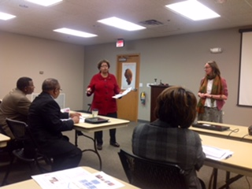
BIG DATA Research-Ready Communities in Chicago ***BUILDING TRUST***

Slide 5
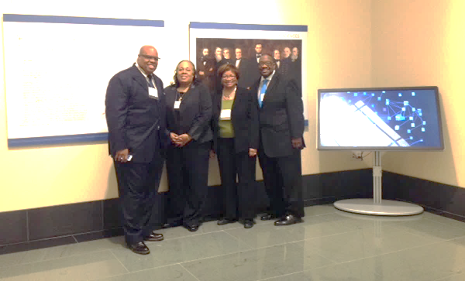
BIG DATA Research-Ready Communities in Chicago
PASTORS4PCOR BOARD LEADERSHIP
Bishop Simon Gordon – Board Chair – Senior Pastor/Triedstone Full Gospel Church – Chicago
Dr. Paris Davis, MBA – ED – Pastors4PCOR – Elder-Triedstone Full Gospel Church/Total Resources Community Development Corporation (TRCDO)
Regina Greer –Smith – Healthcare Research Associates, LLC/Co-founder of Pastors4PCOR/The S.T.A.R. Initiative
Reverend Walter Turner III –Co-Chair-Pastors4PCOR - Senior Pastor/New Spiritual Light Baptist Church - Chicago
Notes:
We represent the founding core of the Pastors4PCOR Research Ministry Advisory Board. Our vision is “to inform, inspire and engage congregations in research through collaboration”
The Chair of the Pastors4PCOR Research Ministry Advisory Board -- Bishop Simon Gordon – pictured here with the project lead Dr Paris Davis and co-chair Pastor Walter Turner – is a member of the SHMN of churches which meets monthly to discuss the health issues and related matters pertaining to congregations in the South suburbs and southside of the city.
Bishop Gordon is the head of his own church Triedstone and a not for profit Community Development Organisation – Total Resource. TRCDO has over 15 years of experience in facilitating information exchanges, health fairs, testings and screenings for underserved communities of color.

Slide 6
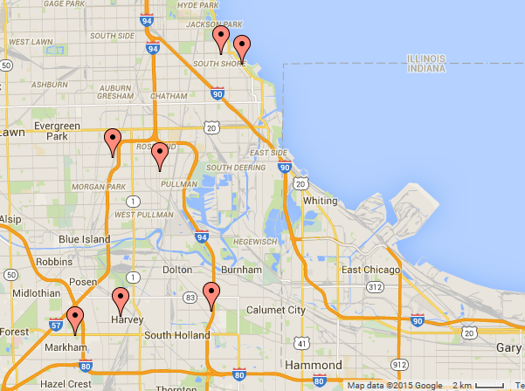





South Chicago faith-based community network and research partners Various congregations from Metro-Chicago participated
BIG DATA Research-Ready Communities in Chicago
Notes:
Pastors4PCOR is a faith based community network of churches, health researchers and representatives from Cook County Health and Hospital Systems. Here are all the partners who currently sit on the board and who oversee our program

Slide 7
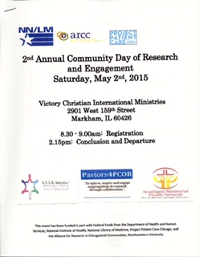
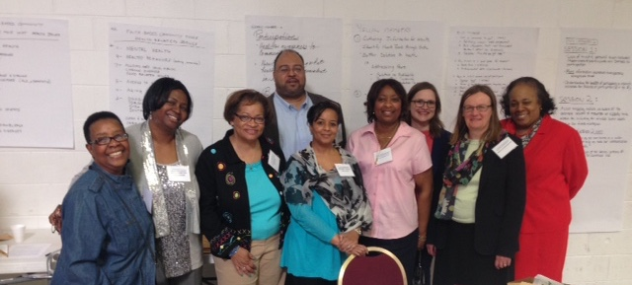
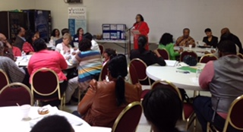
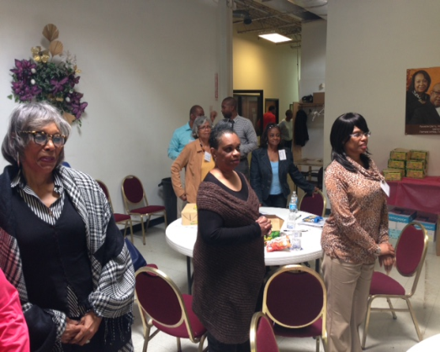
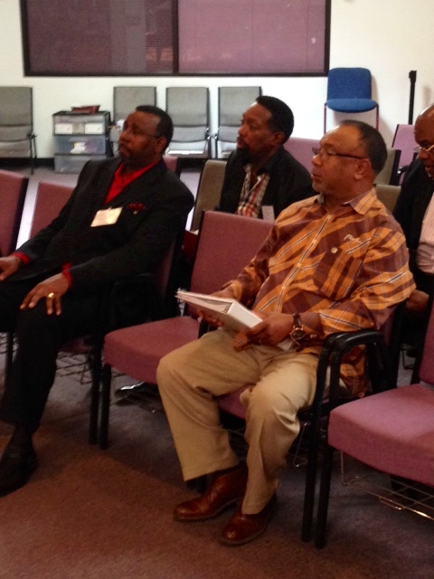
BIG DATA Research-Ready Communities in Chicago
Community engagement/orientation to research (i.e. what would research look like in a faith community
Pastors Certified in Human Subjects Protections
Learning if Faith Community had an “appetite” for research

Slide 8
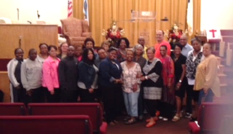
BIG DATA Research-Ready Communities in Chicago
Pastors4PCOR Research Ministry Ambassadors and Team
September 2015
The Journey to Get Our Research Ministry Ambassadors “Research Ready”
Notes:
Trainer Dialogue (RJ)
So we have refreshed where we are on the research ministry journey – now lets turn to the three things we would like you to be confident about doing by the end of todays session.
By the end of today we would like you to
Goal A …
Goal B …
Goal C …

Slide 9
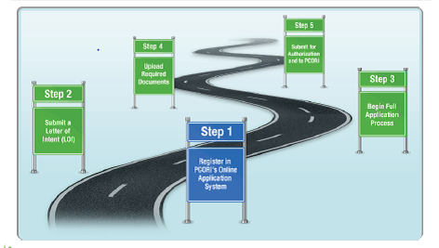

Faith based community research engagement roadmap
BIG DATA Research-Ready Communities in Chicago
Step 6: health research topic generation and personal engagement
Health
priority
surveys
Health asset maps
TODAY’S FOCUS
BIG DATA & COMMUNITY
Big data and community
Community based IRB
Intro to PCOR and EW programs
Notes:
This is why we are taking these six steps. At the end of the engagement journey we hope that you will feel confident and knowledgeable enough to perhaps join the pcor community as a patient reviewer or pcori ambassador or champion pcor and pcor findings to other members of your community

Slide 10
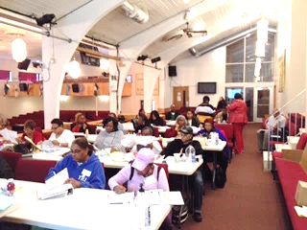
BIG DATA Research-Ready Communities in Chicago
***WE OWN OUR DATA***
Goal A: Know where the big data about health outcomes and related factors comes from and feel confident in engaging with big data projects
Goal B: Have developed a survey to identify the health conditions and factors which are priorities in your faith based community
Goal C: Have the tools to conduct a survey on health conditions and factors impacting your faith based community
Notes:
Trainer Dialogue (RJ)
So we have refreshed where we are on the research ministry journey – now lets turn to the three things we would like you to be confident about doing by the end of todays session.
By the end of today we would like you to
Goal A …
Goal B …
Goal C …

Slide 11
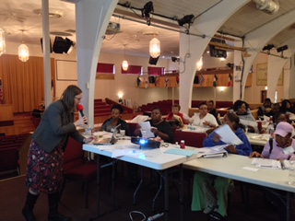
BIG DATA Research-Ready Communities in Chicago
GOAL A:
Know where the big data about health outcomes and related factors comes from and feel confident in engaging with big data projects;
Notes:
Trainer dialogue (RJ)
So we have looked at the big picture !
Now in the next hour we are going to develop a survey to identify the health conditions and factors which are priorities in your faith based communities
We are going to make sure that we group and describe these conditions and factors in ways that are meaningful to policy makers, pcor and community members – a big ask!

Slide 12
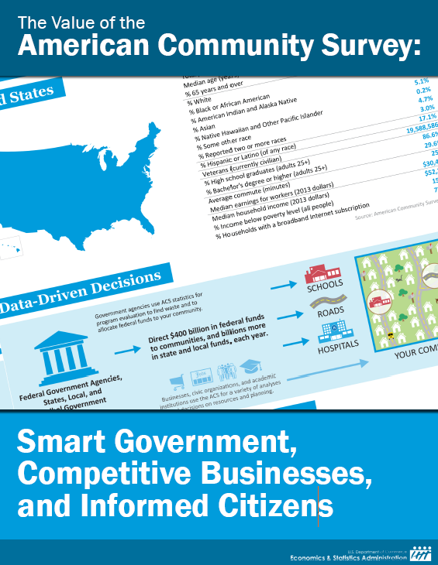
What is big data?
BIG DATA Research-Ready Communities in Chicago
Notes:
Trainer notes
Big data is the data gvt collects to make policy decsions
Has anyone here just received an invitation to take part in the American Community Survey ?
The ACS is an example of big data – it is what govt bases many of its policy decisions on – and because you are legally required to complete it – govt views it as highly trustworthy – indeed what you can see in this table is the number of federal programs which use the ACS data to make decisions about how to distribute resources between men and women, amongst ages groups, by race and ethnicity and how they set income level eligibility
If you don’t respond to the paper copy of the survey you are more likely to get a request to complete over the phone …
ACS data then gets number crunched at different levels by the US census – congressional district, state county

Slide 13
What is big data used for?
BIG DATA Research-Ready Communities in Chicago
Health System score cards
Overall Health Outcomes
Health Behaviors
Addressing Health Disparities
Notes:
Historically big data is used to rank in order to distribute resources. However, there is a new drive to use state and county data to address disparities – particularly in these three areas
Govt is doing this by agreeing benchmarks – i.e where we are now and targets for states to achieve.
State health systems for example are required to show scorecards marking progress in addressing health disparities
The Commonwealth Fund Scorecard on State Health System Performance for Low-Income Populations, 2013, enables states to compare their performance with that of others across key indicators of health system performance specific to low-income populations. It provides stakeholders with achievable targets for improvement by assessing each state’s performance compared with performance attained by the top state. By moving toward benchmark levels of health system performance, states could save lives.
Cook County and The City of Chicago Healthy Chicago have been undergoing a community health assessment exercise to identify the health behaviors which matter to people most through townhalls and interviews – they will then prioritse these.

Slide 14
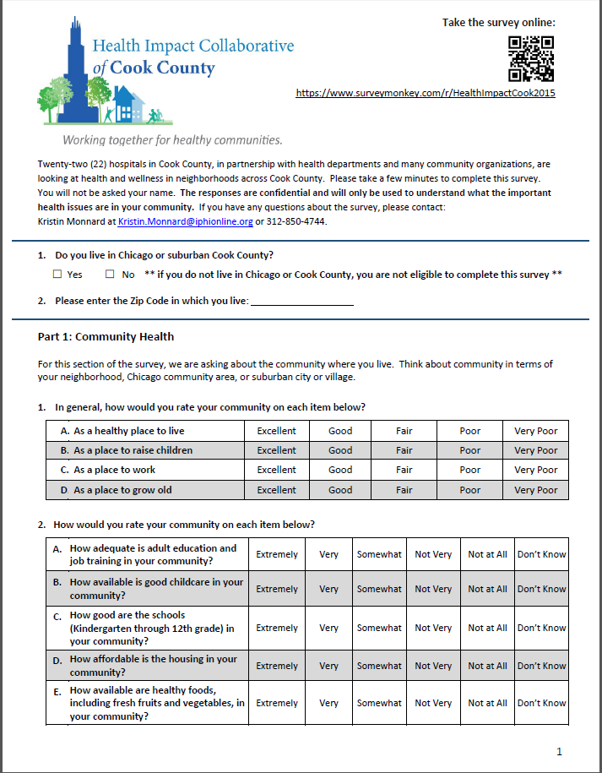
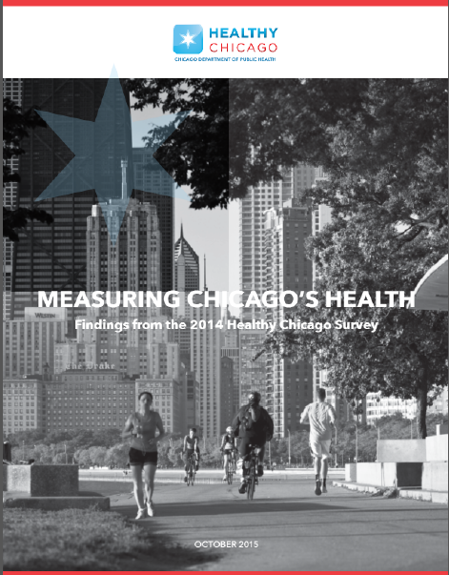
What is happening at County and City level?
BIG DATA Research-Ready Communities in Chicago
“A city with strong communities and collaborative stakeholders, where all residents enjoy equitable access to resources, opportunities and environments that maximize their health and well-being.”
Notes:
City of Chicago Survey has resulted in ten priority action areas: They are publishing their full plan in December 2015.
HEALTHY CHICAGO 2.0 ACTION AREAS
Access to healthcare and human services
Behavioral Health
Chronic disease prevention and control
Community development
Data & Research
Education equity
Infectious Disease
Maternal, Infant, Child and Adolescent Health
Partnerships and Community Engagement
Violence and Injury Prevention
Its important to know whats going on at county and city level because we don’t want to campaign for resources, support etc which are already being covered. Equally we want to know where funds are going so that if we can get involved

Slide 15
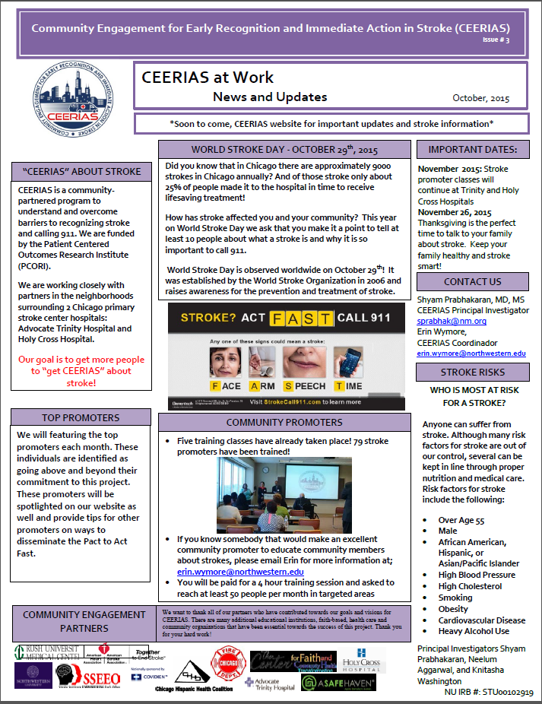
Big Data PCORI style
BIG DATA Research-Ready Communities in Chicago
Created by Chicago Dept of Public Health
Notes:
So how does pcori research use big data and how can you get involved with big data projects ?
Health researchers also often cite national and state heath statistics when they argue for funding prioritization –
Remember too in the last session we talked about the conditions that were impacting African American communities most? Remember that the top two were cancer and cardiovascular health? These priorities are based on big data – collected through surveys
This map shows the numbers of stroke related deaths per 100,000 people – the navy blue shaded areas show areas with high density of mortality from stroke in Chicago
By analyzing big data researchers know that stroke is more common and more severe in minorities, especially African Americans and Hispanics – in other words the data shows us health disparities in outcome – more people from minority groups are likely to die from stroke than other populations - . They also know that both groups are less likely to call 911. They want to know why.
What is being done? The CEERIAS project which some of you selected as a project you would like to learn more about is one pcori project designed to address this issue –
Investigators are developing and adapting a community-partnered intervention using community health promoters ("Stroke Promoters") to deliver messaging regarding stroke symptom awareness and the need for calling 911 after stroke onset. The study investigators will implement this intervention in 2 large south side Chicago communities
Priscilla and her faith based community had been contacted about the CEERIAS project – INVITE Priscilla to talk about this ??
OK now cast your minds back to the activities you completed – sheets 3 and 4 … Can you think of another pcori project you have heard about during our training sessions which tackle heart disease?

Slide 16
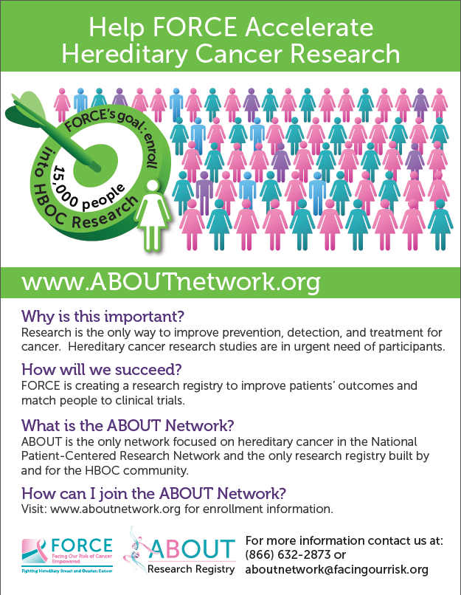
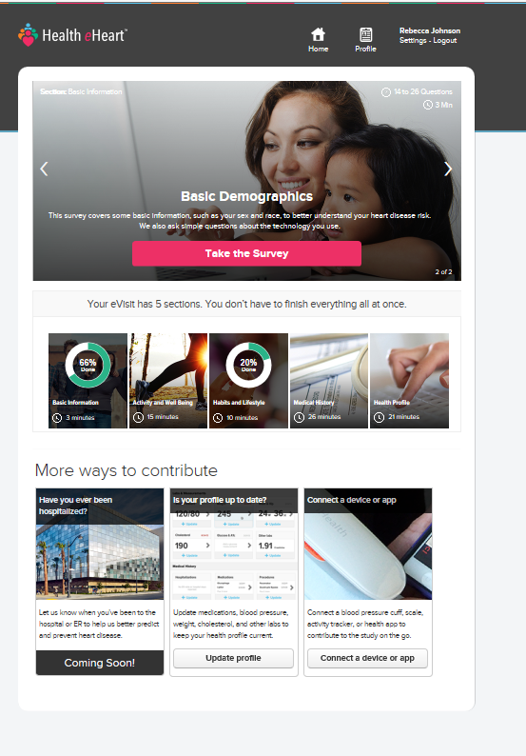
Joining a Big Data Patient-Powered Research Network
BIG DATA Research-Ready Communities in Chicago
Notes:
Trainer (RJ)
One of the problems with big data like the mortality data across Chicago or the stroke data is that it just tells you numbers – not about the other factors that may lead to stoke – social and economic factors – lack of access to healthy foods, toxic environments etc
PPRNs are trying to get better big data – they want to capture the big numbers AND to encourage patients to share information about their health behavior, diets etc as well as their conditions – they are trying to make big data more patient centered and factor aware..
BUT what are they and whats it like to join one?
Before we do this exercise I would like to invite Regina to talk about her experience of Creaky Joints …

Slide 17
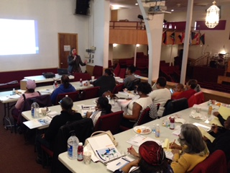
BIG DATA Research-Ready Communities in Chicago
GOAL B:
“Have developed a survey to identify the health conditions and factors which are priorities in your faith based communities”
Notes:
Trainer dialogue (RJ)
So we have looked at the big picture !
Now in the next hour we are going to develop a survey to identify the health conditions and factors which are priorities in your faith based communities
We are going to make sure that we group and describe these conditions and factors in ways that are meaningful to policy makers, pcor and community members – a big ask!

Slide 18
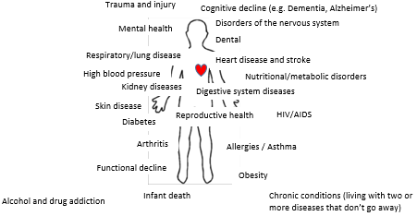
Building a faith-based community health survey
BIG DATA Research-Ready Communities in Chicago
Health outcomes:
Length of life;
Quality of life
Notes:
Trainer dialogue (RJ?)
What we are going to do next is to design a survey which will help you and your communities to identify the health conditions that are prevalent in your community – and to find out which health factors you think faith based communities can best focus on to deliver improved health outcomes -- faith based communities where people have good quality of life and long life
To take advantage of the funds and resources pcori offers we need ot make sure we use language which health researchers, pcori and community members relate to.

Slide 19
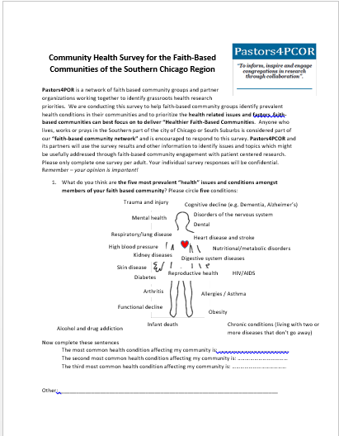
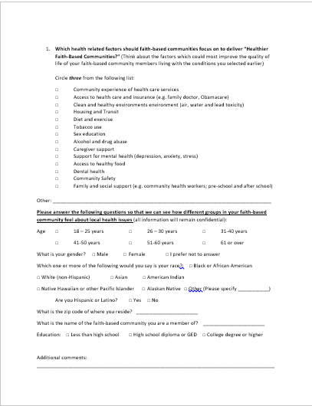
Survey template
BIG DATA Research-Ready Communities in Chicago
Who is doing the survey?
Health conditions
Health factors
Demographics
Notes:
Trainer dialogue (RJ)
The method we will be using to find out about priority health conditions in your community is a survey . Other methods we could use include interviews focus groups. But we want to collect data which enables us to get involved with big data questions and research
Our survey is short and has four key sections
Who is doing the survey
Health conditions
Health factors
And demographics
We want to go over each section with you to make sure you understand all the terms, are comfortable about the purpose of the survey and confident that others will be able and willing to complete the categories covered. It is also an introduction to the key things you find on surveys.

Slide 20
Exercise 1: Who is doing the survey?
BIG DATA Research-Ready Communities in Chicago
Pastors4POR is ….
We are conducting this survey because …
Who can take part? Anyone who lives, works or prays in the Southern part of the city of Chicago or South Suburbs is considered part of our “faith-based community network” and is encouraged to respond to this survey.
What happens to my data? Pastors4PCOR and its partners will use the survey results and other information to …
Notes:
There are four questions you need to be confident about answering before handing the survey out
Can you try completing the sentences ….

Slide 21
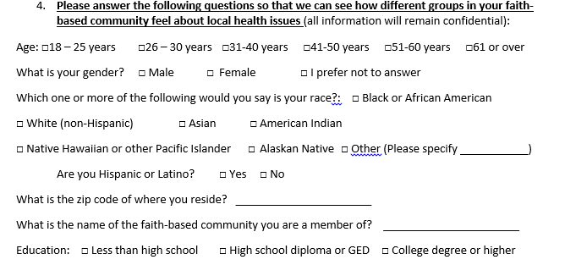
Exercise 3 demographics check
BIG DATA Research-Ready Communities in Chicago
Now take the demographic survey questions yourself. Are there categories which need changing?
Will your community be comfortable providing this data?

Slide 22
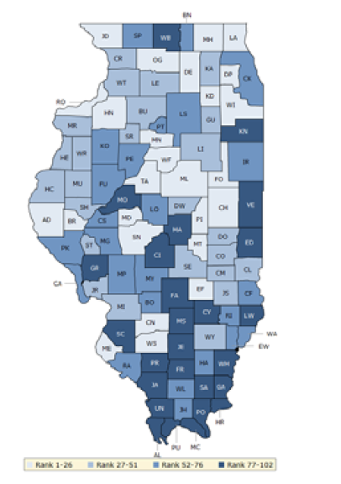
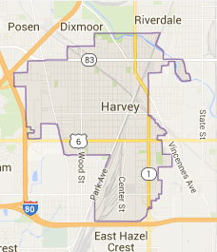
What health factors in B impact A?
BIG DATA Research-Ready Communities in Chicago
Map A: Illinois 2015: overall county ranking for health factors
Map B:
Harvey 2015
http://www.countyhealthrankings.org/app/illinois/2015/overview
Notes:
As you have already seen and is illustrated by the fact sheets in your folder there is a lot of health data info out there at state level and county level
This blue map displays Illinois’s summary ranks for health factors – specifically clinical care, healthy behaviors, environment and social and economic factors - you can see the data sources for these rankings in the 2015 County Health Rankings booklet in your files for Illinois
Lighter colors indicate better performance in the respective summary rankings. So Du Page county for example is lighter than Cook County – and ranks in the top 1-26 whilst Cook County ranks 52-76 Detailed information on
the underlying measures is available at countyhealthrankings.org.
But is this data relevant for our communities and what are the specific health factors in our local areas?
Also which factors are the factors impacting health that faith based communities can address or are addressing?

Slide 23
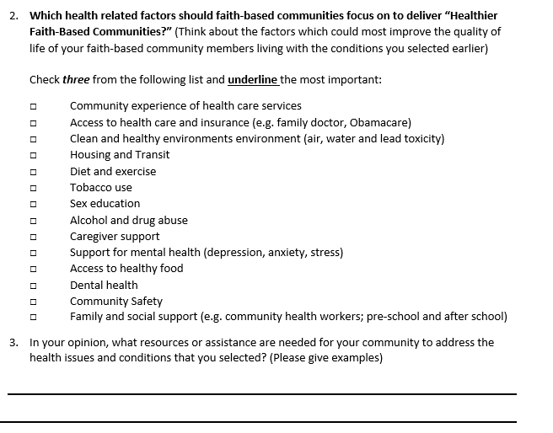
Survey factors
BIG DATA Research-Ready Communities in Chicago

Slide 24
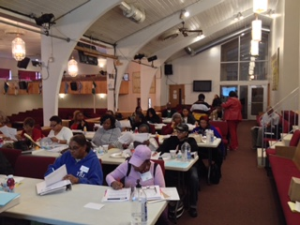
BIG DATA Research-Ready Communities in Chicago
GOAL C:
“Learn how to conduct a survey on health conditions and factors impacting your faith based community”
Notes:
Trainer dialogue (RJ/Dr Ingram)
Ok we have a survey ! I will take the survey away and create a version in survey monkey using all your feedback today. We will also create hard copies for you to disseminate.
Now we need to engage our communities and encourage community member to tell us about the health conditions that they think are prevalent in their communities and the factors impacting those health conditions.
Goal C is therefore to learn how to conduct a survey on health conditions and factors impacting your faith based community
So – in this next section Dr Ingram is going to talk about the steps we would like you to take in order to do this and the support we will provide you with.

Slide 25
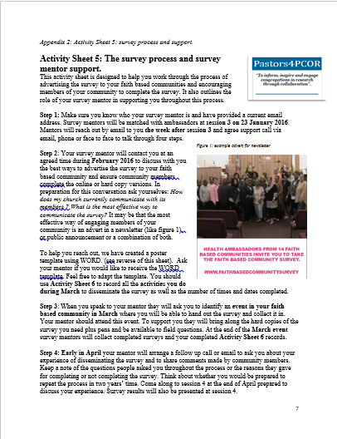

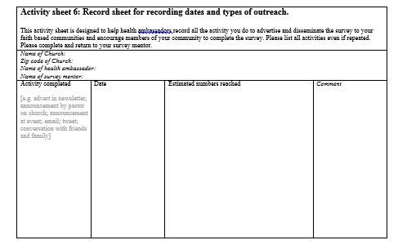
Activities for You and for Research Ministry
BIG DATA Research-Ready Communities in Chicago
Notes:
Trainer dialogue (Diana)
Here are Activity sheets 5 and 6 to add to your folder.
Activity sheet 5 is designed to help you work through the process of advertising the survey to your faith based communities and encouraging members of your community to complete the survey. It also outlines the role of your survey mentor in supporting you throughout this process.
Activity sheet 6 is for you to record all the activity you do to encourage people to take the survey.
We would like you to work through these sheets with the support of your survey mentor who you will meet today -- throughout February and March.
The aim is to have handed out and collected surveys by 3 April 2016 The project team will input the and we will discuss your experience and the results of the survey at the next session -- session four on April 16 2016.
In session 4 we will be able to see what the most prevalent pcori conditions are in your communities and also the health factors impacting health. In session 4 we will talk about what you are already doing to support people living with these conditions – asset mapping – and start to think about the next steps we would like to take

Slide 26

Our Next Steps
BIG DATA Research-Ready Communities in Chicago
Connect with your survey mentor
Inform and inspire your faith based communities to engage with research
Disseminate the faith based community health survey
Read info in your folder,
Use the guidelines in Activity Sheets 5 and 6 to engage your communities
Complete the session evaluation form
Notes:
Trainer dialogue (RJ)
Inform, inspire and engage your faith based communities with research – reach out to your communities to disseminate the health priorities survey with your mentors help
Complete the session evaluation form – there is a hard copy in your folder
Finally make a note of the new date of the next meeting – April 16 when we will be hearing from you about your experiences of sharing the survey and reviewing the data you collected – finding out which health condtions to prioritise so that we can begin to target researchers
NB: Remember the community hands? Well we’ll be looking at the results of that exercise in session 4 too …. And learning how to fund out about how churches support the health of members

Slide 27
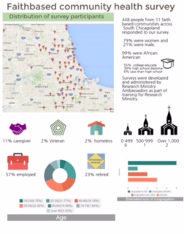
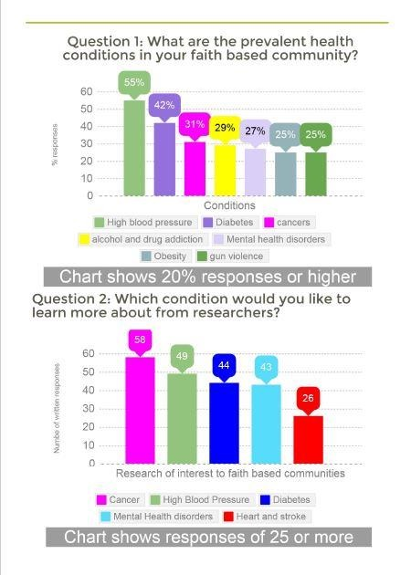
BIG DATA Research-Ready Communities in Chicago
OUR DATA – INFORMATION WE CAN USE & SHARETO MAKE OUR
COMMUNITIES HEALTHIER
Notes:
Trainer dialogue (RJ)
Inform, inspire and engage your faith based communities with research – reach out to your communities to disseminate the health priorities survey with your mentors help
Complete the session evaluation form – there is a hard copy in your folder
Finally make a note of the new date of the next meeting – April 16 when we will be hearing from you about your experiences of sharing the survey and reviewing the data you collected – finding out which health condtions to prioritise so that we can begin to target researchers
NB: Remember the community hands? Well we’ll be looking at the results of that exercise in session 4 too …. And learning how to fund out about how churches support the health of members

Slide 28
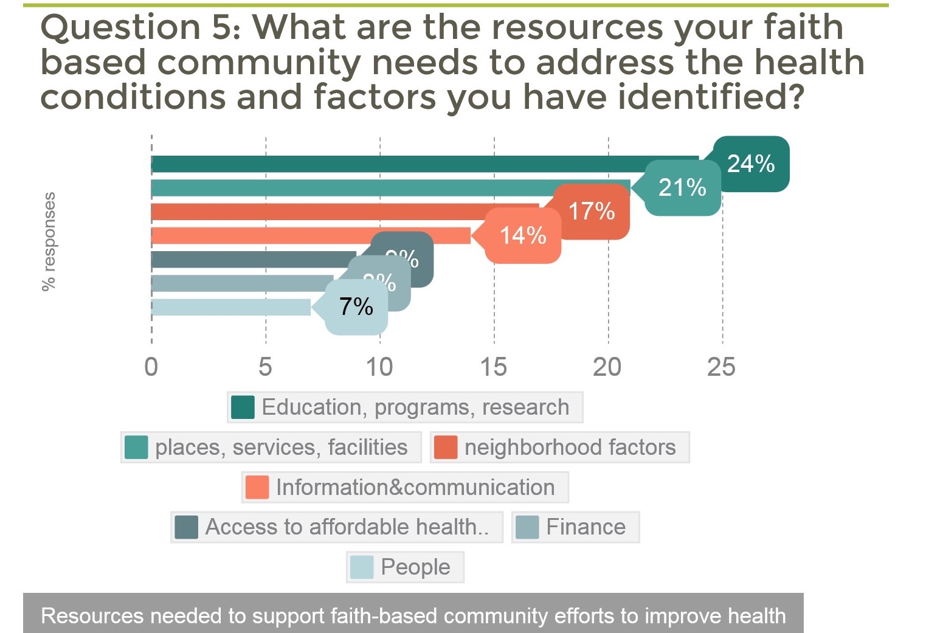
BIG DATA Research-Ready Communities in Chicago
Notes:
Trainer dialogue (RJ)
Inform, inspire and engage your faith based communities with research – reach out to your communities to disseminate the health priorities survey with your mentors help
Complete the session evaluation form – there is a hard copy in your folder
Finally make a note of the new date of the next meeting – April 16 when we will be hearing from you about your experiences of sharing the survey and reviewing the data you collected – finding out which health condtions to prioritise so that we can begin to target researchers
NB: Remember the community hands? Well we’ll be looking at the results of that exercise in session 4 too …. And learning how to fund out about how churches support the health of members

Slide 29
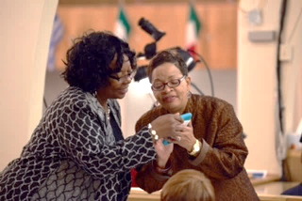
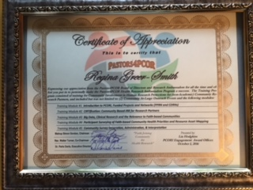
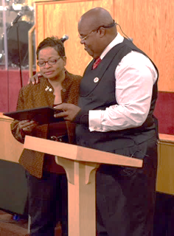
BIG DATA Research-Ready Communities in Chicago
Graduation, Celebration, Appreciation, Affirmation
October 2016
Notes:
Trainer dialogue (RJ)
Inform, inspire and engage your faith based communities with research – reach out to your communities to disseminate the health priorities survey with your mentors help
Complete the session evaluation form – there is a hard copy in your folder
Finally make a note of the new date of the next meeting – April 16 when we will be hearing from you about your experiences of sharing the survey and reviewing the data you collected – finding out which health condtions to prioritise so that we can begin to target researchers
NB: Remember the community hands? Well we’ll be looking at the results of that exercise in session 4 too …. And learning how to fund out about how churches support the health of members

Slide 30

BIG DATA Research-Ready Communities in Chicago
Pastors4PCOR Research Ministry Ambassadors
First Faith-Based Research Ministry Organization
Graduation- Cohort I October 2016
“Our Journey Continues”
Notes:
Trainer Dialogue (RJ)
So we have refreshed where we are on the research ministry journey – now lets turn to the three things we would like you to be confident about doing by the end of todays session.
By the end of today we would like you to
Goal A …
Goal B …
Goal C …

