Slide 1
Data as the Passenger: The Importance of Identifying What Data Matters to the Community
Courtney Clyatt Program Officer, Pipeline to Proposal Awards/Engagement Awards
CEnR - Advancing the Science of Community Engaged Research September 15, 2017

Slide 2
Definition of Data
1 :factual information (such as measurements or statistics) used as a basis for reasoning, discussion, or calculation
2 :information output by a sensing device or organ that includes both useful and irrelevant or redundant information and must be processed to be meaningful
Notes:
Good morning everyone, my name is Courtney Clyatt, I am a Program Officer at PCORI, I work with the Pipeline to Proposal Program on the Engagement Awards Team
I am here today to speak with you about two programs that we have at PCORI on the Engagement Team that aim to shift the research paradigm and put patients and community members in the driver’s seat, while data sits on the passenger side.
Both of my co-presenters have received funding under the Eugene Washington Engagement Awards program, allowing them to engage the community in research that is important to them.
Merriam Webster defines data as
1 :factual information (such as measurements or statistics) used as a basis for reasoning, discussion, or calculation
2 :information output by a sensing device or organ that includes both useful and irrelevant or redundant information and must be processed to be meaningful

Slide 3
What makes data useful to patients when making healthcare decisions?
Data is useful to patients when it provides factual information (such as measurements or statistics) that patients can use as a basis for reasoning, discussion, or determining if a test or treatment is right for them and their health issue.
Notes:
What makes data useful to patients when making healthcare decisions?
Data is useful to patients when it provides factual information (such as measurements or statistics) that the patients can use as a basis for reasoning, discussion, or determining if a test or treatment is right for them and their health issue.
This helps patients and relevant stakeholders make informed health decisions and improve health care and outcomes.

Slide 4
PCORI Vision & Engagement
Vision
Patients and the public have information they can use to make decisions that reflect their desired health outcomes.
PCORI Engagement
We engage patients, caregivers, clinicians, insurers, employers and other stakeholders throughout the research process
Notes:
Vision
It’s PCORI’s Vision that Patients and the public have information they can use to make decisions that reflect their desired health outcomes.
PCORI Engagement
We engage patients, caregivers, clinicians, insurers, employers and other stakeholders throughout the research process

Slide 5
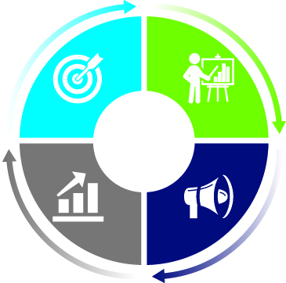
Engagement as a Path to Useful, High-Quality Research
Topic Selection and Research Prioritization
Proposal Review; Design and Conduct of Research
Dissemination and Implementation of Results
Evaluation
Notes:
By "engagement in research," we refer to the meaningful involvement of patients, caregivers, clinicians, and other healthcare stakeholders throughout the research process—from topic selection through design and conduct of research to dissemination of results. We believe that such engagement can influence research to be more patient centered, useful, and trustworthy and ultimately lead to greater use and uptake of research results by the patient and broader healthcare community.
This makes it more likely we’ll get the research questions right and that the study results will be useful and taken up in practice

Slide 6
PCORI Vocabulary
Notes:
At PCORI we provide funding for clinical comparative effectiveness research, comparing option A to option B.
Studies that compare health outcomes and the clinical effectiveness, risks, and benefits of two or more approaches to healthcare
In PCORI speak community can mean patients, caregiver advocacy orgs, caregivers, purchasers, clinicians, payers –primarily anyone who can be considered a stakeholder in healthcare decision making for a particular health issue.

Slide 7
PCORI’s Work Answers Patients’ Questions
Given my personal characteristics, conditions and preferences…
Notes:
PCORI’s Work Answers Patients’ Questions
A patient may thikGiven my personal characteristics, conditions, and preferences

Slide 8
Two funding programs that prepare communities for research
Eugene Washington Engagement Awards
These awards support projects that encourage active integration of patients, caregivers, clinicians, and other healthcare stakeholders as integral members of the patient-centered outcomes research/clinical effectiveness research (PCOR/CER) enterprise.
Pipeline to Proposal Awards
Build a national community of patient, stakeholder, and researcher partnerships that have the expertise and passion to participate in patient-centered outcomes research within their communities
Build capacity and cultivate the development of proposals with sound scientific rigor and robust patient engagement.
Notes:
Two funding programs that prepare communities for research
The Eugene Washington PCORI Engagement Award program is intended to bring more patients, caregivers, clinicians, and other healthcare stakeholders into the research process. The goal is to support projects that will build a community better able to participate in patient-centered research (PCOR) and comparative clinical effectiveness research (CER), as well as serve as channels to disseminate study results.
And the pipeline to proposal program, which provides funding for community and capacity building around a specific health issue, so that those communities can develop a comparative effectiveness research question.

Slide 9
Just as Demographic and Socioeconomic Factors are Major Determinants of Health…
The type of data that is important to the community will vary by access to healthcare, socio-economic status, and demographics.
to determine what information the community values as important, you may need to think outside of the box.
Notes:
Just as Demographic and Socioeconomic Factors are Major Determinants of Health…
The type of data that is important to the community will vary by access to healthcare, socio-economic status, and demographics.
to determine what information the community values as important, you may need to think outside of the box.

Slide 10
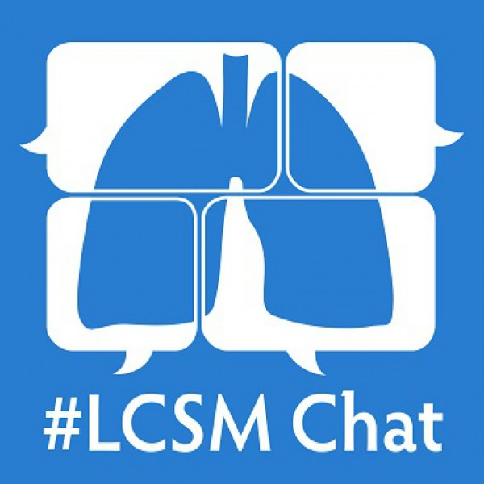
Examples of Projects Where Patients Drive Data in the Development of a Research Study
We’ll take the Village – Sickle Cell Association of NJ is conducting outreach via Facebook and support groups
Cystic Life – patient led project focusing on Cystic Fibrosis and cardio exercise as a treatment
SolSurvivors – patient/survivor-led project focusing on melanoma research
#LCSM – clinician-led project focusing on lung cancer treatment, conducting outreach, sourcing data and determining a research question via Twitter
Notes:
Examples of Projects Where Patients Drive Data in the Development of a Research Study
Here are some examples of funded engagement projects where they’ve used non-traditional ways to engage community members
We’ll take the Village – Sickle Cell Association of NJ is conducting outreach via Facebook and support groups
Cystic Life – patient led project focusing on Cystic Fibrosis and cardio exercise as a treatment
SolSurvivors – patient/survivor-led project focusing on melanoma research
#LCSM – clinician-led project focusing on lung cancer treatment, conducting outreach, sourcing data and determining a research question via Twitter

Slide 11
Strategies that Pipeline and Engagement Awardees Use to Share and Receive Data from their Community of Stakeholders
Message Boards
Twitter Chat
Facebook
Town Halls
World Cafes
Surveys
Conferences
Notes:
Strategies that Pipeline and Engagement Awardees Use to Share and Receive Data from their Community of Stakeholders
Message Boards
Twitter Chat
Facebook
Town Halls
World Cafes
Surveys
Conferences
There is no cookie cutter approach - the way that communities are engaged will not work for all

Slide 12
Community Engagement Strengthens the Research Enterprise
.
Plan Study
Conduct Study
Disseminate Study Results
PCORI Research Process
Pre-planning
Implement Study Results
Community capacity building before a study is planned enables patients and the community to drive the research.
2) It has been shown that when patient and community partners are engaged early on and throughout the research process, they are more likely to help in the implementation and dissemination of study results in their communities.
Notes:
Next slide
Community Engagement Strengthens the Research Enterprise
Community capacity building before a study is planned enables patients and the community to drive the research.
2) It has been shown that when patient and community partners are engaged early on and throughout the research process, they are more likely to help in the implementation and dissemination of study results in their communities.

Slide 13
Importance of Including the Community Voice and Lived Experience in the Development of Data Systems
If the data system isn’t reflecting the full patient experience living with that health issue, then is it a fully integrated data system?
Notes:
Next slide
I wanted to leave you with a thought as you hear from my colleagues,
QUESTION: If the data
system isn’t reflecting the full patient experience living with that health issue, then is it a fully integrated data system?
The answer is no, which is one of the reasons the patient should be the driver, while data takes a seat on the passenger side.

