Slide 1
Engaging Patients and Communities in Translational Research
Petra Kaufmann, MD, MSc, FAAN
Director, Division of Clinical Innovation
Director, Office of Rare Diseases Research
Advancing the Science of Community Engaged Research
September 15, 2017

Slide 2
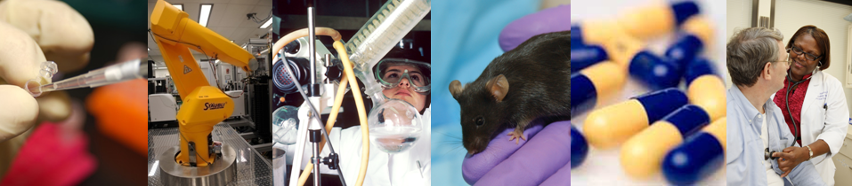
National Center for Advancing Translational Sciences (NCATS)
Mission
To catalyze the generation of innovative methods and technologies that will enhance the development, testing and implementation of diagnostics and therapeutics across a wide range of human diseases and conditions.
Study translation on a system-wide level as a scientific and operational problem, developing and supporting innovative collaborations across traditionally separate scientific disciplines and organizations, including government agencies, academia, industry and patient organizations.

Slide 3
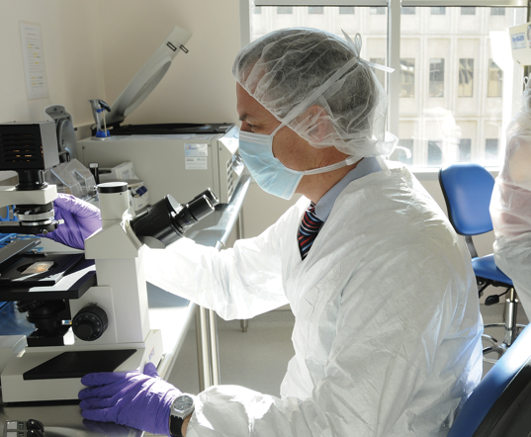

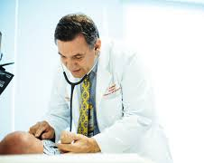


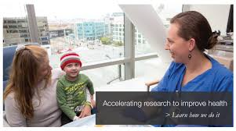


Translation: From discovery to positive health outcomes
Discovery
Exploratory Research
Confirmatory Research
Clinic
Health Outcomes

Slide 4
What is Translational Science?
Translational Science is the field of investigation focused on understanding the scientific and operational principles underlying each step of the translational process.
NCATS studies translation as a scientific and organizational problem.

Slide 5
Examples of patient and community engagement in NCATS programs
  NCATS Toolkit for Patient-Focused Therapy Development
  CTSA Program
    Community Partnerships
  Recruitment Innovation in the Trial Innovation Network

Slide 6

The Toolkit
NCATS Toolkit for Patient-Focused Therapy Development
  Patient group initiated and led program
  Developed to facilitate therapeutics research and development by patient groups
  Provides a web-based interface with a comprehensive collection of rare disease drug development tools
    Aim is to provide an online one-stop resource targeted to patient groups
    Useable
    Accessible
    Practical
  Many tools not specific to rare diseases and useful to patient groups for all diseases and conditions – we welcome everyone to the site
  Launched September 8, 2017
  https://rarediseases.info.nih.gov/toolkit
Notes:
Goal: To engage patients as essential partners in research and development

Slide 7
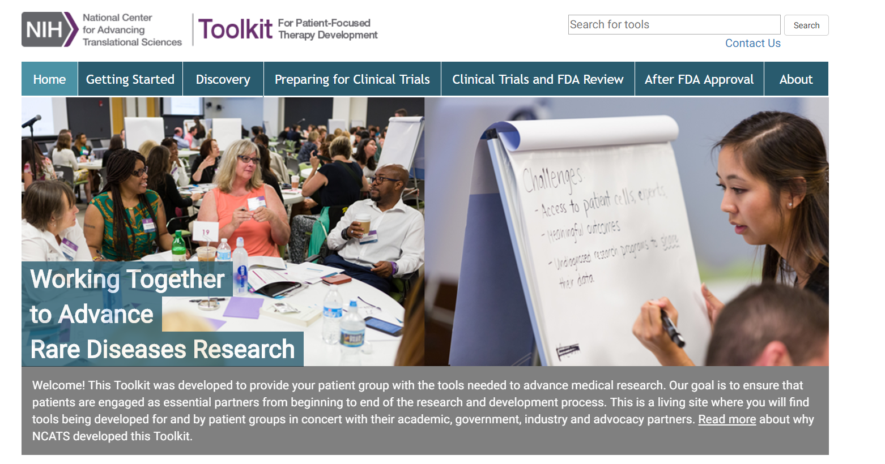
Toolkit Website
https://rarediseases.info.nih.gov/toolkit

Slide 8
Toolkit: Guiding principles
Facilitate opportunities to bring groups together for greater synergy, identify gaps in available online resources that require development, and disseminate information to patient groups.
Provide a single portal with resources that patient groups can readily access along with context.
Convene partners across multiple sectors to create a central source for online educational and informational resources and tools.
Rather than re-create existing resources, the goal is to facilitate coordination.
Facilitate development of resources for patient groups and promote continuity across the translational research and drug development process.
Identify and fill gaps in online resources and disseminate information. Keep it simple from a “how to” perspective.
Notes:
Collaboratively create a well-designed source for online educational and informational research resources and tools.
Provide a single online portal with resources that patient groups can readily access along with context.
Improve coordination rather than re-create existing resources.
Facilitate opportunities to bring groups together, identify gaps in online resources, and disseminate information to patient groups.
Promote continuity across the lifecycle of the drug development process.

Slide 9
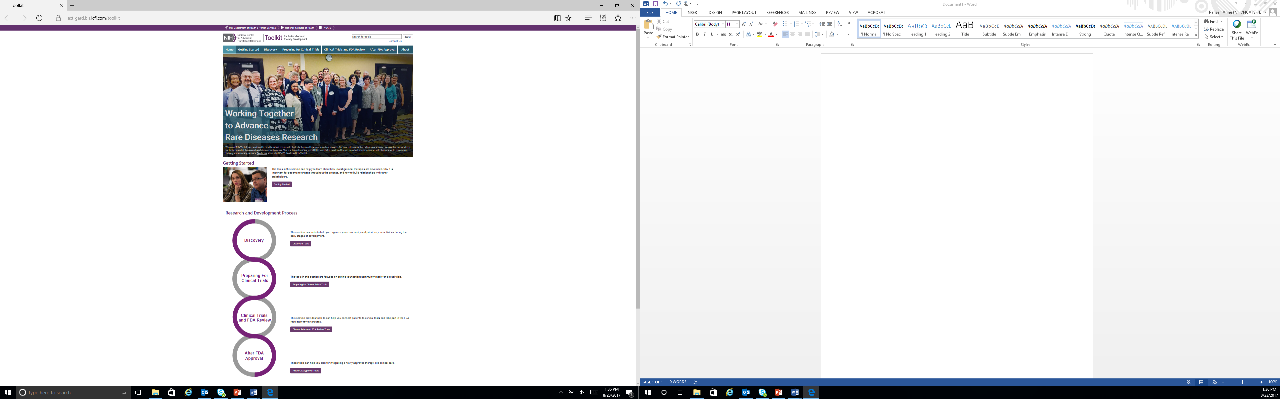
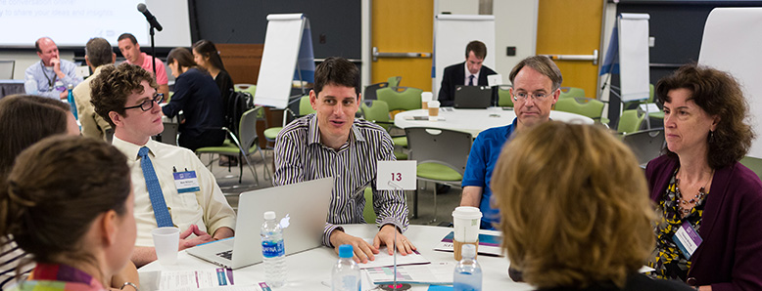
Toolkit Snapshot
Tools organized into 4 topic areas (bins):
Discovery
Preparing for Clinical Trials
Clinical Trials and FDA Review
After FDA Approval
Working together to advance rare diseases research
And a “Getting Started” tab

Slide 10

Community Engaged Research
Component of the
CTSA (Clinical and Translational Science Awards) Program
Image source: http://www.duq.edu/academics/community-engaged-teaching-and-research/faculty/community-engaged-research
Notes:
Community Engaged Research differs from Community Engagement as an activity. CE Research is primarily about the principles of how to collaborate and work together to conduct research and less about methods or methodologies used in the process of conducting community engaged research.

Slide 11
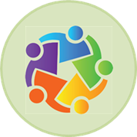
CTSA Program Strategic Goal:
Engage patients and communities in every phase of the translational process
  Develop new, and expand existing models, for stakeholder engagement, collaboration, and partnerships to advance translational science.
  Engage stakeholders in collaborations to advance translation by contributing across the translational sciences spectrum.
  Enable team science to become a major academic model.
Notes:
Examples Boot Camp Translation (BCT) for Patient-Centered Outcomes Research
Community Engagement Studios (Vanderbilt)
Helping Basic Scientists Engage With Community Partners to Enrich and Accelerate Translational Research
CTSA Program Community Mentorship

Slide 12
CTSA Program Funding Opportunity Announcement (PAR-15-304)
Community Engagement (CE) section
Defines communities broadly
  Addresses CE as a scientific problem
  Integrates CE into leadership, research and communication at hubs
  Integrates CE across translational spectrum
  Acknowledges CE in academic policy and culturally competent training for staff fosters innovation, disseminate best practices
Notes:
Most recent CTSA Program Funding Opportunity Announcement (PAR-15-304)
http://grants.nih.gov/grants/guide/pa-files/PAR-15-304.html

Slide 13
Boot Camp Translation (BCT) for Patient-Centered Outcomes Research: Partnering to create community specific approaches to improved health from population level evidence
Overview: Developed by researchers at the University of Colorado CTSA Program
Purpose:
  The program works with patients/community members to make scientific findings and evidence-based guidelines easier to understand by using language, concepts, and materials that were accessible to their local communities.
  The concept of Boot Camp Translation was a grassroots idea and was conducted with over 100 English and Spanish-speaking communities. Patients/Community members chose the health topics to be translated.
Outcome:
  Different communities of patients, providers, and payers responded favorably to the BCT process.
  BCT is a reliable method for successful long-term community engagement. BCT promotes the development of successful community or practice interventions through community engagement.
Notes:
Use of the Boot Camp Translation method has resulted in the development of health care concepts and language that are readily accessible to and understandable by local community members and patients. Use of the method has also prompted increased conversations between patients and health care providers and has improved health care for a host of conditions, including colon cancer, asthma, and hypertension

Slide 14
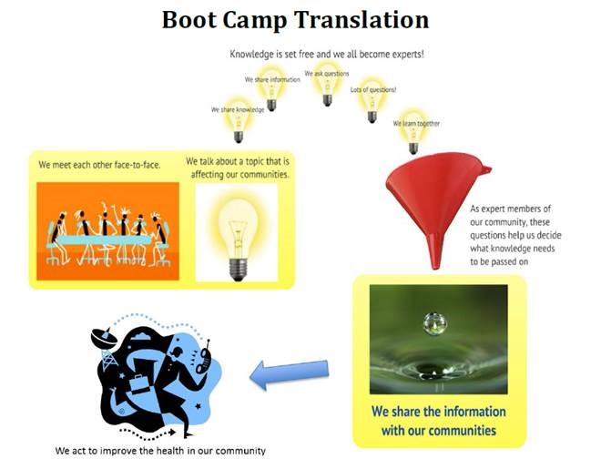
Boot Camp Translation (BCT) for Patient-Centered Outcomes Research:
Partnering to create community specific approaches to improved health from population level evidence
Colorado Clinical and Translational Sciences Institutes (CCTSI) researchers are partnering with local community members to translate medical jargon and terminology into user-friendly terms and to facilitate clearer communication and dissemination of health promotion/disease prevention information to community members.
Notes:
The key message is that the Univ of Colorado CTSI Program has and continues to host a program called “Boot Camp Translation”. Essentially, the CTSI Researchers partner with local community members to translate complex medical jargon and terminology into user-friendly terms and ultimately facilitate clearer communication of Health Promotion/Disease Prevention information to specific community members. They are still implementing the program so I would not cite statistics reported below as they have probably changed by now.
Problem: Clinical recommendations are created by scientists and professional interest groups but often use medical jargon and concepts that are not easily understood by patients. Boot Camp Translation (BCT) offers a process where patients and community members collaborate with researchers to translate evidence-based guidelines into language, concepts, and materials accessible to their community. Originally developed by a grassroots community members and academic researchers, this project studies the efficacy of BCT as a tool to engage diverse rural and urban communities in patient-centered outcomes research.
Approach/Methods: BCT, a process based in community-based participatory research principles, was conducted with 11 different community/patient-academic partnerships to translate the evidence-based guidelines and medical information into culturally-relevant language and concepts for diverse communities. BCT starts with a comprehensive education session followed by facilitated discussions and brain-storming to process and prioritize newly learned information. This all-day retreat is followed by two additional half-day sessions and 4-8 telephone conversations to finalize the intervention development. Patients from urban African American, urban Latino, and rural Colorado communities; providers; and payers have all been involved. Separate BCTs were conducted for English-speaking and Spanish-speaking Latinos. Over 100 community members and 10 academic partners participated.
Outcomes: BCTs were conducted with eleven diverse community and patient groups and a variety of investigators, including public health workers, clinical investigators, and organizational leaders. Topics were identified by the community groups and included hypertension, mental health, diabetes, asthma, and obesity. The pilot BCTs created medically sound health information and materials that reveal and value the different cultures, assets, and needs in each community. For example, multiple BCTs on hypertension were conducted wherein each community group received the same presentation on hypertension but translated the information into different key take home points and intervention materials. The rural and urban African American groups developed hypertension self-management toolkits that used home blood pressure monitoring to improve blood pressure control and translated evidence based recommendations into handbooks for lifestyle change in their communities. The Latino groups focused more on increasing awareness and diagnosis; however the two groups differed on the tone of messages and look of materials. The rural intervention resulted in significant improvement in blood pressure control. The success of this pilot led to the expansion of the original model of community/patient partners to include practice-level patient-provider-staff groups.
Lessons: Diverse communities of patients, providers, and payers respond positively to the BCT process. BCT is a reliable method for successful long-term community engagement. BCT promotes the development of successful community or practice interventions through community engagement.

Slide 15
Community Engagement Studio
Overview:
Dr. Consuelo Wilkins from the Vanderbilt University Medical Center CTSA Program and the Meharry Vanderbilt Alliance has developed an approach called Community Engagement Studio (CE Studios).
Purpose:
CE Studios are “dynamic, roundtable sessions that are used to elicit patient, community, and/or other stakeholder input on a research project”.
Outcome:
The CE Studio model was highly valued by both researchers and patients/community members. Developers have since received funding from PCORI to test the model with traditional stakeholders.
Notes:
In 2009, the Meharry-Vanderbilt Community-Engaged Research Core began testing new approaches for community engagement, which led to the development of the Community Engagement Studio (CE Studio). This structured program facilitates project-specific input from community and patient stakeholders to enhance research design, implementation, and dissemination. Developers used a team approach.

Slide 16
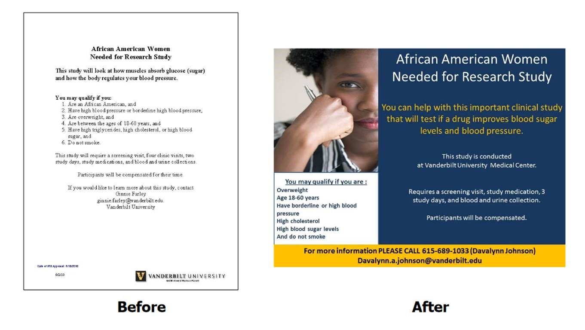
Community Engagement Studio
Example

Slide 17
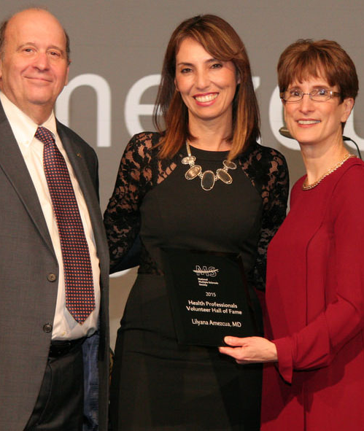
CTSA Program Community Mentorship Helps Advance Multiple Sclerosis Research in Latinos
Lilyana Amezcua, M.D., a University of Southern California (USC) assistant professor and clinical neurologist, investigates the complex genetics of multiple sclerosis (MS) among Latinos in greater Los Angeles.
Through the NCATS’ Clinical and Translational Science Awards (CTSA) Program-supported Community Mentorship Program at the Southern California Clinical and Translational Science Institute (SC CTSI), she developed new relationships with Latino patients and communities.
This work strengthened her translational science skills and gave her a new understanding of her patients’ experiences, perceptions and struggles with MS.
Dr. Lilyana Amezcua, center, is presented with the Health Professionals Volunteer Hall of Fame award from the National MS Society’s National Board Chair Eli Rubenstein and President and CEO Cynthia Zagieboylo.
Notes:
Community engagement is a crucial part of the translational science process, said Cecilia Patino-Sutton, M.D., Ph.D., M.Ed., associate professor of clinical preventive medicine, co-director of the KL2 Program and director of the research career development program at the USC Keck School of Medicine. Under her direction, the medical school has created a program to connect early stage clinical and translational scientists, like Amezcua, with mentors from community-based organizations in Los Angeles who understand the investigators areas of research. USC participants were asked to work with their mentors to identify opportunities for the community to provide feedback to some aspect of the investigators’ research and then present the work to community audiences with expertise in the same topic.
Amezcua found that because of a lack of research studies about MS in the Latino population, little is known about how social and cultural factors affect the disease’s severity and progression.
The experience helped her grow as a translational scientist.
“While I had been focused on better understanding the genetic influences of MS for many years, prior to the SC CSTI community mentorship program, I had not realized I needed to spend more time with families living with the disease,” Amezcua said, adding, “My research now includes a focus on the perception and behaviors of the Latino community with MS to better understand how they live with disabilities that come with the disease.”

Slide 18
Recruitment Innovation Center (RIC)
Our goal is to positively impact human health by improving participant enrollment and retention in multi-center clinical trials.
Achieving this goal will require sophisticated informatics-based recruitment tools and novel engagement approaches to accelerate recruitment and retention.
Participant
Trial
Trial
Notes:
Conference is the “brain child” and organized by the RIC Co-PI, Dr. Consuelo H. Wilkins and most of the attendees are our CTSA Community Engagement Core PIs

Slide 19
Improving Clinical Study Recruitment
Problem: Slow or failed recruitment leads to delays, inefficiency, increased costs
  Affects substantial proportion of clinical studies
  Informatics component: Investigators can’t find participants and vice-versa
  Strategic component: Lack of participant understanding and effective outreach strategies, particularly to underrepresented groups
Solutions in progress
  Innovation in education, outreach and engagement
  CTSA Program Trial Innovation Network includes focus on innovations in recruitment

Slide 20

Engagement and Trust
Recruitment Innovation Center (RIC)
Key Principles
Key to recruitment is meaningful engagement:
  Community engagement studios
  Use of social media
  Sharing results in a way that is accessible & timely
  Culturally-tailored materials
  Inclusive approaches to study design and recruitment
Develop a trust framework
  Safety
  Fairness
  Honesty
  Communication
  Guided by psychosocial and environmental influencers
Notes:
Lack of trust is significant barrier to recruitment;

Slide 21
National Community Advisory Board
Recruitment Innovation Center (RIC)
Ensure operations and strategies are informed by the views of the broader community including the general public, patients, research participants and community providers.
Criteria
Familiarity with health research
Confidence/ability/prior experience in an advisory or leadership role
Represents a community, patient, participant, or non-academic clinician perspective
9-15 members with individuals representing:
  patients or caregivers
  racial/ethnic minorities
  previously participated in a clinical trial
  clinicians practicing in a non-academic setting
  1-2 representatives from the Vanderbilt Institute for Clinical and Translational Research (VICTR) Community Advisory Council

Slide 22
RIC Supplement:
Enhancing Minority Recruitment
Test innovative approaches within trials:
Culturally-tailored messaging
Clinical trial recruitment plans created with minority communities
Training on approaches to engaging minorities and marginalized communities in clinical trials.
Via a web-based portal, disseminate innovations in minority recruitment and engage underrepresented communities

Slide 23
Take-Home Messages
Partner collaboratively with communities across the entire translational research spectrum.
Consider interests of all partners.
Provide training and resources.
Share information and knowledge with all partners.

