Slide 1
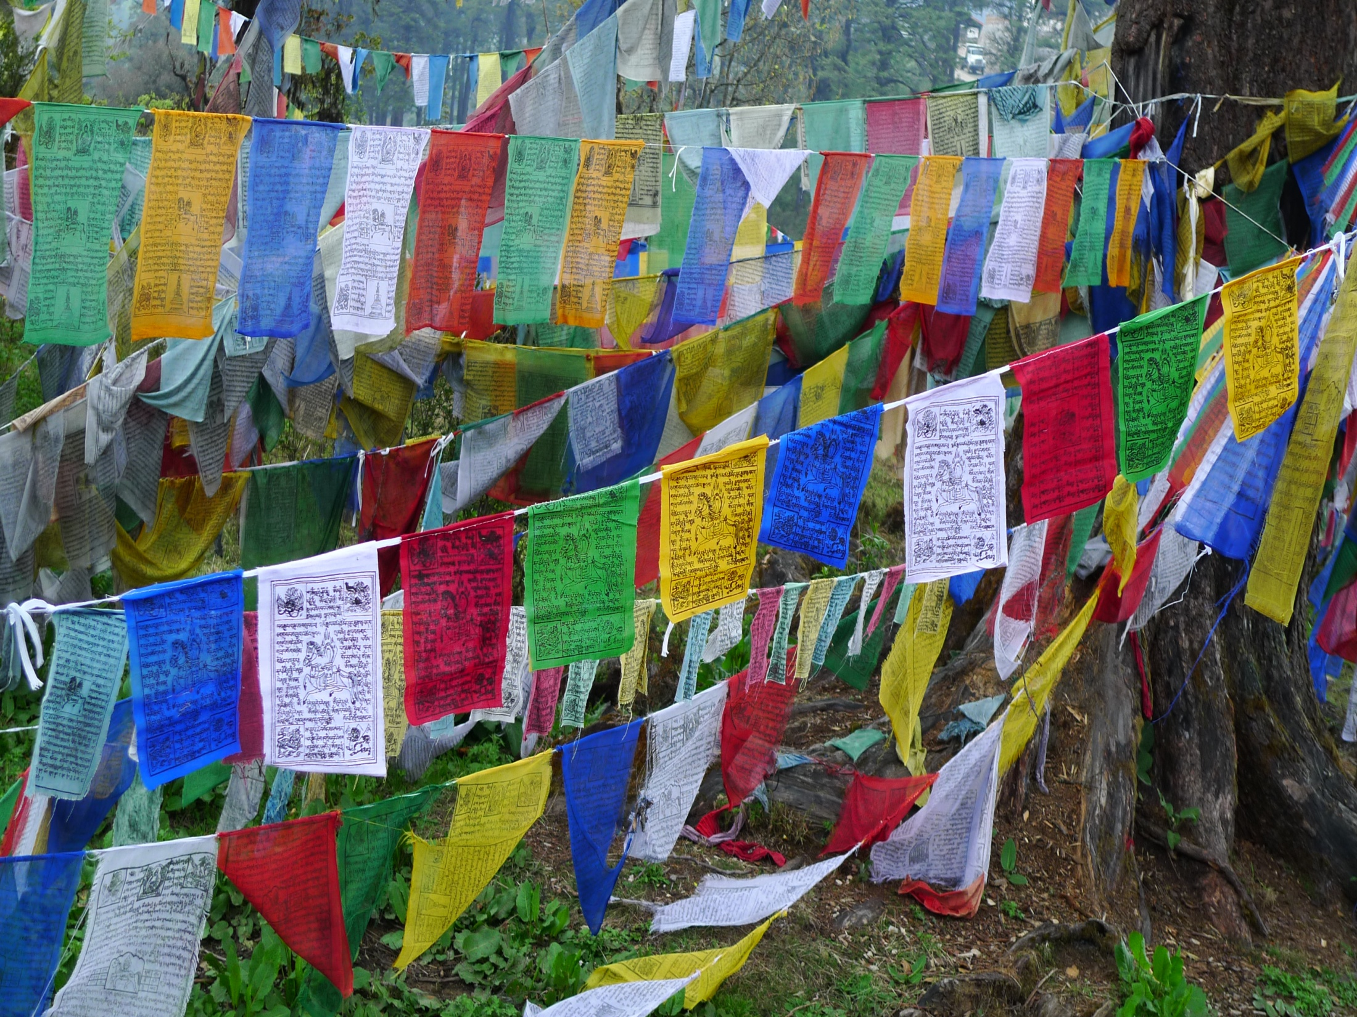
Greetings! I am pleased to see that we are different. May we become greater than the sum of both of us. Vulcan Greeting

Slide 2
From the Frontlines: What Does Precision Medicine Mean for Me?
Usha Menon, PhD, RN, FAAN
Professor;
Associate Dean, Research and Global Advances
Co-Principal Investigator: All of Us Research Program at UA-Banner Health

Slide 3
Of all the forms of inequality, injustice in health care is the most shocking and inhumane. ~Martin Luther King, Jr.

Slide 4
The future of health begins with you

Slide 6
Community Engagement in Precision Medicine
Equality vs. Equity
Engagement
Outreach (uni-directional)
Include bi-directional strategies

Slide 7
Fostering the Norm of Inclusion
Defined as “the planned efforts to consistently engage and examine diverse groups” in research and health care.
Historical paradigms: overreliance on convenience – readily accessible groups
Reorientation towards maximizing diversity, planned and targeted inclusion, and meaningful representation to promote equity
Reaching “hard to reach” underserved/marginalized groups
Thoughtful inclusion/exclusion criteria
The goal is to increase access and acceptability of interventions, and foster early dissemination to all.
Alcaraz, et al, 2016

Slide 8
Engagement at UA-Banner Health
Systematic
Intentional process
Reflects needs, preferences and priorities
Inclusive of the range of age, social, racial, ethnic, cultural, geographical, and health statuses of individuals

Slide 9
Engagement vs. Recruitment
Engagement provides the opportunity to interact with partners where the outcome may be a bi-directional increase of knowledge, information and increased partner input.
Outcome of recruitment and enrollment is participation.
As such, engagement strategies are threaded through awareness, recruitment, enrollment, and retention activities.

Slide 10
Setbacks
Elvis is dead and I don’t feel so good myself!
Lewis Grizzard

Slide 11
Is there a formula?
I wish I had a Kryptonite cross, because then you could keep both Dracula AND Superman away.
Jack Handy

Slide 12
How and where does culture fit in?
Strategies to target health education programs:
Peripheral strategies – colors, images, graphics

Slide 13
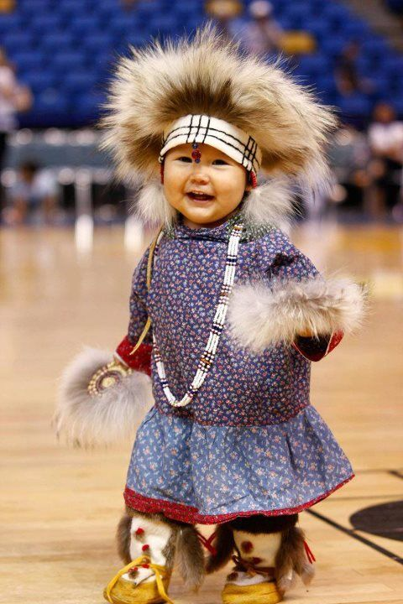

Slide 14
Evidential strategies - enhance the perceived relevance of a health issue for a given group by presenting evidence of its impact on that group

Slide 15
Example
Suicide was the 8th leading cause of death for Asian-Americans, whereas it was the 11th leading cause of death for all racial groups combined.

Slide 16
Example
Hispanic/Latinos are the largest ethnic minority group in the U.S. comprising 17.6 % of the total U.S. population (56.6 million).
Projected that the Hispanic/Latino population will constitute 28.6 % the total U.S. population by 2060.
However, Hispanic/Latinos represent only 1% of participants nationwide in clinical trials.

Slide 17
Linguistic strategies – language, vernacular, idioms

Slide 18
The vodka is good but the steak was bad.
The spirit is willing but the flesh is weak.

Slide 19
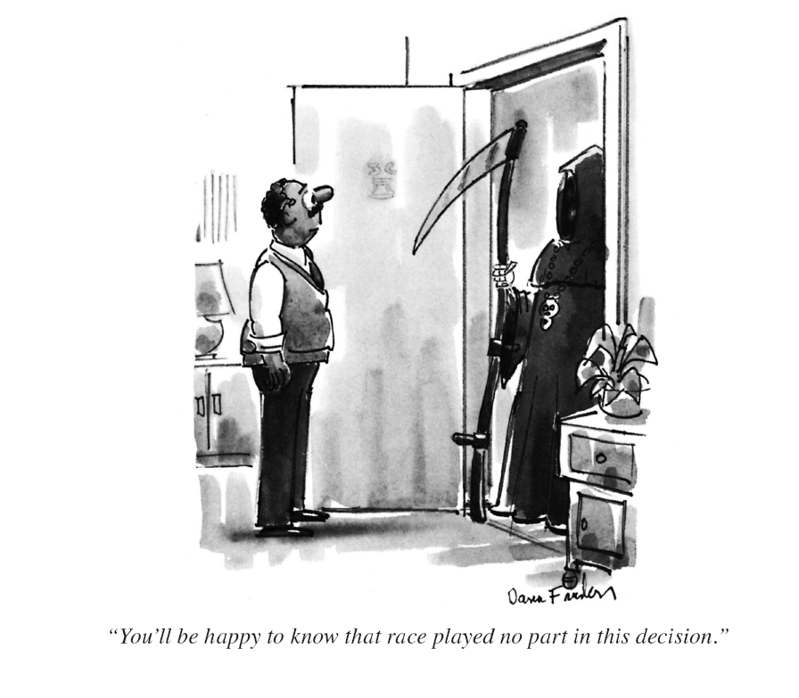
You’ll be happy to know that race played no part in this decision!
Notes:
Humor! To be used with discretion and wisely. Humor differs widely between cultures

Slide 20
Constituent-involving strategies – lay health workers, community members as staff

Slide 22
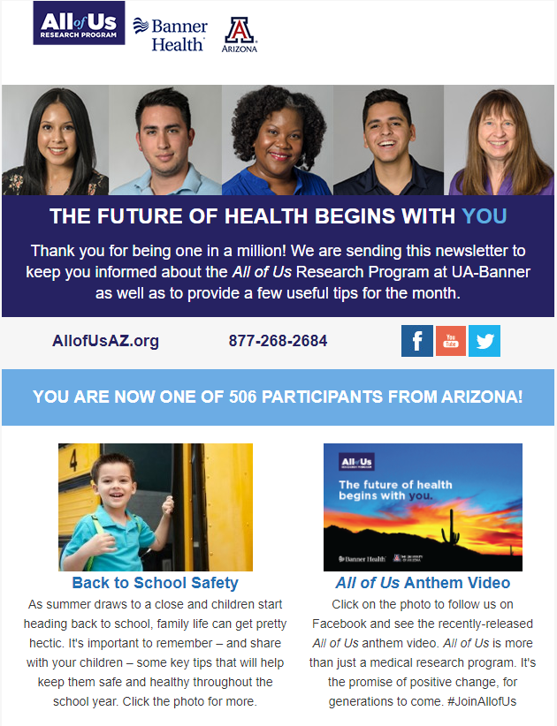

Slide 23
Sociocultural strategies - a group’s cultural values, beliefs, and behaviors are recognized, reinforced, and built upon to provide context and meaning to information and messages about a given health problem or behavior
Kreuter et al. (2003). Achieving cultural appropriateness in health promotion programs: targeted and tailored approaches. Health Education and Behavior, Vol. 30 (2): 133-146

Slide 25
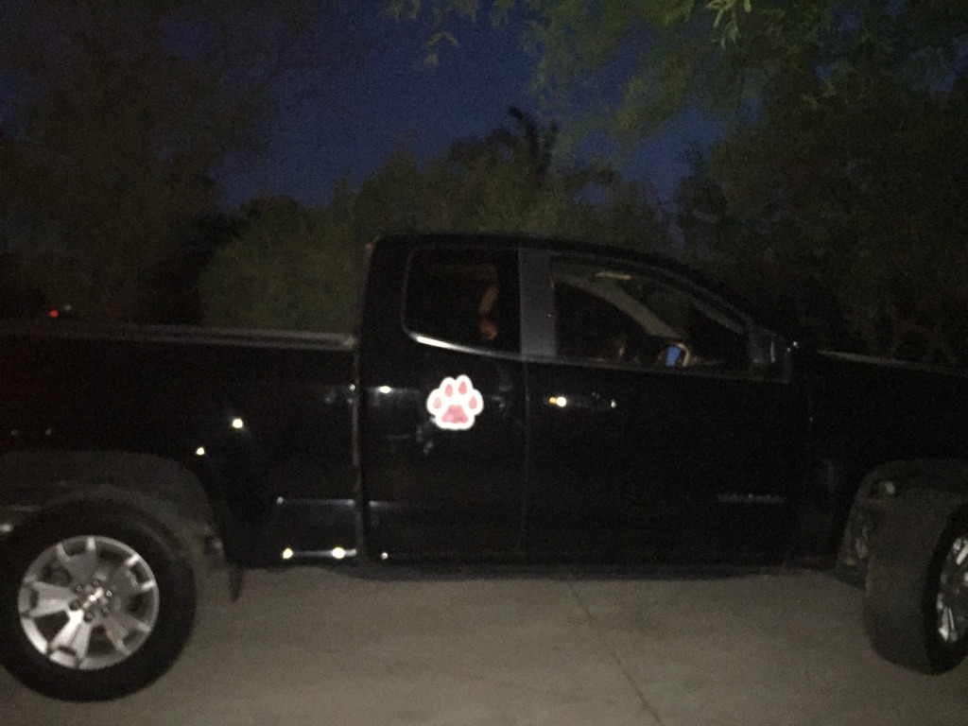

Slide 26
PERSPECTIVE

Slide 27
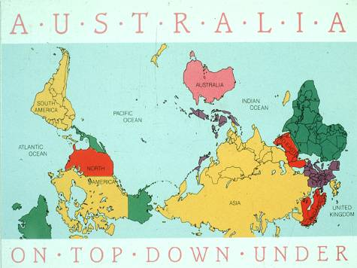

Slide 28
“The impossible could not have happened, therefore the impossible must be possible in spite of appearances.” ― Agatha Christie, Murder on the Orient Express

Slide 31
Who is Accountable?
If you ever crawl inside an old hollow log and go to sleep, and while you're in there some guys come and seal up both ends and then put it on a truck and take it to another city, boy, I don't know what to tell you.
Jack Handy

Slide 32
The time to act is now
When my love comes back from the restroom will I be too old to care?
Lewis Grizzard

Slide 33
Who’s watching us?
Don’t bend over in the garden, Granny, you know them taters got eyes!
Lewis Grizzard

Slide 34
