Slide 1


Little Data, Big Data
Translational Research Partners
Across the Spectrum
Jonathan N. Tobin, PhD
President/CEO Clinical Directors Network, Inc. (CDN), New York NY
Co-Director, Community Engaged Research The Rockefeller University Center for Clinical and Translational Science, New York NY
Professor, Department of Epidemiology & Population Health Albert Einstein College of Medicine/Montefiore Medical Center, Bronx NY
Presented at:
Meharry – Vanderbilt Community Engaged Research Core Advancing the Science of Community Engaged Research (CEnR)
Association of American Medical Colleges
Washington, DC
September 15, 2017

Slide 2
DISCLOSURE
I do not have financial or other relationships with the manufacturer(s) of any commercial product(s) or provider(s) of any commercial service(s) discussed in this educational activity.
In the last 12 months, I have received funding from:
NHLBI, NIDDK, NIMH, NCATS
CDC, AHRQ, PCORI
NYS Department of Health & NYC Department of Health & Mental Hygiene
Chronic Liver Disease Foundation (CLDF)
Hepatitis Foundation International (HFI)/Merck
Leukemia and Lymphoma Society (LLS)
March of Dimes (MoD)
The Rockefeller University Sackler Center for Biomedicine and Nutrition
New York Academy of Sciences/Sackler Institute for Nutrition Science
Opioid Post-Marketing Requirements Consortium (OPC)/Campbell Alliance (Purdue Pharma, LP; Actavis; Endo Pharmaceuticals; Janssen Pharmaceuticals; Mallinckrodt, LLC; Pfizer; Rhodes Pharmaceuticals, LP; Roxane Laboratories; and Zogenix)

Slide 3
SPECTRUM OF TRANSLATIONAL RESEARCH

Slide 4
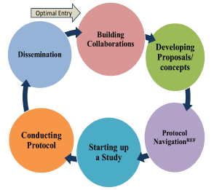
BUILDING COMMUNITY-ACADEMIC
TRANSLATIONAL RESEARCH PARTNERSHIPS
CDN/N² = PBRN INFRASTRUCTURE¹
Quality Improvement
Clinical Outcomes
Comparative Effectiveness Research
Training Clinician Investigators
Implementation Science
Disseminating Methods & Clinical Outcomes Results
CE
CEnR
CER/PCOR
+
Embedded
Mechanistic
Studies
=
+
ROCKEFELLER = CTSA INFRASTRUCTURE
Laboratory Investigation
Mechanistic Questions
Protocol Navigation
Clinical Scholars
Bioinformatics/ Phenotyping
Disseminating Translational Research Methods
CEnR-Navigation Process (CEnR-Nav)²
[Investigators and partners
may enter at any stage]
¹ N²- Building a Network of Safety Net PBRNS, https://www.pbrn.ahrq.gov/sites/default/files/docs/page/N2.pdf
² Kost, R.G., Leinberger-Jabari, A., Evering, T.H., Holt, P.R., Neville-Williams, M., Vasquez, K.S., Coller, B.S., Tobin, J.N.,
“Helping Basic Scientists Engage with Community Partners to Enrich and Accelerate Translational Research.” Academic Medicine. 2017;92(3):374.
Notes:
The Rockefeller University Center for Clinical and Translational Science (CCTS) partnered with Clinical Directors Network to create a community-engaged research navigation (CEnR-Nav) program to foster research pairing basic science and community-driven scientific aims. Through meetings and joint activities, the program facilitates building community-academic partnerships and the development and conduct of joint research protocols.
This model has been implemented for this study and has been especially useful given that we have both clinicians and IT analysts present at monthly meetings allowing the opportunity to strategize collaboratively.
The CEnR-Nav program provides a model for successfully engaging basic scientists with communities to advance and accelerate translational science

Slide 5
Patient-Centered CER Study of Home-based Interventions to Prevent CA-MRSA Infection Recurrence: CA-MRSA Project 2 (CAMP2)
Little Data, Big Data
Case Study 1
Patient Centered Outcomes Research Institute (PCORI), Grant # CER-1402-10800
The Rockefeller University Clinical and Translational Science Award Program (CTSA) and an Administrative Supplement and Pilot Project Awards (NIH-NCATS Grant #UL1-TR-000043)
N²-PBRN: Building a Network of Safety Net PBRNs (AHRQ Grant #1 P30-HS-021667)
Notes:
BD REVISED

Slide 6
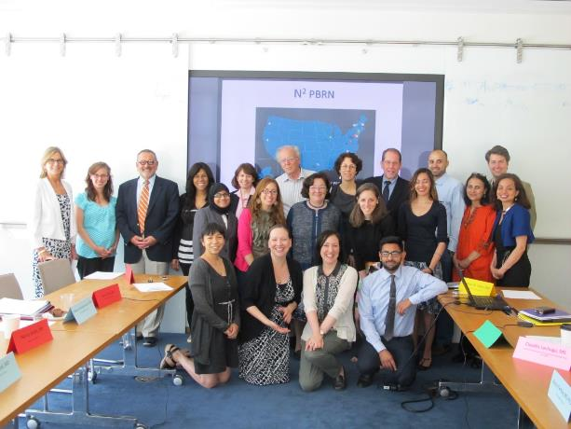
TYPES OF STAKEHOLDERS
Community members
Patients
Caregiver
Family members of patient
Community Health Workers
Clinicians
Academic Stakeholders
Laboratory Investigators
Biostatisticians
Bioinformaticians

Slide 7
CAMP1 (Cohort) & CAMP2 (CER/PCOR RCT)
Stakeholders and Partners
The Rockefeller University
Metropolitan Hospital Center
NYU Lutheran Family Health Centers
Barry Coller, MD
Rhonda G. Kost, MD
Alexander Tomasz, PhD
Herminia de Lencastre, PhD
Maria Pardos de la Gandara, MD, PhD
Marilyn Chung, BA
Cameron Coffran, MS
Joel Correa da Rosa, PhD
Kimberly Vasquez, MPH
Teresa Evering, MD, MS
Mina Pastagia, MD, MS
Maija Neville-Williams, MPH
Getaw Worku Hassen, MD, PhD
Jessica Ramachandran, MBBS
*Van Johnson
William Pagano, MD, MPH
Paula Clemons, PA
Jason Hyde, MA
Jasbir Singh, MBBS
*Keenan Millan
Coney Island Hospital
Regina Hammock, DO
Slava Gladstein, DO
Rosalee Nguyen, DO, MS
*Ronnett Davis
Open Door Family Medical Center
Daren Wu, MD
Asaf Cohen, MD
Community Healthcare Network
Urban Health Plan
CDN
Satoko Kanahara, MD
Katrina Adams
Academic Stakeholders
Samuel DeLeon, MD
Franco Barsanti, PharmD
Shirish Balachandra, MD
Claude Parola, MD
Tracie Urban, RN
*Brenda Gonzalez
Jonathan N. Tobin, PhD
Chamanara Khalida, MD, MPH
Brianna D'Orazio, BA
Tameir Holder, MPH
Musarrat Rahman, BS
Sisle Heyliger, BA
Anthony Rhabb
Cynthia Mofunanya, MD
Jessica Ramachandran, MD
Uma Siddiqui
Christopher Frei, PharmD, MSc, FCCP, BCPS South Texas Ambulatory Research Network/UTHSCSA
Christopher Mason, PhD Weill Cornell Medical College
Eric Lofgren, PhD Washington State University College of Veterinary Medicine
Susan Huang, MD, MPH University of California Irvine
Denny Moe’s Superstar Barbershop
*Dennis “Denny Moe” Mitchell
PCORI Project Officers
*Patient/Community Stakeholders
Anne Trontell, MD, MPH
Jess Robb
Funded by: Patient Centered Outcomes Research Institute (PCORI, CONTRACT # CER-1402-10800)
The Rockefeller University Center for Clinical and Translational Science (CCTS) Pilot Grant and Administrative Supplement (NIH-NCATS Grant # 8-UL1-TR000043)
AHRQ Grant # P30 HS 021667
Notes:
JNT

Slide 8
CAMP1 Qualitative Findings:
Convergence of CER/PCOR Interests
Patients: Responses from the RPPS patient focus group indicated that many patients participated in the CAMP study in order to contribute to knowledge about CA-MRSA transmission and recurrence. Outcomes that patients were most concerned about include: recurrence, pain and inability to work. Among Research Town Hall participants, 78% ranked “Reducing the spread of MRSA in your household” as being “most important” on a scale of 1-5.
Clinicians: “[It is assumed that] colonization is ongoing, because we’ve had patients return with recurrent infections. …If you just use systemic antibiotics, the nasal colonization persists. Another question to consider is if the source is in the house. We can take all measures to decolonize the person but if the infection is still in the house (pet, towel, sheets, etc), then it’s a huge factor.” – Dr. Balachandra
Laboratory Investigators: “Does the MRSA recurrent phenotype reflect single or multiple genotypes?
Clinical Investigators: 31% of MRSA+ wounds and 28% of MSSA+ wounds are recurrent
THIS CONVERGENCE OF INTERESTS LED US TO FOCUS ON
LABORATORY & CLINICAL CORRELATES
OF INFECTION RECURRENCE
AND TO PRIORITIZE THE STUDY OF
PREVENTION OF INFECTION RECURRENCE
Notes:
Dr. Evering/Dr. Pastagia
-Recurrence was a topic that patients, clinicians, laboratory and clinical investigators were all concerned about

Slide 9
CAMP1 Clinical Outcomes (n=153)
Retrospective Recurrence: History of SSTIs/MRSA Before Enrollment
T1: Recurrent infection
Prospective Recurrence: Subsequent Incident of SSTIs/MRSA After Enrollment
T3: Re-occurring complaint of SSTI at more recent primary care visit
T2: Received treatment of this lesion previously
T3: Previously documented MRSA infection or colonization

Slide 10
OBJECTIVES
To evaluate the comparative effectiveness of a CHW/Promotora-delivered home intervention (Experimental Group) as compared to Usual Care (Control Group) on the primary patient-centered and clinical outcome (SSTI recurrence rates) and secondary patient-centered outcomes (pain, depression, quality of life, care satisfaction) and public health outcomes (household transmission) using a two-arm randomized controlled trial (RCT).
Notes:
This community-academic partnership involves the creation of a multisite de-identified Electronic Health Records (EHR) database that will demonstrate the feasibility of using available measures conducted as part of routine clinical care to explore associations and identify targets for future interventions that address adolescent nutritional and pregnancy outcomes.
Currently in the second year of the project, a basic science/community-engaged “Big Data” collaborative study is being conducted to address the disproportionate health burdens experienced by overweight and obese adolescents and their infants up to the age of 24 months.
The Sackler Institute for Nutrition Science, a program of the New York Academy of Sciences, partnered with The Rockefeller University Sackler Center for Biomedicine and Nutrition, The Rockefeller University Center for Clinical and Translational Science, and Clinical Directors Network (CDN), to address knowledge gaps about the nutritional status of adolescent women in the New York City Metropolitan area. The project’s model is to develop a collaboration with health centers serving low-income groups to describe their population using de-identified Electronic Health Records (EHR) and identify avenues for interventions.

Slide 11
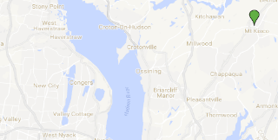
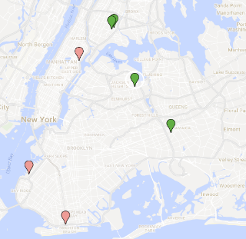
CAMP2 Participating Sites
*
Participating Sites | Clinician Stakeholders
Open Door Family Medical Center Mt. Kisco, NY | Daren Wu, MD Asaf Cohen, MD
Urban Health Plan Bronx, NY Corona, NY | Claude Parola, MD Tracie Urban, RN, BSN
Community HealthCare Network Bronx, NY Jamaica, NY | Satoko Kanahara, MD
Metropolitan Hospital New York, NY | Getaw Worku Hassen, MD, PhD
Lutheran Medical Center Brooklyn, NY | Barry Kohn, MD Paula Clemons, PA
Coney Island Hospital Brooklyn, NY | Regina Hammock, DO Slava Gladstein, DO Jessica Padron, PA Glenn Donovan, DPM Mark Trezia, DPM Rosalie Nguyen, DO, MS
*
*
Community Health Centers
Community Hospitals
* Participated in Previous MRSA Studies

Slide 12
CAMP2 Research Design
Usual Care
(CDC Guidelines)
Control Intervention
(n=139)
+
Usual Care
(CDC Guidelines) + Experimental Intervention
(n=139)
+
+
-
+
+
CDC Guidelines Concordant Care:
Incision & Drainage
+ Oral Antibiotics
Assessment of Household Environmental Contamination & Household Members Colonization
Patient & Household Members
Decolonization
Home Environment
Environmental Decontamination
(after S. Huang, 2014)
Nasal Mupirocin
Chlorhexidine Baths on Skin
Chlorine Bleach Cleaning of Household Surfaces

Slide 13
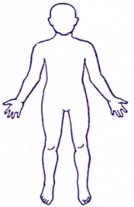
CAMP2 Home Visit Assessment:
Household Surface Sampling
Collected at Baseline and 3 Months Post Intervention from:
Index patients (n=278)
Consenting household members
Home Environment Surfaces
Environment
(n=13 surfaces per household)
Index Patients and
Household Members
(n=3 per participant)
Baseline and 3-Months
Surface to Swab
Front doorknob | Kitchen floor
TV remote | Bathroom sink handle
Telephone | Hair brush
Kitchen light switch | Toilet seat
Kitchen countertop | Bedroom floor
Refrigerator door handle | Favorite child's toy (non-plush)
Kitchen sink handle
Axilla
Nares
Groin

Slide 14
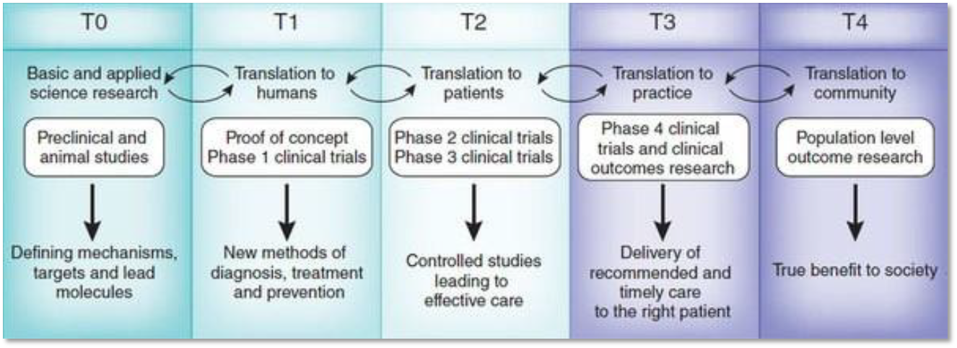
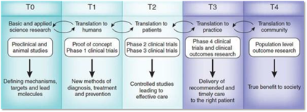
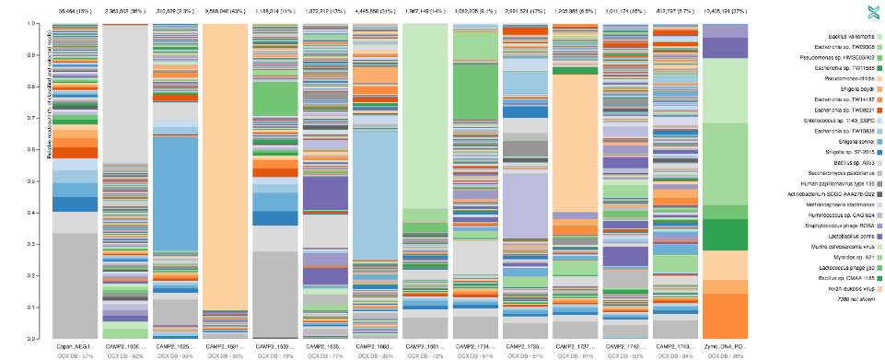
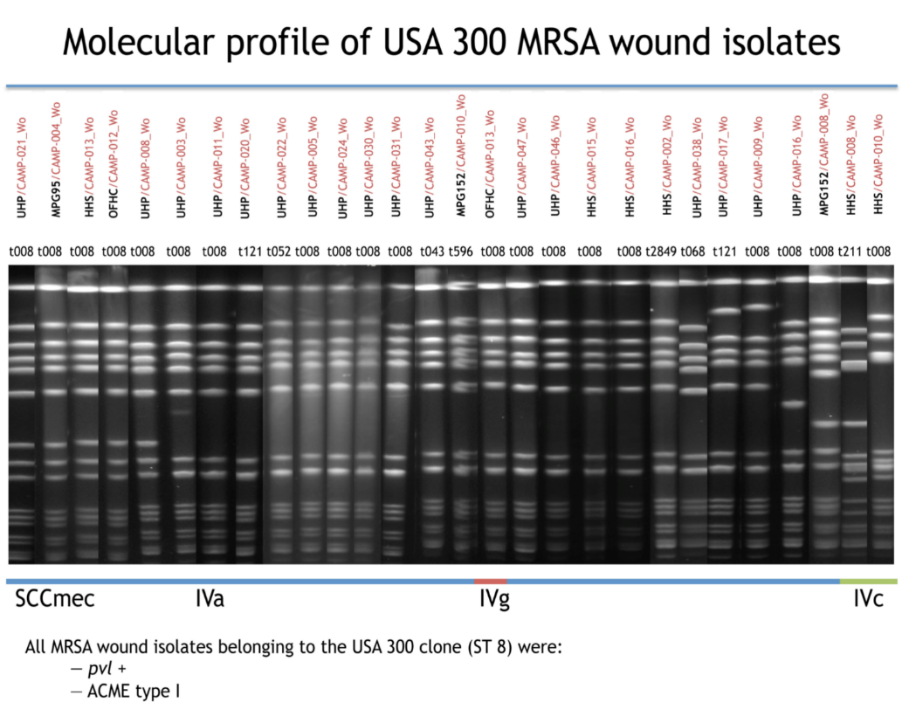

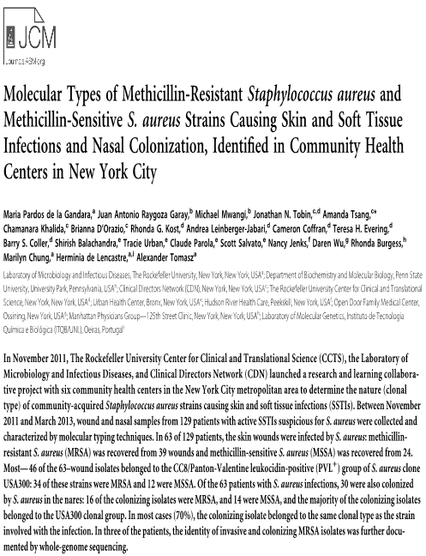
CAMP2 Household Specimens Meta-Genomics
One Codex: A Sensitive and Accurate Data Platform for Genomic Microbial Identification, Samuel S Minot, Niklas Krumm, Nicholas B Greenfield
bioRxiv 027607; doi: https://doi.org/10.1101/027607

Slide 15
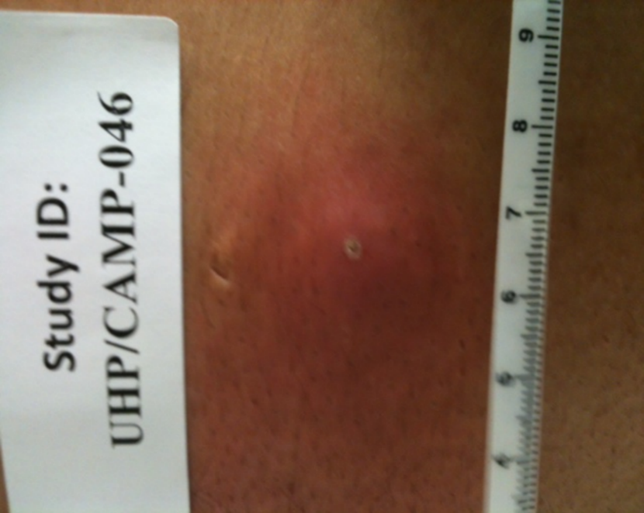
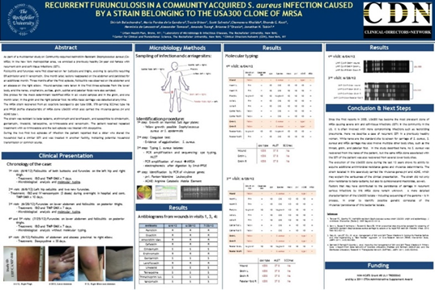
Shirish Balachandra, MD (CDN/Urban Health Plan FQHC)
Maria Pardos, MD PhD (Rockefeller)
Case Study of MRSA Infection Recurrence
(T3 Clinician Investigator Expertise/Interest)

Slide 16
(T3/T4 Clinician & Public Health Investigators Expertise/Interest)
CAMP2 Baseline Results (4/17/17)
Surveillance Site | Patient Colonization (n=135) | Household Member Colonization (n=40)
Nares | 51.9% | 10.0%
Axilla | 17.8% | 17.5%
Groin | 34.1% | 25.0%
0 Colonized sites | 33.3% | 67.5%
1 Colonized site | 35.6% ] | 15.0% ]
2+ Colonized sites | 29.7% ] 65% | 17.5% ] 33%
Household Surface Site | Household Surface Contamination (n=52)
Kitchen floor | 19.2%
Toilet seat | 23.1%
Bedroom floor | 21.2%
Refrigerator handle | 13.5%
TV remote | 11.5%
Telephone | 11.5%
Bathroom sink handle | 11.5%
Kitchen countertop | 9.6%
Kitchen light switch | 5.8%
Front doorknob | 5.8%
Child’s toy | 3.8%
Hairbrush | 3.8%
Kitchen sink handle | 1.9%
No Contamination (0 surfaces) | 40.4%
Moderate Contamination (1-3) | 48.1% ]
High Contamination (> 4) | 11.5% ] 60%

Slide 17
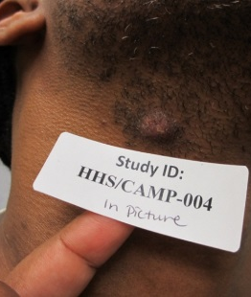
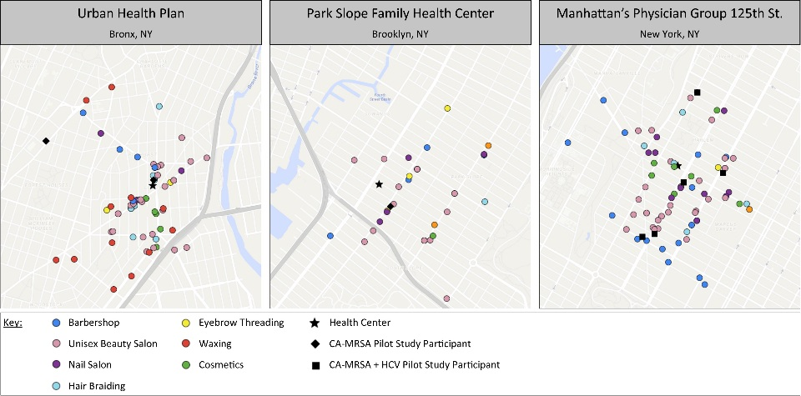
(T4 Clinician Investigator Interest)
Community-Engaged Research Pilot Project:
Expanding the Study of SSTIs/CA-MRSA
to Barbershops and Beauty Salons in NYC
The CA-MRSA Project (CAMP1) extended its learning collaborative to the barbershop/hair salon settings to increase awareness and prevention of CA-MRSA and other infections
Previous studies have shown the receptiveness of male barbershop owners, employees, and patrons to learning more about disease prevention and occupational safety and health
SSTIs/lesions are often observed on face, scalp, head, neck, arms, hands
About 20% of CAMP participants’ lesions presented in these locations
Barbers and their clients were highly receptive to inquiries and information about MRSA
Barbers welcome an in-depth public health education in the barbershop setting

Slide 18


Slide 19

Obesity, Cardiometabolic Risk and Adolescent Pregnancy: Building a De-Identified Electronic Clinical Database to Examine the Biological and Social Determinants of Nutritional Status, Pregnancy and Birth Outcomes
Little Data, Big Data
Case Study 2
FUNDED BY:
The Sackler Center for Biomedicine and Nutrition (SCBN) Research at The Rockefeller University; The Sackler Institute for Nutrition Science at The New York Academy of Sciences; (3) N²: Building a Network of Safety-Net PBRNs (AHRQ 1-P30-HS-021667); (4)The National Center for Advancing Translational Sciences/ The Rockefeller University Center for Clinical and Translational Science (NIH-NCATS Grant #UL1-TR-000043)

Slide 20


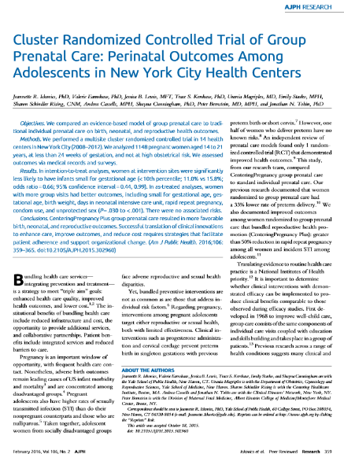
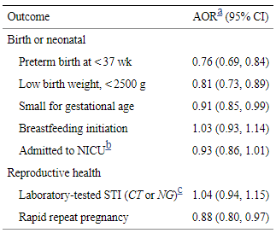
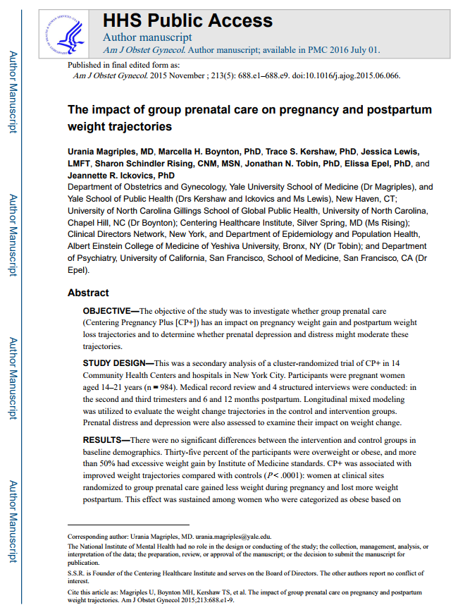
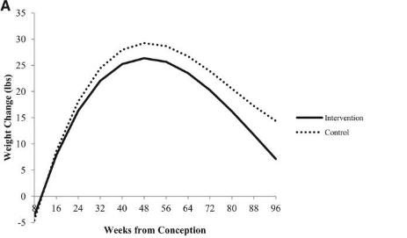
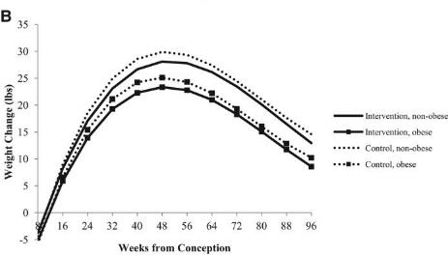
COMPARISONS
Usual Care Individual prenatal care
Experimental Centering Pregnancy Plus (Group prenatal care)
WEIGHT CHANGE OVER TIME BY INTERVENTION CONDITION AND OBESE GROUP STATUS

Slide 21
COLLABORATORS
The Rockefeller University Jan L. Breslow, MD* Peter R. Holt, MD Caroline S. Jiang, MS Bruce S. McEwen, PhD Rhonda G. Kost, MD Kimberly S. Vasquez, MPH Joel Correa da Rosa, PhD Cameron Coffran, MS Donna Brassil, MA, RN, CCRC The Sackler Institute for Nutrition Science/The New York Academy of Sciences Mireille McLean, MA MPH* Julie Shlisky, PhD Gilles Bergeron, PhD Megan Bourassa, PhD Clinical Directors Network, Inc. (CDN) Jonathan N. Tobin, PhD** Amanda Cheng, MPH Dena Moftah, BA Julie Wilcox, MFA | Albert Einstein College of Medicine/ Montefiore Medical Center Peter S. Bernstein, MD, MPH Rebecca Mahn, MD/MS candidate Siobhan Dolan, MD Stephanie Morgan, MS Clinician Advisory Committee - Tyler Evans, MD - Elizabeth Dubois, MSN, FNP-BC, AAHIVS - Mayer Sagy, MD - William Pagano, MD, MPH - Barry Kohn, MD - Rabih Nemr, MD - Abbe Kirsch, CNM, MSN, MPH - Daryl Wieland, MD, MSMI - Peter Bernstein, MD, MPH - Siobhan Dolan, MD - Isaac Dapkins, MD, FAAP *Project Officers **Principal Investigator

Slide 22
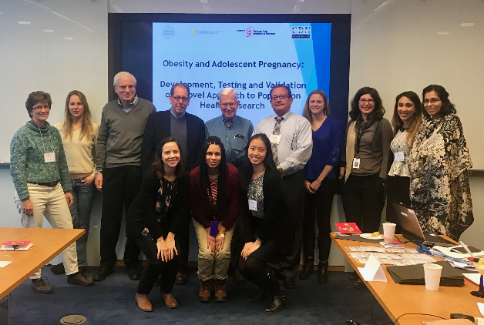
TYPES OF STAKEHOLDERS
Physicians
Pediatrics
OBGYN
Family Medicine
Bariatric Surgery
Midwives
Nurses
Nutritionists
Researchers
IT Analysts
Biostatisticians
Bioinformaticians
Basic Scientists
Funders
Scientific Publishers

Slide 23
OBJECTIVES
This community-academic partnership involves the creation of a multisite de-identified Electronic Health Records (EHR) database that will demonstrate the feasibility of using available measures conducted as part of routine clinical care to explore associations and identify targets for future interventions that address adolescent nutritional and pregnancy outcomes.
This “Big Data” EHR-based study addresses the disproportionate health burdens experienced by overweight and obese adolescents and their infants up to the age of 24 months.
Notes:
This community-academic partnership involves the creation of a multisite de-identified Electronic Health Records (EHR) database that will demonstrate the feasibility of using available measures conducted as part of routine clinical care to explore associations and identify targets for future interventions that address adolescent nutritional and pregnancy outcomes.
Currently in the second year of the project, a basic science/community-engaged “Big Data” collaborative study is being conducted to address the disproportionate health burdens experienced by overweight and obese adolescents and their infants up to the age of 24 months.
The Sackler Institute for Nutrition Science, a program of the New York Academy of Sciences, partnered with The Rockefeller University Sackler Center for Biomedicine and Nutrition, The Rockefeller University Center for Clinical and Translational Science, and Clinical Directors Network (CDN), to address knowledge gaps about the nutritional status of adolescent women in the New York City Metropolitan area. The project’s model is to develop a collaboration with health centers serving low-income groups to describe their population using de-identified Electronic Health Records (EHR) and identify avenues for interventions.

Slide 24
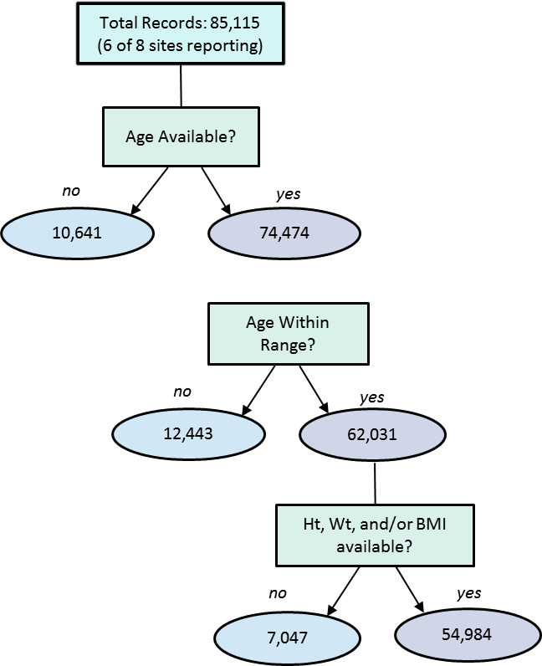
METHODS/STUDY POPULATION
Partnering New York City Community Health Centers (n=4) and Hospitals (n=4) are working with The Rockefeller University, The Sackler Institute for Nutrition Science and Clinical Directors Network (CDN) to build a de-identified database extracted from EHR data from all female adolescents, aged 12-21 years and their offspring through 24 months, who received their primary care at these eight (8) clinical sites between 2011-2015.
This time period covers all care visits:
Preconception
Prenatal
Postnatal
Pediatric
Notes:
Through partnering with 4 New York City Community Health Centers (n= 4) and 4 Hospitals (n= 4), a de-identified database extracted from EHR data from all female adolescents, ages 12-21 years and their offspring through 24 months who received their primary care at these 8 clinical sites between 2011-2015 will be constructed.
This time period covers all care visits ranging from
Preconception
Prenatal
Postnatal
Pediatric

Slide 25
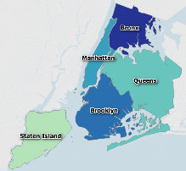
COMMUNITY HEALTH CENTERS/COMMUNITY HOSPITALS
New York City
Community Health Center/Hospital | Location(s) | Co-Investigators | IRB
Community Healthcare Network | Bronx, NY Brooklyn, NY New York, NY Queens, NY | Tyler Evans, MD Elizabeth Dubois, MSN, FNP-BC, AAHIVS | Clinical Directors Network (CDN)
Morrisania Diagnostic and Treatment Center | Bronx, NY | Mayer Sagy, MD | BRANY
Gouverneur Health | New York, NY | Mayer Sagy, MD | BRANY
NYU Family Health Centers | Brooklyn, NY | William Pagano, MD, MPH Barry Kohn, MD Rabih Nemr, MD | BRANY
Bronx Lebanon Hospital Center | Bronx, NY | Abbe Kirsch, CNM, MSN, MPH | BRANY
Jacobi Medical Center | Bronx, NY | Daryl Wieland, MD, MSMI | BRANY
North Central Bronx Hospital | Bronx, NY | Daryl Wieland, MD, MSMI | BRANY
Montefiore Medical Center | Bronx, NY | Peter Bernstein, MD, MPH Siobhan Dolan, MD | BRANY
Borough (n=84,714)* | Percent
Bronx | 68.5%
Brooklyn | 15.4%
Manhattan | 5.0%
Queens | 5.3%
Staten Island | 0.4%
Westchester | 1.6%
Yonkers | 1.1%
Other | 1.2%
*Reflects patients who provided a zip code
Notes:
The table on the right provides the details of the 8 participating sites.
The table on the left provides the geographic breakdown of our patient population
A preliminary analysis was conducted on data available from six of the partnering Community Health Centers and Hospitals, with data to date from 85,115 patients. The majority (about 69%) of the patients were from the Bronx,

Slide 26
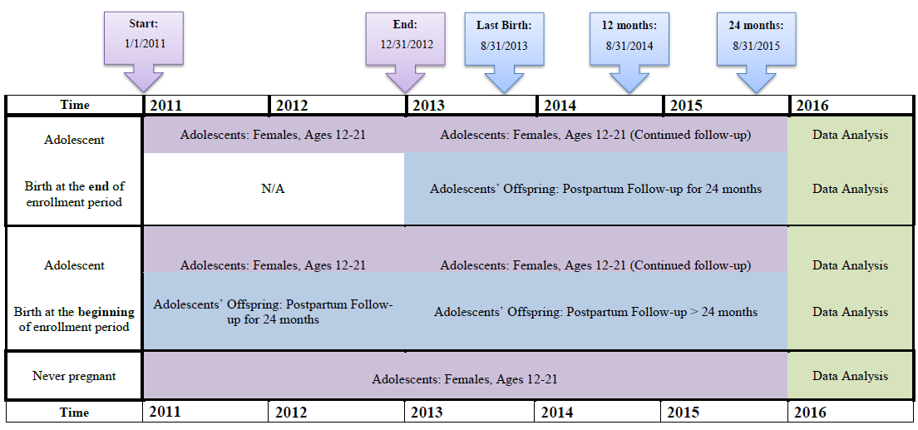
COHORTS AND TIMELINE
Key: Adolescents Offspring Data Analysis *Age during enrollment (1/1/11-12/31/12)
Notes:
This figure details the project timeline and defines the 3 cohorts used in this study.
Defined Three Cohorts
Adolescent Females (ages 12-21)
Adolescent Females who become pregnant
Babies born to Adolescent Females
The data extraction will be done retrospectively, from 2011-2015, which includes a two year enrollment period, 1/1/2011-12/31/2012, for adolescents and a 24 month follow-up, 1/1/2013-12/31/2015, for the offspring (See Timeline). All adolescent females must be between the ages of 12-21 at any point during the enrollment period. Data for all follow-up for teens (both pregnant and non-pregnant) as well as their offspring will be included through the end of 12/31/2015. The end date of 12/31/2015 will ensure that all babies born will have at least 24 months of follow-up. Note that 2011 has been chosen since this was the earliest date that all collaborating hospitals and health centers had their Electronic Health Records in place. This time period covers preconception, prenatal, postnatal, and pediatric visits.
Identifying All Female Adolescents:
At each Community Health Center and Hospital, we will query the EHR database to identify all female patients during the two year enrollment period, 1/1/2011-12/31/2012.
Inclusion criteria:
1. Date of birth between 1/1/1990 and 12/31/2000
2. At least 1 primary care visit during 1/1/2011-12/31/2012
Identifying Pregnant Adolescents:
At each Community Health Center and Hospital, we will query the EHR database to identify all female patients pregnant at the beginning of the two year enrollment period (1/1/2011-12/31/2012) or became pregnant during the two year enrollment period. The identification of the pregnant cohort uses an algorithm for EHRs developed by the Indian Health Service (1).
Inclusion criteria (please refer to Appendix D for ICD-9-CM and CPT Pregnancy Codes):
1. Date of birth between 1/1/1990 and 12/31/2000
2. At least 1 primary care visit
AND at least one of the following:
1. A pregnancy-related or delivery ICD-9-CM code at any point of contact
2. A positive urine human chorionic gonadotropin (hCG) test result
3. Obstetric ultrasound determined from CPT codes
4. Obstetric ultrasound indicated in the narrative of the records using a keyword search
5. NOTE: If a patient has a pregnancy code followed by a spontaneous or induced abortion code, please flag the patient.

Slide 27
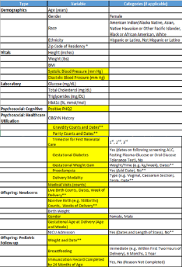
SACKLER – FROM BIG PICTURE TO IMPLEMENTATION
Confirmation of De-Identification
Data Cleaning
3 separate extractions & transmissions
Combining data from multiple transmissions
Data Analysis
List of 100+ Variables
1
2
3
Reporting
Dissemination
PBRN Staff Biostatistician/
Bioinformatician
PBRN Staff Biostatistician/
Bioinformatician
Primary Investigator and Clinicians
Site IT and PBRN Staff

Slide 28
CARDIOMETABOLIC ANALYSIS

Slide 29
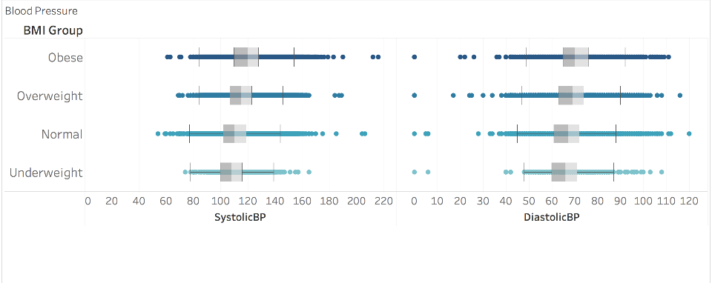
Blood Pressure
(Sites A, B, C, D, E; n = 45,541)
120 (13)
71 (9)
115 (13)
69 (9)
111 (12)
67 (8)
108 (13)
66 (9)
N = 45,537
Trend p < 0.0001
N = 45,541
Trend p < 0.0001
* Mean (SD)
Notes:
Glucose – need to add site B Bronx Lebanon once the glucose data has been reformatted
Overall p-values from mixed model with site as a random effect Also tried including site as a fixed effect and saw similar results.
No significant BMI_group-by-site interactions
The same results hold (overall and post hoc) for all 4 labs when excluding pregnant females.

Slide 30
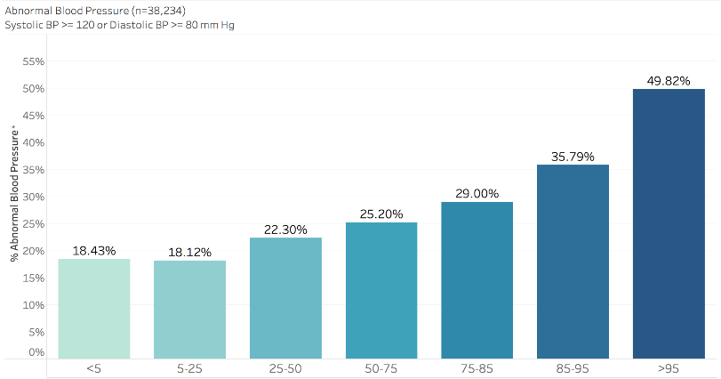
ABNORMAL BLOOD PRESSURE BY BMI PERCENTILE
3%
5%
11%
19%
Rate of Abnormal BP is 2-4x Higher
BMI Percentile
P < 0.0001
*3 measurements with systolic BP > 120 or diastolic BP > 80 mmHg per Cheung et al. 2017

Slide 31
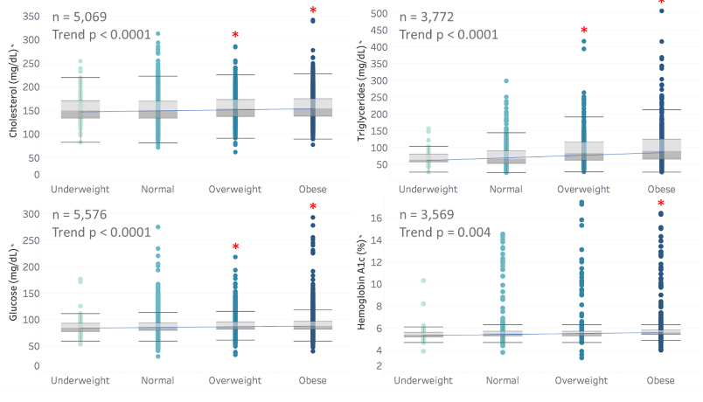
Cardiometabolic Measures (Sites A, B, C)
(n = 3,569 – 5,576)
Notes:
Laboratory measures for hemoglobin A1c, total cholesterol, glucose and triglycerides were provided as indicators of nutritional status. The results for each of the four biomarkers were log-transformed and summarized in Figure 2 by BMI group. The analyses showed that there were statistically significant differences across the BMI groups for each of the four biomarkers. In addition, pairwise comparisons showed that glucose, total cholesterol, and triglycerides levels were significantly different between the overweight group and the normal group. The same was true for the obese group under all 4 biomarkers measured. All laboratory measures examined demonstrated a significant positive linear trend across increasing weight and BMI categories.

Slide 32
PREGNANCY & BIRTH OUTCOMES ANALYSES

Slide 33
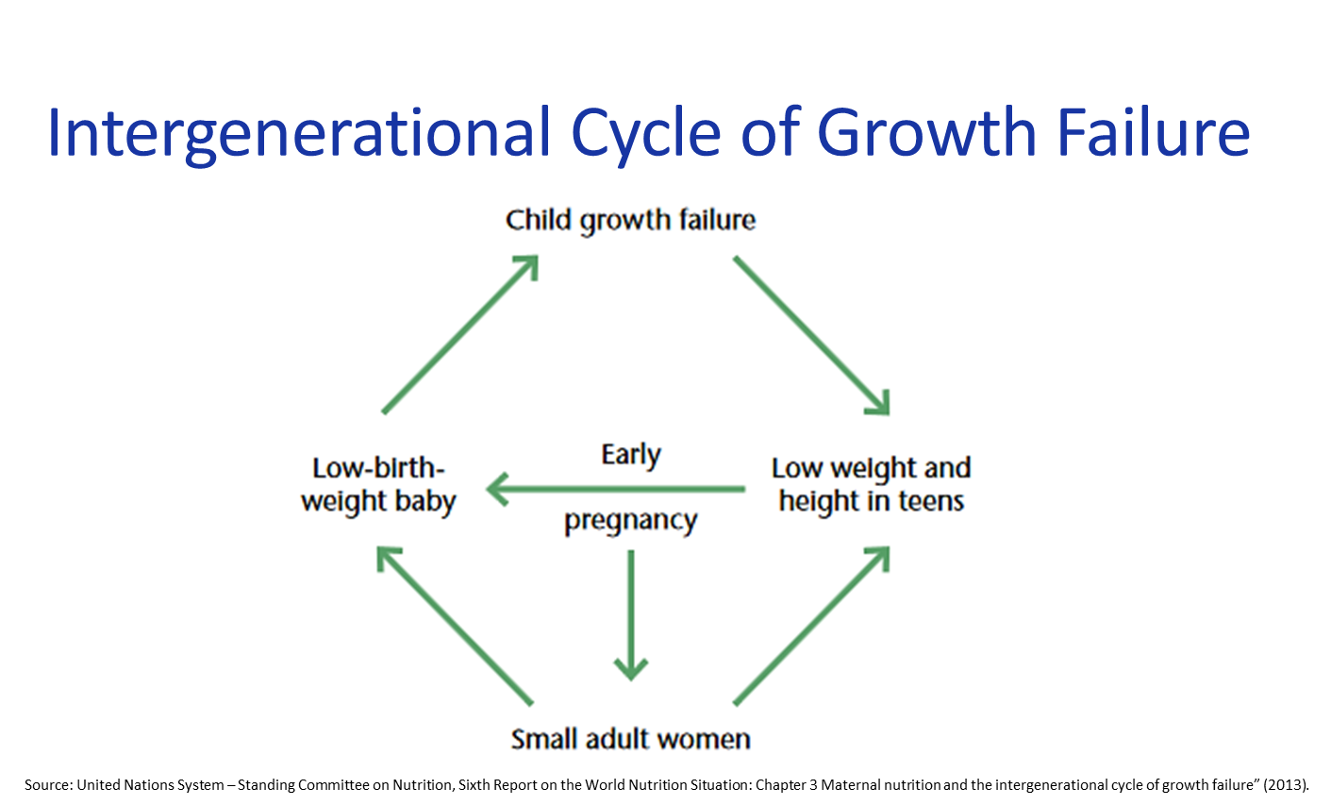
LOW BIRTHWEIGHT BY MATERNAL BMI GROUP
Trend test: p=0.001
(n=2,866)
OR [Obese/Normal] = 0.44,
95% CI [0.26, 0.74]
The odds of having a
low birth weight baby are
0.44 lower in obese
compared to
normal weight
female adolescents
(n=94)
(n=1,278)
(n=809)
(n=685)
Data Source | OR/RR | 95% CI
Sackler (sites A-D) | OR = 0.44 | (0.26, 0.74)
McDonald et al 2010 | RR = 0.84 | (0.75, 0.95)
Notes:
The odds of having a low birth weight baby is 0.44 lower in obese compared to normal weight female adolescents.

Slide 34
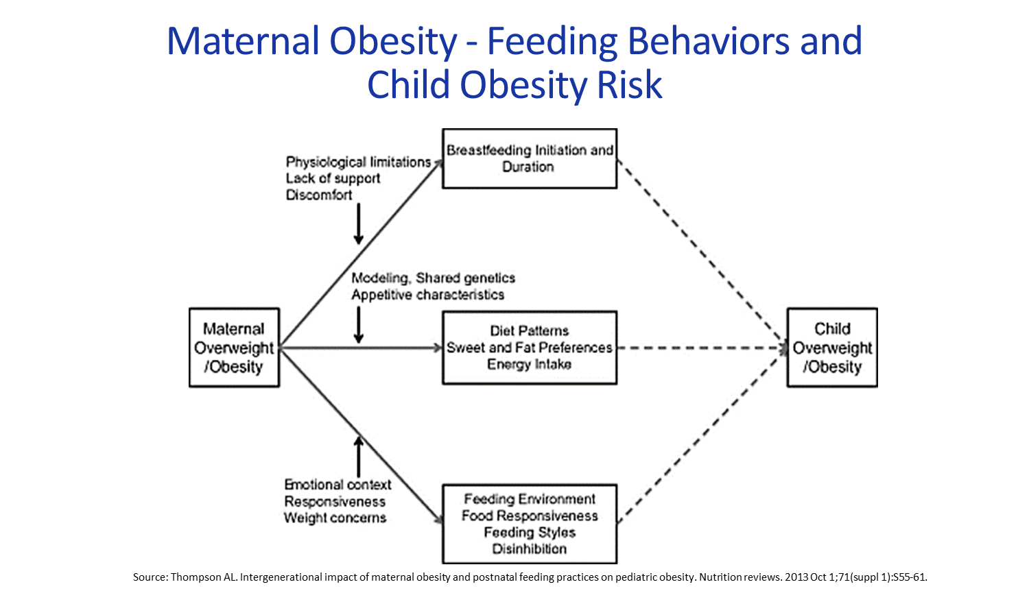
HIGH BIRTHWEIGHT BY MATERNAL BMI
*Defined as a birthweight >4,000 grams according to Institute of Medicine (IOM) guidelines

Slide 35
Baby Birth Weight by Maternal BMI Group for Pregnant Adolescents
(Sites A, B, C, D: n=2,866)
Birth Weight Group | Underweight (n=94) (3%) | Normal (n=1,278) (45%) | Overweight (n=809) (29%) | Obese (n=685) (23%) | Total (n=2,866) (100%) | P-value
Extremely LBW | 0% | 0.5% | 0.7% | 0.9% | 0.6% | 0.001*
Very LBW | 1.06% | 0.7% | 0.5% | 0.3% | 0.6%
LBW | 8.5% | 7.4% | 4.9% | 3.8% | 5.9%
Normal | 90.4% | 90.3% | 92.6% | 91.7% | 91.3%
Large | 0% | 1.2% | 1.2% | 3.4% | 1.7%
*P-value from logistic regression after combining [ELBW, VLBW, LBW] and [Normal, Large]
with BMI group as a continuous variable for trend testing and site as a fixed effect.
Observed
F0
Grandmother
F1
Mother
F2
Child
F3
Grandchild
Inference of multi-generational health effects
9/13/2016
Notes:
This table shows that low birth weight (LBW) babies were more likely to be born to mothers who were underweight or normal weight. However, the large babies were more likely to be born to overweight or obese mothers.

Slide 36

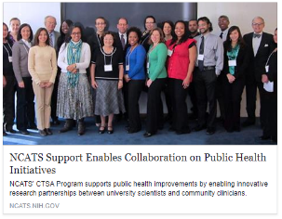

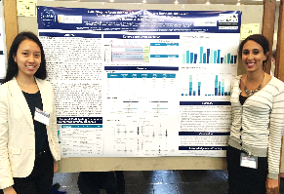
SACKLER DISSEMINATION
NIH-NIMHHD/Weill Cornell-Hunter CTSA Conference: “Stress & Resilience: The Science of Adapting to a Challenging World Symposium – 30th Annual Symposium of the Center for Translational and Basic Research Conference” (NYC May 15, 2017) - Received Best Poster Award: 1st Place (out of 81 posters).
NIH-NCATS article entitled “NCATS Enables Scientists, Community Clinicians to Collaborate on Health Initiatives” (Posted August 2017 at https://ncats.nih.gov/pubs/features/rockefeller )

Slide 37
Team Science Principles of Community-Academic Research-to-Practice Partnerships
HOW DID WE DO THIS?

Slide 38
COMPARISON OF CAMP2 & SACKLER STUDIES
Project Components | CAMP2 | SACKLER
Study Design | RCT | Observational Cohort
Start Year | 2010 | 2014
Monthly team meetings (alternating teleconference & in-person) | + | +
Collaborative development and testing of hypothesis
Patient defined measures and study parameters | + | -
Clinician defined study parameters | + | +
Stakeholders
Clinicians | + | +
Academic researchers | + | +
Patients and community members | + | -
Data type
Many patients, few data points available (Big Data) | - | +
Few patients, many clinical data points available (Little Data) | + | -

Slide 39
Team Meeting Agenda Template
ENGAGEMENT STRATEGIES
TOPIC PRESENTER
Welcome & Introductions Principal Investigator
Progress Update Project Manager
Site Reports Clinicians and Staff
Hand-On Exercise Breakout Session All
Case Report Clinician Investigator
Literature Update Academic Investigator
Dissemination All
Next Steps Principal Investigator
Wrap Up & Adjourn Principal Investigator

Slide 40
Sample Breakout: Collaborative Grant Writing Activity
Group 1:
Creating Meaningful Patient Engagement In Planning The Study Design And Protocol
Group 2:
Patient Recruitment and Baseline Assessments
Group 3:
Incorporating patient needs in the methodology
Group 4:
Defining study outcomes

Slide 41
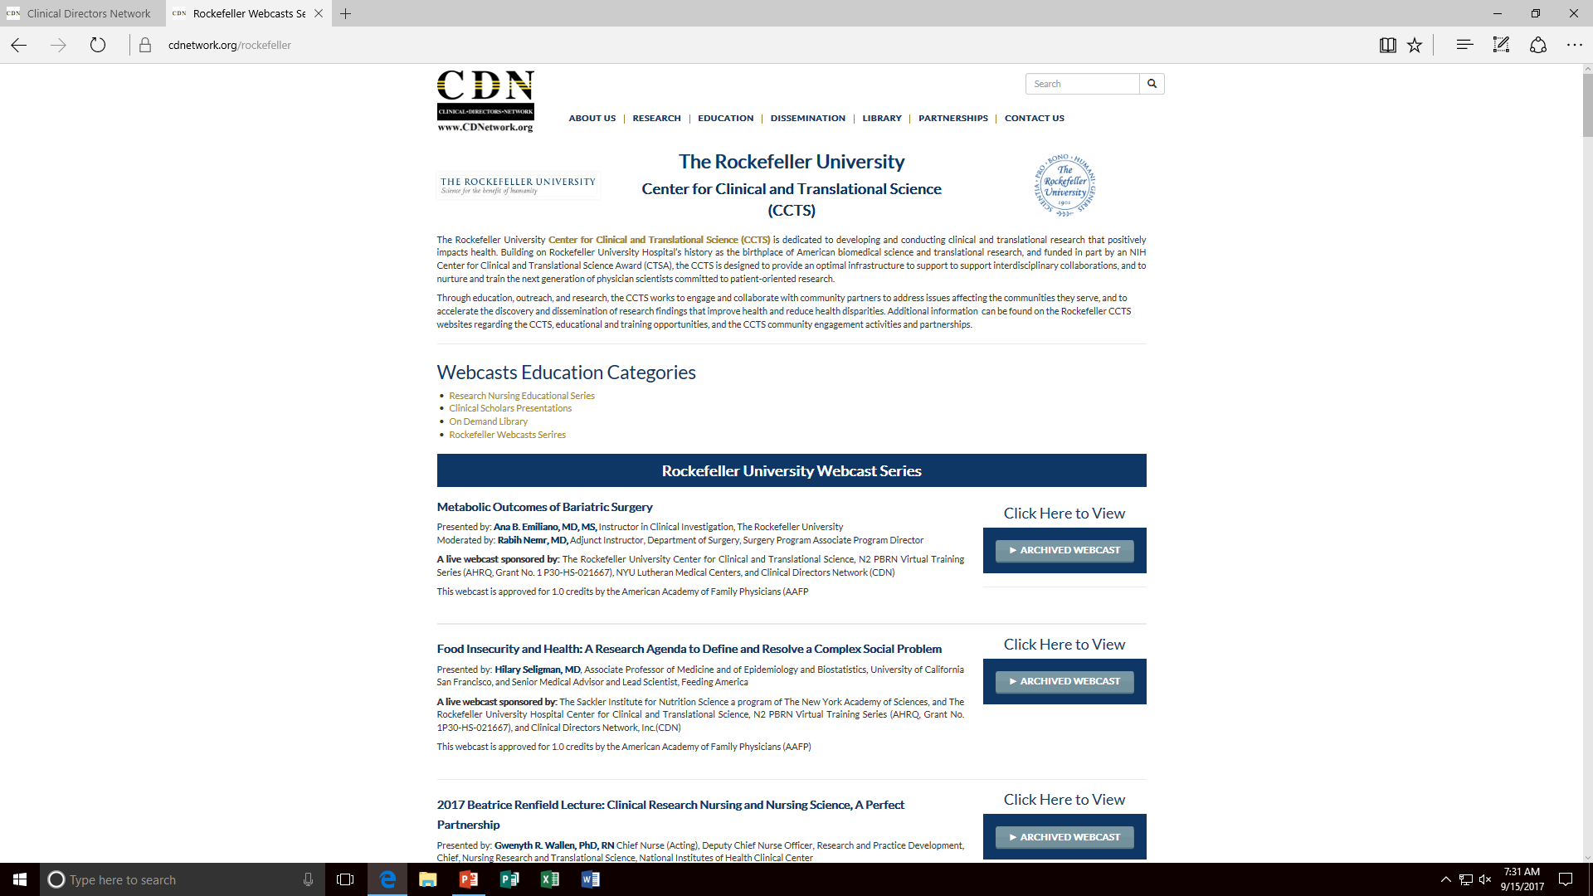
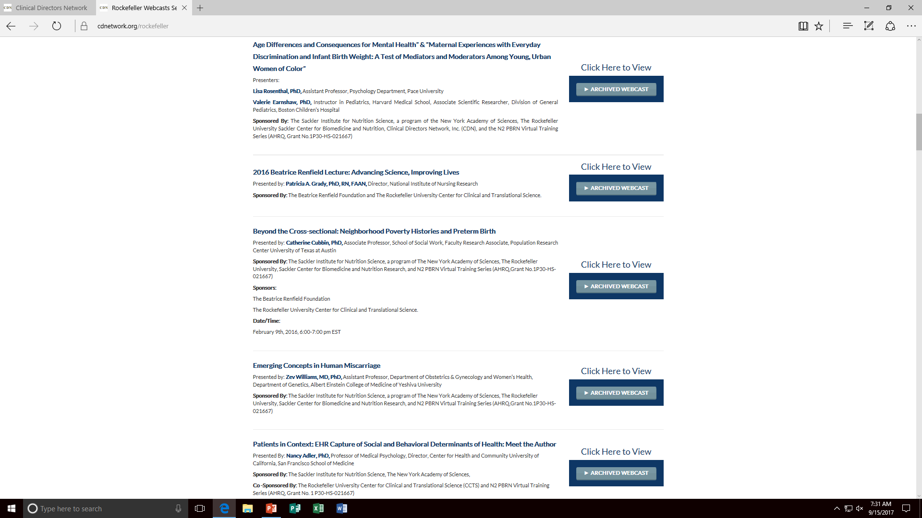

Slide 42
SPECTRUM OF TRANSLATIONAL RESEARCH
CAMP2 | Metagenomics | Molecular Epidemiology/ Genotyping | Incision & Drainage Antibiogram | CDC Guidelines Dissemination and Implementation | Prevention of Recurrence and Transmission
Sackler | Micronutrient & Macronutrient | Allostatic Load Index | Efficacy and Effectiveness Studies of Health Care: Preconception Prenatal Postnatal Pediatric | Implementation and Dissemination Studies of Health Care: Preconception Prenatal Postnatal Pediatric | Validation with NCHS Surveys and Meta-Analysis

Slide 43
CRITICAL STEPS FOR PARTNERSHIP DEVELOPMENT FOR LITTLE DATA & BIG DATA STUDIES
Listen to each stakeholders’ needs, priorities, obligations & reward systems
Elicit each stakeholders’ specific priorities for measurement/assessment and intervention/outcome
Align each set of measures and priorities
Focus on pragmatic (> explanatory) interventions & designs
Define outcomes in terms of:
Laboratory/Biological
Clinical
Patient-Centered
Health Services
Public Health
Conduct Embed Mechanistic Studies with
Biological Measures (T0, T1) from clinical specimens
Well-characterized clinical phenotypes (T2, T3)

Slide 45

THANK YOU!
Jonathan N. Tobin, PhD
5 West 37th Street – 10th FL
New York NY 10018 USA
Tel 212-382-0699 x234
JNTobin@CDNetwork.org

Slide 46

THANK YOU!
CEnR
D A T A

Slide 47
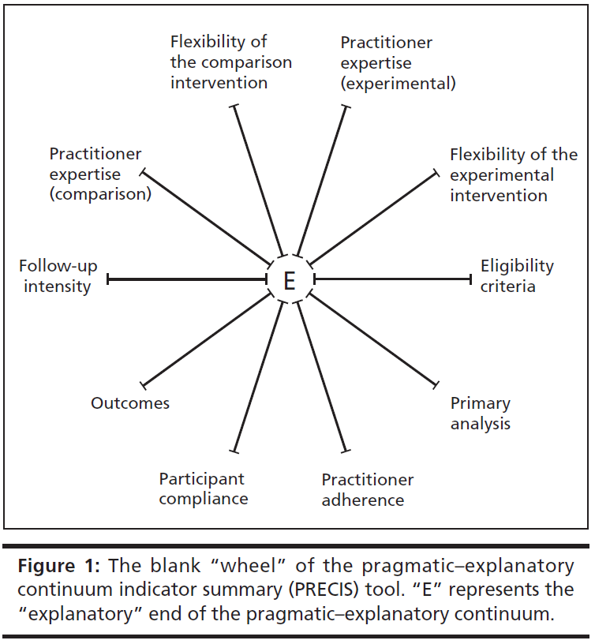
Pragmatic-Explanatory Continuum Indicator Summary (PRECIS) Tool
Thorpe KE et al. A pragmatic-explanatory continuum indicator summary tool (PRECIS): a tool to help trial designers. CMAJ 2009; 180(10):E47-57.

Slide 48
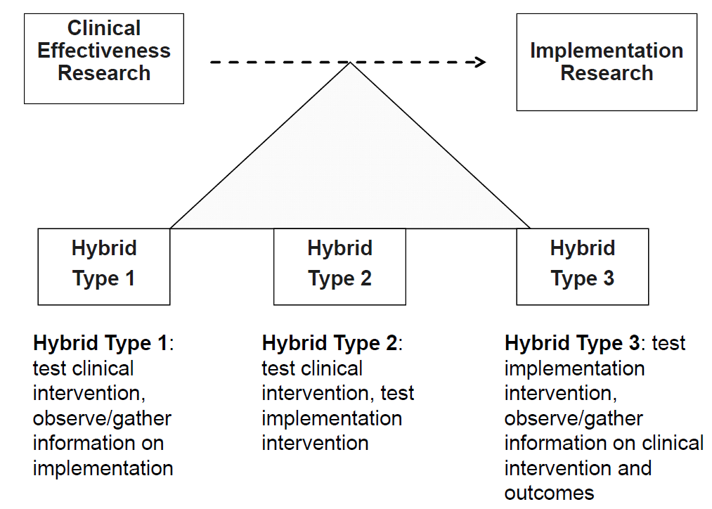
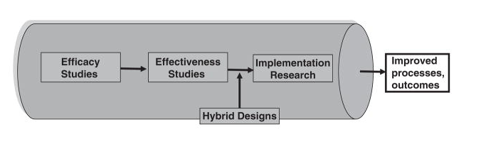
EFFECTIVENESS-IMPLEMENTATION HYBRID DESIGNS
Curran, G. M., Bauer, M., Mittman, B., Pyne, J. M., & Stetler, C. (2012). Effectiveness-implementation Hybrid Designs: Combining Elements of Clinical Effectiveness and Implementation Research to Enhance Public Health Impact. Medical Care, 50(3), 217–226.

